Slide 1
COVID-19 (QUESTION1, PART1
Arshia Firdaus
HAP 823

Slide 2
QUESTION
Describe the order of occurrence of the variables
Assume that age, and gender occur at birth. Assume that vaccination information occurs before onset of symptoms. Assume home tests occurs after onset of symptoms. Assume that laboratory PCR test occurs after home test.
Establish the order with which symptoms occur
Count for each pair of symptoms, the number of times one symptom occurs before another. Use column AK in the database to identify if one symptom has occurred before another.
Use the pairwise count of one symptom occurring before another to establish a sequence of occurrence of symptoms.

Slide 3
Based on the assumptions provided, the order of occurrence of the variables is:
Gender: Occurs at birth.
Age: Occurs at birth.
Vaccination Information: Occurs before onset of symptoms.
Onset of Symptoms: Occurs before home test and laboratory PCR test.
Home Test: Occurs after onset of symptoms.
Laboratory PCR Test: Occurs after home test.
Therefore, the chronological order of occurrence of these variables is: Gender, Age, Vaccination Information, Onset of Symptoms, Home Test, and Laboratory PCR Test.

Slide 4
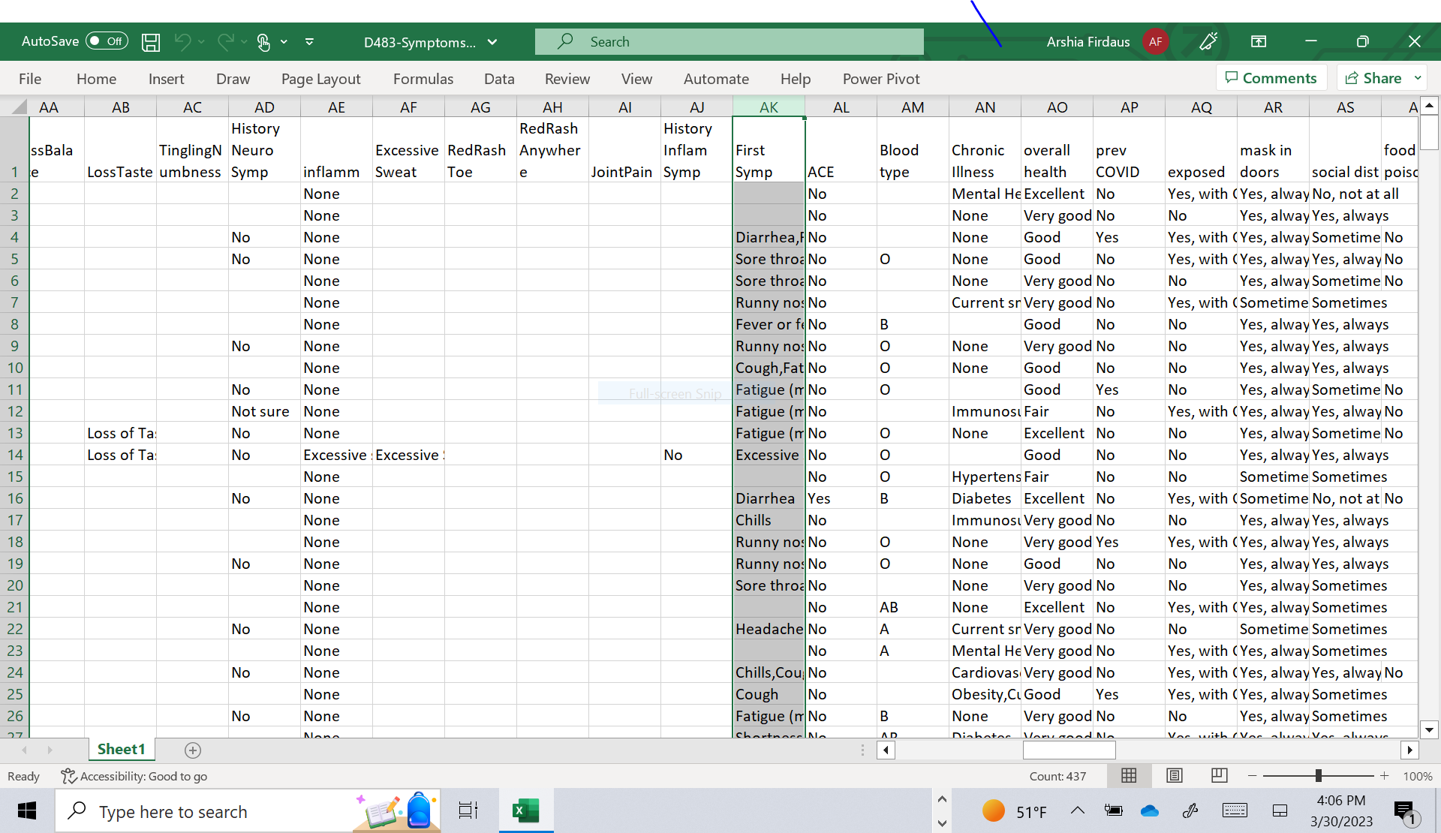
STEP1
Convert the excel file into a csv file and preprocessed the file by removing the empty rows in the column AK.

Slide 5
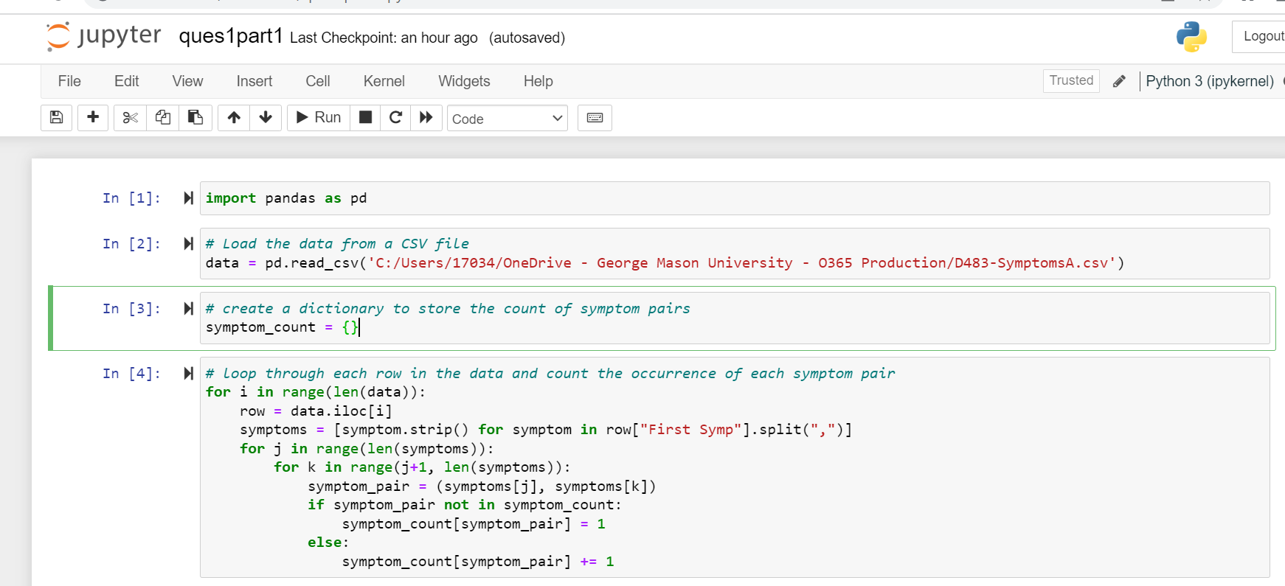
STEP2: import the data into python

Slide 6
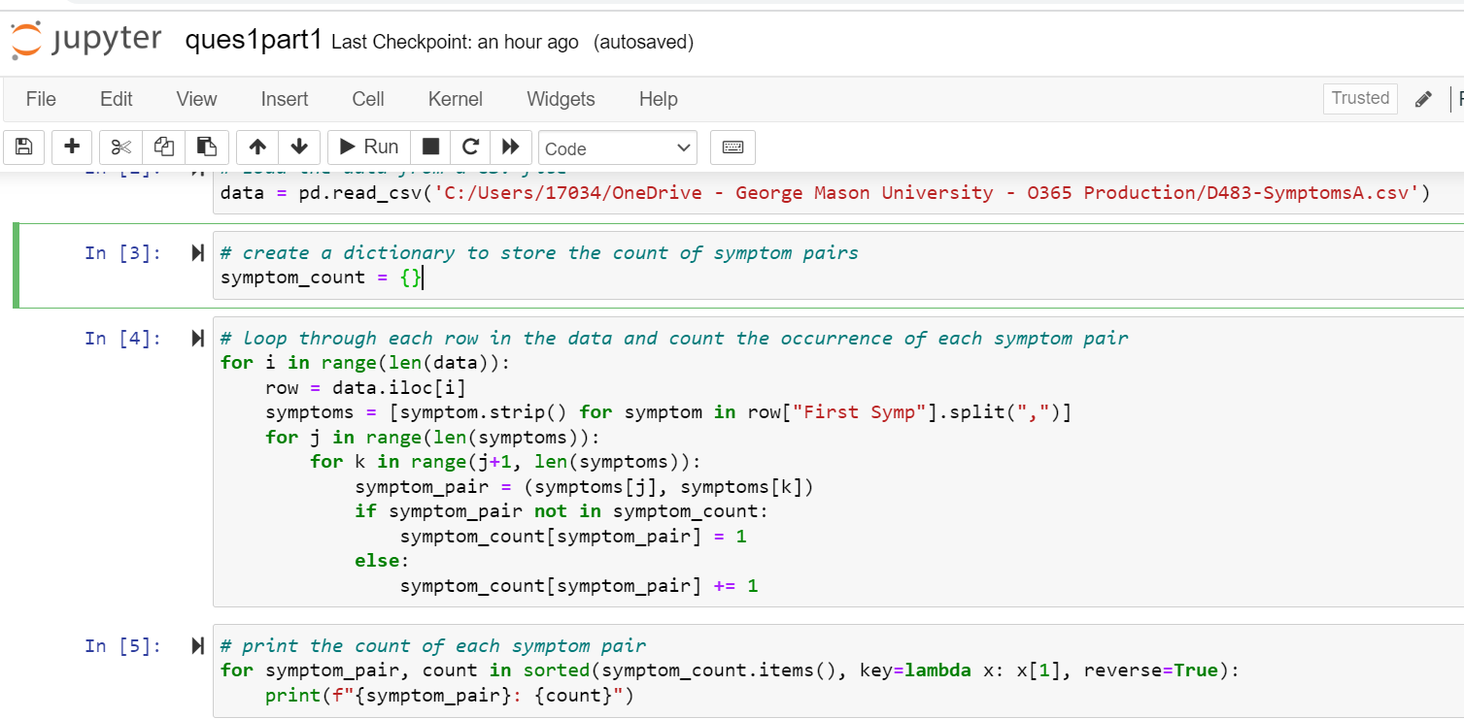
Step 3:
In this code, create an empty dictionary to store the pairwise counts of symptoms. We then iterate over each row in the database and count the pairwise occurrences of symptoms using a nested loop. For each pair of symptoms that occur together, we update the count in the dictionary.

Slide 7
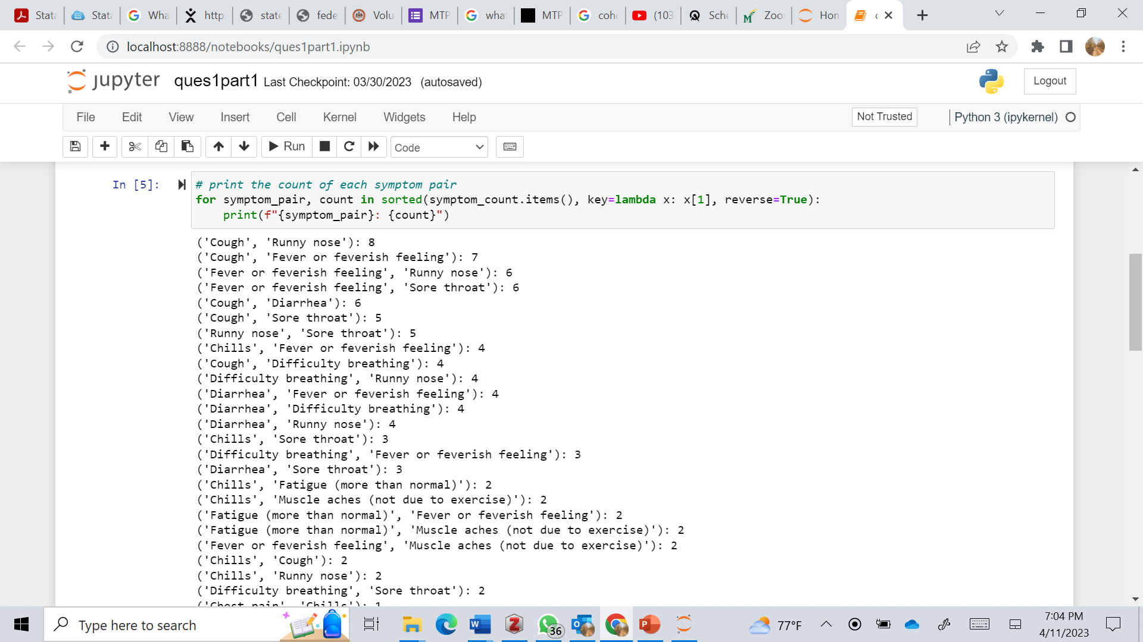
RESULT:

Slide 9
THANK YOU

