Slide 1
Sentiment Analysis
Farrokh Alemi, Ph.D.
Wednesday, April 24, 2019

Slide 2
Sentiment Analysis
Automated Analysis of Opinions

Slide 3
Scope of Analysis
Review, Sentence, Phrase

Slide 4
Scope of Analysis
The doctor was terrible; I could not understand him. The nurses were a different story. They were a pleasure to communicate to.
Review, Sentence, Phrase

Slide 5
Methods of Analysis
Keywords/Rule Based, Statistical

Slide 6
Methods of Analysis
The doctor was terrible; I could not understand him. The nurses were a different story. They were a pleasure to communicate to.
Keywords/Rule Based, Statistical

Slide 7
Methods of Analysis
The doctor was terrible; I could not understand him. The nurses were a different story. They were a pleasure to communicate to.
Keywords/Rule Based, Statistical

Slide 8
Methods of Analysis
He knows nothing and was killing me with poor advice.
You are killing it.
Keywords/Rule Based, Statistical

Slide 9
Keywords
Context Insensitive

Slide 10
Keywords
Can’t Scale Up to Big Data
To Do List
1
Oh So
2
Many
3
Words

Slide 11
Statistical
Radical Improvements

Slide 12
Opinion
Training
Classified Opinion
Word / Phrase Extraction
Machine Learning Model
Label

Slide 13
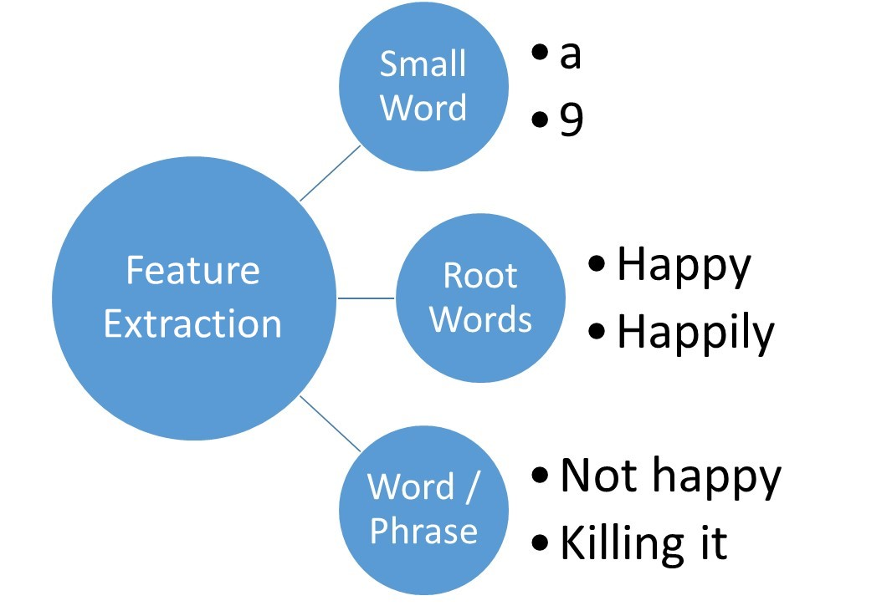
Opinion
Training
Classified Opinion
Word / Phrase Extraction
Machine Learning Model
Label

Slide 14
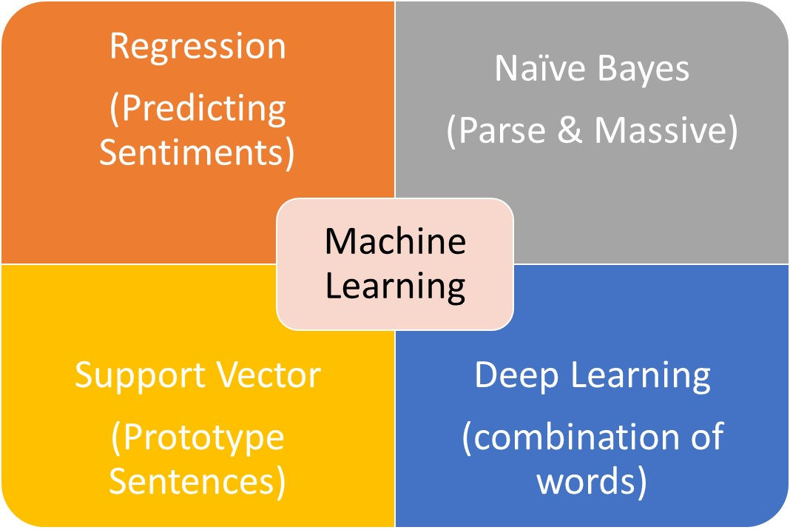
Opinion
Training
Classified Opinion
Word / Phrase Extraction
Machine Learning Model
Label

Slide 15
Opinion
Training
Classified Opinion
Word / Phrase Extraction
Machine Learning Model
Label
Opinion
Prediction
Label
Word / Phrase Extraction
Machine Learning Model
New
Phrase

Slide 16
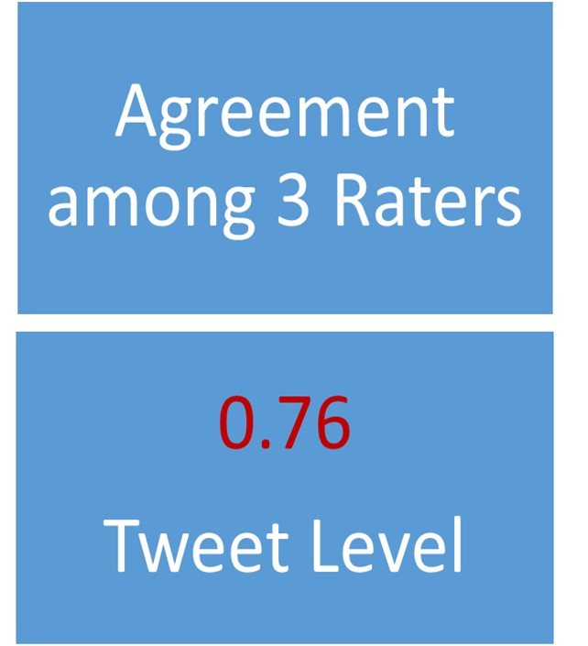

Slide 17
Last Mile Problem
Misses Obvious Text Occasionally

Slide 18
4 Statistical Methods
Maximum Likelihood Ratio

Slide 19
Likelihood Ratio
$$LR=\frac{Prevalance of Word in Complaints}{Prevalence of Word in Not Complaints}$$

Slide 20
100 praises
I am happy with front desk
50 Complaints
Likelihood Ratio
All I can say is that the breast surgery made me happy and young
$$LR=\frac{1/5}{3/100}=0.17$$
I am happy we stayed with this doctor
This surgeon is knife happy

Slide 21
Last Mile Problem
Can’t Learn from One Case

Slide 22
I am happy with front desk
Last Mile Problem
All I can say is that the breast surgery made me happy and young
LR (Happy)=0.17
LR(Knife)=1
I am happy we stayed with this doctor
This surgeon is knife happy

Slide 23
4 Statistical Methods
Longest Match &
Maximum Likelihood Ratio

Slide 24
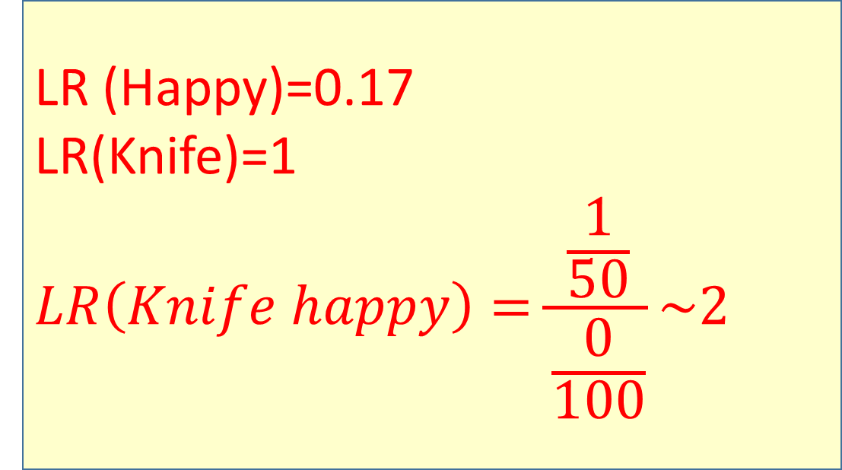
Longest Match & Maximum Likelihood
I am happy with front desk
LR (Happy)=0.17
LR(Knife)=1
$$LR\left(Knife happy\right)=\frac{\frac{1}{50}}{\frac{0}{100}}\sim 2$$
All I can say is that the breast surgery made me happy and young
I am happy we stayed with this doctor
This surgeon is knife happy

Slide 25
Complaints
New Sentence
n take time not schedule patients close together
2533 0 0 1 0 0 0 0
670 0 1 0 0 0 0 0
371 0 0 0 0 1 0 0
284 1 0 0 0 0 0 0
120 0 0 0 1 0 0 0
99 0 0 1 0 1 0 0
34 1 1 0 0 0 0 0
33 0 1 1 0 0 0 0
28 0 0 0 0 0 1 0
22 0 1 0 0 1 0 0
21 1 0 1 0 0 0 0
12 0 1 0 1 0 0 0
10 0 0 0 0 0 0 1
9 0 0 1 1 0 0 0
8 0 0 1 0 0 1 0
7 1 0 0 0 1 0 0
4 0 0 1 0 0 0 1
4 1 1 0 0 1 0 0
3 0 0 0 1 0 1 0
2 0 0 0 1 1 0 0
2 0 0 0 0 1 1 0
2 1 0 0 1 0 0 0
1 0 0 1 1 1 0 0
1 1 1 0 0 0 0 1

Slide 26
Complaints
Match to Not
n take time not schedule patients close together
2533 0 0 1 0 0 0 0
670 0 1 0 0 0 0 0
371 0 0 0 0 1 0 0
284 1 0 0 0 0 0 0
120 0 0 0 1 0 0 0
99 0 0 1 0 1 0 0
34 1 1 0 0 0 0 0
33 0 1 1 0 0 0 0
28 0 0 0 0 0 1 0
22 0 1 0 0 1 0 0
21 1 0 1 0 0 0 0
12 0 1 0 1 0 0 0
10 0 0 0 0 0 0 1
9 0 0 1 1 0 0 0
8 0 0 1 0 0 1 0
7 1 0 0 0 1 0 0
4 0 0 1 0 0 0 1
4 1 1 0 0 1 0 0
3 0 0 0 1 0 1 0
2 0 0 0 1 1 0 0
2 0 0 0 0 1 1 0
2 1 0 0 1 0 0 0
1 0 0 1 1 1 0 0
1 1 1 0 0 0 0 1

Slide 27
Praise
n take time not schedule patients close together
34 0 0 0 0 0 0 1
81 0 0 0 0 0 1 0
1369 0 0 0 0 1 0 0
1 0 0 0 0 1 1 0
236 0 0 0 1 0 0 0
2 0 0 0 1 0 0 1
4 0 0 0 1 1 0 0
3263 0 0 1 0 0 0 0
2 0 0 1 0 0 0 1
16 0 0 1 0 0 1 0
133 0 0 1 0 1 0 0
1 0 0 1 0 1 0 1
26 0 0 1 1 0 0 0
2 0 0 1 1 1 0 0
1628 0 1 0 0 0 0 0
2 0 1 0 0 0 0 1
1 0 1 0 0 0 1 0
105 0 1 0 0 1 0 0
55 0 1 0 1 0 0 0
0
Match to: not together

Slide 28
Praise & Complaint
Praise nCompl take time not schedule patients close together
1369 371 0 0 0 0 1 0 0
676 284 1 0 0 0 0 0 0
236 120 0 0 0 1 0 0 0
133 99 0 0 1 0 1 0 0
560 34 1 1 0 0 0 0 0
137 33 0 1 1 0 0 0 0
81 28 0 0 0 0 0 1 0
105 22 0 1 0 0 1 0 0
83 21 1 0 1 0 0 0 0
Match to: take not

Slide 29
Likelihood
Ratios
Phrase | Prevalence in Complaints | Prevalence in Praise | LR
together | 10 | 34 | 0.59
close | 28 | 81 | 0.69
patients | 371 | 1369 | 0.54
not | 2533 | 3263 | 1.56
time | 670 | 1628 | 0.83
take | 284 | 676 | 0.84
schedule | 120 | 236 | 1.02

Slide 30
Likelihood
Ratios
Phrase | Prevalence in Complaints | Prevalence in Praise | LR | Length of Match
close schedule | 3 | NULL | 4.00 | 2
patients schedule | 2 | 4 | 1.01 | 2
together schedule | NULL | 2 | 0.33 | 2
together time | NULL | 2 | 0.33 | 2
close time | NULL | 1 | 0.50 | 2
close take | NULL | 1 | 0.50 | 2
patients take | 7 | 43 | 0.33 | 2
schedule take | 2 | 5 | 0.80 | 2
not take | 21 | 83 | 0.51 | 2
time take | 34 | 560 | 0.12 | 2
patients time | 22 | 105 | 0.42 | 2
schedule time | 12 | 55 | 0.44 | 2
not time | 33 | 137 | 0.48 | 2
together not | 4 | 2 | 4.02 | 2
close not | 8 | 16 | 1.01 | 2
patients not | 99 | 133 | 1.50 | 2
schedule not | 9 | 26 | 0.70 | 2
close patients | 2 | 1 | 4.02 | 2

Slide 31
Likelihood
Ratios
Phrase | Prevalence in Complaints | Prevalence in Praise | LR | Length of Match
patients schedule not | 1 | 2 | 1.01 | 3
together time take | 1 | NULL | 2.00 | 3
patients time take | 4 | 71 | 0.11 | 3
close not take | NULL | 1 | 0.50 | 3
patients not take | NULL | 6 | 0.14 | 3
close time take | NULL | 2 | 0.33 | 3
schedule time take | NULL | 12 | 0.08 | 3
not time take | NULL | 30 | 0.03 | 3
patients schedule time | NULL | 5 | 0.17 | 3
patients not time | NULL | 5 | 0.17 | 3
together patients not | NULL | 1 | 0.50 | 3
patients not time take | NULL | 6 | 0.14 | 4
patients schedule time take | NULL | 1 | 0.50 | 4
Longest
Strongest among Longest

Slide 32
4 Statistical Methods
Longest Match &
Largest Switch in Sentiments

Slide 33
Longest Match & Largest Switch
Both phrases are same length
$$Switch\left(Knife happy\right)=Yes$$
$$Switch\left(Competent staff\right)=No$$
Competent staff but surgeon is knife happy

Slide 34
For the "Complaint" topic, "The doctor took a long time to talk to me" was classified as "False". We decided on this classification because of the combination of words doctor, took, time, talk. There were 60870 cases in the training set (14364 positive, 46506 negative). Prior odds of positive was set to 1 to 1. The following words were excluded as common words not central to the analysis: the, a, to, to, me. The index sentence had 5 remaining words. The minimum number of replications needed for a single word match was 96. The following combinations of words were examined before the process was aborted:
Order | Word Combination | Positive | Negative | Likelihood Ratio | Required Minimum Repetition | Z
1 | doctor, took, time, talk | 0 | 6 | 0.14 | 0.32 | 135.90
2 | long | 291 | 493 | 1.91 | 96 | 39.49

Slide 35
The Way Forward?
Not Sure?

