Slide 1
Forms and Reports
09

Slide 2
Outline
Create a Form
Create a Report
Import and Export XML files using Access

Slide 3
Introduction
Forms provide a user-oriented interface to the data in a database application.
For example, the AutoForm Wizard enables you to create a form based on a table with just a single click.

Slide 4
Forms
“Bound” Form ← This Lecture
It is directly connected to a data source such as a table or query
When you amend any data within form, your changes are immediately written to the tables.
“Unbound” Form
It does not link directly to a data source
Involve more coding work (e.g., good understanding of VBA coding ) in order to initially populate them in normal view.

Slide 5
“Bound” Forms
To control access to data
Certain users might need to see only several fields in a table with many fields.
Providing those users with a form that contains only those fields makes it easier for them to use the database.
Think of bound forms as
windows through which people
see and reach your database.

Slide 6
Relationships between Forms, Queries, and Tables
Like queries, forms do not contain any data. Instead, they provide a “window” through which tables and queries can be viewed.
Tables: All data is stored in tables.
Queries: Use a query to find or operate on the data in your tables.
Forms: These are screens for displaying data from and inputting data into your tables.

Slide 7
Relationships between Forms, Queries, and Tables
Forms
Queries
Tables

Slide 8
MS Access
How do I create a form?
How do I create a form using the form wizard?
How do I create a form from scratch?

Slide 9
Create a form using Form Wizard (1)
Choose the “Create”
Click on the “Form”
On the bottom of the Form, you can
display the records by clicking “>” and “<”
search a record by using the “Search” window

Slide 12
Insert a new record using a form
Create a new record
Fill in the information for the new patient in the form
Save the form
Now go to the patient table to check whether the record exist or not

Slide 16
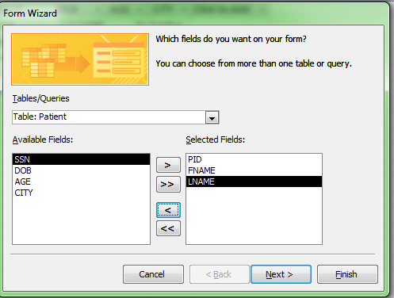
Create Form from more tables Using Form Wizard

Slide 17
Patient and Visit table

Slide 18
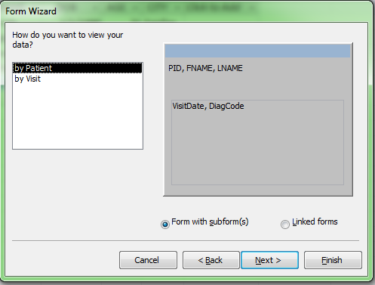
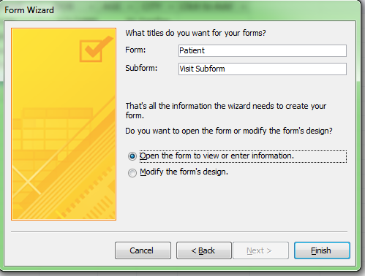

Slide 19
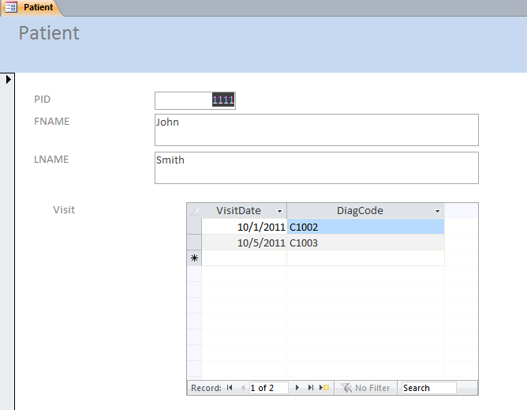

Slide 20
Creating a Form from Scratch
Create a new blank form based on the Patient table

Slide 21
Create a Form from Scratch
Select the “Create” tab in the toolbar at the top of the screen.
Then click on the “Form Design” button in the Forms group.
We are now viewing our form in design view.

Slide 23
You should see a blank form that looks like this:

Slide 24
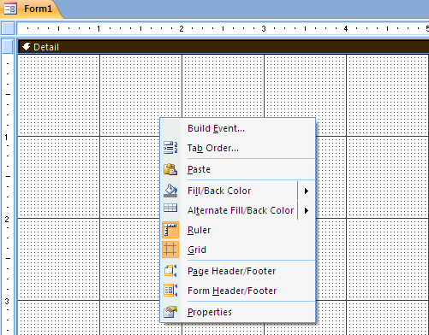
Create a Form from Scratch
Right-click on the form and select Properties from the popup menu.

Slide 25
Create a Form from Scratch
When the Property Sheet appears, select “Form” from the drop down.
You should now see the properties for the Form object.

Slide 28
Record Source property
The Record Source property sets the source of the data for the form.
For example, if you want to create a data entry form for the “Patient” table, you would specify Patient as the Record Source.
Notes:
Let's take a few moments to explore some of the more commonly used properties for a Form object.

Slide 30
Caption Property
The Caption property is the value that displays in the title bar of your form.
We'll set the Caption property to display "Add/Edit Patients".

Slide 32
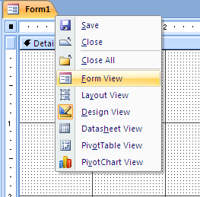
Caption Property
Change the Form from “Design view” to the “Form view”
Now we can view the Form as an end-user

Slide 33
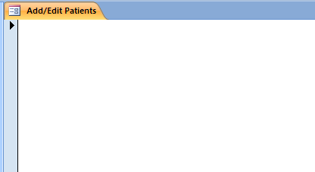
Caption Property
As you can see there is a title bar at the top of the form and it displays the value that we set in the Caption property.

Slide 34
Default View property
If you look at the options available, there are six values that you can choose from - Single Form, Continuous Forms, Datasheet, PivotTable, PivotChart, and Split Form.

Slide 36
Single Form
The Single Form option allows a user to view one record at a time in the form.
At the bottom of the form, you will see record selectors.
This allows you to navigate from one record to another.

Slide 38
Continuous Forms
This option allows you to see multiple records in the form at once.
The scroll bar on the right allows you to scroll through the records.
At the bottom of the form, you are still given the record selectors to navigate through the records. In this sample, there are 6 records that can be viewed in this form.

Slide 39
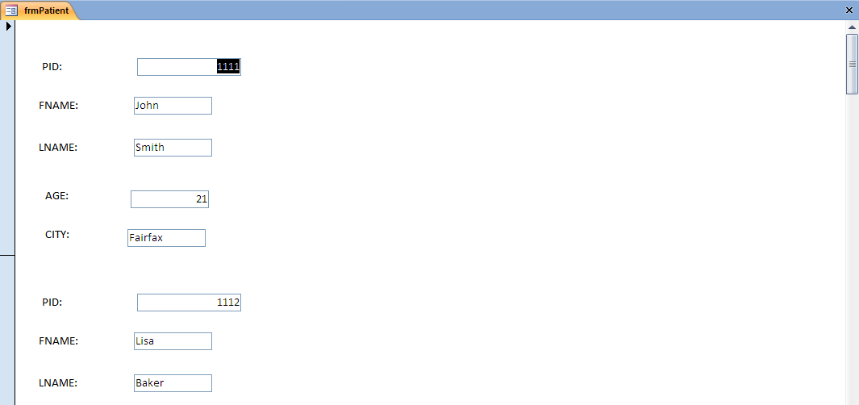

Slide 40
Datasheet
This option makes the form appear as if you are looking at the actual table.
In the datasheet mode, you can resize the columns or even reorder the columns by highlighting and dragging the column to another location.
Notes:
Choose the datasheet mode and right click the frmPatient to choose “Datasheet” view.

Slide 42
Split Form
It gives you two views of your data:
The top of the form displays a Single Form which allows a user to view one record at a time.
The bottom of the form displays a Datasheet view of the records.
The two views are synchronized so that when you select a field in one section of the form, it displays the corresponding field in the other section of the form.
This option gives you all of the functionality of the Single Form as well as the Datasheet.

Slide 44
Auto Center property
This property can be set to either Yes or No.
If this property is set to Yes, the form will center itself automatically when it is opened.
If this property is set to No, the form will appear in exactly the same position as you saved it (when you were in Design view).

Slide 46
Create a Form from Scratch
We've set the Form properties as follows:
Record Source = Patient
Caption = Add/Edit Patients
Default View = Single Form
Auto Center = Yes
You can close the Property Sheet by clicking on the X in the top right corner of the Property Sheet.

Slide 47
Create a Form from Scratch
Now, let's build our form.

Slide 48
Adding objects to our form
Let’s add objects from the Patient table to our form
Since we've already specified our Record Source, Access gives us some nice features to quickly drop objects onto our form.
Select the “Design tab” in the toolbar at the top of the screen.
Then click on the “Add Existing Fields” button in the Tools group.

Slide 50
A Field List window should appear on your screen as follows

Slide 51
Adding objects to our form
This window lists all of the fields that are available for your form to use, based on the Record Source property.
To add one of these fields to your form, highlight the object in the window, and then drag it to the location in the form where you wish to add this object.

Slide 52
Adding objects to our form
We've chosen to add the following five objects to our form.
Patient ID
First Name
Last Name
Age
City

Slide 54
Adding objects to our form
Resize the objects
Click the object that you wish to resize.
When your mouse pointer displays double-headed arrow, hold down the left mouse button and drag the object to the desired size.
If you wish to move the object, move your mouse pointer until it looks like a diamond with 4 arrows. Then hold down the left mouse button and drag the object to the desired location.

Slide 56
Viewing your form as a user would
Now that you have finished placing your objects on the form, you will want to view the form as a user would.
To view your form, select the “Design” tab in the toolbar at the top of the screen. Then click on the “View” button in the Views group and select “Form View” from the popup menu.

Slide 59
Saving form
Click on the “Save” button in the top left of the toolbar.
A "Save As" window should appear
Select a name for the form and click on the “OK” button. We usually always prefix our form name with "frm".

Slide 61
Saving form
Now when you return to the Navigation Pane, you will see your form in the list.
Congratulations! You've now created your first form in MS Access.

Slide 63
Access Report
Having all your data stored in Access is great for maintaining a database, but it isn't the best when you want to share the data or view it away from a computer.
Solution: Access report (A ready-to-print document)

Slide 64
Creating an Access Report
The billing department of a hospital wants a list of patients and total amount of their costs.
Luckily, these information are stored in the Access database

Slide 65
SQL Query
SELECT PID, SUM(COST) as TotalCost
FROM Billing
GROUP BY PID
And Save this query as “PatientCostQuery”

Slide 67
Creating an Access Report
Select the “Create” tab in the toolbar at the top of the screen.
Then click on the “Report Wizard” button in the Reports group.

Slide 69
Creating an Access Report
In the Report Wizard widow, select the query we created (PatientCostQuery) and add both fields to the report.
Click “Next”
Skip the “Add any grouping levels”
Sort your records with the “TotalCost” column

Slide 70
Creating an Access Report
Use the default “Lay out” – Tabular and Portrait
Use the default “Style” – Office
Rename the “title” of the report – Patient Cost
Click “Finish”

Slide 77
Import and Export XML files using MS Access

Slide 78
XML
eXtensible Markup Language (XML) is a set of rules for encoding documents in machine-readable form.
XML, like HTML, is a markup language, which means that it’s not a full function language such as C++ or JAVA.
XML gives structure to the document’s content while HTML deals only with formatting the text and graphics in a document.

Slide 79
XML
The structure of an XML documents is provided by its XML Schema –metadata (data about data).
An XML schema describes where elements may occur in a document and in what order.
XML files are rapidly becoming a universally accepted standard for exchanging data between dissimilar platforms and displaying them on the World Wide Web.

Slide 80
Export Access data to XML files
Export any table, query, form, or report to XML files from a regular Access database.
When you export a form or report, you actually export the data behind the form or report.
Now, we want to export our Patient table to XML

Slide 81
Export Procedure
To begin with, launch Access and open the EMR database.
Select the Patient table in the Objects list in the Database window
Navigate to “External Data” tab
Click the “More” in the Export group
In the drop-down list, choose the second option “XML File”

Slide 83
Export Procedure
The Export dialog box opens. Navigate to the folder in which you want to store the exported data.
C:\Hua\Teaching\HAP361\Presentation\Patient.xml
Click “OK”

Slide 86
Summary
What is a Form?
Forms, Queries and Tables
Create a Form using Form Wizard
Create a Form from scratch
Create a Report using Report Wizard

