Slide 1
Area under the Receiver Operating Curve
Farrokh Alemi, PhD

Slide 2
Data Used in this Example
Row number for data sorted by cutoffs
rNum | cutoff | sensitivity | specificity
1 | 1 | 0 | 1
2 | 0.95 | 0.933575 | 0.419035
3 | 0.9 | 0.953408 | 0.350141
4 | 0.8 | 0.973398 | 0.255942
5 | 0.4 | 1 | 0
6 | 0.2 | 1 | 0
7 | 0 | 1 | 0
Must include cutoff of 1 & 0

Slide 3
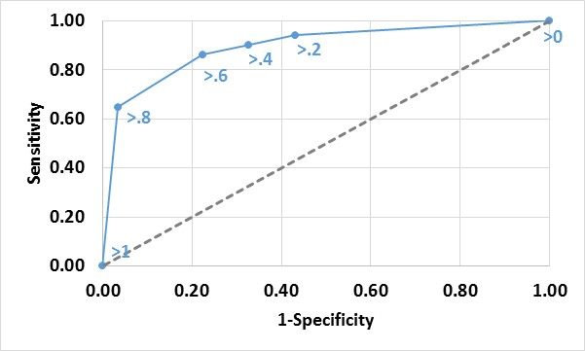
Area Approximated from Triangles and Rectangles under the Curve
Run
Notes:
We approximate the curve as a series of adjacent trapezoids.

Slide 4
Area Approximated from Triangles and Rectangles under the Curve
Run
Notes:
The tops of the trapezoids approximate the curve line

Slide 5
Area Approximated from Triangles and Rectangles under the Curve
Run
Notes:
The area under the curve is the sum of the areas of the trapezoids

Slide 6
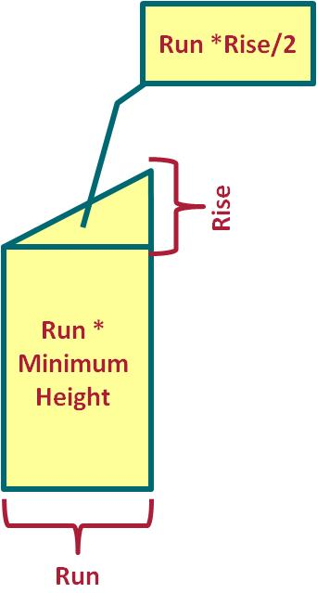
Sum of Trapezoids under Consecutive Cutoffs
-- Data has two aliases a and c, for cutoffs a and c
-- Join 2 versions of data on consecutive rows
-- Calculate area under 2 cutoffs
SELECT
SUM(ABS(a.[specificity] - c.[specificity])
* (a.[sensitivity] + c.[Sensitivity])/2) AS Area
FROM Data AS a INNER JOIN Data AS c
ON a.rNum = c.rNum - 1;
-- The output is 0.679 for sample data

