Slide 1
Conditional Probabilities & Reduced Universe of Possibilities
Farrokh Alemi, Ph.D.
Notes:
This section provides a brief intuitive definition of probability and conditional probability. This brief presentation was organized by Dr. Alemi. It was narrated by xxx

Slide 2
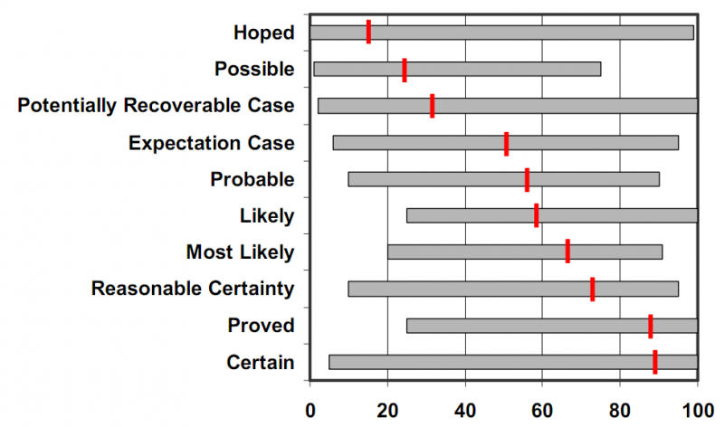
Cross Join
Probability
0 .2 .4 .6 .8 1
Notes:
Probability is a quantitative measure of uncertainty. When we are sure that an event will occur, we say that it has a probability of 1. When we are sure that an event will not occur, we assign it a probability of zero. When we are completely in dark, we give it a probability of 0.5, or note that it has a 50 % chance of occurrence. Values between 0 and 1 measure how uncertain we are about the occurrence of an event

Slide 3

Cross Join
Count of Times any Event Occurs
Definition
Notes:
If there are a total of n mutually exclusive possible events

Slide 4
Cross Join
Count of Times Event A Occurs
Count of Times any Event Occurs
Definition
Notes:
and m of these are event A, then the probability of event A can be calculated as the count of times the event occurs divided by the count of times any event could have occurred.

Slide 5
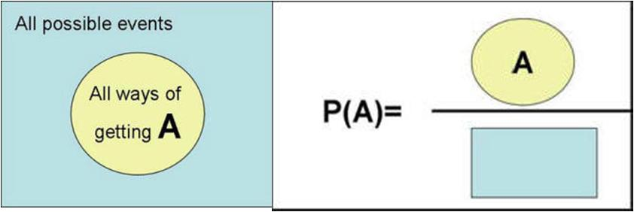
Cross Join
Definition
Notes:
Visually this can be shown as a Venn diagram. The rectangle blue area shows the universe of possibilities. The circle shows all ways in which event A occurs.

Slide 6
Cross Join
Definition
Notes:
The probability of event A is defined as the yellow circle area divided by the blue rectangle area.

Slide 7


Cross Join
Definition
Notes:
We have provided a simple definition of probability as the ratio of count of observed events to count of all possible events. Is this definition practical?

Slide 8
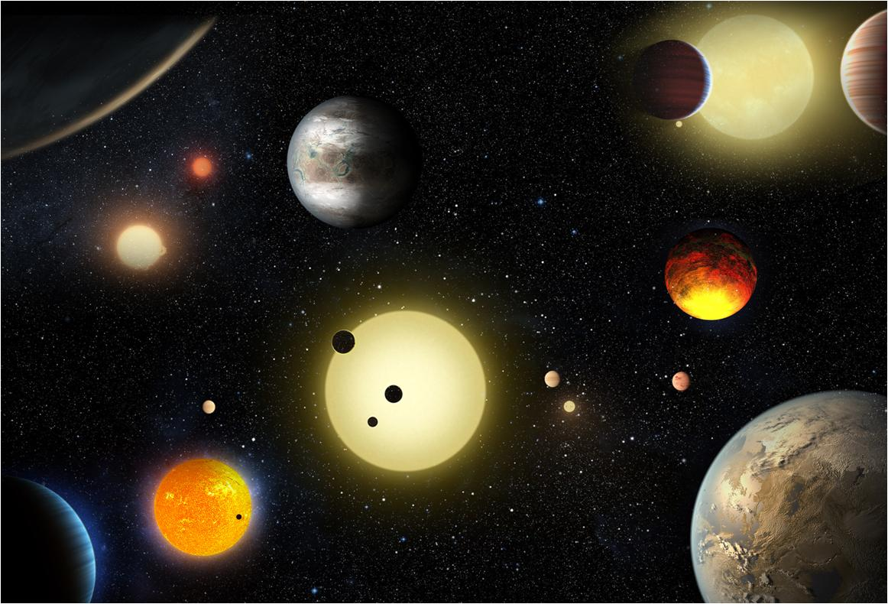
Cross Join
Universe of Possibilities
Notes:
The universe of possibilities is an important part of defining the concept of probability. Of course, counting the universe of possibilities is an impossible task.

Slide 9
Cross Join
Yes, you
CAN
!
… if you use SQL
Universe of Possibilities
Notes:
Inside electronic health records it is a different issue. Inside the computer, the universe is well defined and contained. We know exactly how many patients we have data on. We know exactly how many of them have had a particular disease. We can easily count probability of diseases and events inside the electronic health records. SQL can help us count the number of mutually exclusive events, so we can have a good estimate for the universe of possibilities. We have a practical way to count the number of possible events

Slide 10
Cross Join
Yes, you
CAN
!
Union, Joint & Conditional Probabilities
… if you use SQL
Universe of Possibilities
Notes:
The definition allows us to calculate many difficult concepts such as union of two event, joint occurrence of two events, and conditional probabilities.

Slide 11
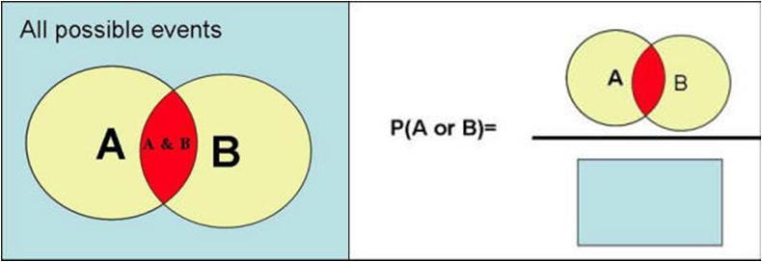
Cross Join
Probability of Either of Two Events
Notes:
The probability of two overlapping events also be calculated as a fraction of the universe of possibilities. Here we see a Venn diagram with event A and B. The red area shows situations where both events occur and the remainder of the yellow circle shows when one happens but not the other.

Slide 12
Cross Join
Probability of Either of Two Events
Notes:
The probability of either one of the two events occurring is the two overlapping circles, making sure that we do not double count the red area, divided by the universe of possibility or the rectangular area.

Slide 13
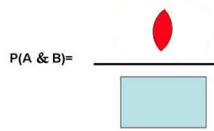
Cross Join
Probability of Either of Two Events
Notes:
The probability that both events occur together is given by the red area divided by the universe of possibilities.

Slide 14
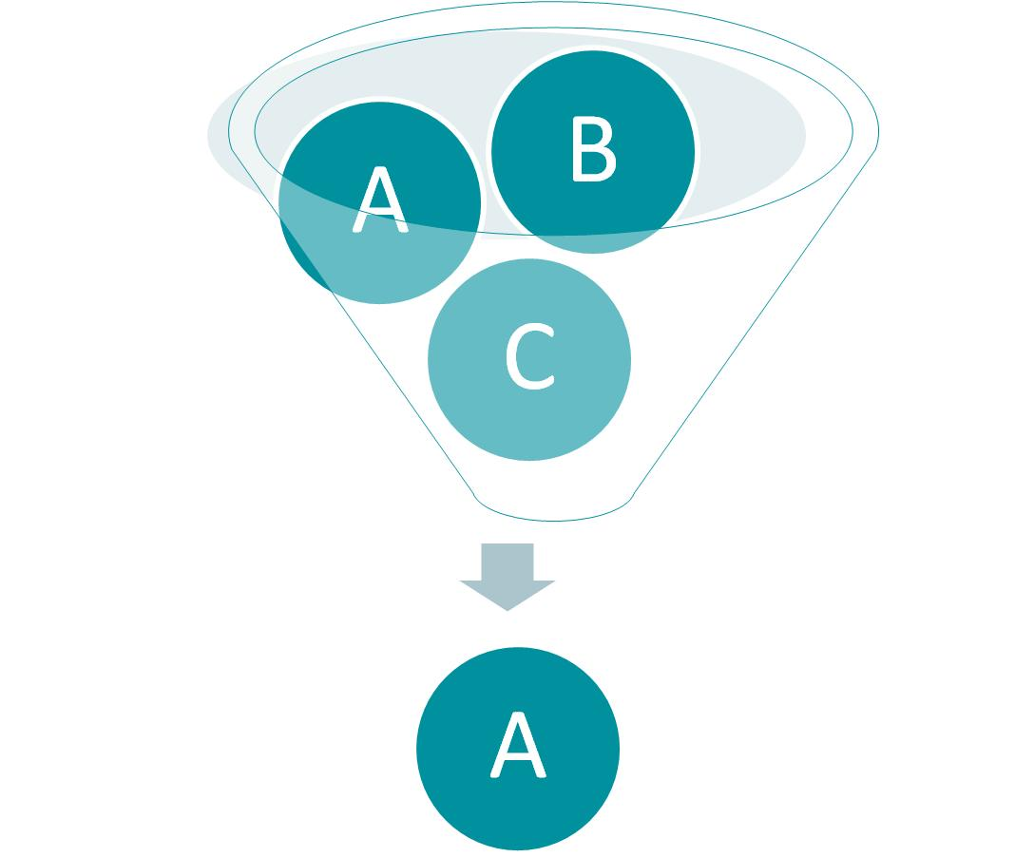
Cross Join
The universe shrinks to the event that has occurred
Conditional Probabilities
Notes:
Conditional probability is calculated by shrinking the universe of possibilities. Of all the possibilities the only thing that is now possible is the event that has occurred or in other words the condition in the conditional probability.

Slide 15
Cross Join
In SQL:
WHERE A is true
Conditional Probabilities
Notes:
In SQL, this translate to filtering the data using a WHERE command. The WHERE command reduces the massive data in the electronic health record to a smaller subset where event A has occurred.

Slide 16
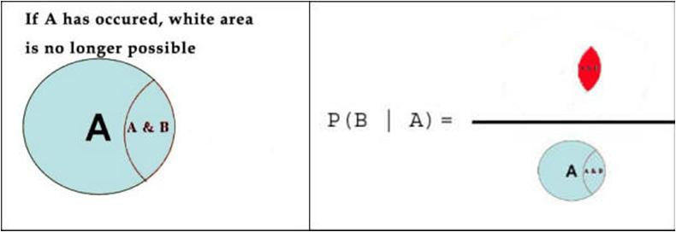
Cross Join
A
Conditional Probabilities
Notes:
When we know that event A has occurred, then the universe of possibilities in the Venn diagram is shrunk to the blue circle area. We see here that the area where A and B co-occur is red and the rest of the area where A occurs but B does not is blue.

Slide 17
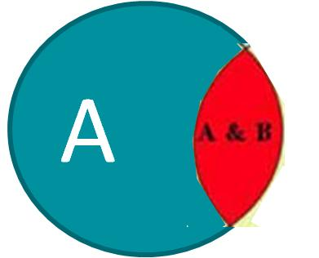
A
Conditional Probabilities
Notes:
The probability of B given A is now calculated as the red area, where both A and B occur, divided by the reduced universe of possibility, which is the circle area for A. The point is that the conditional probability is calculated using the definition of probability in the reduced universe of possibilities.

Slide 18
 |  | Event B
 |  | Present | Absent | Total
Event A | Present | a | b | a+b
 | Absent | c | d | c+d
 | Total | a+c | b+d | a+b+c+d
Contingency Table
Notes:
Data in a sample or data in electronic health records can always be reported as a contingency table. A contingency table is a count of how two or more events co-occur.

Slide 19
 |  | Event B
 |  | Present | Absent | Total
Event A | Present | a | b | a+b
 | Absent | c | d | c+d
 | Total | a+c | b+d | a+b+c+d
Inner cells
Contingency Table
Notes:
The counts of joint observations are provided in the inner cells of the table.

Slide 20
 |  | Event B
 |  | Present | Absent | Total
Event A | Present | a | b | a+b
 | Absent | c | d | c+d
 | Total | a+c | b+d | a+b+c+d
Both Events
Contingency Table
Notes:
The total number of times that both events occur together is given on the left upper cell as “a”.

Slide 21
 |  | Event B
 |  | Present | Absent | Total
Event A | Present | a | b | a+b
 | Absent | c | d | c+d
 | Total | a+c | b+d | a+b+c+d
Neither Event
Contingency Table
Notes:
The number of times neither event is present is given as “d”.

Slide 22
 |  | Event B
 |  | Present | Absent | Total
Event A | Present | a | b | a+b
 | Absent | c | d | c+d
 | Total | a+c | b+d | a+b+c+d
Contingency Table
Marginal Cells
Notes:
In the margins, the row and column totals are provided.

Slide 23
 |  | Event B
 |  | Present | Absent | Total
Event A | Present | a | b | a+b
 | Absent | c | d | c+d
 | Total | a+c | b+d | a+b+c+d
Event A Present
Contingency Table
Notes:
So the total number of times that event a is present is “a+b”.

Slide 24
 |  | Event B
 |  | Present | Absent | Total
Event A | Present | a | b | a+b
 | Absent | c | d | c+d
 | Total | a+c | b+d | a+b+c+d
Contingency Table
Event B Present
Notes:
The total number of times that event b is present is “a+c”.

Slide 25
 |  | Event B
 |  | Present | Absent | Total
Event A | Present | a | b | a+b
 | Absent | c | d | c+d
 | Total | a+c | b+d | a+b+c+d
Contingency Table
Universe
Notes:
In the contingency table, the universe of possibilities is given by “a+b+c+d”. This is our entire sample of data. This is the count of all events that are possible.

Slide 26
 |  | Event B
 |  | Present | Absent | Total
Event A | Present | a | b | a+b
 | Absent | c | d | c+d
 | Total | a+c | b+d | a+b+c+d
Contingency Table
Universe
, Count(distinct, ID) AS [Unique Pts]
Notes:
Usually in an electronic health record we analyze the data by patients so the universe of possibilities is all unique patients. The emphasis in analysis is to make sure we count only distinct patients. We should not double count a patient if he or show has many encounters. One way to do so is to use the Count Distinct SQL command. If the unit of analysis is the patient, then the universe of possibilities is the number of unique patients in our data.

Slide 27

 |  | Event B
 |  | Present | Absent | Total
Event A | Present | a | b | a+b
 | Absent | c | d | c+d
 | Total | a+c | b+d | a+b+c+d
Contingency Table
Count of A Present
Universe
Notes:
Using our definition of probability, the probability of event A is calculated as the number of times it occurs, a+b, divided by the universe of possibilities, a+b+c+d:

Slide 28

 |  | Event B
 |  | Present | Absent | Total
Event A | Present | a | b | a+b
 | Absent | c | d | c+d
 | Total | a+c | b+d | a+b+c+d
Contingency Table
Count of B Present
Universe
Notes:
Similarly, the probability of occurrence of event B can be calculated as the number of times that event B occurs divided by the universe of possibilities.

Slide 29

 |  | Event B
 |  | Present | Absent | Total
Event A | Present | a | b | a+b
 | Absent | c | d | c+d
 | Total | a+c | b+d | a+b+c+d
Contingency Table
Count of B Absent
Universe
Notes:
The probability of event B not occurring is the number of times it does not occur, or b+d, divided by the universe of possibilities. You can see from these calculations how our definition of probability helps us calculate probability of events, even negative events or events not occurring.

Slide 30
 |  | Event B
 |  | Present | Absent | Total
Event A | Present | a | b | a+b
 | Absent | c | d | c+d
 | Total | a+c | b+d | a+b+c+d
Contingency Table
New Universe
Notes:
The conditional probability is calculated by shrinking the universe of possibilities to occasions where the condition has occurred. For example, to estimate the probability of event A occurring once we know that event B has occurred, then the universe is shrunk from a+b+c+d to all situations where the condition, i.e. event B, has occurred: a+c.

Slide 31

 |  | Event B
 |  | Present | Absent | Total
Event A | Present | a | b | a+b
 | Absent | c | d | c+d
 | Total | a+c | b+d | a+b+c+d
Contingency Table
Count of Event A
New Smaller Universe
Notes:
Now the conditional probability of event A occurring given event B is calculated by the frequency of event A in the reduced universe, i.e. a, divided by the reduced universe of a+c. The point is that conditional probabilities can be and should be calculated in the reduced universe where the condition has occurred. Our definition and the concept of shrinking the universe helps us calculate the conditional probability correctly.

Slide 32

 |  | Event B
 |  | Present | Absent | Total
Event A | Present | a | b | a+b
 | Absent | c | d | c+d
 | Total | a+c | b+d | a+b+c+d
Contingency Table
Count of Event B
Reduced Universe
Notes:
Many students make a mistake in calculating the conditional probability from a contingency table. The easiest way to avoid making a mistake is to remember always first calculate the reduced universe and then the conditional probability. Here is the conditional probability for event B occurring given that event A has occurred is shown. Note how the universe of possibilities is now reduced to only the situations where the condition has occurred. Pay attention to the condition and you will not make a mistake in these calculations.

Slide 33

 |  | Event B
 |  | Present | Absent | Total
Event A | Present | a | b | a+b
 | Absent | c | d | c+d
 | Total | a+c | b+d | a+b+c+d
Contingency Table
Count of not B
Reduced Universe
Notes:
If you follow this procedure, then you will not have any difficulty in calculating conditional probabilities involving double negatives such as “what is the probability of event B not occurring given that event A has not occurred. It is even difficult to understand what is meant by these negative events, unless we follow our procedure. Reduce the universe to the condition. In this case reduce it to the situation where event A has not occurred. Then examine the frequency of event B not occurring, which is d.

Slide 34
 | Blood pressure
Row Labels | Normal | Above Normal | Grand Total
Hypertensive | 3 | 10 | 13
Non-Hypertensive | 6 | 0 | 6
Grand Total | 9 | 10 | 19
Likelihood Ratio
Notes:
Let us try our hand at some sample data. Here we have 19 patients, that is our universe of possibilities. 10 of them have above normal blood pressure and 9 have blood pressure in normal range. In the inner cells we have number with normal and abnormal blood pressure that were diagnosed with hypertension.

Slide 35

 | Blood pressure
Row Labels | Normal | Above Normal | Grand Total
Hypertensive | 3 | 10 | 13
Non-Hypertensive | 6 | 0 | 6
Grand Total | 9 | 10 | 19
Likelihood Ratio
Count of Hypertension
Universe
Notes:
What is the probability of having a hypertensive patient? It is calculated from number of hypertensives divided by the universe of possibilities, total number of patients.

Slide 36
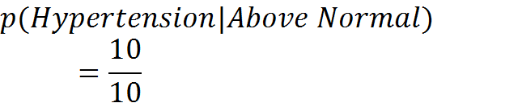
 | Blood pressure
Row Labels | Normal | Above Normal | Grand Total
Hypertensive | 3 | 10 | 13
Non-Hypertensive | 6 | 0 | 6
Grand Total | 9 | 10 | 19
Likelihood Ratio
Count of Hypertension
Reduced Universe
Notes:
What is the probability of having a hypertensive patient? It is calculated from number of hypertensives divided by the universe of possibilities, which is now the reduced group with above normal blood pressure.

Slide 37

Probability & Odds
Notes:
Before we leave this topic, I like to point out to you the relationship between probabilities and odds of an event. Odds of an event is the ratio of the probability of the event occurring over the probability of the event not occurring.

Slide 38

Probability & Odds
Notes:
One can calculate the odds from the probability of the event and vice versa. The probability of an event is its odds plus 1 divided by its odds.

Slide 39
Probability | Odds
0 | 0
0.1 | 0.11 to 1
0.2 | 0.25 to 1
0.3 | 0.43 to 1
0.4 | 0.67 to 1
0.5 | 1 to 1
0.6 | 1.50 to 1
0.7 | 2.33 to 1
0.8 | 4.00 to 1
0.9 | 9.00 to 1
1 | Infinity
Probability & Odds
Probability | Odds
0.95 | 19.00 to 1
0.99 | 99.00 to 1
Notes:
Both probability and odds are used to express uncertainty about occurrence of an event. Some people prefer to talk of odds of events and others prefer to talk in terms of probability of the event. There is one advantage to the use of odds. Probability ranges between 0 and 1, while odds can be zero or a number larger than 0. In other words, odds have no upper bounds. After odds of 0.8 the increase in odds is matched with smaller increases in probability, producing probabilities increasingly but in small steps getting nearer to 1. For example, odds of 9 to 1 is equivalent of probability of 0.9; odds of 19 to 1 is equivalent to probability of 0.95; and odds of 99 to 1 gets this to probability of 0.99. As odds increase to very large numbers, they add a very small amount to the probability of the event. Also note that odds can never produce a probability of 1.

Slide 40
Conditional probability Is calculated in reduced Universe of Possibilities
Notes:
Conditional probability can be thought of as probability in a reduced Universe of Possibilities

