Slide 1
Likelihood Ratios for
Repeated Infections
Farrokh Alemi, Ph.D.

Slide 7
Shortcut in a Separate Video

Slide 10
Shortcut in a Separate Video

Slide 25
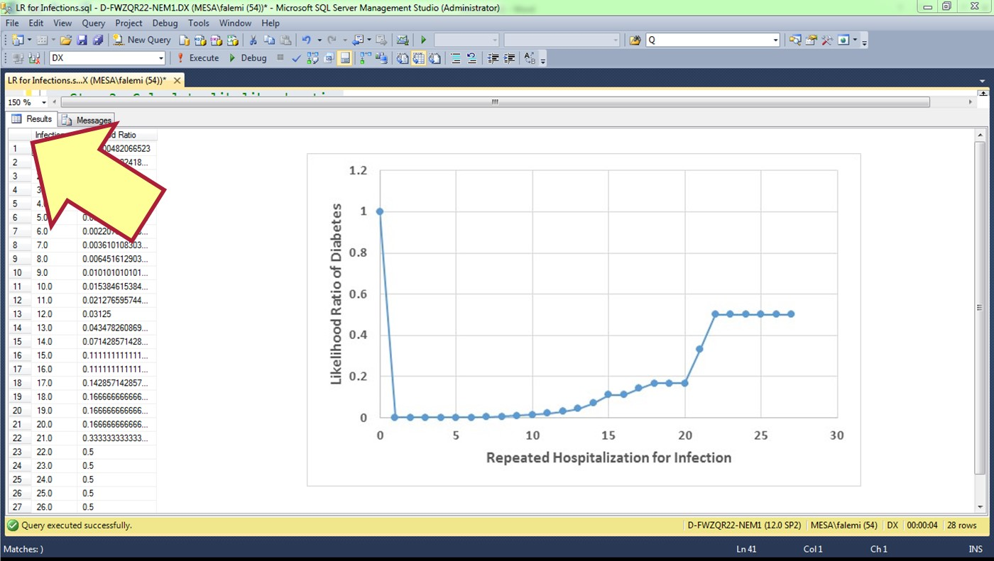

Slide 26
Submit Code & Graph in Word Document in Black Board

