Slide 1
Relationships as Primary & Foreign Keys
Organized by Farrokh Alemi, Ph.D.
Narrated by Samantha Tone
Notes:
This section describes the relationship among tables. This brief presentation was organized by Dr. Alemi and narrated by Samantha Tone.

Slide 2
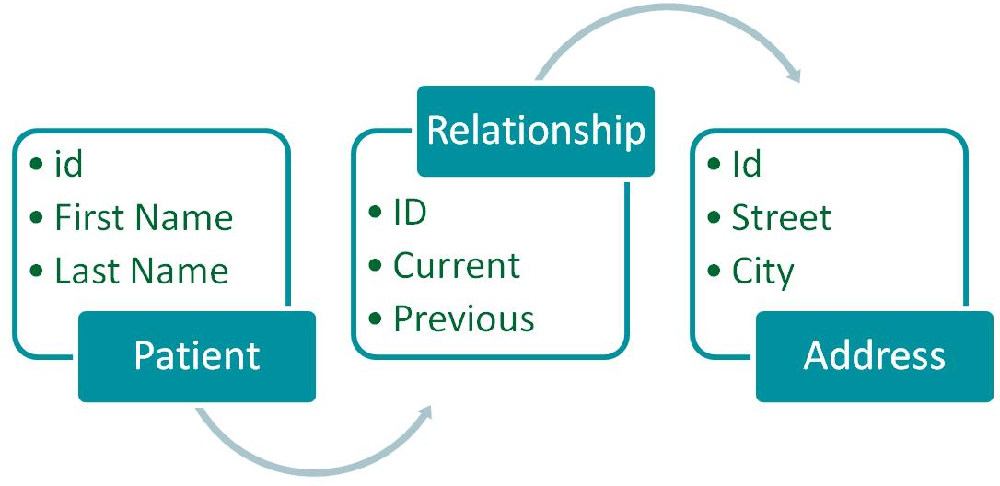
Relationships
Notes:
ER diagrams describe the entities that should be included in the database as tables and the relationship among these entities. Here we see two entities one describing the patient and the other street addresses. The relationship between these two entities is described by another table called relationship. This table indicates if the address is current or old address.

Slide 3
Relational Model Concepts
A table = a schema/relation
A row of table = a relational instance/tuple
A column of table = an attribute
Cardinality = number of rows
Degree = number of columns
Notes:
Relational databases are made of tables. Each table defines either a schema for an entity or a relationship. The rows in the table are relational instances. A column in the table represents entity attributes or table fields. The cardinality of the table refers to number of the rows in the table. Degree of the table refers to number of columns in the table

Slide 4
Example Instance of Student Relation
StudentID | StudentName | login | Age | GPA
53666 | Jones | jones@cs | 18 | 3.4
53688 | Smith | smith@eecs | 18 | 3.2
53650 | Smith | smith@math | 19 | 3.8
Cardinality = 3, degree = 5
Notes:
Here we have a table with cardinality 3 and degree 5, meaning we have 3 rows of data and 5 columns or fields.

Slide 5
From design to implementation
ER Diagram | Database implementation
Entity, Relationship | Table
Relationship | Primary & Foreign key(s)
Attribute | Field
Notes:
To map an ER diagram to the database one builds a table for each entity; if necessary builds a table for relationships among tow entities, makes a column in the table for each attribute in the entity, sets a primary key in the table and puts related foreign keys. Combination of primary and foreign keys are used to implement relationships.

Slide 6
Entity Sets to Tables
Name
EmployeeID
Address
Employee
Notes:
Here Employee entity is mapped to a table with three fields, Employee ID which is a Primary key, name which is an attribute of the employee and now a field in the table, and an address, which is also an attribute of the employee and now another field in the table.

Slide 7
PK
Primary Key
Unique for Each Row of the Table
Notes:
No two distinct records in a table can have the same values of the primary key. For example, a patient record number identifies one record in “patient” table. Another example, G number identifies one student in GMU patriotweb system

Slide 8
PK
Foreign Key
Relationship to Other Tables
Notes:
Foreign Key is used to identify records in other table following relations. Foreign Key in one table always corresponds to PK in another table

Slide 9
One-to-One Relationships
Employee
Security
EmployeeID
FirstName
LastName
…
EmployeeID
DateObtained
SecurityLevel
…
Notes:
Using a common identifiers in both entities creates the relationship. Here the primary key in the employee table is a foreign key in the Security table. Note that Types of primary and foreign keys must be identical. You cannot have patient ID once as numeric and once as text field.

Slide 10
Keys – let’s make it more complicated
A Key Can Be Multiple Fields
Notes:
A key does not need to be defined as a single field. For example Patient name + date of birth can be used as a key (assuming it uniquely identifies patients).

Slide 11
Example
PatientID | AddressType | Address | City | Zip
1111 | Home | 12345 Ox Rd | Fairfax | 22030
1111 | Business | 11111 Lee Hwy | Fairfax | 22030
Notes:
Patient ID + address type can be a primary key for address.

Slide 12
One-to-One Relationships
One-to-One Relationships
Notes:
One-to-one relationships are rare and are used in specific situations, such as: To avoid missing data, To model hierarchies, For privacy/security reason, or to break very large tables, if some fields are rarely accesses at the same time.

Slide 13
(2) One-to-Many Relationships
One-to-Many Relationships
Notes:
One to many relationships are the most important and the most frequent type of relationship in relational databases. They are used to represent all types of relationships in relational databases. When modeling one-to-many relationships you use foreign key in “many” to refer to record in “one”. Examples include patient-address. The primary key is the patient ID is used several times as foreign key in address table to indicate multiple addresses for the patient.

Slide 14
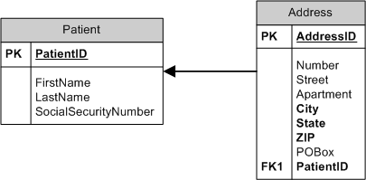
Foreign keys
Notes:
Here is an example of one patient having many addresses: Foreign key in address points to primary key in patient.

Slide 15
Primary and foreign keys
RecordNumber | FirstName | LastName
123 | John | Smith
445 | Andrew | Brown
AddressID | PatientRecordNumber | Number | Street | City
1 | 123 | 4400 | University Dr. | Fairfax
2 | 445 | 4310 | University Dr. | Fairfax
3 | 123 | 650 | K St. NW | Washington
Notes:
These two tables are related to each other because the ferign key in the second table points to the first table’s primary key.

Slide 16
Some Relationships Suggest New Entities
Many to Many Relationships

Slide 17
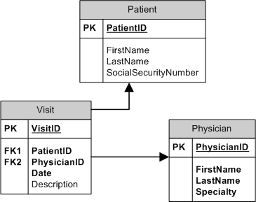
Notes:
Sometimes we have entities that have many to many relationships. In this design, patients can have many physicians and physicians can have many patients. It is not possible to indicate the many to many relationship with just foreign key in either table.

Slide 18
(3) Keys in many-to-many
Notes:
The solution is to have a relationship table that indicates the nature of the relationship in connecting many to many entities. Here, the visit table is the linking table between physicians and patients. In this design, patients can have many physicians and physicians can have many patients and the nature and number of each can be discovered in the visit table. The Linking table has two foreign keys. These foreign keys point to two different entities. Neither one of the foreign keys are unique in the linking table.

Slide 19
Notes:
Let us look at an example. This group has several clinics. Each clinic employs a number of healthcare providers. The group serves a number of patients in the area. The database to be constructed will serve the information needs of practice group management as well as providers and patients.

Slide 20
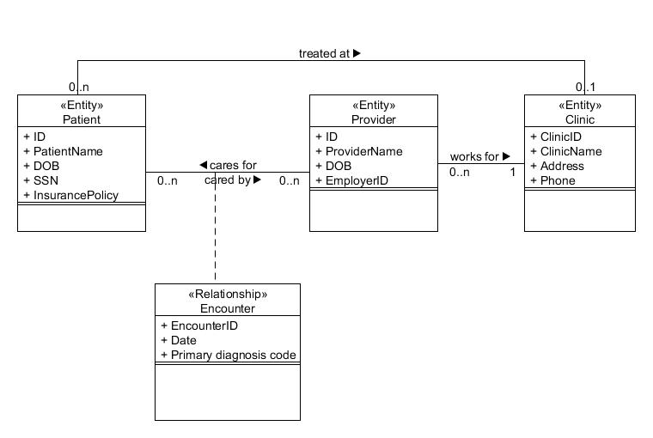
Entity - Table
Notes:
We have three entities: patient, provider and clinic. The attributes of each of these 3 entities are listed as fields within the 3 tables. Patient table has ID, Patient Name, Date of birth, Social security number and Insurance Policy.

Slide 21
Entity - Table
Notes:
The provider table has ID, Provider Name, Date of birth and Employee ID.

Slide 22
Entity - Table
Notes:
The clinic has Clinic ID, Clinic Name, Address, and Phone.

Slide 23
Relationship - Table
Notes:
We also need a relational table or an association table, here called encounter. It has an id, date and diagnosis code.

Slide 24
Keys
Patient (ID, PatientName, DOB, SSN, Insurance Policy, ClinicID)
Provider (ID, ProviderName, DOB, EmployeeID, ClinicID)
Clinic (ClinicID, ClinicName, Address, Phone)
Encounter (EncounterID, Date, DiagnosisCode, PatientID, ProviderID)
Notes:
To make this scheme work, we need to also introduce various relationships among these tables by introducing foreign keys. The clinic id is added as a foreign key to the patient and provider ID as these are one to many relationships and do not require additional association tables.

Slide 25
Keys
Patient (ID, PatientName, DOB, SSN, Insurance Policy, ClinicID)
Provider (ID, ProviderName, DOB, EmployeeID, ClinicID)
Clinic (ClinicID, ClinicName, Address, Phone)
Encounter (EncounterID, Date, DiagnosisCode, PatientID, ProviderID)
Notes:
The relationship between patients and providers is many to many and requires an additional association table, now called encounter table. We introduce both the patient and provider ID as foreign keys in the encounter table.

Slide 26
Primary and Foreign Keys indicate relationship among tables
Notes:
Cursor and Do-While commands repeatedly execute an SQL code

