Slide 1
Analytics for Accountable Care Organizations
Mark Hulse, RN
Vice President, Information Technology
Chief Information Officer
Moffitt Cancer Center

Slide 2
Key Changes in Healthcare Reform
Health Insurance Reform
Expand Insurance Coverage
Expand Consumer Protections
Reform Industry Practices
Payment Reform
Evolve Medicare Payment Systems from Fee-For-Service to Value Based Payment
Test new payment methodologies and patient care delivery models for Medicare, Medicaid
National Goals
Expand Access to Health Insurance to 95%
Lower Health Spending Growth Rate
Incentivize Delivery System Change
ARRA Structure Investments
Health Information Technology (EHRs)
Comparative Effectiveness Research (CER)

Slide 3
Accountable Care Organization
A legal entity comprised of hospitals, primary care and specialty physicians, networks of physician practices, or suppliers involved in patient care who work together to coordinate care for a defined population of patients.
Improve Population Health
Triple AIM
Improve Care for Individuals
Reduce Per Capita Costs

Slide 4
Critical Focus Areas
Measurable improvements in quality of care and outcomes through continuous process improvement that aligns financial incentives with desired behaviors and practices.
Providing care “at the right place and time” by optimizing utilization of services (increasing preventative services, chronic disease management, coordination of care, reduction of ED utilization and unnecessary redundant testing).
Reducing the unit cost of care through elimination of waste, excess capacity and process inefficiencies.
Each of these areas will require a robust analytics platform

Slide 5
Enabling the Learning Healthcare System EMRs are just the starting point…
Robust, Interoperable Informatics…
Trustworthy clinical data
Clinicians
Patients
Research
Guidelines and results lead to more standardized & optimized processes
Decision support analytics for research & at point of care
Measure, teach, activate and transform practice from discovery to point of care
Track outcomes & deviations for continuous improvement
Basic/Translational Research
Clinical Research/Trials
Comparative Effectiveness
Deep Analytics/Informatics
…creates “learning” healthcare and life sciences systems
Source: Oracle Health Sciences

Slide 6
Advanced Analytics Requires an Integrated View Across Organizations and Roles
“What worked on patients with similar clinical and genomic profiles?”
CLINICAL
INTEGRATED
VIEW ANALYTICS
“How much does it cost us to treat a diabetic patient?”
FINANCIAL
“How can I use what we know about a similar therapy to inform design of the new one?”
PATIENT REPORTED
SUPPLY CHAIN
“How has our “Just In Time” ventilator equipment affected the profitability of our ICUs?”
‘OMICS
Notes:
6
Objective: Identify the importance of connection, collaboration and empowerement.

Slide 7
Four Portals to Total Cancer Care™
Researcher View
Next Generation Health and Research Informatics Platform
Cohort Identification
Molecular Profiling
Biomarker Discovery
Comparative Effectiveness
Patient View
Personal Health Record
Longitudinal Follow-up
Personalized Search
Administrators View
Operational Dashboards
Quality & Safety Reporting
Meaningful Use
Clinician View
Decision Support
Clinical Pathways
Clinical Trial Matching
Access for Affiliate Network

Slide 8
Patient Engagement
Engaging patients as active participants in care - staying well and managing chronic disease.
Importance of capturing and influencing lifestyle choices.
Patients performing self-care activities, taking readings, following medication and nutritional guidelines; wellness guidelines and recommended health screenings for disease prevention
Creating customer “stickiness” - keeping patients within the ACO: engaging members through self-service options for appointment scheduling, registration and check-in, communicating with providers and managing financial and administrative aspects of their care.

Slide 9
Patient Engagement: IT Implications
Patient Portals
Access to demographic, insurance and clinical data (notes, results)
Transactions: secure provider messaging, alerts, reminders, prescription refills, scheduling
Patient self-reported data: questionnaires, journals, home monitoring systems
Access to condition-specific health management content (smart search capabilities)
Real-time chat
Access to social networks for support
Mobile applications that interface with glucose analyzers for diabetic patients or scales for heart failure patients and upload the data directly to the patient portal.
Improving the Patient Experience
Kiosk check-in
Care Traffic Controllers supported by RTLS capabilities

Slide 10
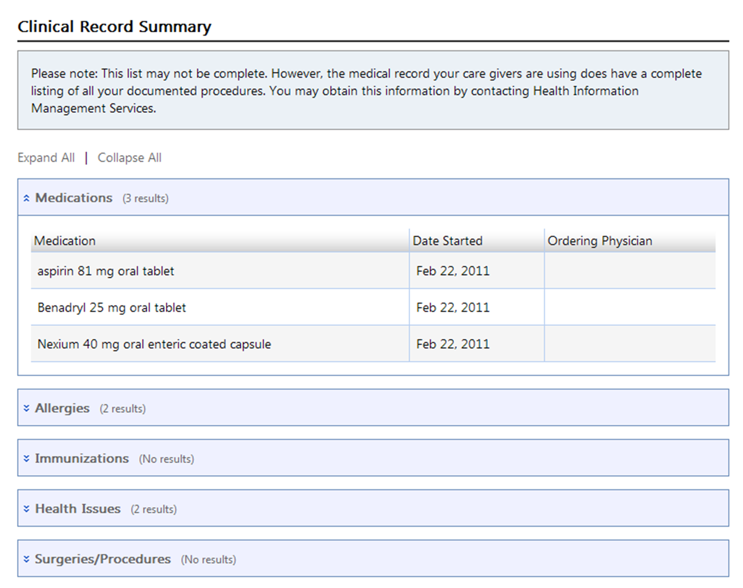
Notes:
jenn

Slide 11
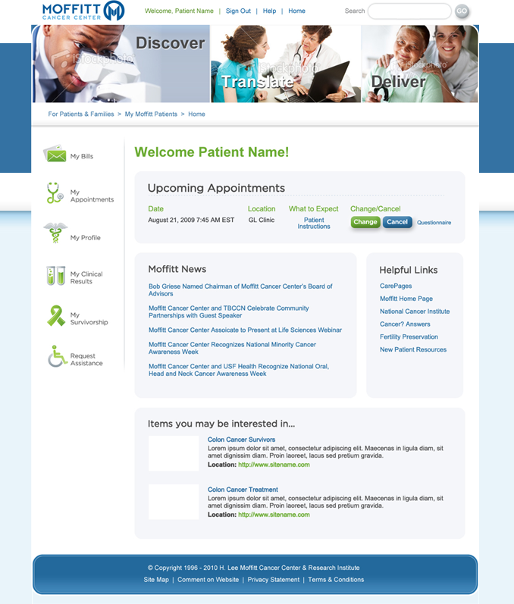
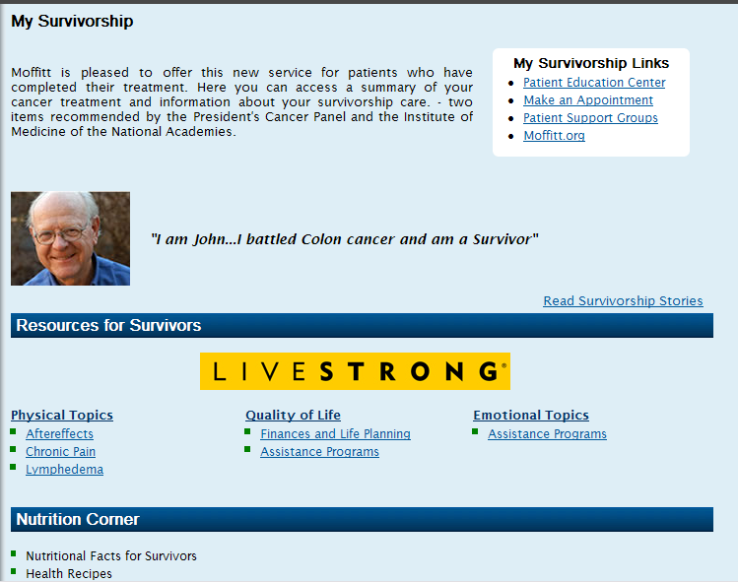
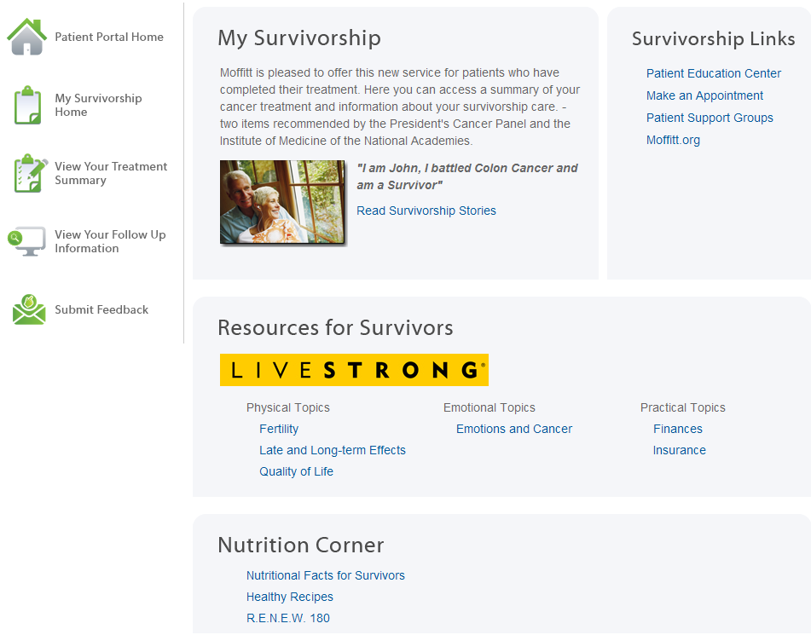
http://m-portal2:89/
Notes:
jenn

Slide 12
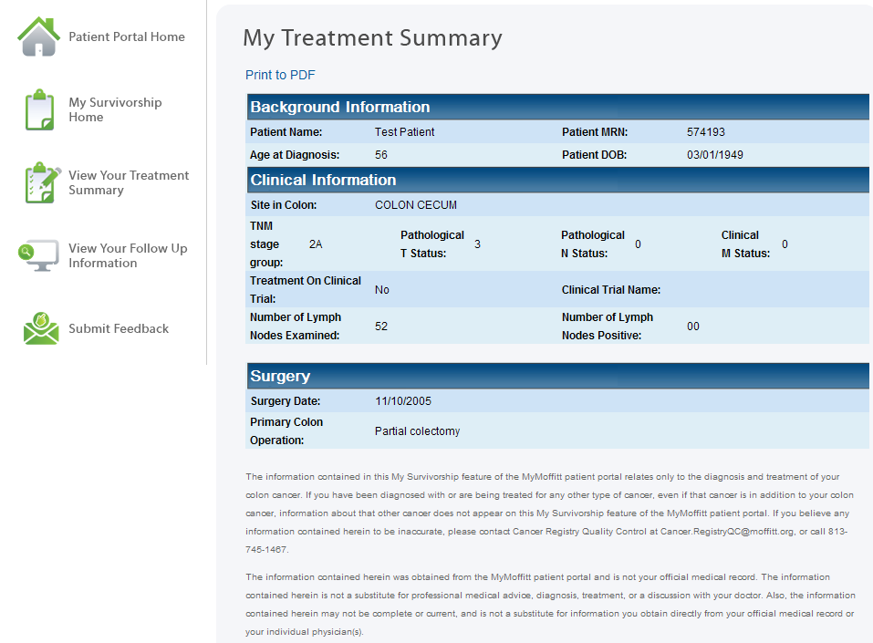
Notes:
jenn

Slide 13
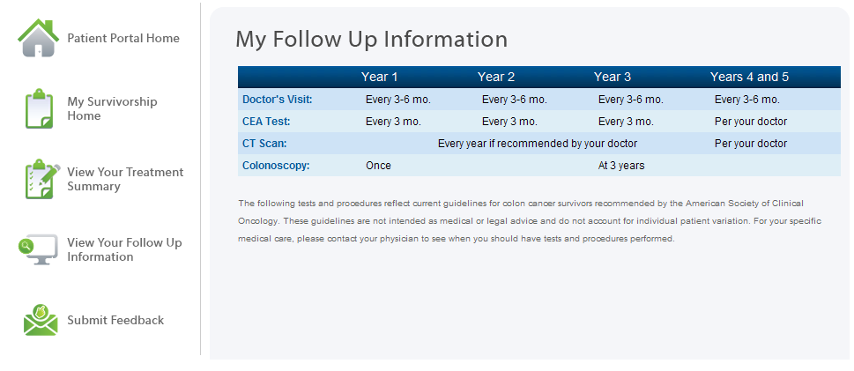
Notes:
jenn

Slide 14
Cross Continuum Care Management
Ready access to medical record across all care settings.
ACO-wide consistent care practices: problem lists, evidence-based order sets, case management, disease management, care plans, up-to-date med lists/reconciliation and discharge plans.
Clinical decision support.
Secure communication/messaging between and among providers.

Slide 15
Moffitt’s EHR Program
Oncology EMR
Meaningful Use
Closed Loop Medication Management
Computerized Provider Order Entry
(CPOE)
Advanced Decision Support
Patient Portal
Analytics & Reporting
Clinical Documentation Tracking Board
Autofax
Outside Records
Message Center
Discharge Planning
PowerChart/ PACS integration
Integration of EPQ
Treatment Summary
Clinical Trials Matching
ePrescribing
Medication List
Medication Reconciliation
Medication Allergies
Rx Renewals
Assessment and cleanup of current orders and environment
Provider Orders
Provider Sets
Provider Devices
Clinical Decision Support
Drug Interactions
Clinical Decision Support
Pathways
Drug Interactions
Clinical Pathway Guidance
Portability to Affiliates
Reminders
Rx Renewals
Referrals
Follow Up
Online Results
Secure Provider/Patient Communication
Survivorship
Electronic Patient Questionnaire
Metrics
Reports
Profile key data for adoption rate
Compliance data
Outcomes management data for providers
Incentive program requiring facilities to demonstrate meaningful use of certified EHR technology.
Core
Electives
Laboratory Radiology Pharmacy Perioperative Orders Core Common Data Repository Nursing Documentation (Admission & Clinic Notes) PPID/POC Meds Admin and Blood Draw
Foundation/Best in Class Platform

Slide 16
Analytics & Predictive Modeling
CMS has proposed 65 quality metrics.
EHR and other systems need to be designed to capture and report on the requisite data elements (NQF is moving from claims-based to EHR-based data).
Quality measures also need to be translated into required data elements and decision-support rules through alerts and automated reminders to providers and patients.
ACOs must have the ability to analyze entire populations of which that patient is a member as well as the time horizon that would include the life of the payer contract.

Slide 17
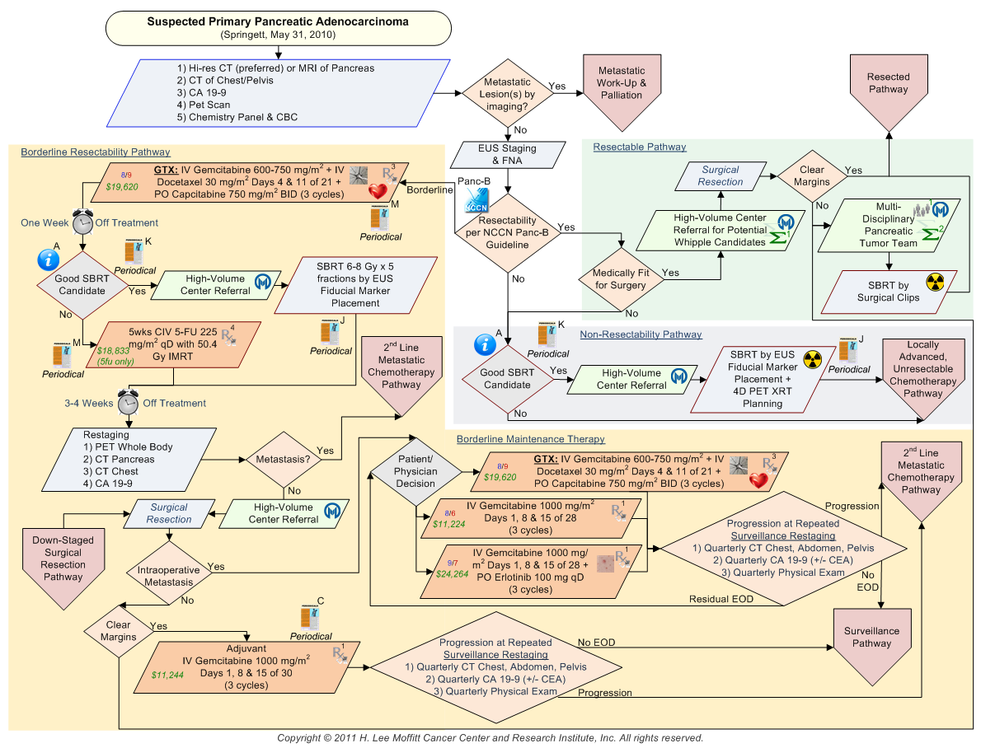

Slide 18
ACO Risk & Revenue Cycle Management
Revenue Cycle Systems will need to recognize and capture information before, during and after the period when individuals become patients - in effect managing beneficiaries rather than patients. So ACOs will need to adopt systems similar to health plans’ membership management systems (CRM) to ensure they can properly identify, monitor and report on all activity associated with their population.
Cost and Patient Accounting Systems will need to be expanded as well since ACOs will provide a broader array of services to their population.

Slide 19
Implications for IT Architecture
Migration from systems built around transactions (orders, registration, etc.) to an ecosystem designed around events and data/information.

Slide 20
Implications for IT Leadership
A critical role of the CIO in an ACO is to help guide the use of the best of today’s technology in the short term, while identifying the gaps between the best of today’s technology and what is ultimately needed to manage the health of individuals and populations in a cost-effective manner. A balanced portfolio between near-term improvement and longer-term technology R&D.

Slide 21
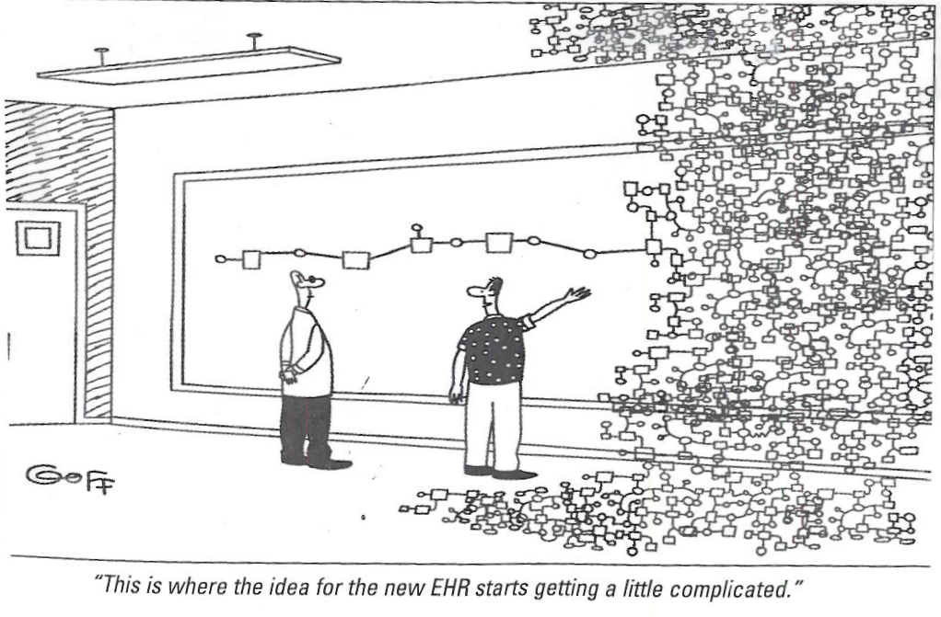
“This is where our data analysis starts getting a little complicated”

Slide 22
Questions?

