Slide 1
Social Media Marketing

Slide 2
You can’t buy word of mouth, or can you?

Slide 3
Sentiment Analysis for Business Intelligence
Networks can recruit providers with more satisfied patients
Notes:
pateint

Slide 4
Example of Direct Marketing Email
Dear Jim,
We noticed that you have been visiting Dr. James Tweedy for your primary care needs. We are grateful that you are doing so and encourage you to continue. Your relationship with Dr. Tweedy. Meanwhile, we would like you to also give Dr. Joseph Cavuto a try too. Both Dr. Tweedy and Dr. Cavuto are within 30 minutes of your house. Patients of Dr. Cavuto are more satisfied than patients of Dr. Tweedy. Furthermore, Dr. Cavuto charges are below Dr. Tweedy and therefore you can expect to have less out of pocket costs. Click here to compare these two doctors side by side and see which one will work best for you.
We are delighted that you continue to use Capital Blue Cross’s network. No matter what choice you make, both doctors are great and we will cover your within plan visits in the same manner. We just wanted to alert you to the choices you have.
Sincerely yours,
Network Management

Slide 5
Sentiment Analysis for Business Intelligence
Providers can attract more patients through better web reputation
Notes:
pateint

Slide 6
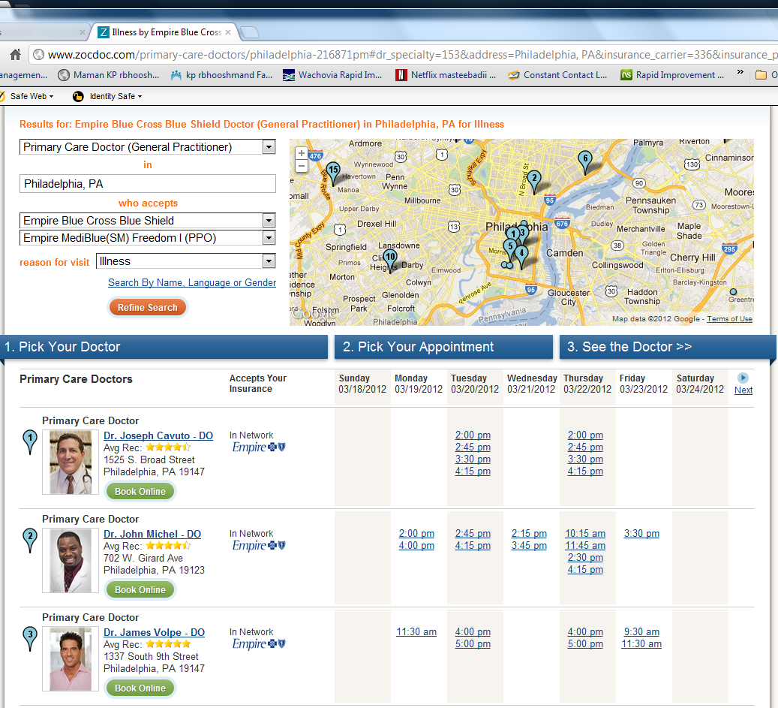
Example : Zoc Doc

Slide 7
Sentiment Analysis for Business Intelligence
Managers can verify if changes improve satisfaction with care
Notes:
pateint

Slide 8
Easy to Use Universal Surveys
One-Question Satisfaction Surveys

Slide 9
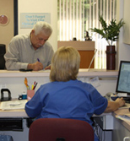

Invitation by comment card, email, phone, Web, ...

Slide 10
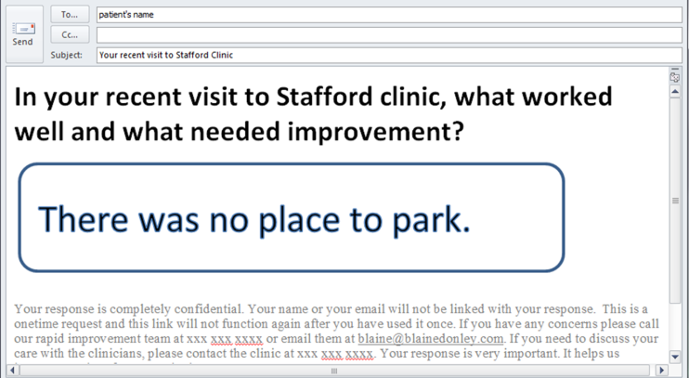

Slide 17
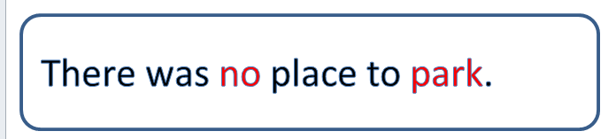
Complaint

Slide 18
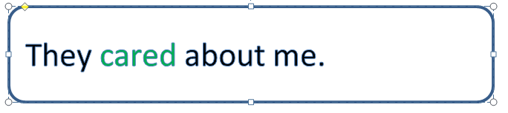
Complaint
Praise

Slide 19
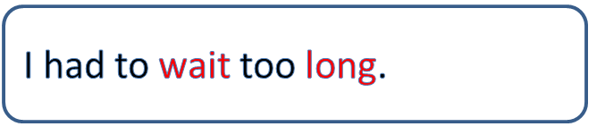
Complaint
Praise
Complaint
Benchmarked by Number of Visits to Next Complaint

Slide 20
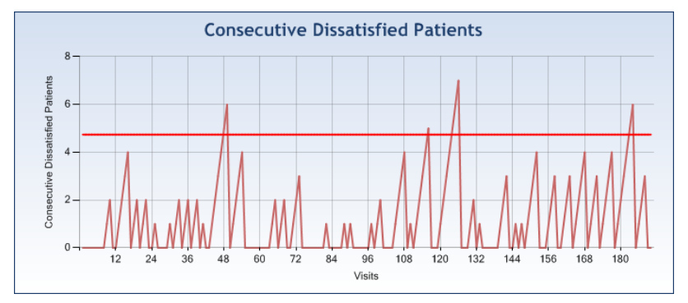
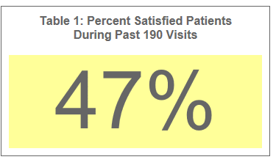
Real Time Alerts

Slide 21
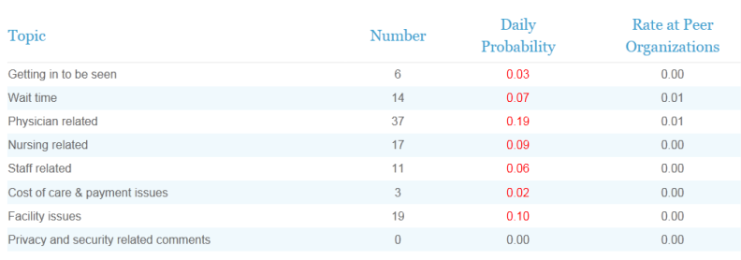
Peer Comparisons

Slide 22
Providers Get New Customers
Comments Posted to Web

Slide 23
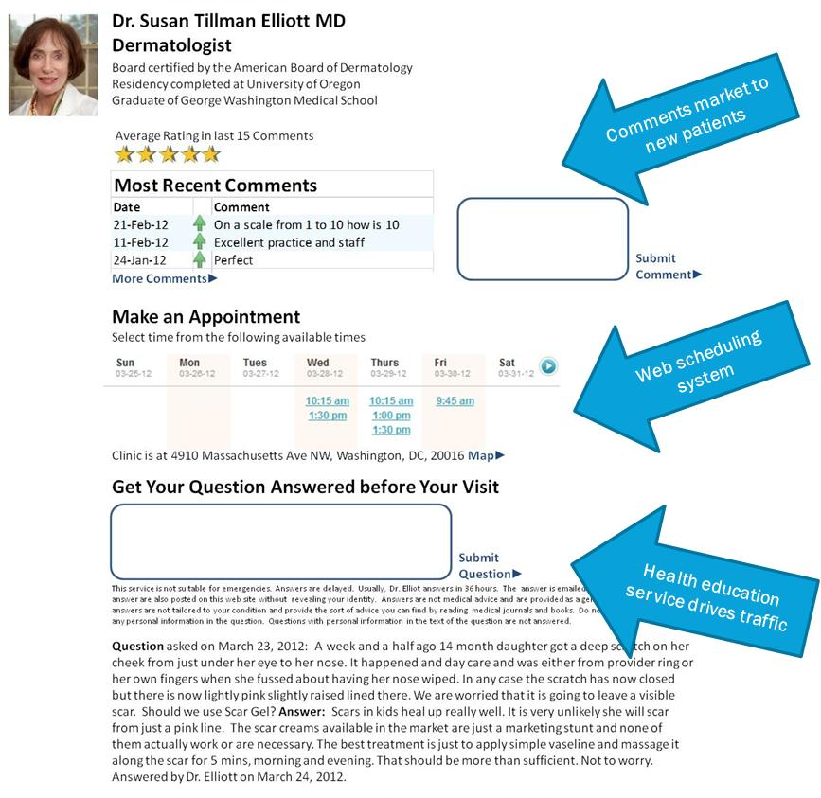

Slide 24
Providers Get New Customers
Comments Pushed to Other Social Media

Slide 25



Thank you for your comment. Would you also like to post your comment to any of the following sites?
Submit
Social Media
Crowd Sourcing

Slide 26
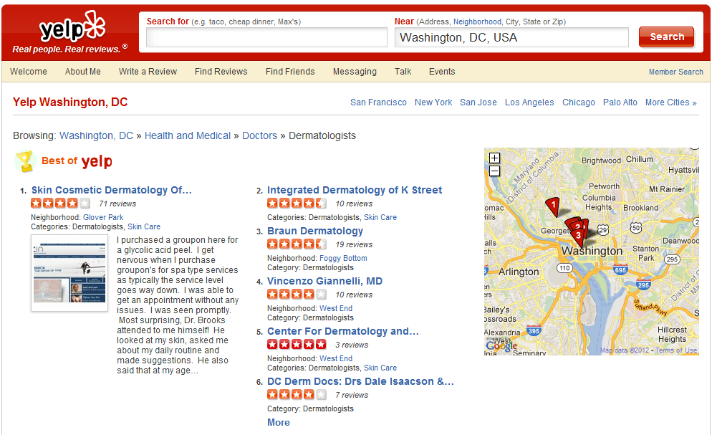
Posting affects who is recommended

Slide 27
You raise a good point. In the past 6 months, there have been 4 other clients with the same complaint. We are trying to address this problem. Would you like to hear back about our progress. If so, please enter your email below.
Submit
Social Media
Crowd Sourcing

Slide 28

You raise a good point. In the past 6 months, there have been 4 other clients with the same complaint. We are trying to address this problem. Would you like to hear back about our progress. If so, please enter your email below.
Submit

Slide 29
80% less cost than traditional Surveys
http://rapidimprovementsystem.com
Faster, better information at lower cost that also markets the service

Slide 30
You can’t buy word of mouth, or can you?

Slide 31
For More Information
Contact
Farrokh Alemi, Ph.D. at alemi@cox.net

