Slide 1
Solution to
Benchmarking Exercise
Farrokh Alemi, Ph.D.

Slide 2
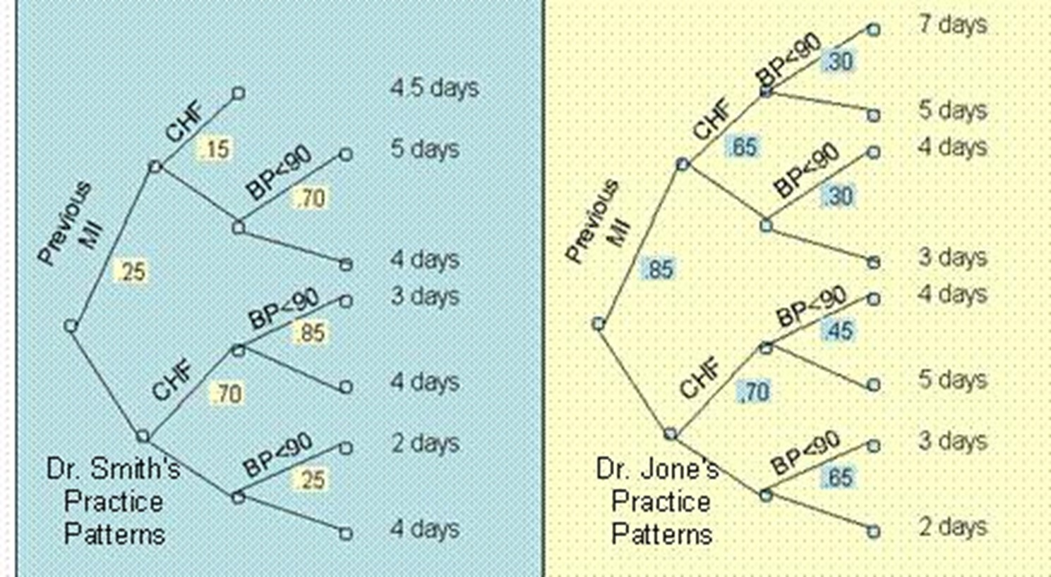
Compare Dr. Smith and Dr. Jones

Slide 3
Compare Dr. Smith and Dr. Jones
Decision Tree

Slide 4
Compare Dr. Smith and Dr. Jones
Event Tree

Slide 5
Compare Dr. Smith and Dr. Jones
A branch in tree

Slide 6
Compare Dr. Smith and Dr. Jones
Length of Stay
Probability
Arc
Node

Slide 7
Around Each Node Probabilities Add Up to 1
Given
Can be Calculated as
1 -.15 = .85

Slide 8
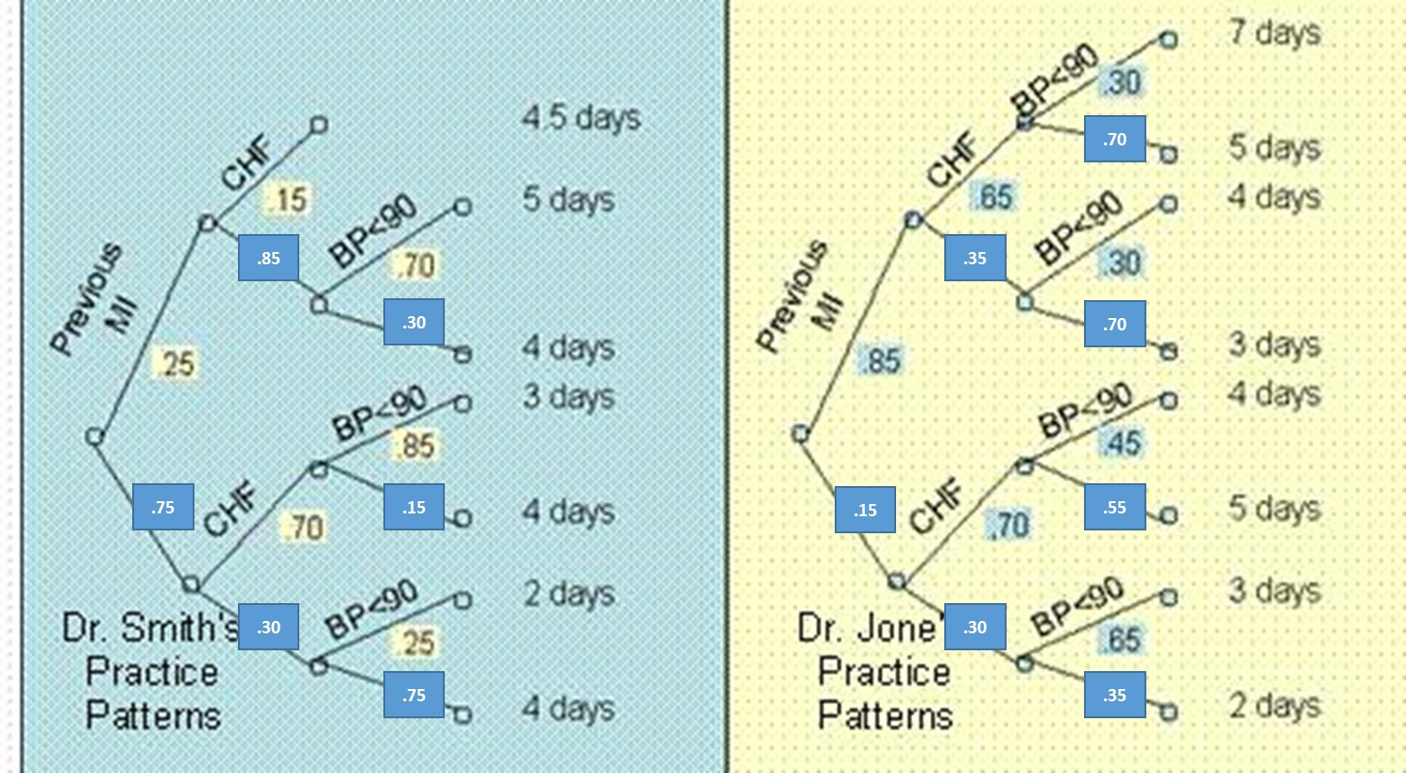
Calculate Probabilities for Each Arc
Probabilities of events after a node add to 1

Slide 9
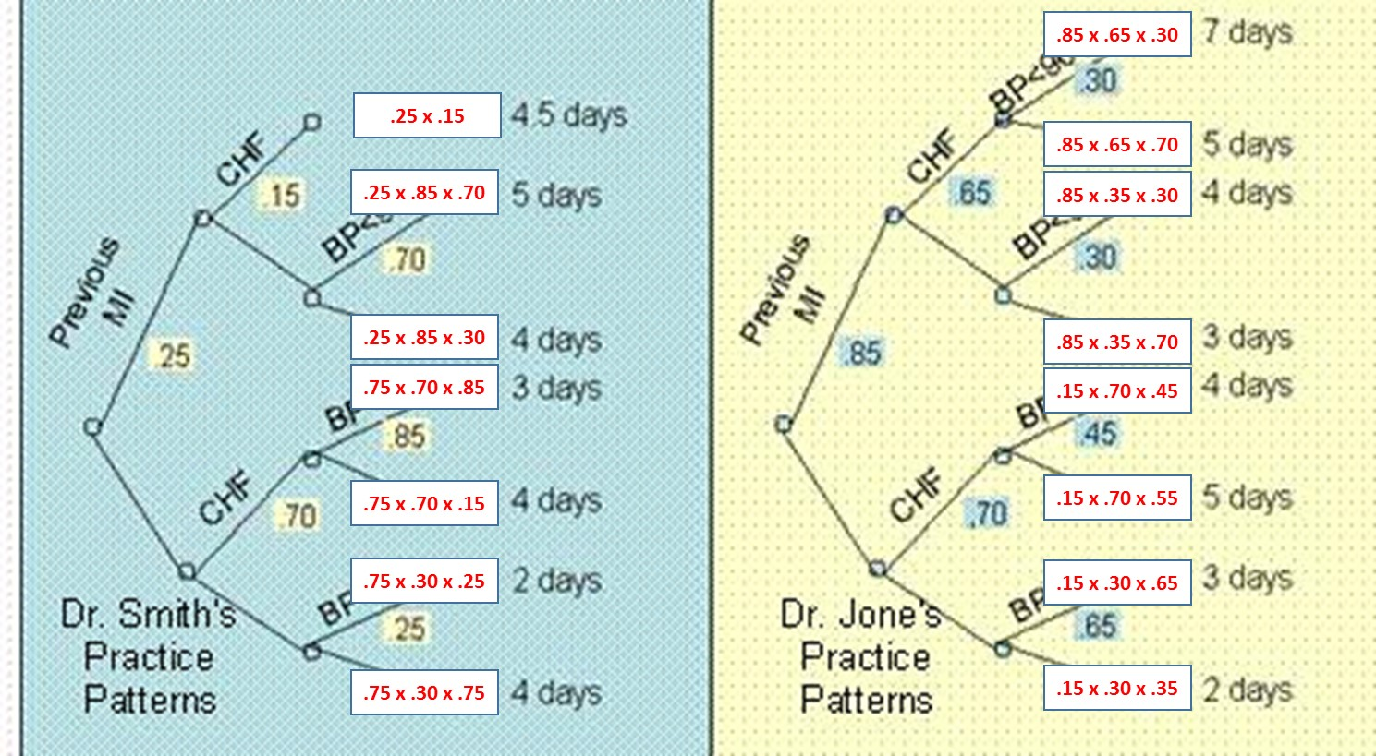
Calculate Probability of Each Branch
Product of all probabilities on the branch

Slide 10
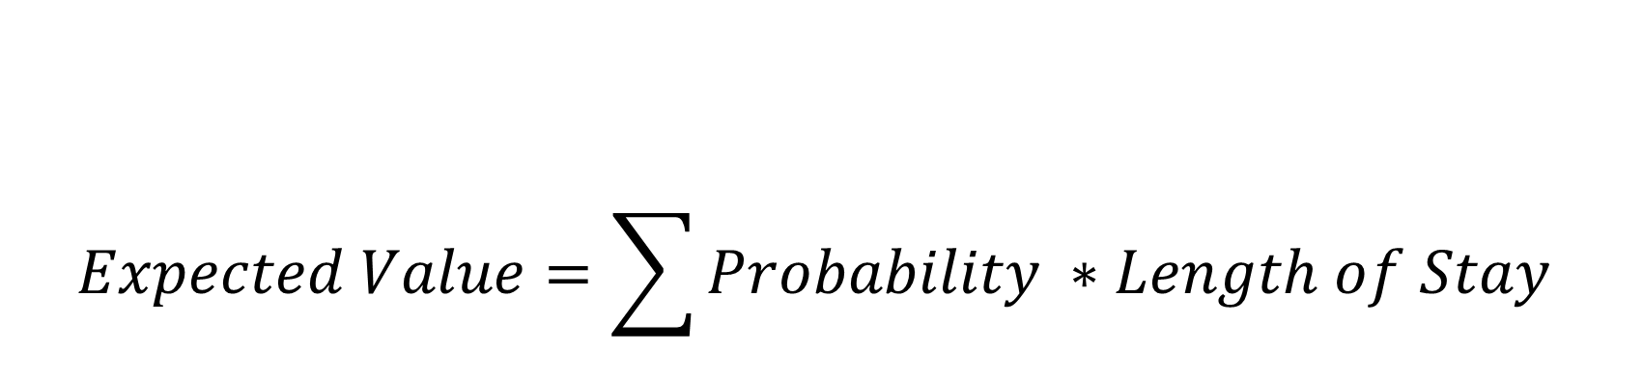
$$Expected Value=\sum{Probability ∗Length of Stay}$$

Slide 11
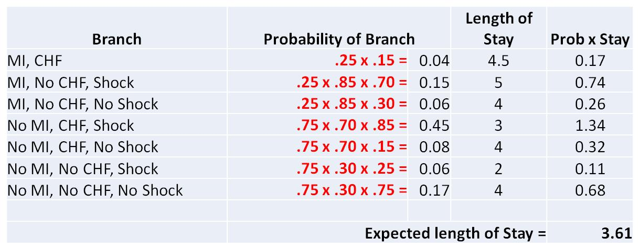
Expected Stay for Dr. Smith

Slide 12
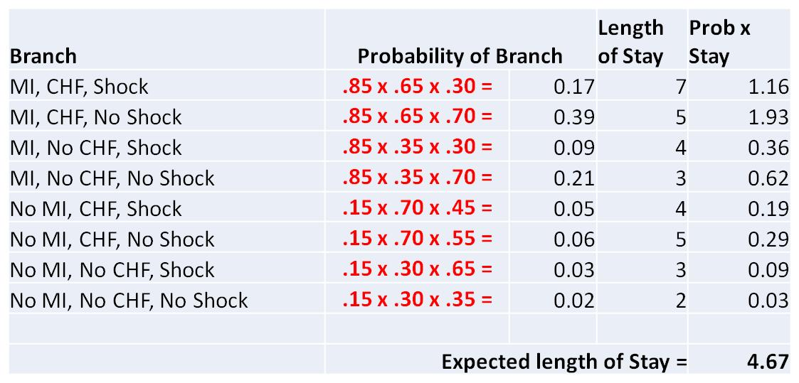
Expected Stay for Dr. Jones

Slide 13
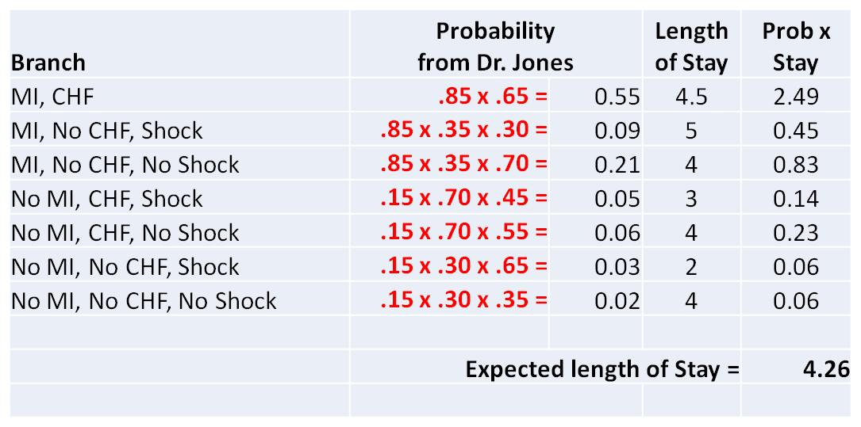
If Dr. Smith Sees Dr. Jones Patients

Slide 14
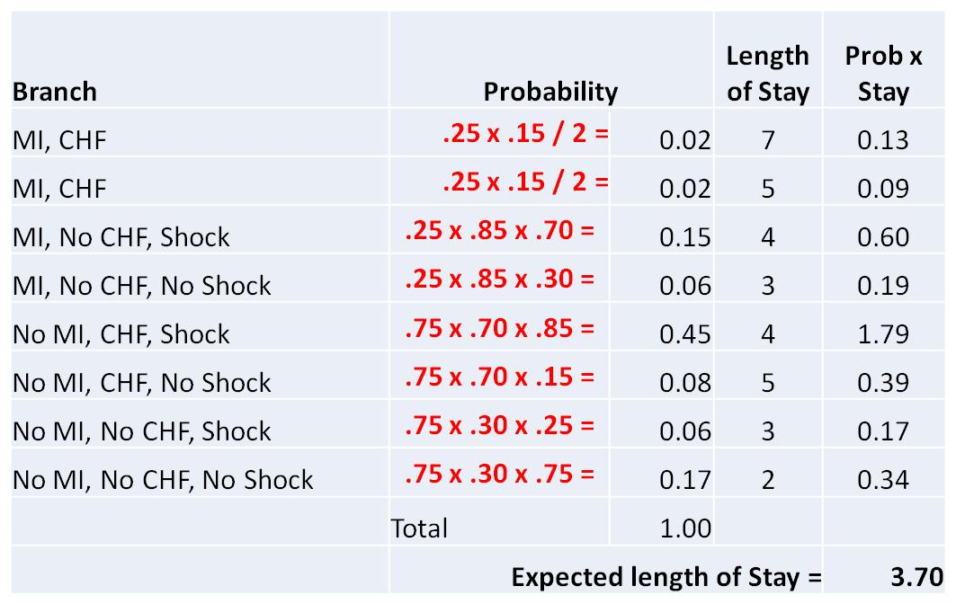
If Dr. Jones Sees Dr. Smith’s Patients

