Slide 1
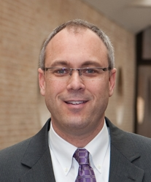
Title: Senior Vice President and CIO
Bio: Tim Thompson currently serves as Senior Vice President and Chief Information Officer for BayCare Health System (BayCare) in Clearwater, Florida. His responsibilities include leadership of the technology planning and operations for the system-wide Information Services operation.
Mr. Thompson has over 30 years of experience in health care administration and information technology. Prior to joining BayCare in 2010, he most recently served as Senior Vice President and Chief Information Officer for The Methodist Hospital System in Houston, Texas. Prior to working at Methodist, Tim was the CIO and Senior Vice President at both Adventist Health System in Orlando and Palmetto Health in Columbia, South Carolina. In addition he held senior management positions at The Cleveland Clinic, Dynamic Healthcare Technologies, Inc., and Proctor Healthcare Incorporated.
Tim earned a bachelor’s degree in management from the University of Illinois. He is a member of the College of Healthcare Management Executives (CHIME) and Healthcare Information and Management System Society (HIMSS).

