Slide 1
Teach One: Benchmarking Clinicians
By: Akbar Soleimani
George Mason University
HAP 725: Statistical Process Improvement

Slide 2
Question 2
The following data, report patients with 10 Diagnostic Related Groups and 3 HCC indices cared by a clinician and his peer group.
DRG: Diagnostic Related Groups
HCC: Hierarchical Condition Category
Low medium high severity
1 2 3
Dr: cared for by clinician or peer group.
LOS: Length of Stay
Determine if the clinician is more efficient than his peer group.

Slide 3
Import Libraries & Data

Slide 4
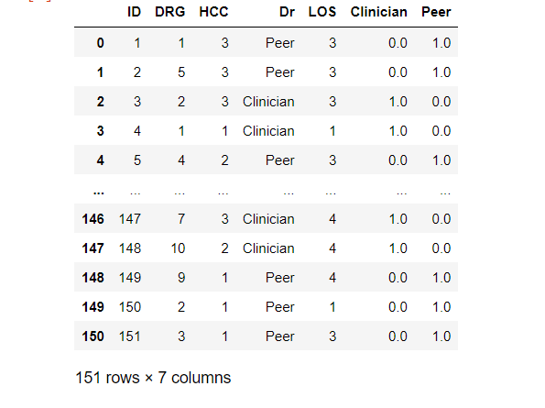
Binarizing

Slide 5
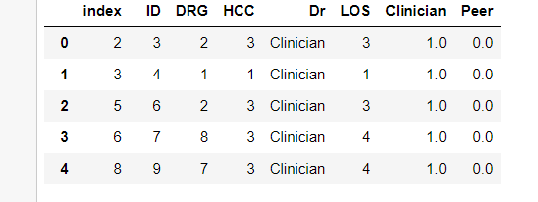
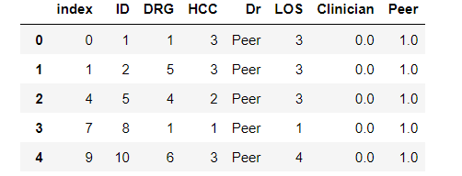
Two Tables

Slide 6
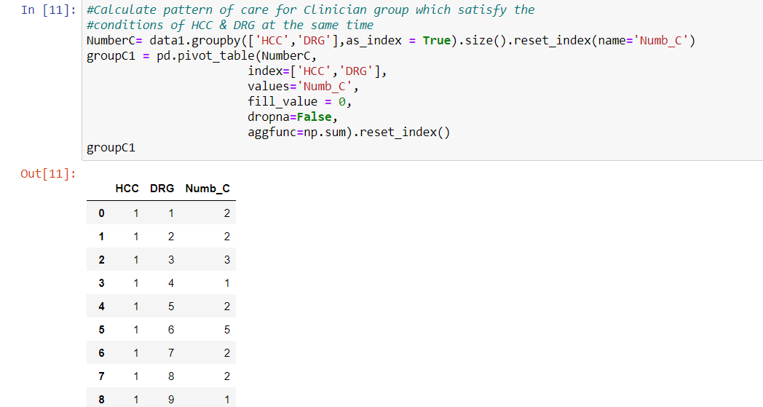
Pattern of Care For Clinician

Slide 7
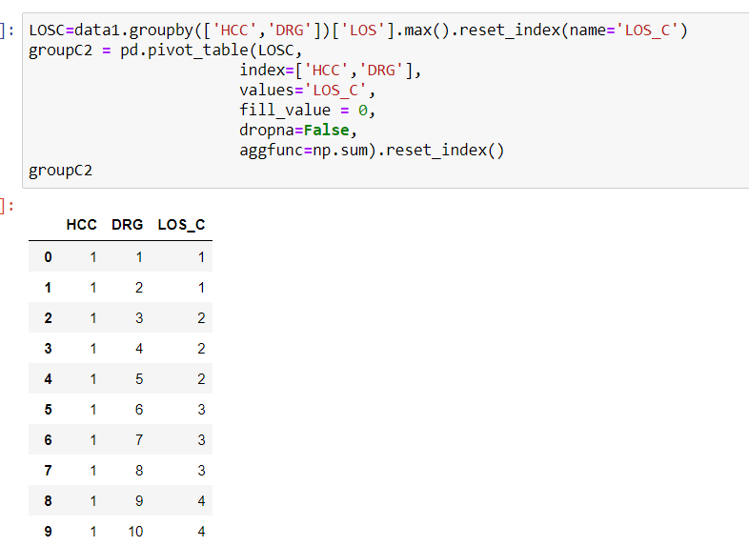
Length of Stay for Clinician

Slide 8
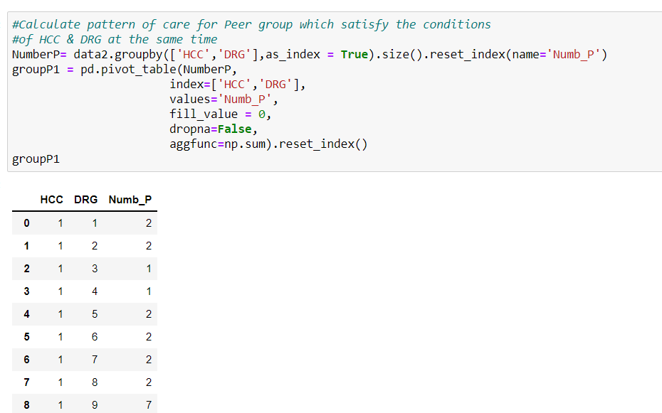
Pattern of Care for Peer

Slide 9
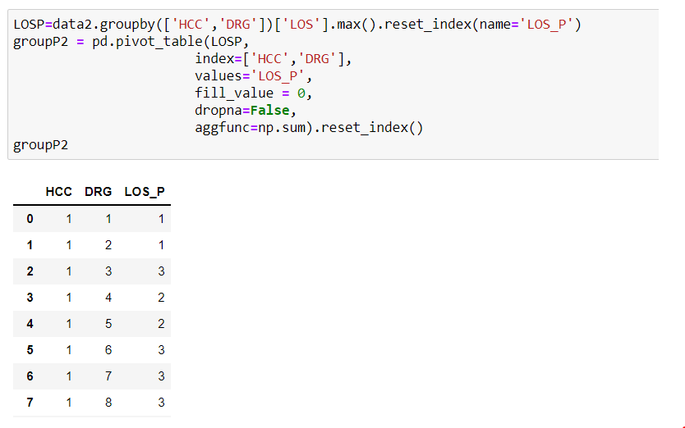
Length of Stay for Peer

Slide 10
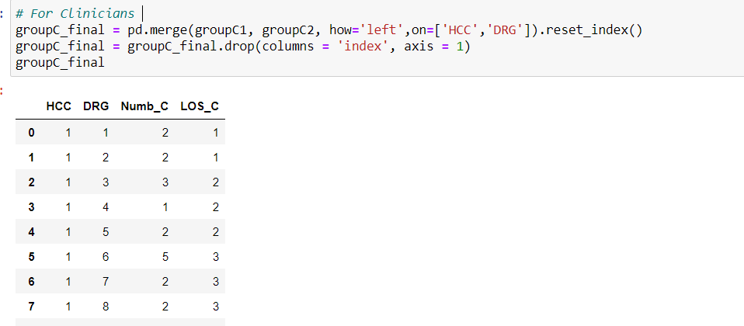
Merge for Clinicians Group

Slide 11
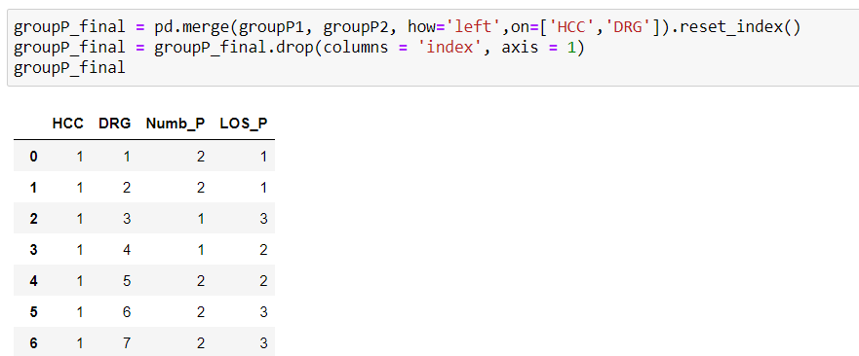
Merge for Peer Group

Slide 12
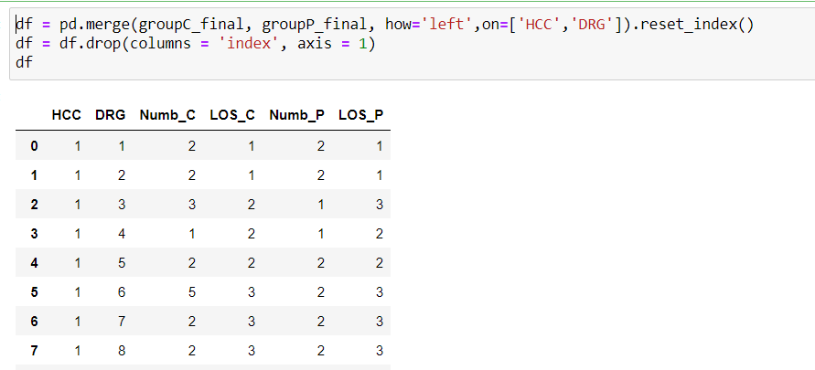
Merge clinicians and peer group on common strata

Slide 13
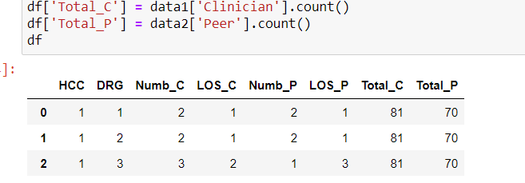
Calculate Total Number of patients for Clinician and Peer group

Slide 14
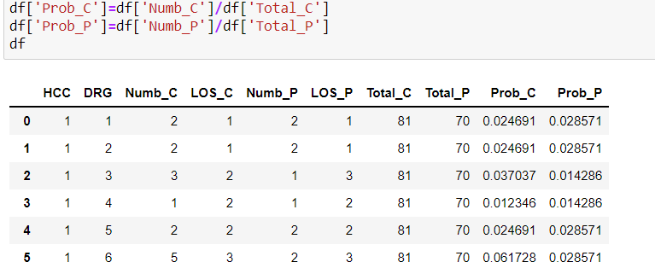
Calculate Probability of each combination for Clinician and Peer group

Slide 15
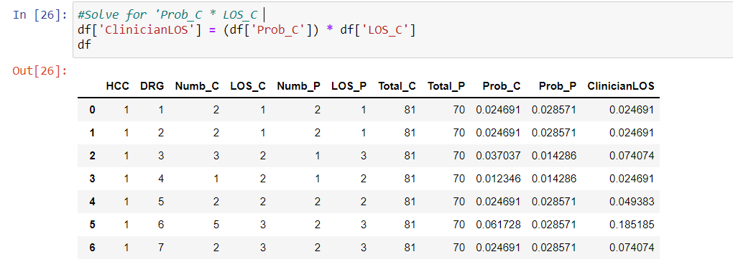
Calculate LOS for each combination for Clinician Group

Slide 16
Calculate LOS for each combination for Peer group

Slide 17
Peer group's null values require Synthetic Control Calculations

Slide 18
Overlap between peer and clinician cases

Slide 19
Merge Tables related to HCC

Slide 20
Merge Tables related to DRG

Slide 21
List the LOS value for peer group (based on HCC) which is null

Slide 22
List the LOS value for peer group (based on DRG) which is null

Slide 23
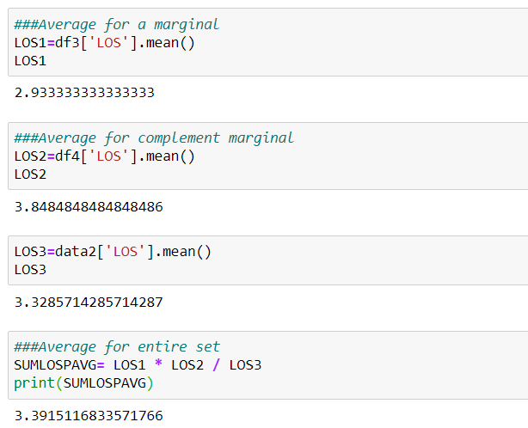
Averages
HCC
DRG

Slide 24
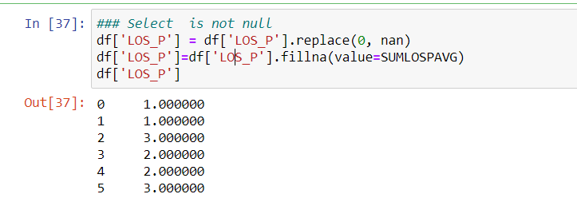

Slide 25
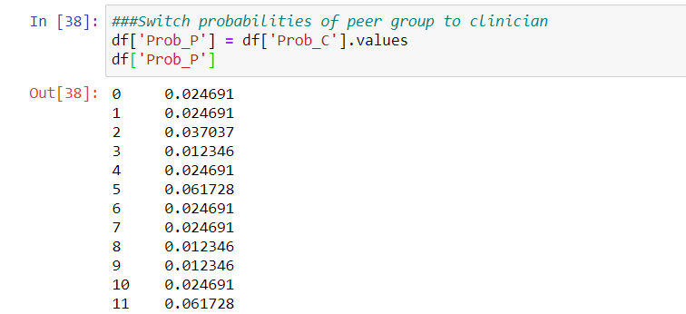

Slide 26
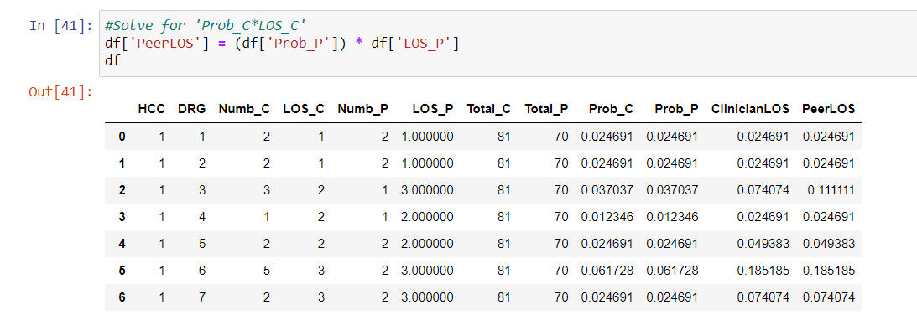

Slide 27
For Clinicians
For Peer
LOS (peer group)> LOS (clinician)

Slide 28
Clinician LOS
2.78% more efficient than peer group

