Slide 1
Has Rate of Hospitals Exceeding National Payment for AMI Changed?
Farrokh Alemi, Ph.D.

Slide 2
Download, Unzip, Rename Data
1. Download
2. Unzip
3. Rename
To H-YYYY-MM

Slide 3
Merge into Access in Order of Date
1
2
4
3

Slide 4
Note Change in File Names
From 2015 01 database
From 2015 04
Only 3 Years Show Change in Data
From 2015 05
From 2015 07 database
From 2015 10
From 2015 12
From 2016 05
From 2016 08
From 2016 11 database

Slide 5
Ignore Tables with Same Time Periods
Only 3 unique time periods in 9 tables:
2010-2013 in HQI_HOSP_AMI_Payment
2011-2014 in HQI_HOSP_Payment
2012-2015 in HQI_HOSP_PaymentAndValueOfCare

Slide 6
Field Names Change in Different Files
Prob2010-2013:
Sum(InStr([HQI_HOSP_AMI_Payment]![Compared to National],"Greater"))/ Count([HQI_HOSP_AMI_Payment]![Compared to National])
Prob2011-2014:
Sum(InStr([HQI_HOSP_Payment]![Category],"Greater"))/ Count([HQI_HOSP_Payment]![Category])
Prob2012-2015:
Sum(InStr([HQI_HOSP_PaymentAndValueOfCare4]![Payment Category],"Greater"))/ Count([HQI_HOSP_PaymentAndValueOfCare4]![Payment Category])

Slide 7
2010-2013
Remove Hospitals Not Reporting
Prob2010-2013: Sum( InStr ([Compared to National], "Greater")) / Count ( [Compared to National])
Select Measure Payment_30_AMI

Slide 8
2010-2013 from HQI_HOSP_AMI_Payment
SELECT Count([Compared to National]) AS [Hospitals2010-2013]
, Sum(InStr([Compared to National],"Greater")) / Count([HQI_HOSP_AMI_Payment1]![Compared to National]) AS [Prob]
, [Measure Start Date]
, [Measure End Date]
FROM HQI_HOSP_AMI_Payment1
WHERE Denominator<>"Not Available” AND [Measure ID]="PAYM_30_AMI”
GROUP BY Measure Start Date, Measure End Date;

Slide 9
2011-2014
Different File & Fields

Slide 10
2011-2014
SELECT
Count(Category) AS [Hospitals]
, Sum(InStr([Category],"Greater"))/Count([Category]) AS [Prob]
, [Measure Start Date]
, [Measure End Date]
FROM HQI_HOSP_Payment
WHERE Denominator<>"Not Available” AND [Measure ID]="PAYM_30_AMI”
GROUP BY [Measure Start Date], [Measure End Date];

Slide 11
2012-2015

Slide 12
2012-2015
SELECT Count([Provider ID]) AS Hospitals
, Sum(InStr([Payment Category],"Greater"))/Count([Payment Category]) AS [Prob]
, [Measure Start Date]
, [Measure End Date]
FROM HQI_HOSP_PaymentAndValueOfCare4
WHERE Denominator<>"Not Available” AND [Payment measure ID])="PAYM_30_AMI”
GROUP BY [Measure Start Date], [Measure End Date];

Slide 13
Query Results
Hospitals 2010-2013 | Prob 2010-2013 | Measure Start Date | Measure End Date
2424 | 0.157591 | 07/01/2010 | 06/30/2013
Hospitals 2011-2014 | Prob 2011-2014 | Measure Start Date | Measure End Date
2369 | 0.154073 | 07/01/2011 | 06/30/2014
Hospitals 2012-2015 | Prob 2012-2015 | Measure Start Date | Measure End Date
2343 | 0.108408 | 07/01/2012 | 06/30/2015

Slide 14
Calculate Control Limits
Time Period | 2010-2013 | 2011 2014 | 2012-2015
Number of Hospitals | 2424 | 2369 | 2343
Observed | 0.158 | 0.154 | 0.108
Standard Deviation | 0.007 | 0.007 | 0.007
Upper Limit | 0.161 | 0.162 | 0.162
Lower Limit | 0.119 | 0.119 | 0.119
Grand Average Rate | 0.140
Average Rate =SUMPRODUCT(Number Hospitals, Observed)/SUM(Observed)
Standard Deviation =SQRT((Average Rate*(1-Average Rate))/# of Hospitals)
Upper Limit =Average Rate + 3 * Standard Deviation
Lower Limit =Average Rate - 3 * Standard Deviation

Slide 15
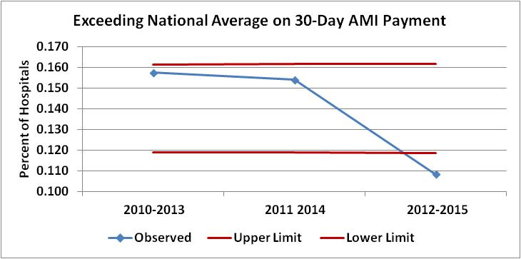
Plot Control Chart

Slide 16
Fewer Hospitals ExceedED Average National 30-day AMI Payments.

