Slide 1
Analysis of Observed & Expected Infections
Farrokh Alemi, Ph.D.

Slide 2
Copy Data into Excel
Week | Risk of Infection for each Patient |  |  |  |  |  | Number Infected
1.00 | 0.90 | 0.80 | 0.70 | 0.80 | 0.90 | 0.85 | 6.00
2.00 | 0.70 | 0.80 | 0.70 | 0.60 | 0.80 | 0.90 | 5.00
3.00 | 0.80 | 0.95 | 0.92 | 0.87 |  |  | 4.00
4.00 | 0.50 | 0.60 | 0.66 | 0.67 |  |  | 3.00
5.00 | 0.30 | 0.40 | 0.50 | 0.40 | 0.50 | 0.34 | 2.00
6.00 | 0.30 | 0.40 | 0.50 |  |  |  | 1.00

Slide 3
Calculated Expected Rate
Expected Infection
0.83
0.75
0.89
0.61
0.41
0.40
=AVERAGE(expected rate for each patient)

Slide 4
Calculate Expected Deviation
0.15 = SQRT(SUMPRODUCT(B2:G2,B9:G9))/COUNTA(B2:G2)

Slide 5
Look Up t-Values
Number Infected | Expected Infection | Expected Deviation | One sided t value
6.00 | 0.00 | 0.15 | 2.015
5.00 | 0.75 | 0.17 | 2.015
4.00 | 0.89 | 0.16 | 2.353
3.00 | 0.61 | 0.24 | 2.353
2.00 | 0.41 | 0.20 | 2.015
1.00 | 0.40 | 0.28 | 2.920
Use a web calculator to find 2 sided (but occasionally 1 sided) t-values.
Degrees of freedom is one minus number of observations
1-sided assumes observations can only exceed upper limit

Slide 6
Calculate Upper and Lower Limits
Number Infected | Expected Infection | Expected Deviation | t value | Upper Limit | Lower Limit | Observed
6.00 | 0.00 | 0.15 | 2.015 | 1.00 | 0.52 | 1.00
5.00 | 0.75 | 0.17 | 2.015 | 1.00 | 0.40 | 0.83
4.00 | 0.89 | 0.16 | 2.353 | 1.00 | 0.52 | 1.00
3.00 | 0.61 | 0.24 | 2.353 | 1.00 | 0.04 | 0.75
2.00 | 0.41 | 0.20 | 2.015 | 0.81 | 0.01 | 0.33
1.00 | 0.40 | 0.28 | 2.92 | 1.00 | 0.00 | 0.33
Limits above 1 set to 1, limits below 0 set to 0

Slide 7
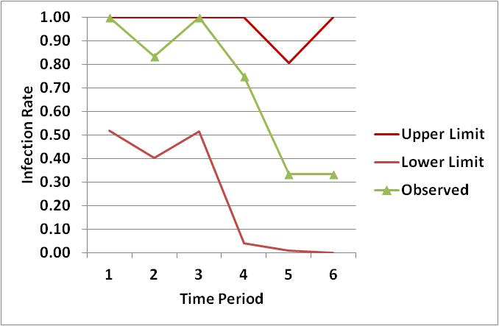
Plot the Control Chart

