Slide 1
Referrals from Ultrasound

Slide 2
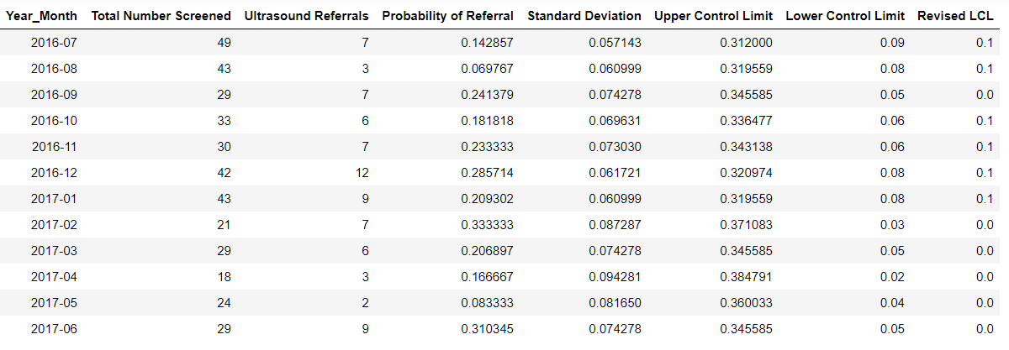

Slide 3
