Slide 1
Answer for Comparing George Washington Hospital to Its Competitors
Farrokh Alemi

Slide 2
Problem Statement
Analyze "Death rate for CABG surgery patients", this is measure code MORT_30_CABG. Choose George Washington University Hospital. Choose for its competitors Medstar Washington, VHC, and INNOVA Fairfax. You will find this measure inside "Complications and Deaths - Hospital" file. The measure was named this way in the year 2018. Include all years of data. The denominator reports the number of cases. The numerator reports the risk-adjusted mortality rate. Note that the name of the file may change in different years but the measure code remains the same. Compare the performance of the hospital to the competing hospitals in its market. Make the chart for GWU average observed rate. The control limits should come from the experiences of its competitors, which is a weighted average of each of the competitor.

Slide 3
Data
Hospital | Year | N | Score
GWU | 2014 | 99 | 2.2
 | 2015 | 86 | 3.1
 | 2016 | 82 | 5.1
 | 2017 | 83 | 5.7
MED WAS | 2014 | 692 | 2.3
VHC | 2014 | 50 | 3.6
INOVA F. | 2014 | 337 | 2
MED WAS | 2015 | 697 | 1.9
VHC | 2015 | 66 | 3.4
INOVA F. | 2015 | 335 | 1.8
MED WAS | 2016 | 731 | 1.8
VHC | 2016 | 84 | 3.2
INOVA F. | 2016 | 329 | 1.6
MED WAS | 2017 | 749 | 1.6
VHC | 2017 | 98 | 3.4
INOVA F. | 2017 | 332 | 1.3

Slide 4
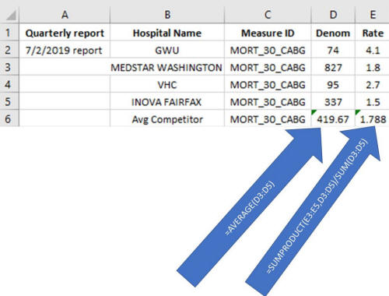
Calculate Averages for Competitors

Slide 5
Weighted Average Values for Competitors
Year | GWU | Competitors
2014 | 2.2 | 2.267
2015 | 3.1 | 1.960
2016 | 5.1 | 1.845
2017 | 5.7 | 1.665

Slide 6
Calculation of Tukey Control Limits for Competitors
Competitors Ordered |  |  | UCL | LCL
1.665 | Median | 1.902 | 2.649 | 1.218
1.845 | Lower 4th | 1.755 | 2.649 | 1.218
1.960 | Upper 4th | 2.113 | 2.649 | 1.218
2.267 | 4th Spread | 0.358 | 2.649 | 1.218

Slide 7
Resulting Control Chart

