Slide 1

LET’S GET INTO THESE ROC-CURVES!
Bethlehem Belaineh
HAP 725: Statistical Process Improvement
Teach One for Risk Assessment ROC Curves
Notes:
Hi everyone,
Today we are going to be talking about ROC Curves. This is also to answer the fifth question of the Risk Assessment Assignment. Stay tuned !

Slide 2
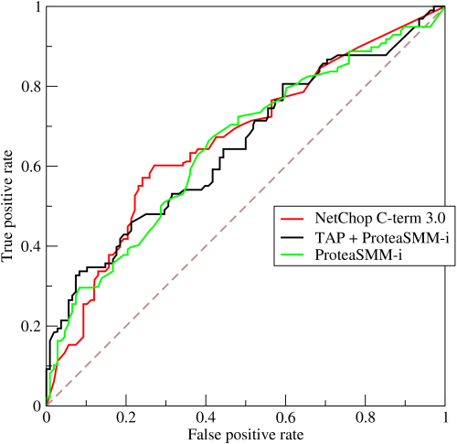
Quick Intro to ROC Curves!
A receiver operating characteristic curve, or ROC curve, is a graphical plot that illustrates the diagnosis tic ability for a binary classifier system as its discrimination threshold is varied.
Sensitivity: True Positive Rate
Specificity: True Negative Rate
Notes:
A brief introduction to ROC Curves!
ROC curves are a graphical plot that illustrates the diagnostic ability of a binary classifier system as it’s discrimination threshold is varied. The discrimination Threshold here is defined as Sensitivity and Specificity.

Slide 3
ROC :
Receiver Operating Characteristic
True Positive (TP)
True Negative (TN)
False Positive (FP)
False Negative (FN)
Sensitivity = TPR = TP/P
Specificity = TNR = TN/N

Slide 4
Calculating Receiver Operating Characteristic Curve with age prediction
Question 5: Calculate the Receiver Operating Characteristic curve associated with predicting from age whether the patient will live or die. The data do not provide a predicted values, but you can construct a prediction based on age exceeding the cutoff value. If the patient's age exceeds the cutoff value, then we would predict that the patient will die. For example, the cutoff values for the ages provided can be 40, 50, 60, 70, 80, 90. If we take the cutoff value 60, then we predict that all patients above 60 will die and all patients below 60 will live. Calculate sensitivity and specificity for all cutoffs. Then, draw the Receiver Operating Characteristic curve. At what age cutoff the sum of the sensitivity and specificity is at its maximum?
 |  | Mid-Point of Age Range |  |  |  |  | Total
 |  | 45 | 55 | 65 | 75 | 85
True Condition | Alive | 33 | 30 | 35 | 25 | 20 | 143
 | Dead | 3 | 5 | 7 | 15 | 33 | 63
 | Total | 36 | 35 | 42 | 40 | 53 | 206

Slide 5
Calculating Specificity
 |  | Mid-Point of Age Range |  |  |  |  | Total
 |  | 45 | 55 | 65 | 75 | 85
True Condition | Alive | 33 | 30 | 35 | 25 | 20 | 143
 | Dead | 3 | 5 | 7 | 15 | 33 | 63
 | Total | 36 | 35 | 42 | 40 | 53 | 206
For a Cut-off Age of 65, let’s calculate the Specificity:
Specificity (Age =65) = 33 + 30 / 143 = 0.44056

Slide 6
Calculating Sensitivity
 |  | Mid-Point of Age Range |  |  |  |  | Total
 |  | 45 | 55 | 65 | 75 | 85
True Condition | Alive | 33 | 30 | 35 | 25 | 20 | 143
 | Dead | 3 | 5 | 7 | 15 | 33 | 63
 | Total | 36 | 35 | 42 | 40 | 53 | 206
For a Cut-off Age of 65, let’s calculate the Specificity:
Sensitivity (Age =65) = 7 + 15+33 / 63 = 0.873016

Slide 7
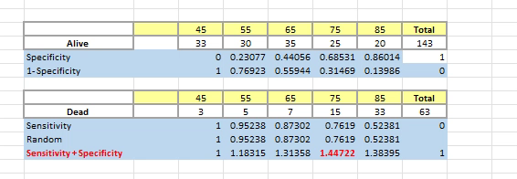
Excel Demonstration: Specificity and Sensitivity Calculation

Slide 8
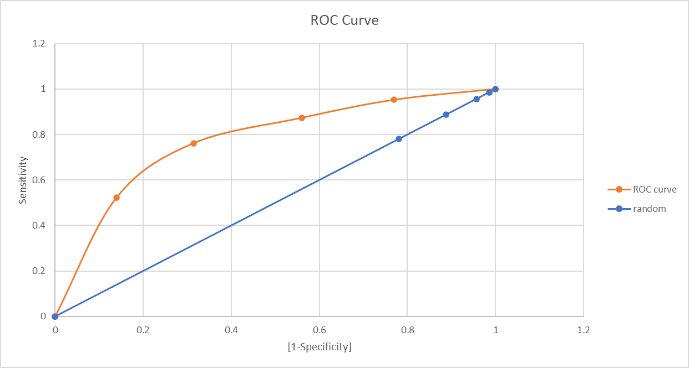
Final ROC Curve
Sensitivity | 1-Specificity
1 | 1
0.952380952 | 0.769230769
0.873015873 | 0.559440559
0.761904762 | 0.314685315
0.523809524 | 0.13986014
0 | 0

