Slide 1
Benchmarking Clinicians using Data Balancing
Organized by Farrokh Alemi, Ph.D.
Notes:
This section provides a brief introduction to Benchmarking clinicians using data balancing. This brief presentation was organized by Dr. Alemi.

Slide 2
Same Set of Patients
Notes:
Data balancing enables the analyst to compare the performance of clinicians to their peer groups on the same set of patients.

Slide 3
Terminology
Notes:
We are going to use the terminology of benchmarking clinicians to facilitate the discussion. Data balancing using a different set of terminology. It is important to understand how these different terms are the same so you can understand benchmarking using data balancing.

Slide 4
Terminology
Data Balancing | Benchmarking
Sample | Patients
Covariate | Comorbidities
Stratum | Patient Types
Treatment | Clinician vs Peer Group
Cases | Clinician's Patients
Controls | Peer Group's patients
Propensity Weights | --
Notes:
Sample is replaced with patient groups.

Slide 5
Terminology
Data Balancing | Benchmarking
Sample | Patients
Covariate | Comorbidities
Stratum | Patient Types
Treatment | Clinician vs Peer Group
Cases | Clinician's Patients
Controls | Peer Group's patients
Propensity Weights | --
Notes:
Covariates is replaced with patient comorbidities.

Slide 6
Terminology
Data Balancing | Benchmarking
Sample | Patients
Covariate | Comorbidities
Stratum | Patient Types
Treatment | Clinician vs Peer Group
Cases | Clinician's Patients
Controls | Peer Group's patients
Propensity Weights | --
Notes:
A stratum, or a unique combination of covariates, is replaced with patient types, which is a unique combination of comorbidities.

Slide 7
Terminology
Data Balancing | Benchmarking
Sample | Patients
Covariate | Comorbidites
Stratum | Patient Types
Treatment | Clinician vs Peer Group
Cases | Clinician's Patients
Controls | Peer Group's patients
Propensity Weights | --
Notes:
In context of benchmarking, the clinician is the treatment variable. Treatment effect is replaced with clinician’s impact on outcomes

Slide 8
Terminology
Data Balancing | Benchmarking
Sample | Patients
Covariate | Comorbidites
Stratum | Patient Types
Treatment | Clinician vs Peer Group
Cases | Clinician's Patients
Controls | Peer Group's patients
Propensity Weights | --
Notes:
Cases are clinician’s patients.

Slide 9
Terminology
Data Balancing | Benchmarking
Sample | Patients
Covariate | Comorbidites
Stratum | Patient Types
Treatment | Clinician vs Peer Group
Cases | Clinician's Patients
Controls | Peer Group's patients
Propensity Weights | --
Notes:
Controls are peer group’s patients.

Slide 10
Terminology
Data Balancing | Benchmarking
Sample | Patients
Covariate | Comorbidites
Stratum | Patient Types
Treatment | Clinician vs Peer Group
Cases | Clinician's Patients
Controls | Peer Group's patients
Propensity Weights | --
Notes:
Data balancing often relies on a set of weights, sometimes called propensity weights. In benchmarking this concept is replaced with switching distributions, in essence we do not use the weights but accomplish the same goals of balancing the data.

Slide 11
1. Patient Types
Notes:
First, the patients are described in terms of combination of their features/comorbidities. We refer to these combinations as different patient types.

Slide 12
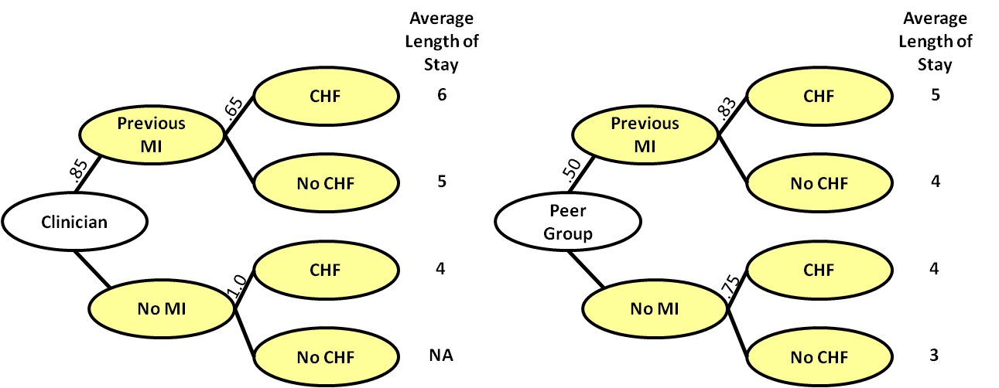
Notes:
Here we see an example with two diseases: previous MI and CHF. A patient type is the combination of these diseases. So when a patient has CHF but no previous MI this is one type of patient and when the patient has both of these diseases then this is another type.

Slide 13
2. Distribution of Patient Types
Notes:
Second, these patient types are used to calculate distributions of clinician’s and peer group’s patients. Naturally, these two groups will differ in who is taking care of sicker types of patients.

Slide 14
Notes:
The probability of different patient types is referred to as the distribution of patients.

Slide 15
Notes:
Here we see that 85% of patients seen by the clinician have previous MI.

Slide 16
Notes:
Among those who have previous MI, 65% have CHF.

Slide 17
Chance of MI & CHF 0.85 * 0.65
Notes:
So the probability of the patient type that has previous MI and CHF is 85% times 65%.

Slide 18
Chance of MI & CHF 0.50 * 0.83
Notes:
The equivalent probability for peer group is 50% times 83%. These probabilities show the distribution of patient types under clinician and peer group’s care. Obviously the clinician and the patient see different types of patients.

Slide 19
3. Switch Distributions
Notes:
In calculating the expected outcome for the peer group the distribution of peer group’s patients is switched with the distribution of the clinician’s patients. In this fashion, the analyst simulates the performance of peer group on the same clinician’s patients.

Slide 20
Notes:
The switching of distributions is done by replacing the peer group probabilities with the probabilities from the clinician’s patients.

Slide 21
Notes:
So we replace .50 in the peer group’s patients with 0.85.

Slide 22
Notes:
We replace 0.83 with 0.65 and so on with all other probabilities in the two distributions. Now the peer group sees the same frequency of patient types as the clinician.

Slide 23
Expected Outcome
Probabilities of patient types
Outcomes for Patient Types
Notes:
The expected outcome for the clinician is calculated as the sum of the product of the probability of observing a patient type times the outcome for those patient types.

Slide 24
Notes:
The expected outcome for the peer group is simulated on the patients of the clinician by replacing the peer group’s probabilities for different patient types with the clinician’s probabilities. In this way the clinician and the peer group are evaluated on same patient types. This is the essence of distribution switches. The probabilities are switched while the outcomes are not.

Slide 25
4. Synthetic Cases for Missing Values
Notes:
Finally fourth, in reporting the outcomes of peer group on clinician’s patients, a problem arises when the peer group does not see patients seen by the clinician. To compensate, the peer group’s outcomes for these situations are constructed using synthetic cases. These synthetic cases replace missing cases and allow all clinician’s patients to have at least one match among peer group’s patients.

Slide 26
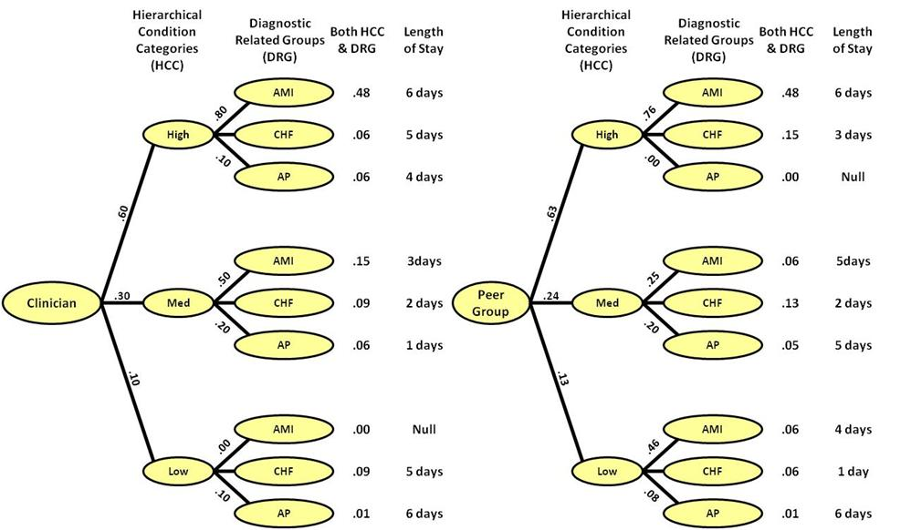
Notes:
Here we see that the peer group sees no patients with high HCC and AP DRG. The clinicians sees these types of patients but the peer group does not. The peer group’s expected outcome are calculated with the clinician’s frequencies so we are not missing anything there. But the outcome for the peer group for these types of patients is not known and should be estimated.

Slide 27
DRG | HCC
 | Low | Med | High
Angina Pectoris | 6 | 5 | ?
Congestive Heart Failure | 1 | 2 | 3
Acute Myocardial Infarction | 4 | 5 | 6
Notes:
We do not know the outcome for Angina Pectoris with high HCC category. To estimate this outcome we calculate the marginal outcomes.

Slide 28
DRG | HCC |  |  | Average
 | Low | Med | High
Angina Pectoris | 6 | 5 | ? | 5.5
Congestive Heart Failure | 1 | 2 | 3
Acute Myocardial Infarction | 4 | 5 | 6
Notes:
The marginal outcome for Angina Pectoris is 5.5 days, the average of the values in the row.

Slide 29
DRG | HCC |  |  | Average
 | Low | Med | High
Angina Pectoris | 6 | 5 | ? | 5.5
Congestive Heart Failure | 1 | 2 | 3
Acute Myocardial Infarction | 4 | 5 | 6
Average |  |  | 4.5
Notes:
The marginal outcome for the high HCC category is 4.5 days, the average of the vertical column.

Slide 30
DRG | HCC |  |  | Average
 | Low | Med | High
Angina Pectoris | 6 | 5 |  | 5.5
Congestive Heart Failure | 1 | 2 | 3
Acute Myocardial Infarction | 4 | 5 | 6
Average |  |  | 4.5 | 4
Notes:
Under assumption of independence, the joint outcome for a person with both Angina Pectoris and High HCC is calculated as the product of the marginal values divided by the average outcome for the entire set of data.

Slide 31
Expected Outcomes
Notes:
Now that synthetic case calculations allows us to match every patient type seen by clinician with at least one patient type seen by the peer group, we can switch the distributions and calculate expected outcomes.

Slide 32
6.2 days
Notes:
The synthetic estimation process allows us to anticipate 6.2 days for peer group taking care of angina pectoris with high HCC levels. We can now switch the probabilities and calculate expected outcomes

Slide 33
Clinician’s Expected LOS =
6*(0.6*0.8)+5*(0.6*0.1)+4*(0.6*0.1)+3*(.3*.5)+2*(.3*.3)+1*(.3*.2)+5*(.1*.9)+6*(.1*.1) = 4.62
Notes:
To highlight how these calculations are made, we have kept the probabilities in green and the outcomes in red. The expected outcome for the clinician is 4.62 days.

Slide 34
Clinician’s Expected LOS =
6*(0.6*0.8)+5*(0.6*0.1)+4*(0.6*0.1)+3*(.3*.5)+2*(.3*.3)+1*(.3*.2)+5*(.1*.9)+6*(.1*.1) = 4.62
Peer’s Expected LOS =
=6*(0.6*0.8)+3*(0.6*0.1)+6.2*(0.6*0.1)+5*(0.3*0.5)+2*(0.3*0.3)+5*(0.3*0.2)+1*(0.1*0.9)+6*(0.1*0.1) = 4.81
Notes:
Now let us look at the performance of the peer group. As before the probabilities are shown in green. These are the same as the probabilities for the clinician, as by definition they see the same types of patients. The peer group’s outcomes are shown in red.

Slide 35
Clinician’s Expected LOS =
6*(0.6*0.8)+5*(0.6*0.1)+4*(0.6*0.1)+3*(.3*.5)+2*(.3*.3)+1*(.3*.2)+5*(.1*.9)+6*(.1*.1) = 4.62
Peer’s Expected LOS =
=6*(0.6*0.8)+3*(0.6*0.1)+6.2*(0.6*0.1)+5*(0.3*0.5)+2*(0.3*0.3)+5*(0.3*0.2)+1*(0.1*0.9)+6*(0.1*0.1) = 4.81
Notes:
Note that 6.2 was missing and estimated for a synthetic case composed of marginal components of the missing case.

Slide 36
Clinician’s Expected LOS =
6*(0.6*0.8)+5*(0.6*0.1)+4*(0.6*0.1)+3*(.3*.5)+2*(.3*.3)+1*(.3*.2)+5*(.1*.9)+6*(.1*.1) = 4.62
Peer’s Expected LOS =
=6*(0.6*0.8)+3*(0.6*0.1)+6.2*(0.6*0.1)+5*(0.3*0.5)+2*(0.3*0.3)+5*(0.3*0.2)+1*(0.1*0.9)+6*(0.1*0.1) = 4.81
Notes:
These data show that peer group keeps the patients more in the hospital than the clinician. On an average patient, the peer group keeps the same patients 0.19 days more in the hospital. So in 100 patients, the clinician saves the cost of care by 19 days.

Slide 37
Data Balancing allows us to compare clinicians and peer group on same patient types
Notes:
The take home lesson is that distribution switch and synthetic case calculations allows us to balance data and compare clinicians and peer group on same types of patients.

