Slide 1
Benchmarking clinicians XMR chart
By: Namra Rasib
George Mason University
HAP 725- Fall 2020
Instructor: Prof. Farrokh Alemi, PhD

Slide 2
Question #3
The following table shows the observed and expected length of stay for 30 patients. Use paired comparison of means to test that the expected and observed length of stay are the same. Assuming normal distribution of the length of stay, use risk-adjusted control chart to plot the data. Make sure that control limits are derived from the expected values and observations are contrasted to these limits. This analysis can be done using Tukey or XmR and you need to select which chart produces tighter control limits. The conclusions you arrive at based on (a) paired comparison of expected and observed length of stay and (b) the risk-adjusted control charts should be the same if in both situations we were calculating the control limits from the same number of cases. Are they?

Slide 3
Step1 : Download the excel file

Slide 4
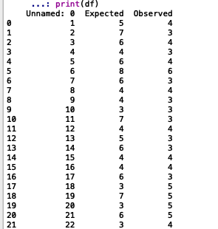
Step 2 : Import data

Slide 5
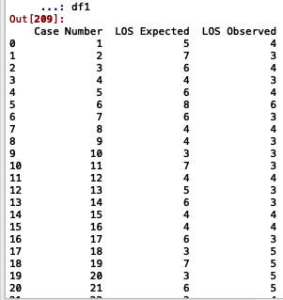
Step 3 : Data cleaning

Slide 6
Step 4 :Calculate Expected Average

Slide 7
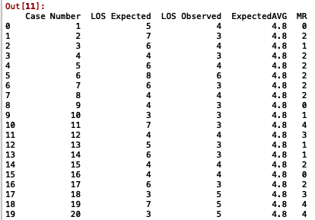
Step 5 :Calculate moving range(MR)
Notes:
MR = the absolute value of each value minus the previous value.
difference between between adjacent values for column LOS expected and name it Moving Range(MR)

Slide 8
Step 6 : Calculate mr average

Slide 9
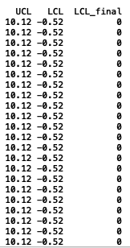
Step 7 : calculate upper control limit and lower control limit
Upper Control Limit = Average of observations + E * Average of moving range
Lower Control Limit = Average of observations - E * Average of moving range
Notes:
The constant E depends on how many consecutive observations are included in the moving range. When 2 consecutive observations are examined, the constant is 2.66 for control limits that include 99% of the data

Slide 10
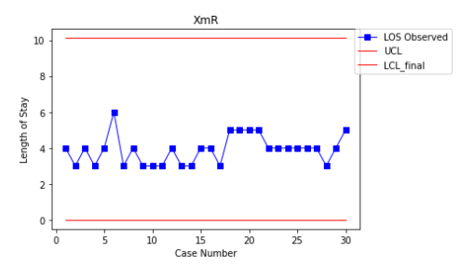
Step 8 : Plot xmr chart

Slide 11
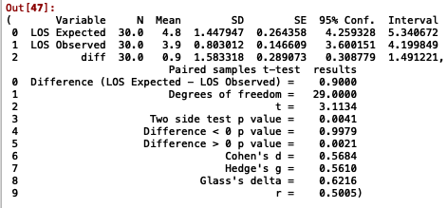
T-test analysis: paired two samples for mean
Null Hypothesis (Ho): Expected and observed length of stay means are the same.
Alternative hypothesis (Ha): Expected and observed length of stay means are not equal.
Ho:μ1=μ2
Ha:μ1≠μ2
The p-value (0.00) < alpha(0.05), we reject the null hypothesis and there is statistical difference between the means.

Slide 12
References
Farrokh Alemi, Ph.D.(2017). XmR Chart in Excel[PowerPoint slides]. George Mason University. http://openonlinecourses.com/spc/Comparison%20of%20Means.html

