Slide 1
HAP 725 TEACH ONE TUKEY CHARTS (Q4)
Rachel Prasanth
George Mason University
Fall 2021
Professor Farrokh Alemi

Slide 2
Tukey Charts
Analyzes a single observation per time period.
Not affected by outliers , based on median distribution.
Median and fourths are calculated.
Upper fourth – 3rd quartile(75% data)
Lower fourth – 1st quartile(25% data)
Fourth spread: Difference of upper fourth and lower fourth.

Slide 3
Question: 4
Analyze "Death rate for CABG surgery patients”
The file is the "Complications and Deaths - Hospital" file or the “Readmissions and Deaths – Hospital” file.
This is measure code MORT_30_CABG.
Choose George Washington University Hospital.
Choose for its competitors Medstar Washington, VHC, and INNOVA Fairfax.
The denominator reports the number of cases. The numerator reports the risk-adjusted mortality rate.
Compare the performance of the hospital to the competing hospitals Draw the observed rate at GWU. The control limits should come from the experiences of its competitors, which is a weighted average of each of the competitor.

Slide 4
Data Source
CMS website

Slide 5
2015 and 2016
2017,2018,2019,2020
Saved Data

Slide 6
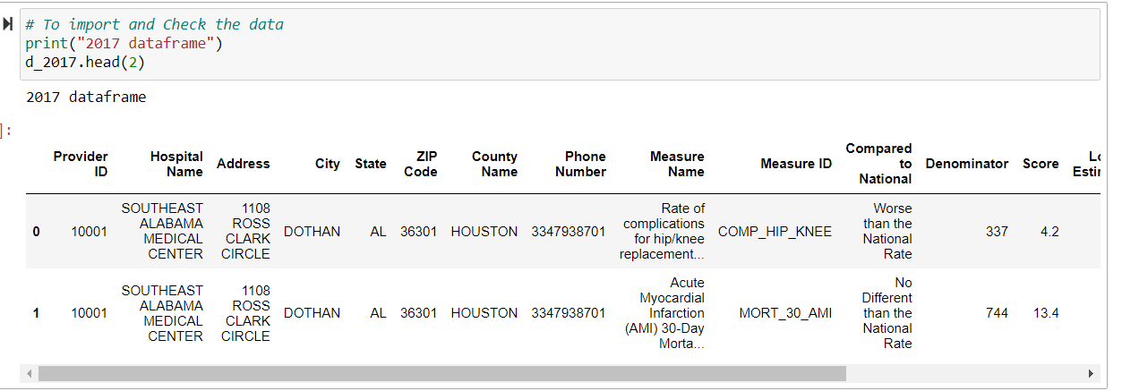
Importing the libraries and data
Check the data

Slide 7
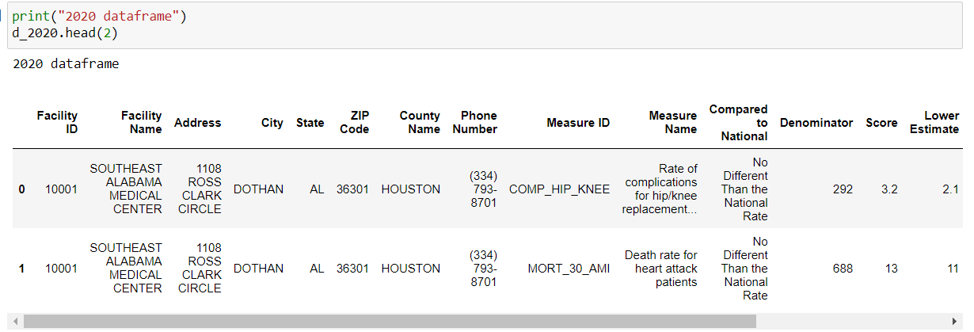
Check the data (contd)

Slide 8
Step1: Filter the dataset to include only Measure ID – “MORT_30_CABG”

Slide 9
Step 2: Select only the required columns

Slide 10
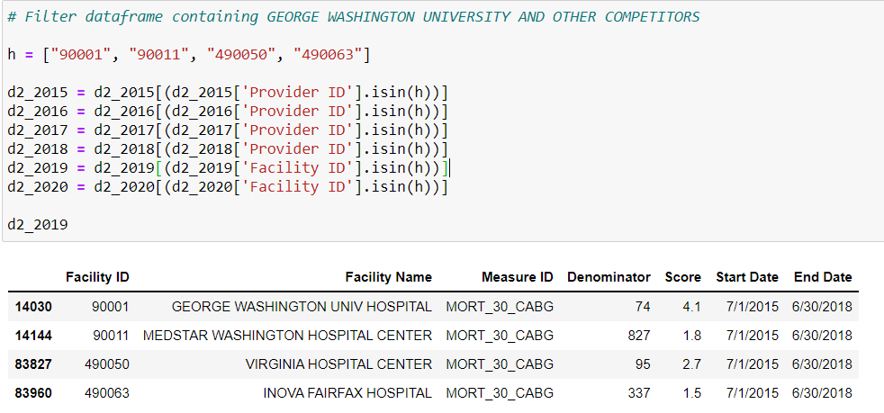
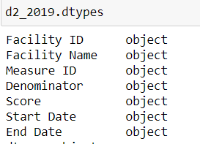
Step 3: Filter dataframe containing George Washington Hosp and the other competitors
Check data types

Slide 11
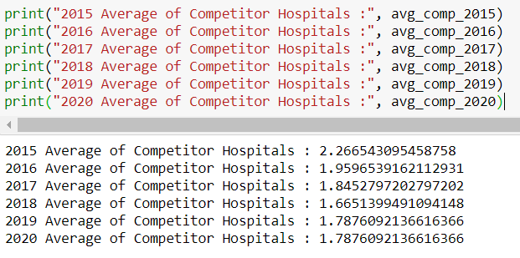
Step 4: Calculate average score of competitors
= sum(score of each competitor *denominator of each competitor) / sum(denominator of competitors)
Output

Slide 12
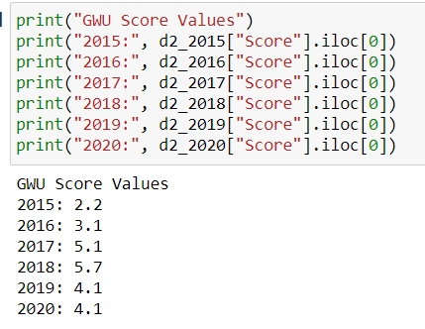
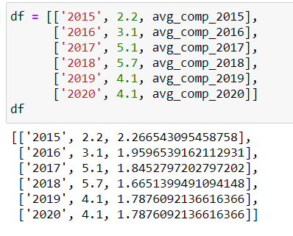
Step 5: Create a table that contains GWU vs competitors
1)
2)
3)

Slide 13
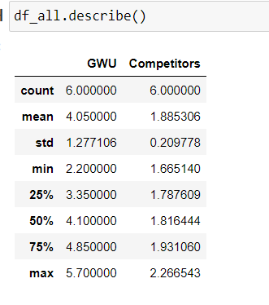
Step 6: Determine the lower and upper quartiles of competitors
1)
First Sort competitors from lowest to highest
2)
Display descriptive statistics of the dataframe
Lower quartile
Upper quartile

Slide 14
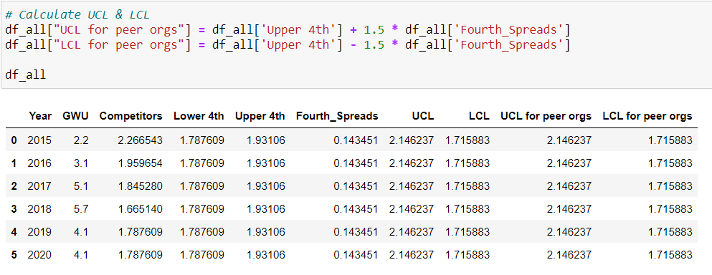
Step 7: Calculate fourth spreads, UCL, LCL
Fourth Spread
UCL & LCL

Slide 15
Step 8: Plot the Tukey Control Chart

Slide 16
The CABG mortality rate has been rising above the UCL since 2015.
It has been the highest in 2018.
Overall, the death rate for CABG patients at GWU is worse than the other competitor hospitals.

Slide 17
Thank you

