Slide 1
HAP 725 Teach One Week 7 Question 4
Fall 2020
Prof. Farrokh Alemi
YA TING, YANG

Slide 2
Question 4: Use the procedure described for outcomes in synthetic cases, to estimate mortality rate for 80 years residents with walking and toileting disabilities but no other disabilities. Note that we want to rely on at least 30 cases in making this estimate. In the database there are not 30 cases with these two disabilities and 80 years of age. Therefore, we would like you to estimate the survival days using synthetic case outcomes. You can create a synthetic case from 80-year-old who are unable to walk and residents who are unable to toilet. Alternatively you can select a different set of residents, such as 80-year-old who are unable to toilet and residents who are unable to walk.

Slide 3
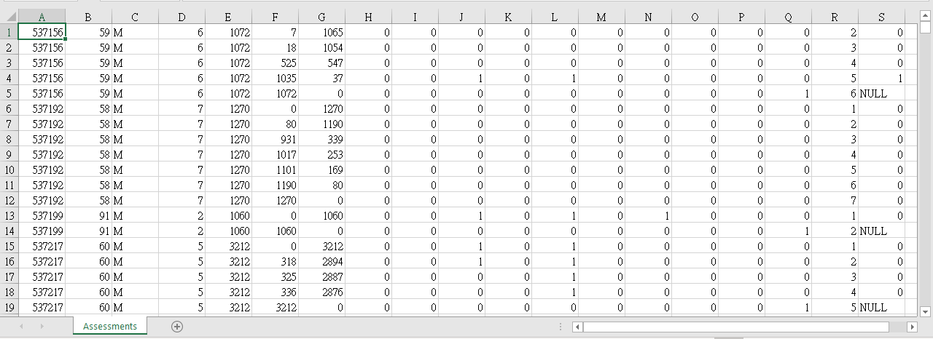
STEP 1: read the data file and Import Data

Slide 4
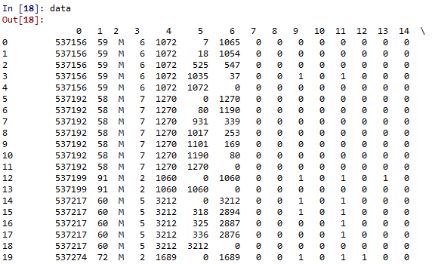
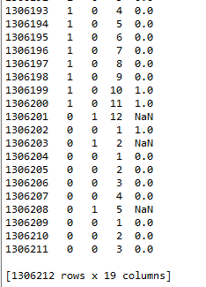
STEP 1: : read the data file and Import Data
Your data frame will be 19 columns and 1306212 rows.

Slide 5
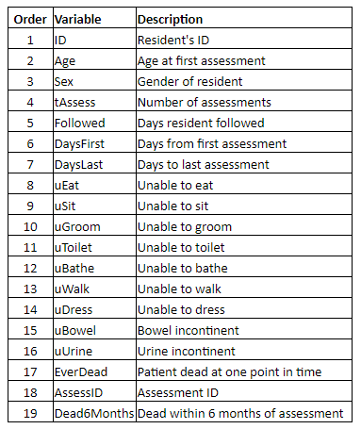
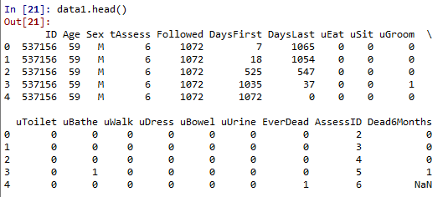
STEP 2: Add header name of csv file

Slide 6
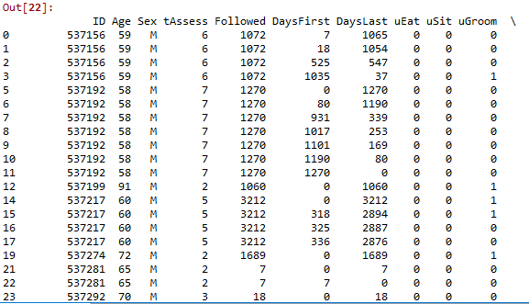
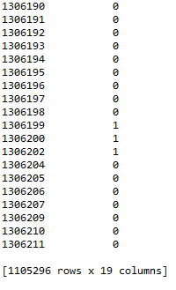
STEP 3: clean data with Dead6Months is not null
Your data frame will be 19 columns and 1105296 rows.

Slide 7
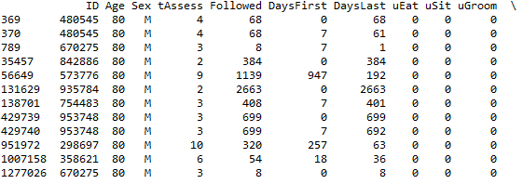
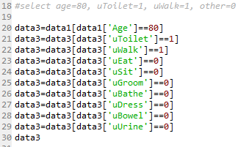
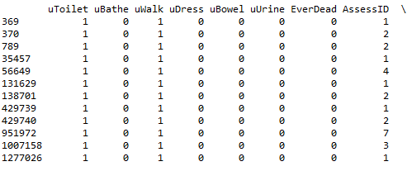
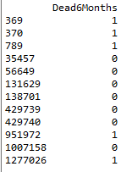
STEP 4: calculate the estimate of mortality for 80 years old resident with toileting disability and walking disability
Your data frame will be 19 columns and 12 rows.

Slide 8
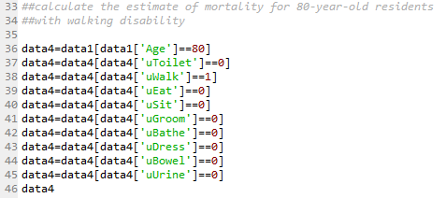
STEP 5: calculate the estimate of mortality for 80 years old resident with walking disability

Slide 9
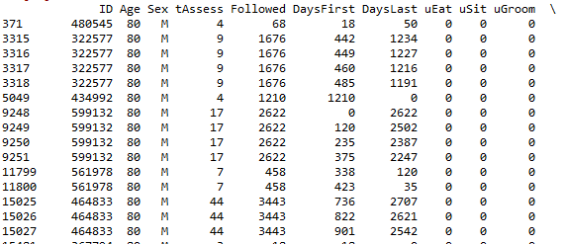
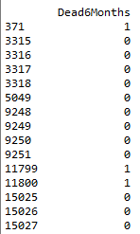
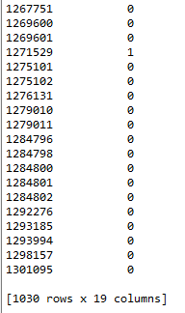
Partial outcome of step 5
Your data frame will be 19 columns and 1030 rows.

Slide 10
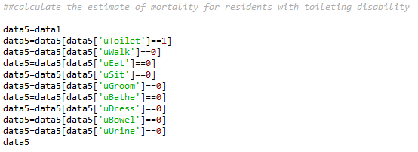
STEP 6:calculate the estimate of mortality for people with toileting disability

Slide 11
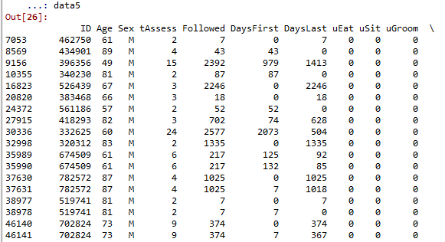
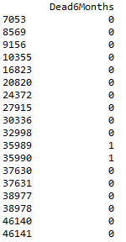
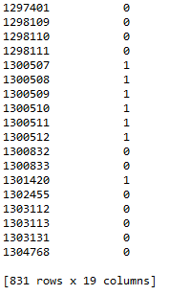
Partial outcome of step 6
Your data frame will be 19 columns and 831 rows.

Slide 12
STEP 7: calculate the final estimate mortality from previous estimate mortality

Slide 13
Thank you

