Slide 1
Apple Watch data analysis
Venkata Vamsi Ram Patibandla
HAP – 725
Instructor: Dr. Farrokh Alemi

Slide 2
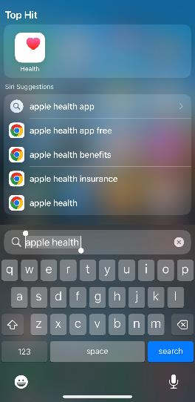
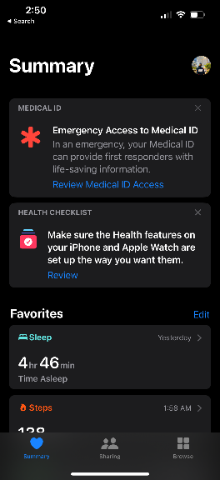
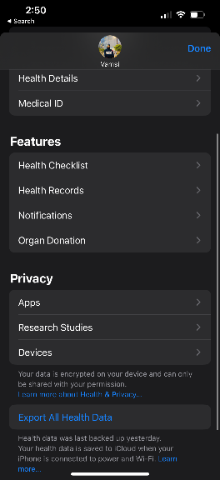
Extract data from apple watch
STEP 1
STEP 2
STEP 3

Slide 3
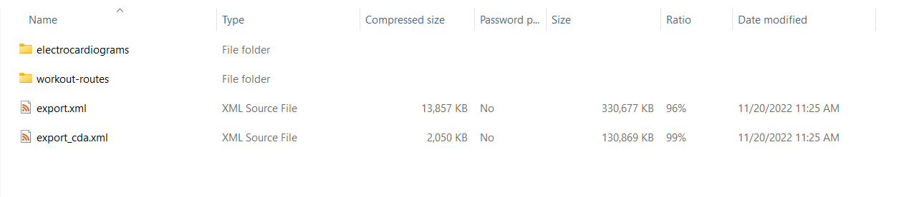
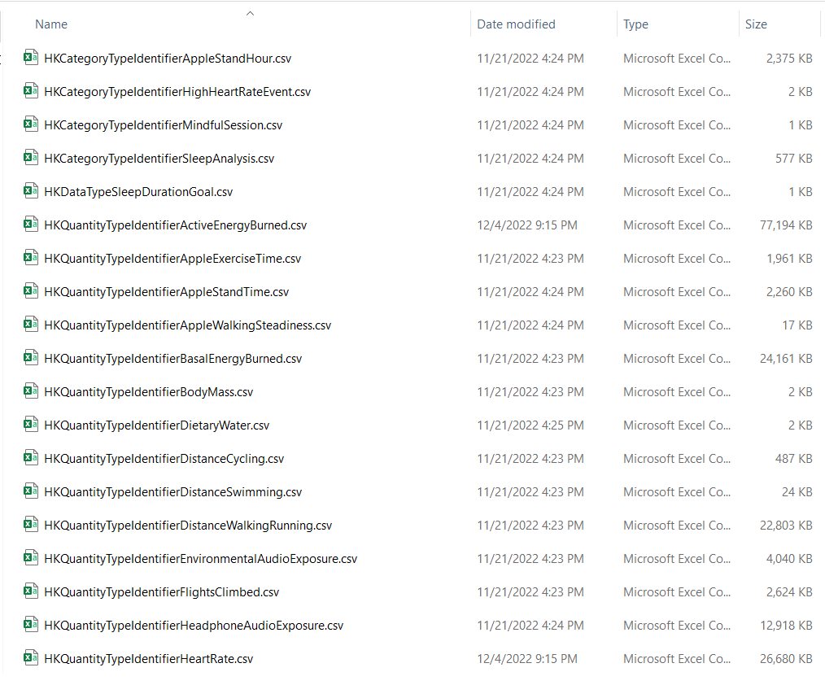
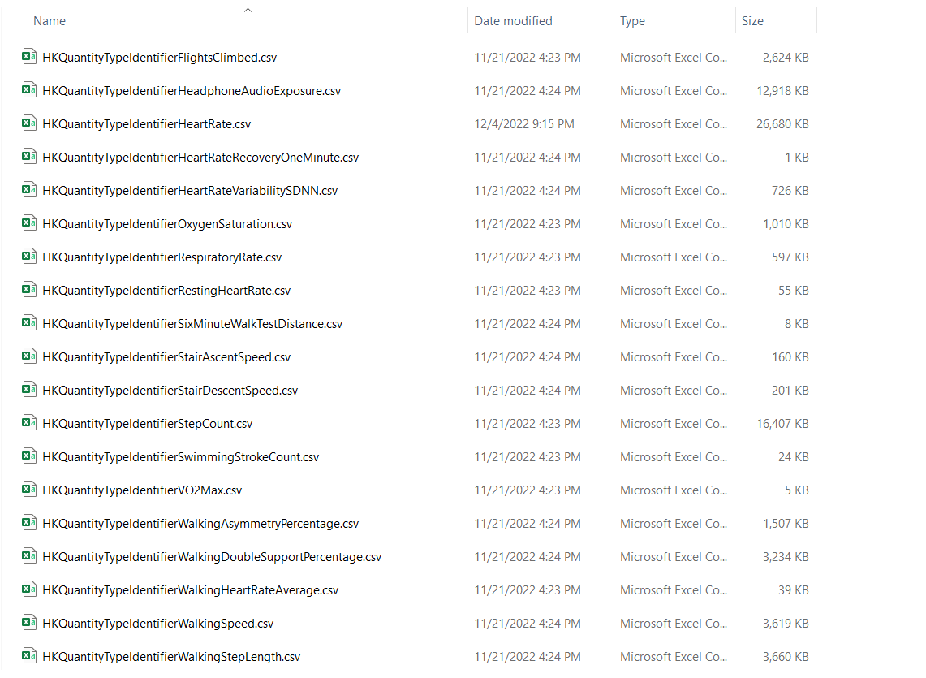
Extract data from apple watch(contd.)

Slide 4
Heart Rate vs Expected Heart Rate

Slide 5
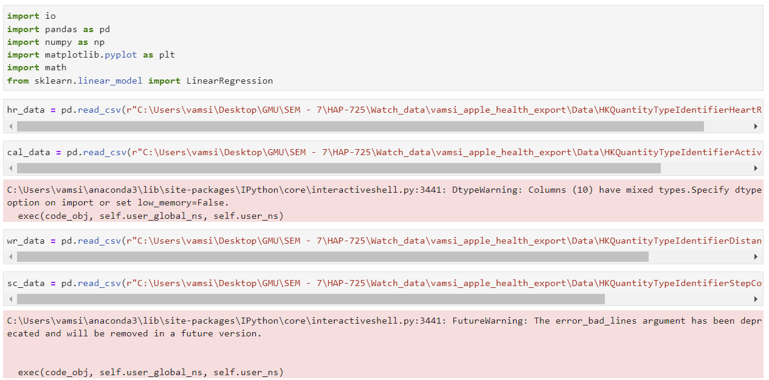
Import packages and data

Slide 6
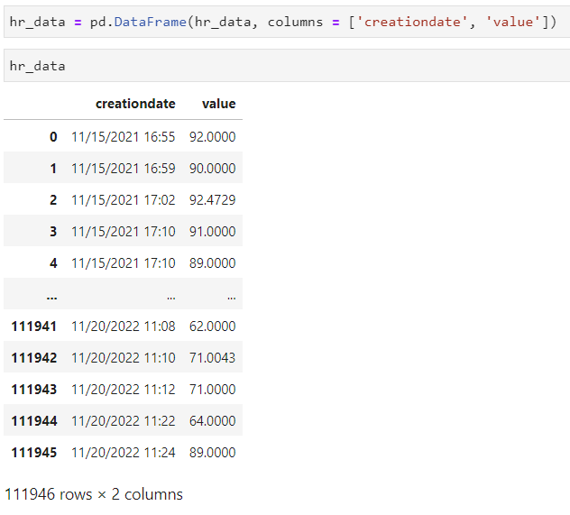
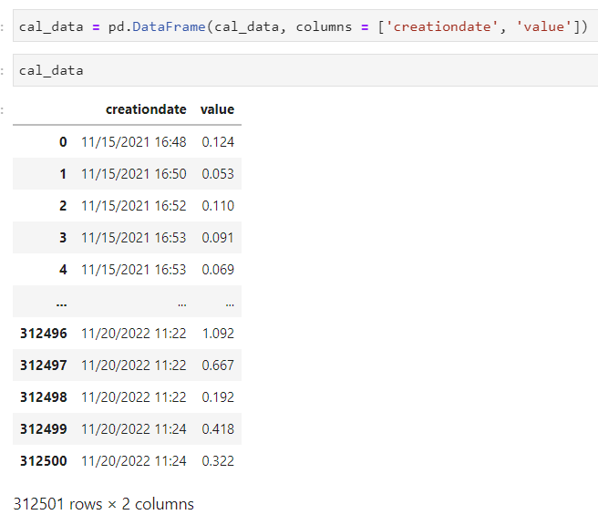
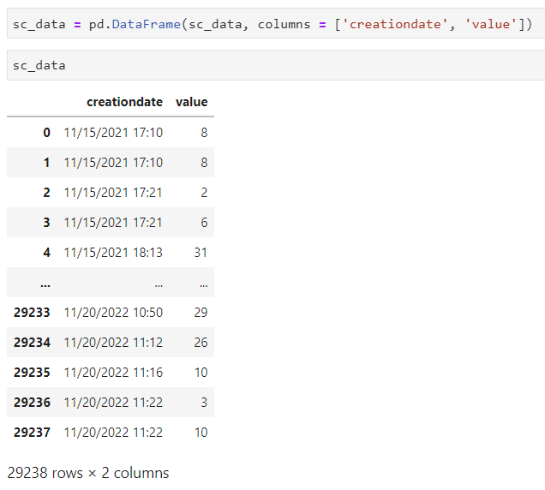
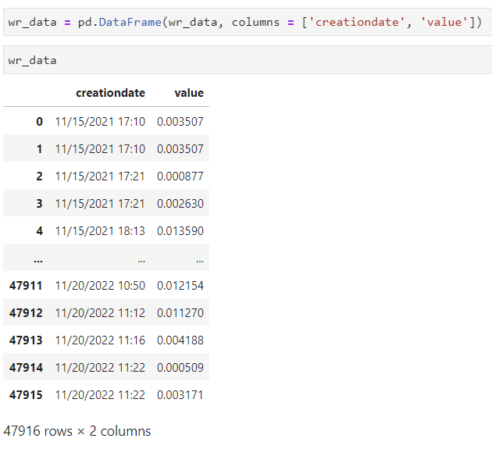
date column and value column

Slide 7
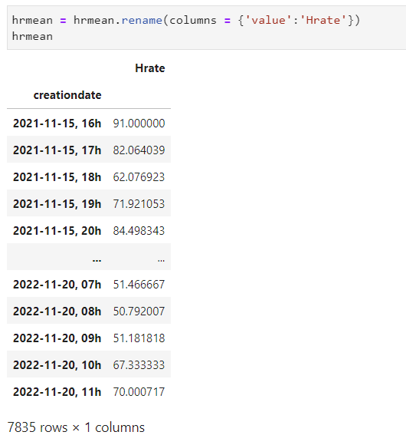
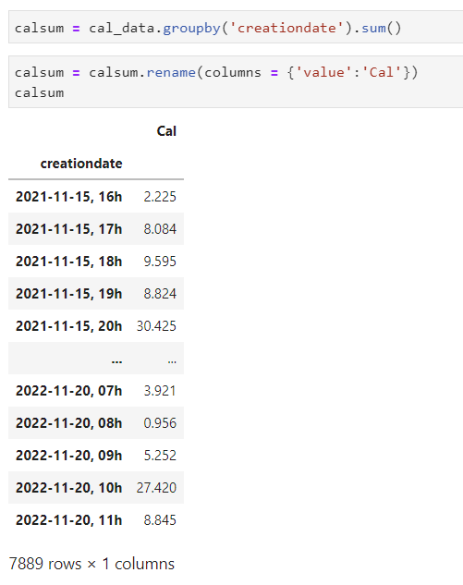
Calculate the average heartrate and total calories

Slide 8
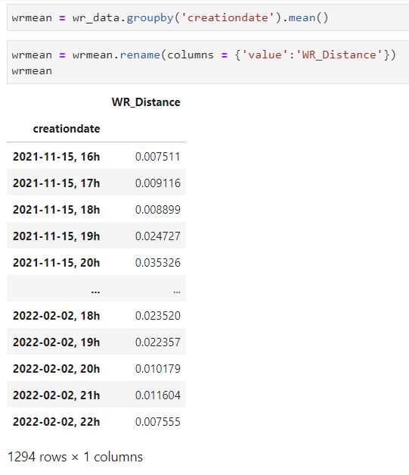
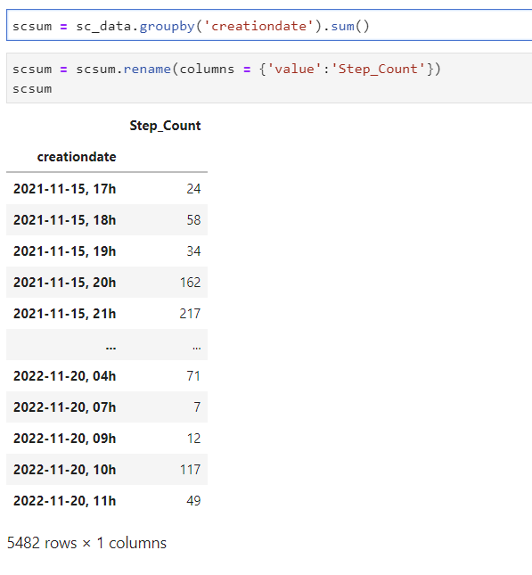
Calculate the Average walking/running distance and total step count

Slide 9
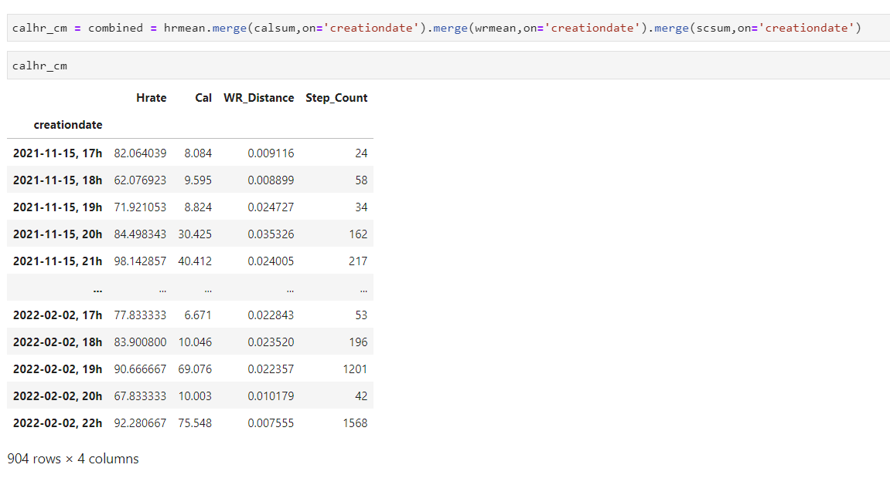
Merge the columns

Slide 10
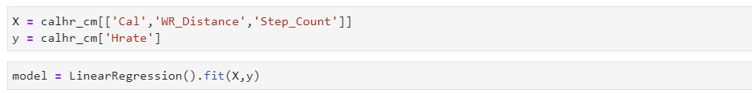
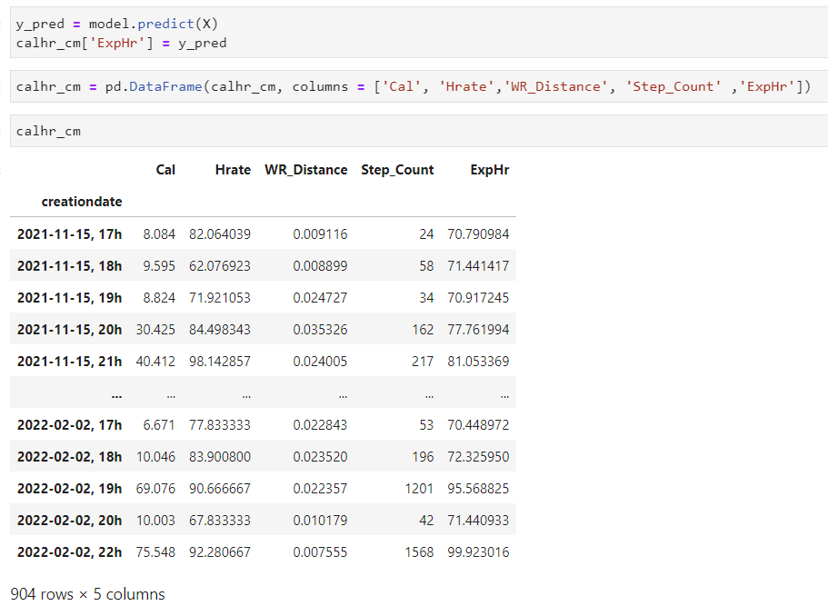
Linear regression to predict the expected heart rate

Slide 11
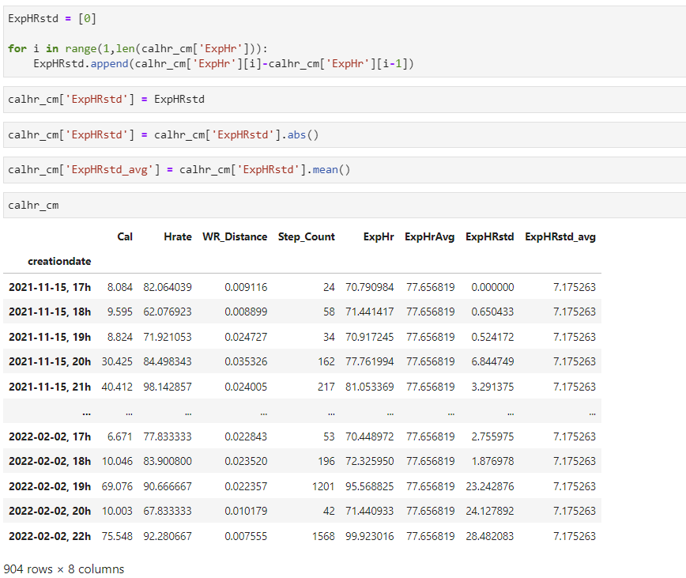
Calculate standard deviation

Slide 12
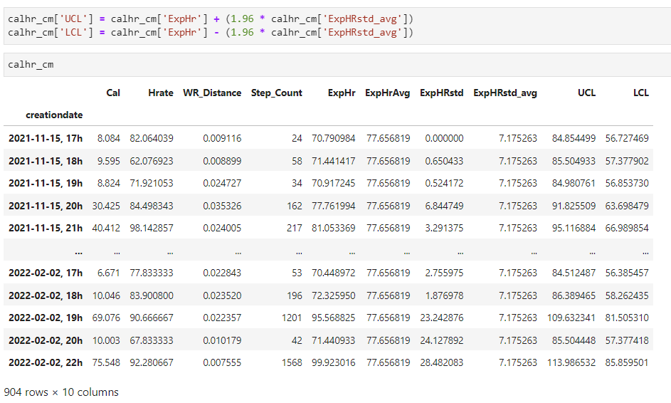
Calculate ucl and lcl for expected heart rate

Slide 13
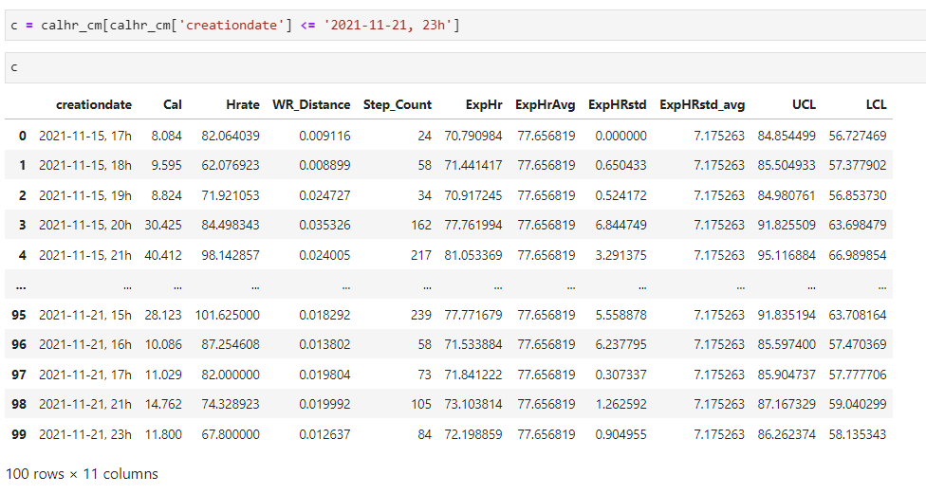
Filter the data to first week of November 2021

Slide 14
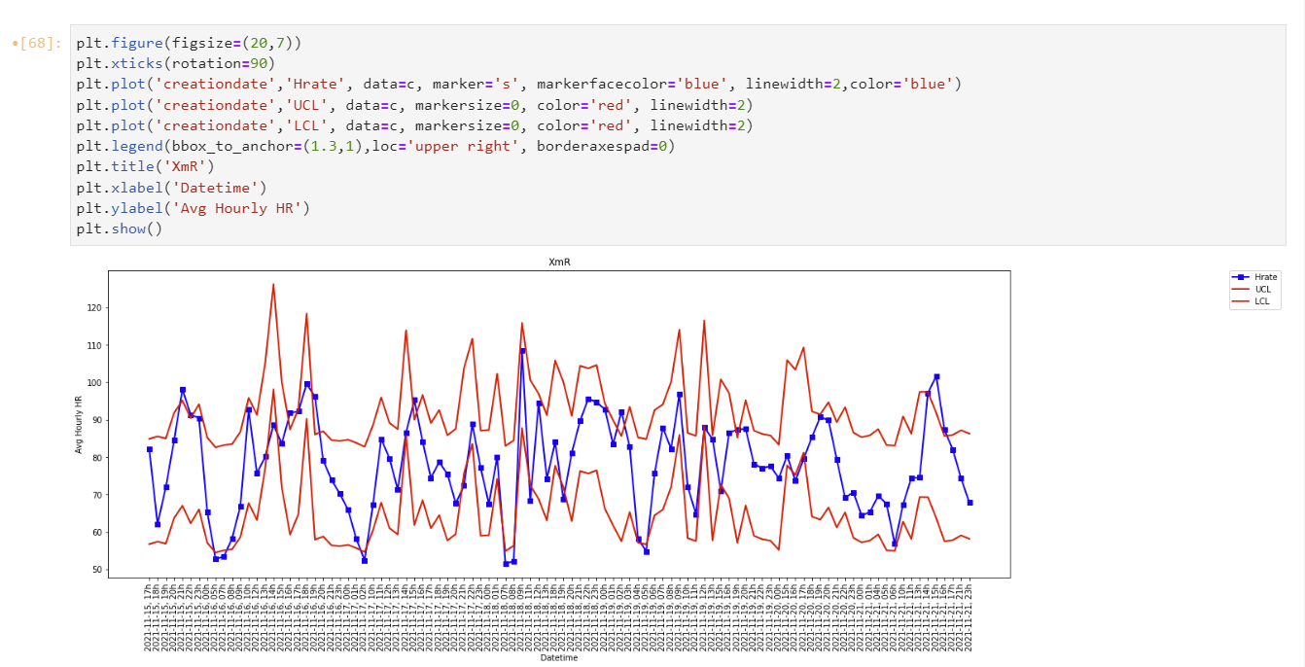
Risk adjusted x-bar Control chart for one week

Slide 15
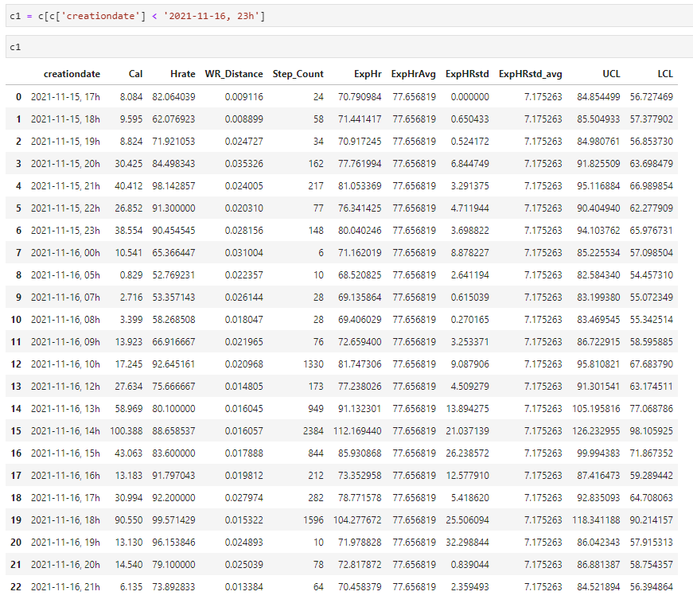
Filter the data to 15 November 2021

Slide 16
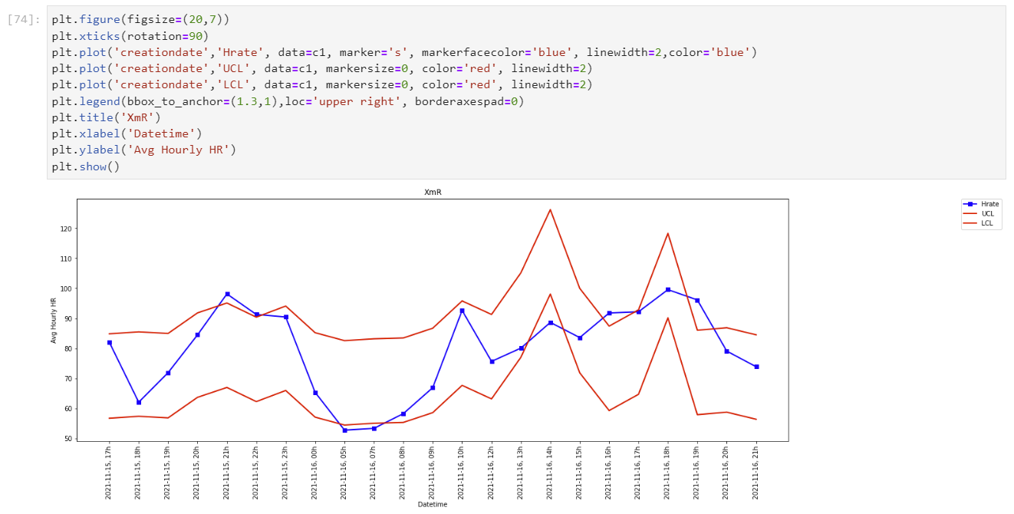
Risk adjusted x-bar Control chart for one day

Slide 17
Thank You

