Slide 1
Teach one
Suhashini Ramanathan
HAP 725

Slide 2
Question??
Healthcare organizations are often interested in assessing the impact of screening efforts in generating new referrals. Patients may return to many different clinics and not just to the original screening clinic. They may also return to a clinic months later and not immediately. The attached data shows visits from pregnant mothers who received ultrasound tests. Data are presented on date of visits and clinics that were visited. Re-organize the data to count the number of referrals per month to neurology. Construct a p- chart for the probability of a subsequent neurological visits in mothers who had an ultrasound screening

Slide 3
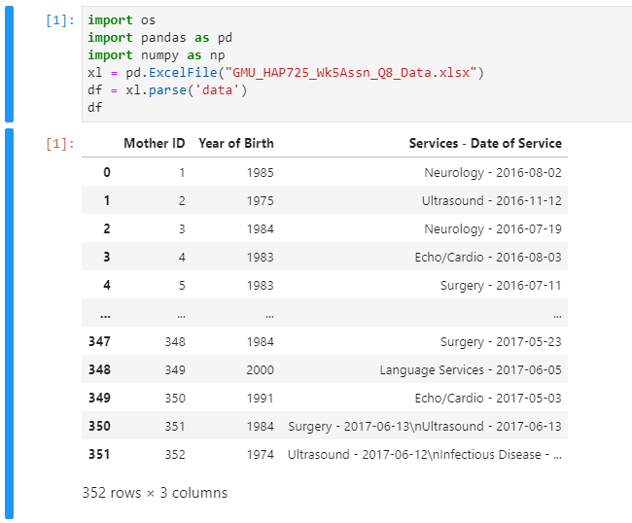
Import Data
There are multiple Services recorded against a single row
Service and Date of Service is saved in one column

Slide 4
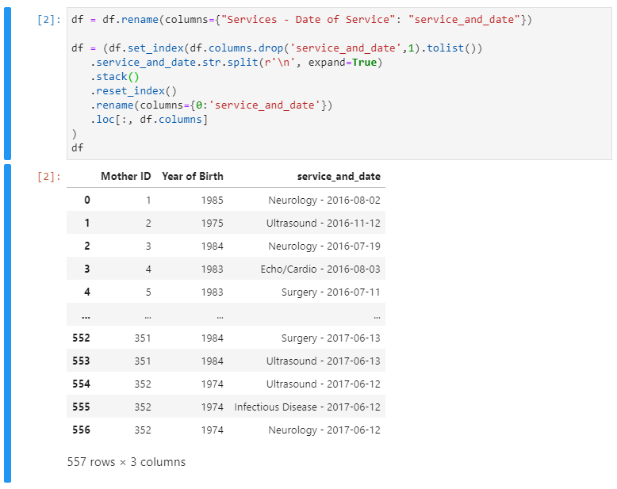
Split Services into multiple Rows
Using inbuilt Pandas function Split and Stack, services within each row are split into multiple rows
Unique services are separated by a line break (“\n”) which can used in the split function

Slide 5
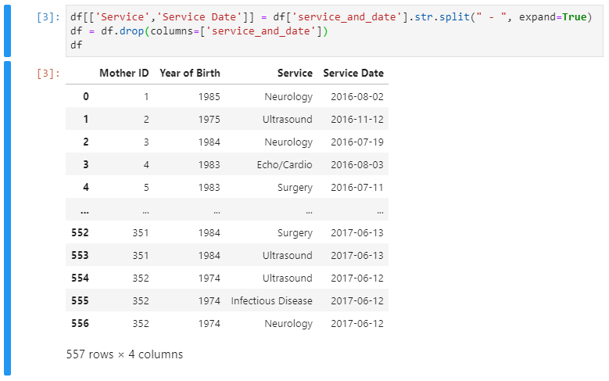
Split Service and Service Date into separate columns
To identify Neurology referrals by month we will need to have the Service and Service Date as separate columns.
Based on the data we can see that the name and date values are separated by “ – “ (space before and after hyphen)
Use split function to create 2 new columns with the respective data

Slide 6
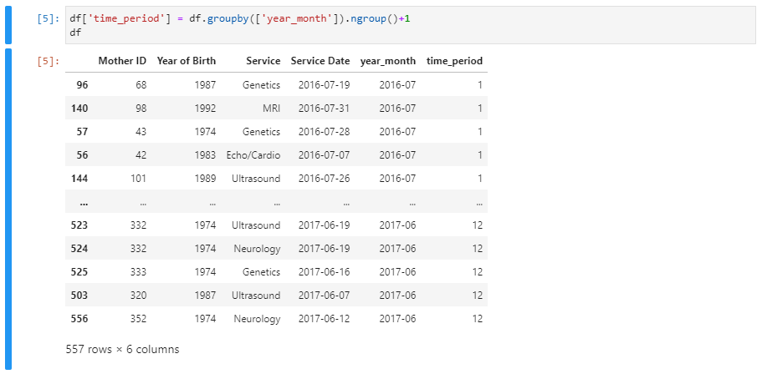
Identify the time period
With the Service date as a separate column, we can identify the unique combination of Year & Month in the data set
Based on the results, we can see that there are 12 unique time periods starting from July 2016 to June 2017
We then assign the time period in sequence as a new column

Slide 7
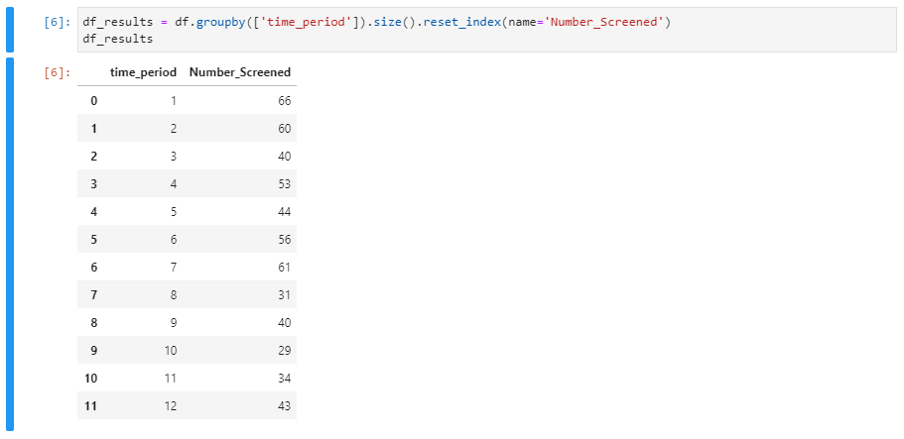
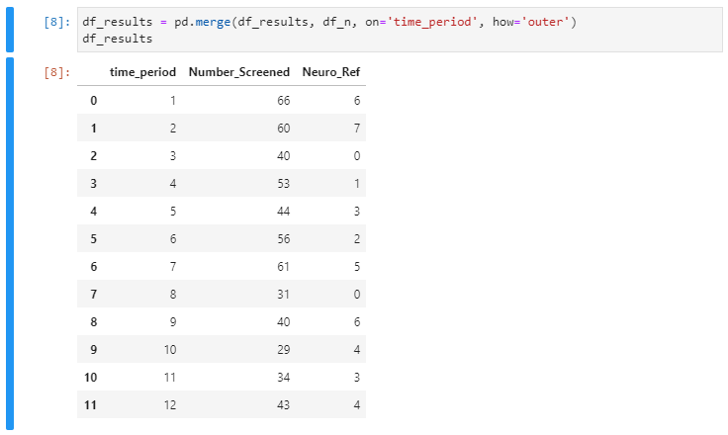
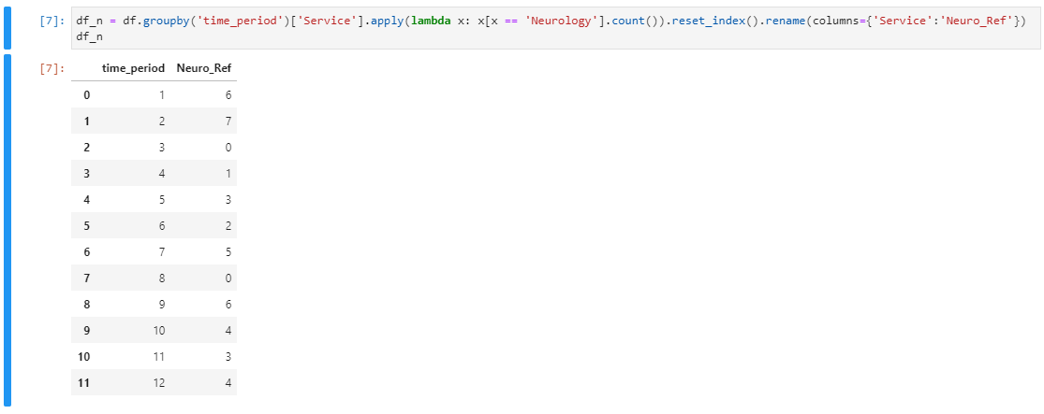
Calculate the No. of Screened and No. of Neurology Referrals
Using the group by function you can calculate and assign the No. of patients Screened and No. patients referred to the Neurology department to separate data frames
Then, using the Merge function we can combine the data to the results data set

Slide 8
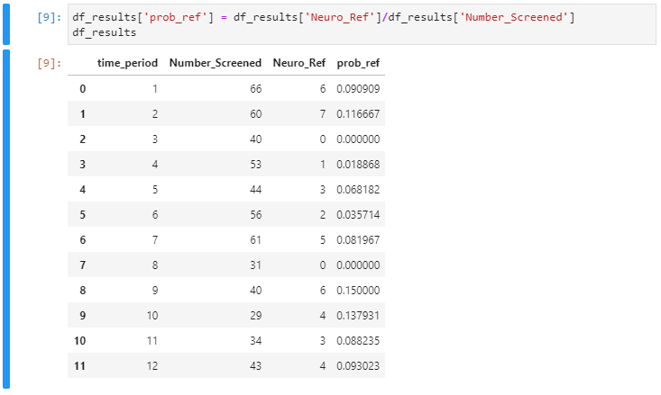
Calculate the Probability of Neurology Referrals & P-Bar
Using the below formula we calculate the probability of Neurology Referrals for each time period.
$$Probablity of Neurology Referrals=\frac{No. ofNeurology Referrals}{No. of Patients Screened}$$
P-Bar is calculated using below formula and assigned to a separate variable. We will use this in calculating the remaining columns
$$P−Bar=\frac{Total No. ofNeurology Referrals}{Total No. of Patients Screened}$$

Slide 9
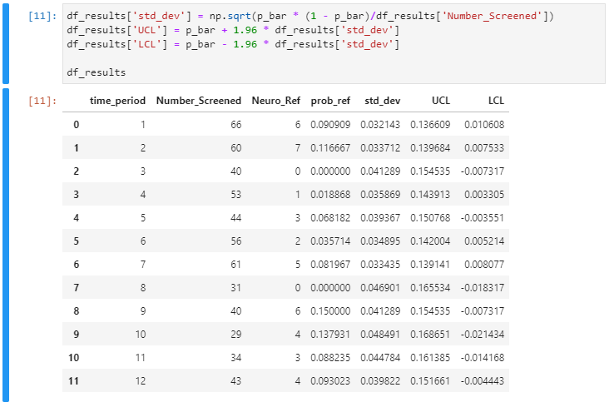
Calculate the Std Dev , UCL & LCL
Use the below formulas to calculate the additional columns
$$Standard Deviation= \sqrt{\frac{\overline{P} \left(1 − \overline{P} \right)}{No. of patients Screened}}$$
$$UCL=\overline{P}+1.96 ∗Standard Deviation$$
$$LCL=\overline{P}−1.96 ∗Standard Deviation$$

Slide 10
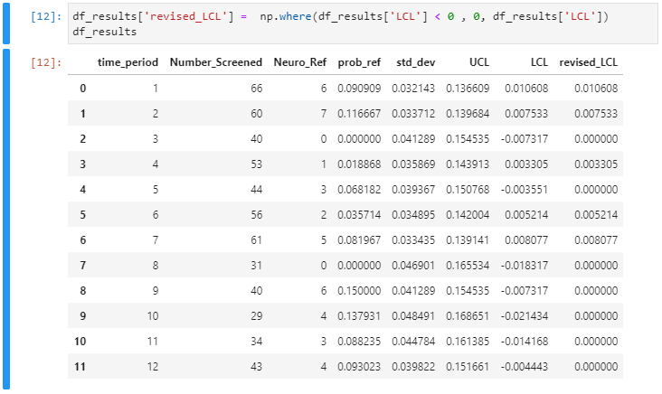
Revised LCL
Identify the negative values of LCL and replace with Zero

Slide 11
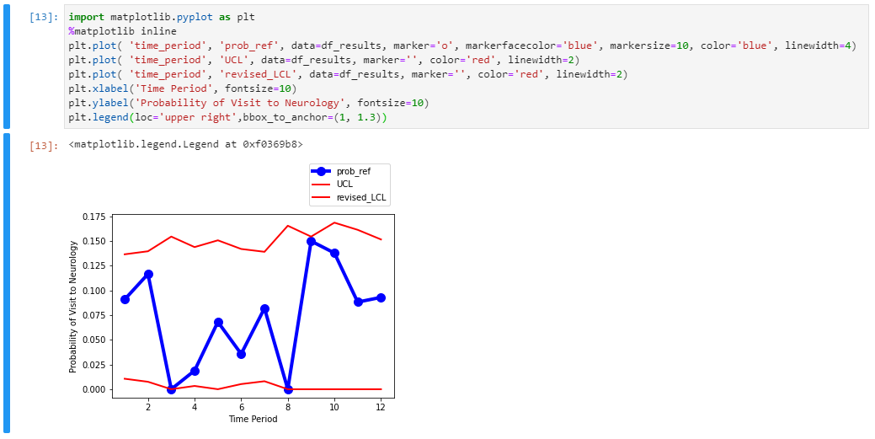
P-Chart

