Slide 1
PROBABILITY AND DISTRIBUTION
Priscille Ngana
HAP725 Dr. Farrokh Alemi

Slide 2
QUESTION 4:
Plot the relationship between rate of complications for hip/knee replacements and pressure scores. Use a scatter plot in Python. Have the rate of complications as X-axis and pressure scores as Y-axis.

Slide 4
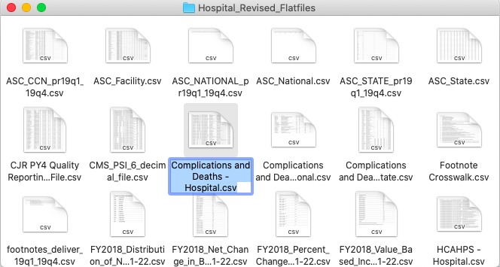

Slide 5
STEP 1: IMPORT LIBRARIES

Slide 6
PANDAS
MATPLOTLIB

Slide 7
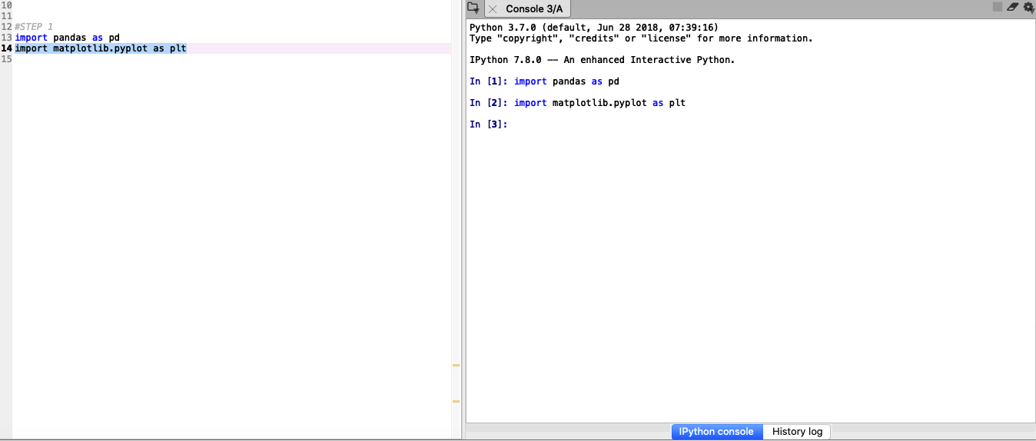

Slide 8
STEP 2: READ DATA

Slide 9
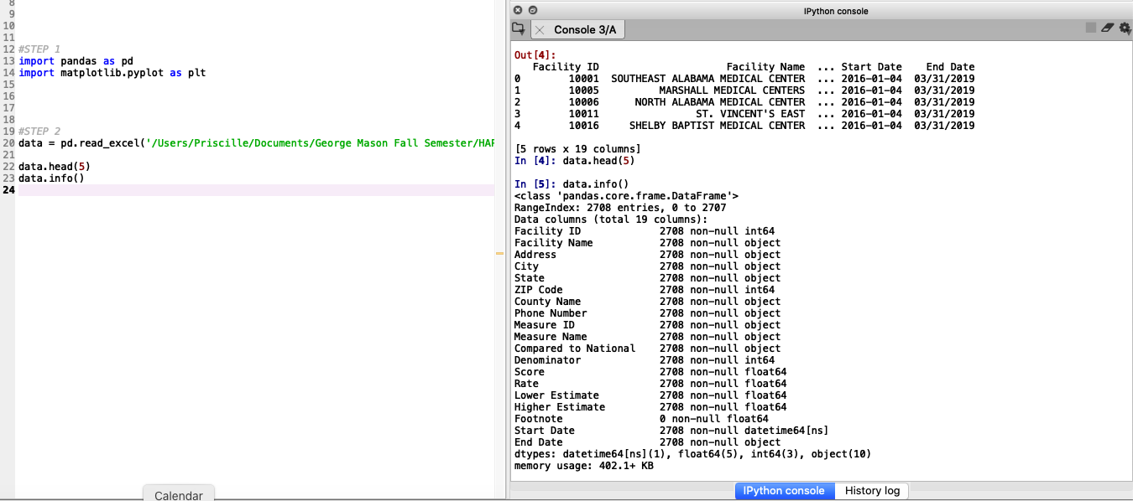

Slide 13
STEP 3: CREATE SCATTER PLOT

Slide 15
STEP 4: LABELS

Slide 16
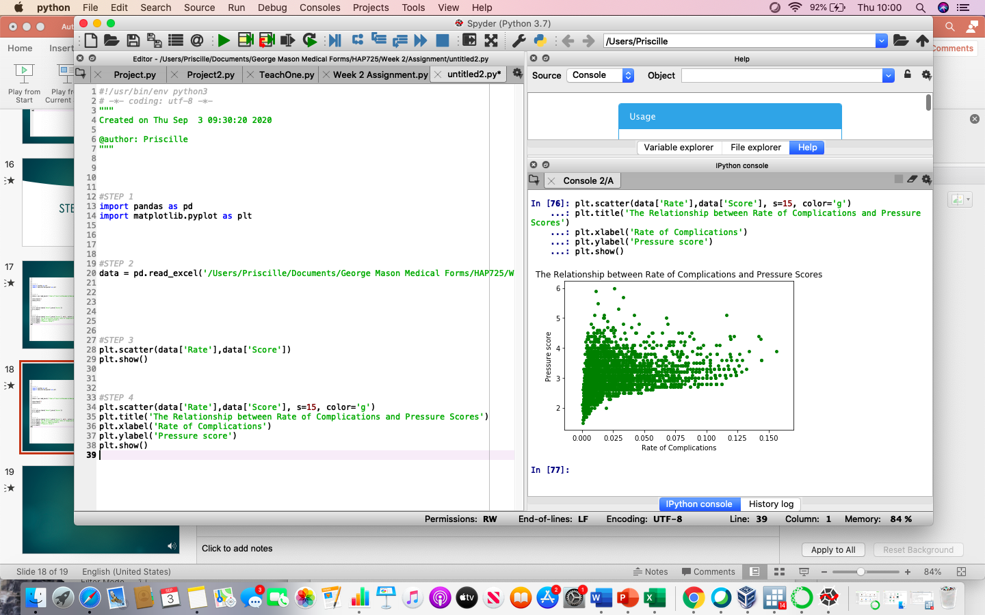

Slide 17
THANK YOU

