Slide 1
Problems I faced/fixed
Claire Kim

Slide 2
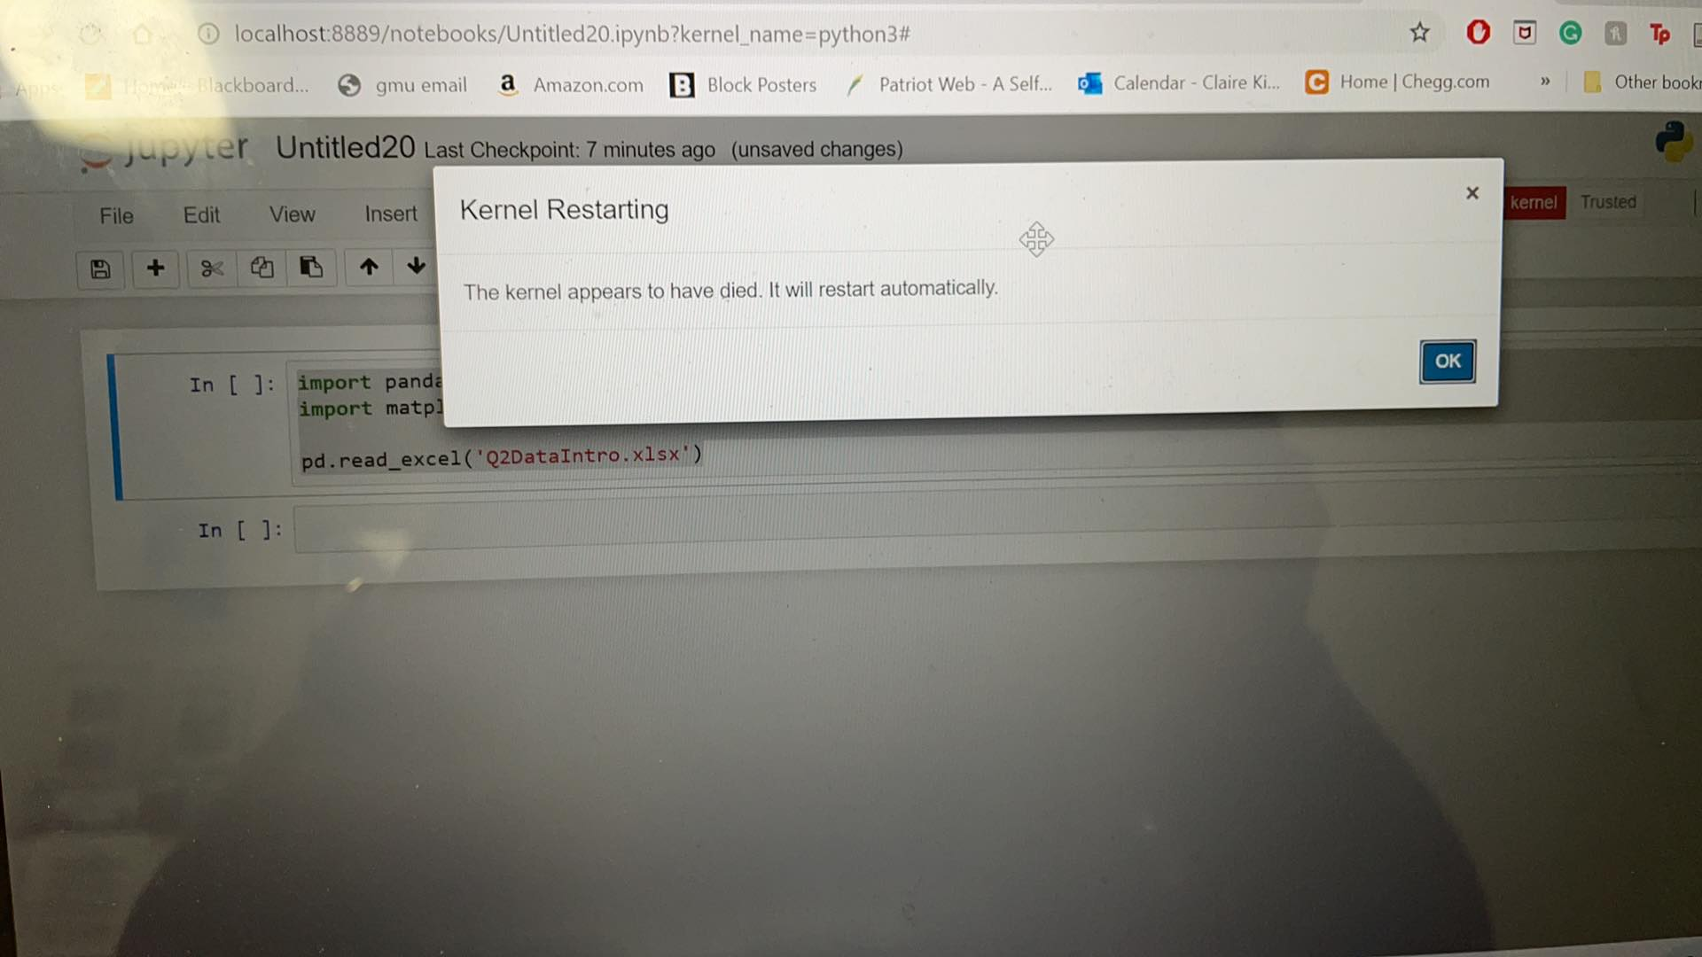
Dead kernel problem

Slide 3

To fix this problem, I had to delete jupyter and anaconda navigator and reinstall the apps again. Here is my teach one on installing the apps. (00:08-00:37)

Slide 4
Thank you

