Slide 1
Quadratic Distribution
Ends Up Normal
By Farrokh Alemi, Ph.D. and Amr Elrafey
Notes:
.

Slide 2
Average of Samples from All Distributions Will End Up Normal,
As Larger Samples Are Averaged

Slide 3
Average of Samples from All Distributions Will End Up Normal,
As Larger Samples Are Averaged

Slide 4
Average of Samples from All Distributions Will End Up Near Normal
As Larger Samples Are Averaged

Slide 5
We start with Quadratic and end up with near Normal Distributions

Slide 6
We start with Quadratic and end up with near Normal distribution

Slide 7
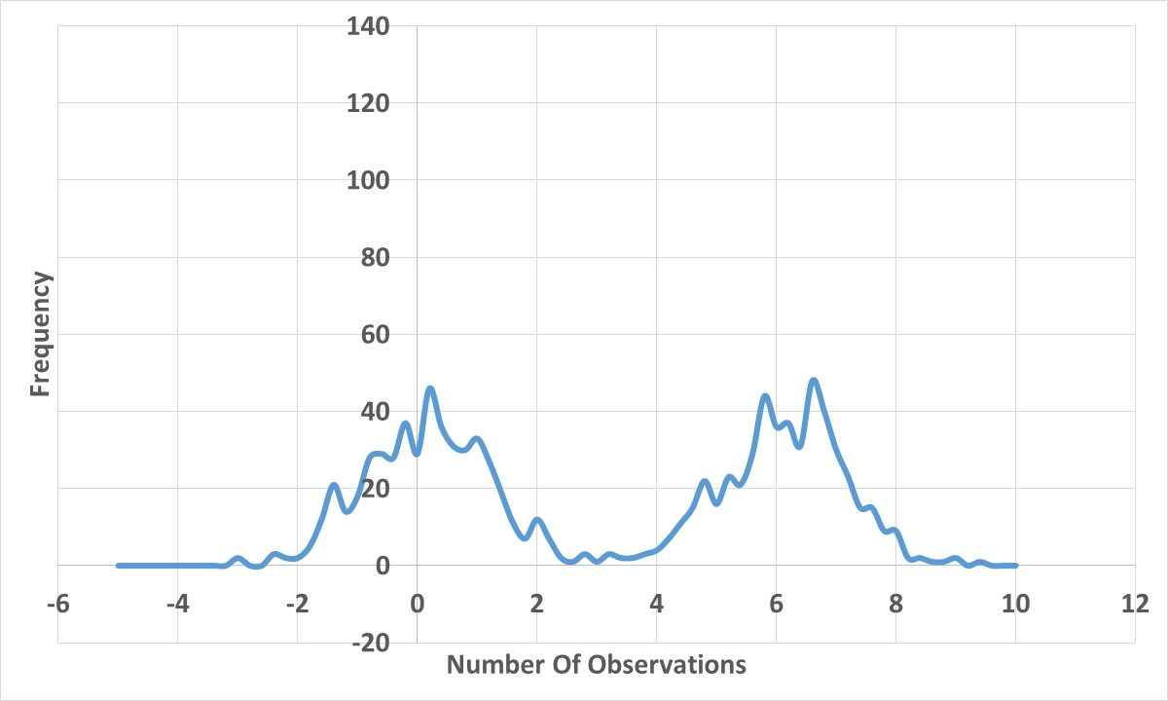
Average of
1
Quadratic with 2 Maximums
Observations

Slide 8
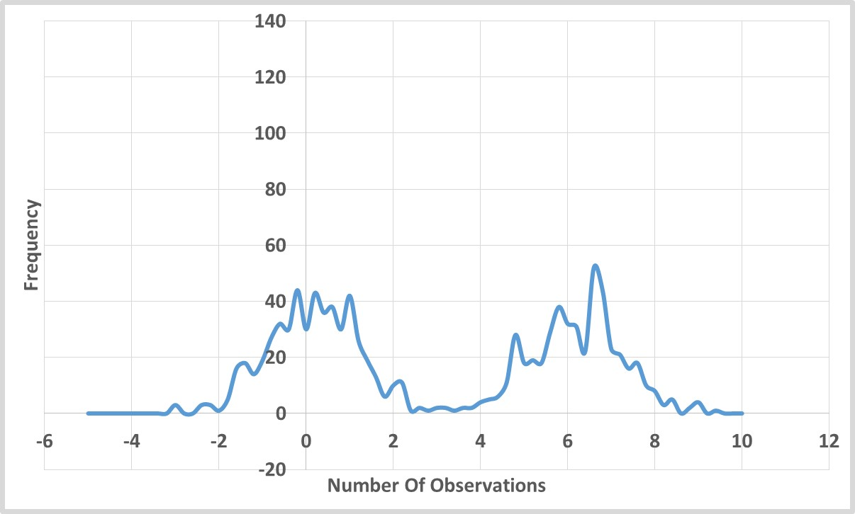
Average of
2
Observations

Slide 9
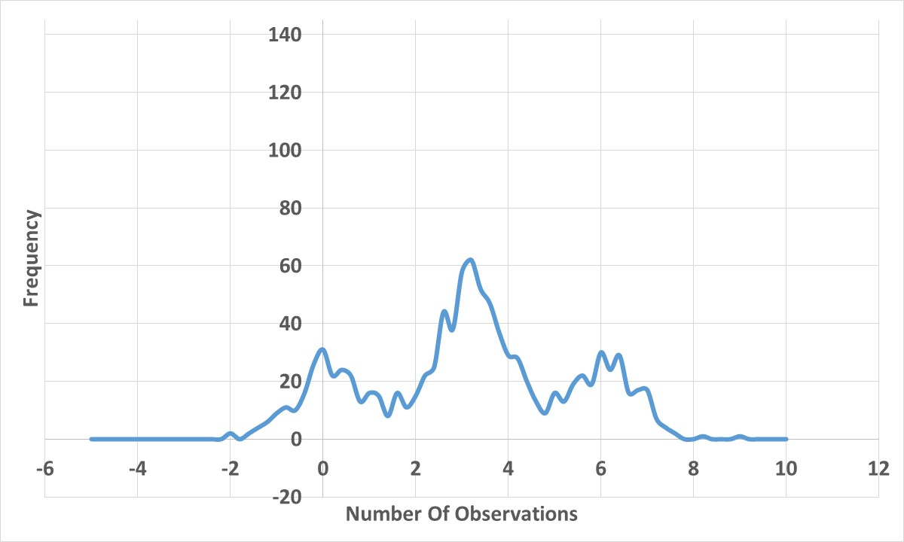
Average of
3
Observations

Slide 10
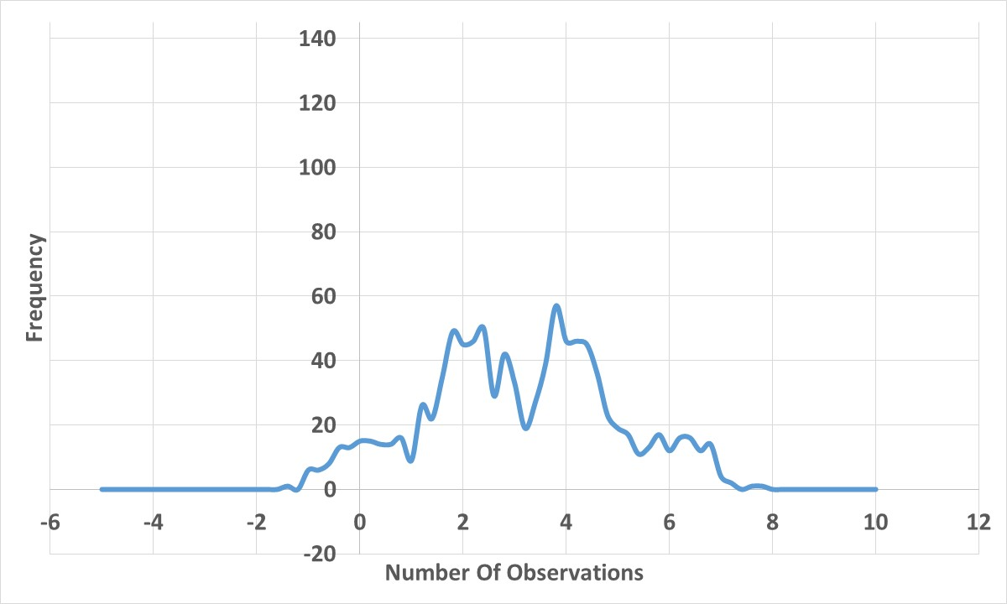
Average of
4
Observations

Slide 11
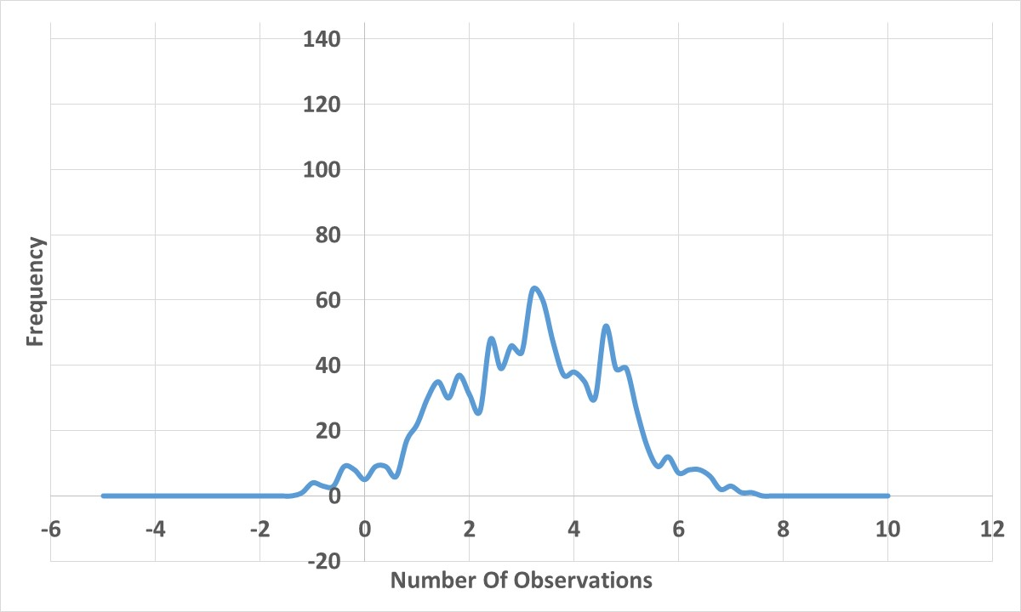
Average of
5
Observations

Slide 12
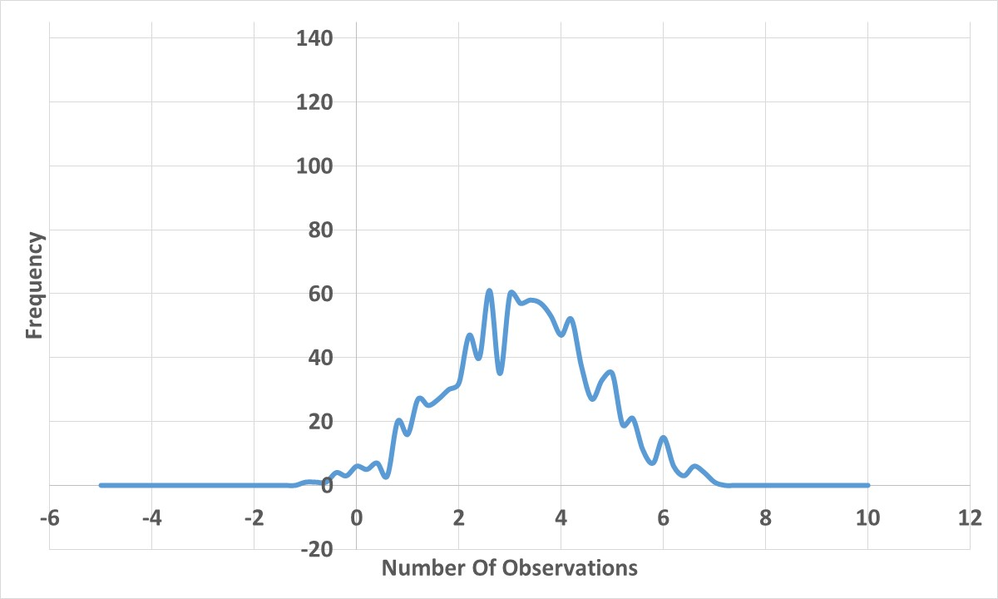
Average of
6
Observations
Notes:
Sampling refers to the process of examining a subset of cases to infer the rate in the entire population

Slide 13
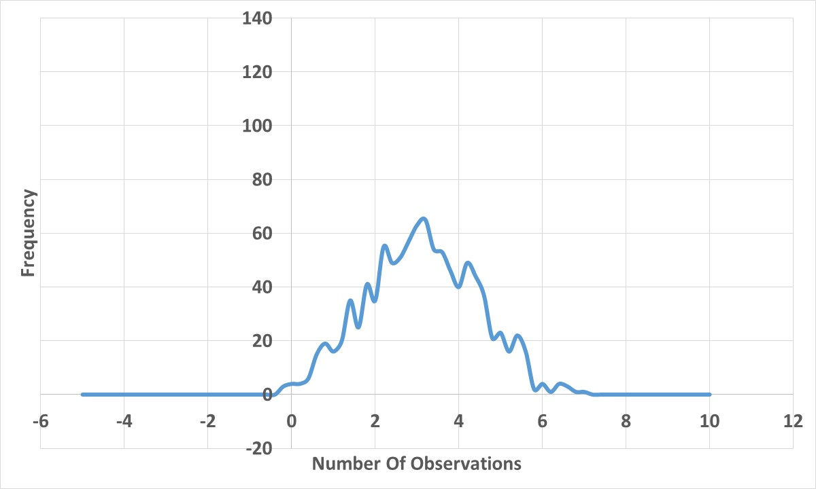
Average of
7
Observations

Slide 14
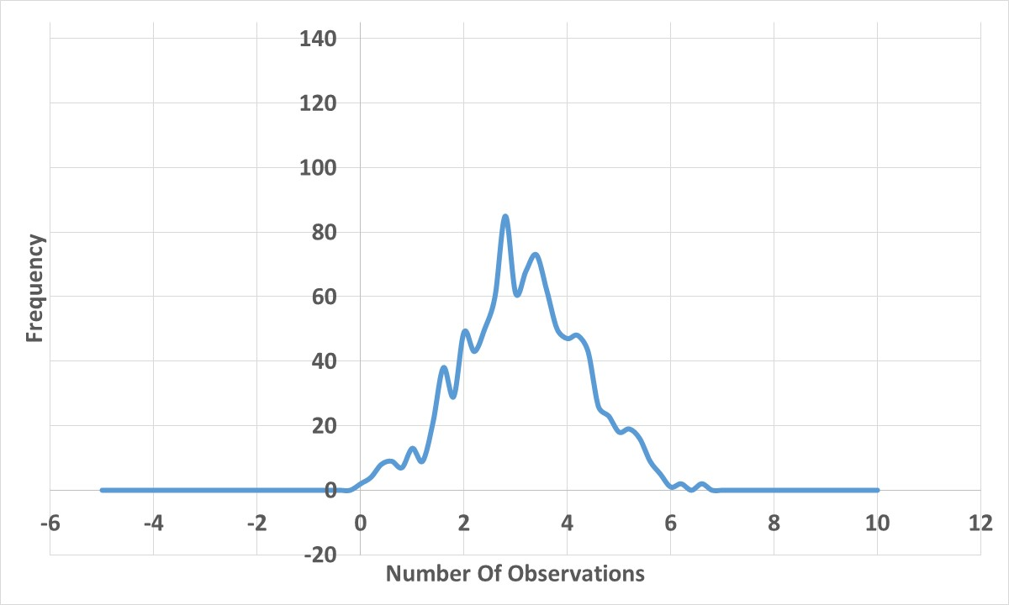
Average of
8
Observations

Slide 15
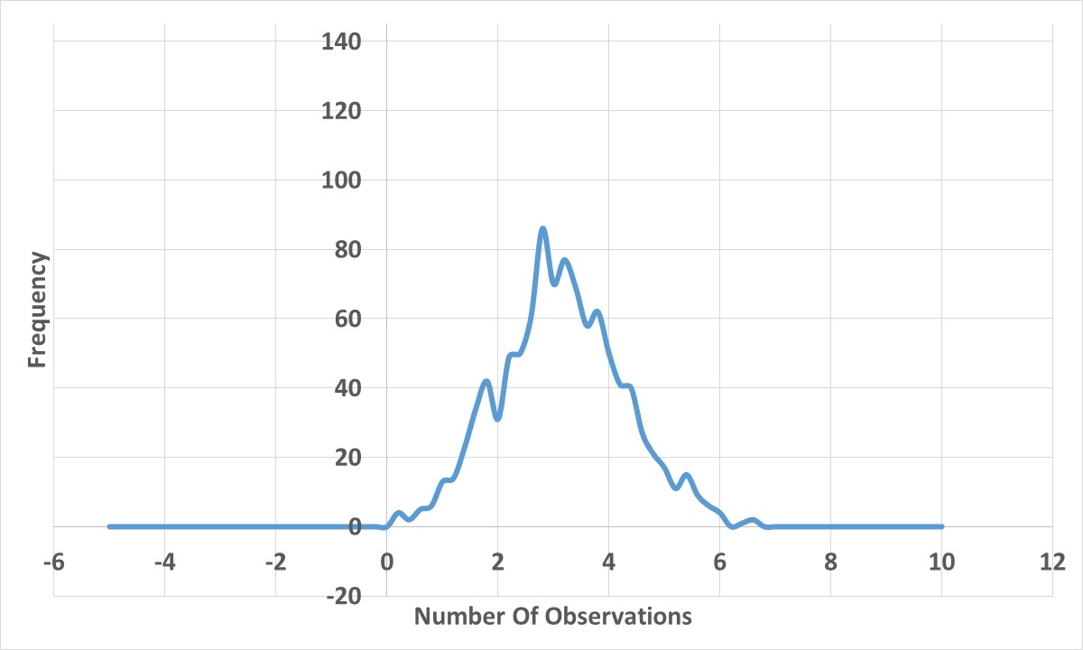
Average of
9
Observations

Slide 16
Average of
10
Observations

Slide 17
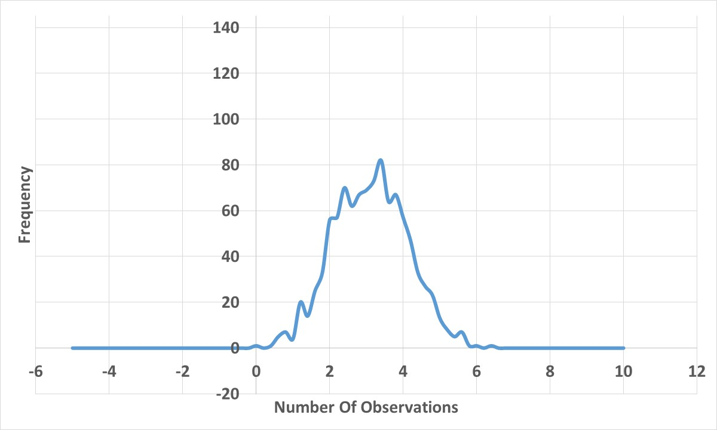
Average of
11
Observations

Slide 18
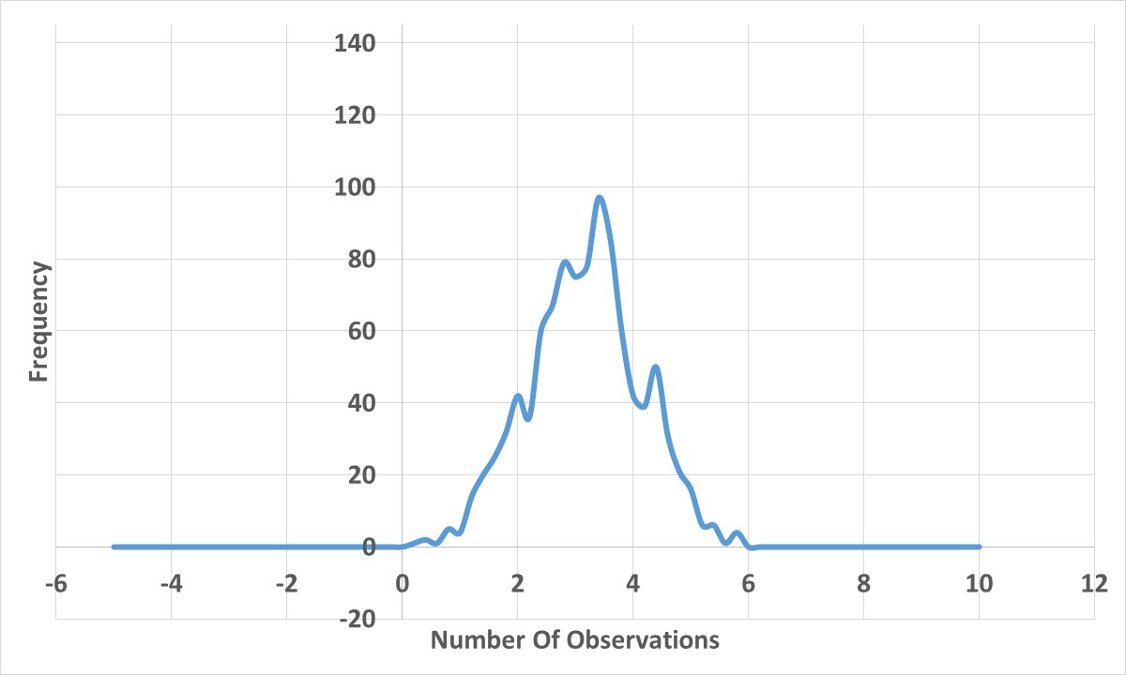
Average of
12
Observations

Slide 19
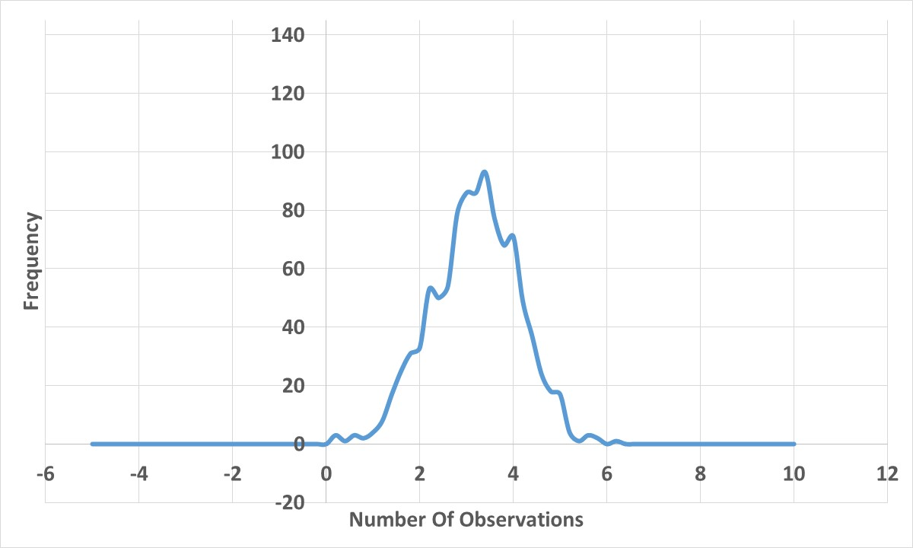
Average of
13
Observations

Slide 20
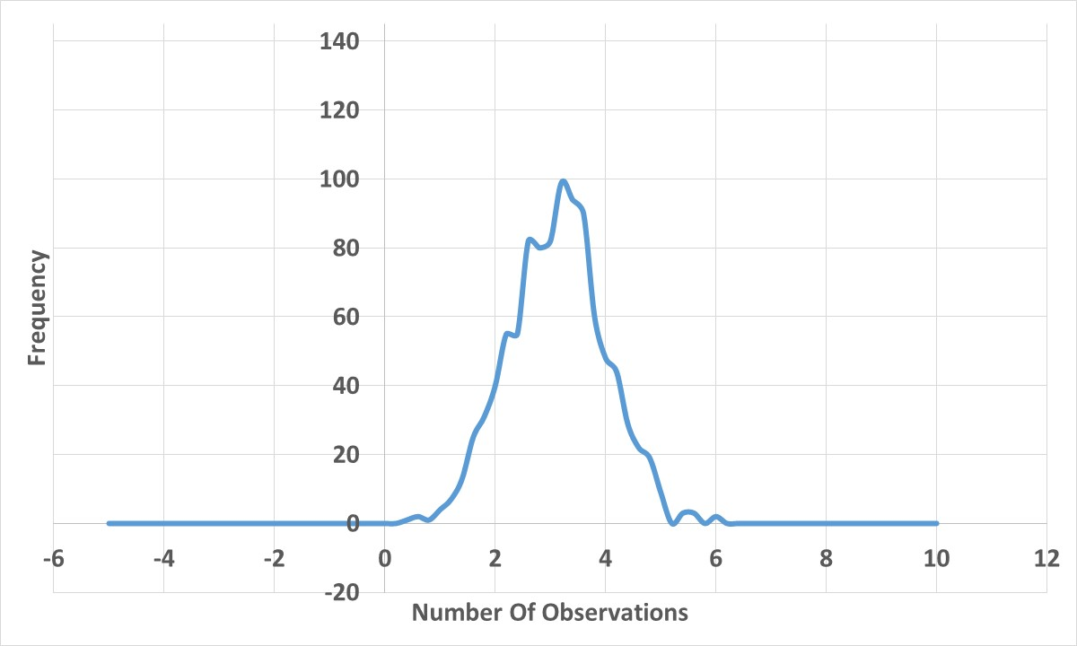
Average of
14
Observations

Slide 21
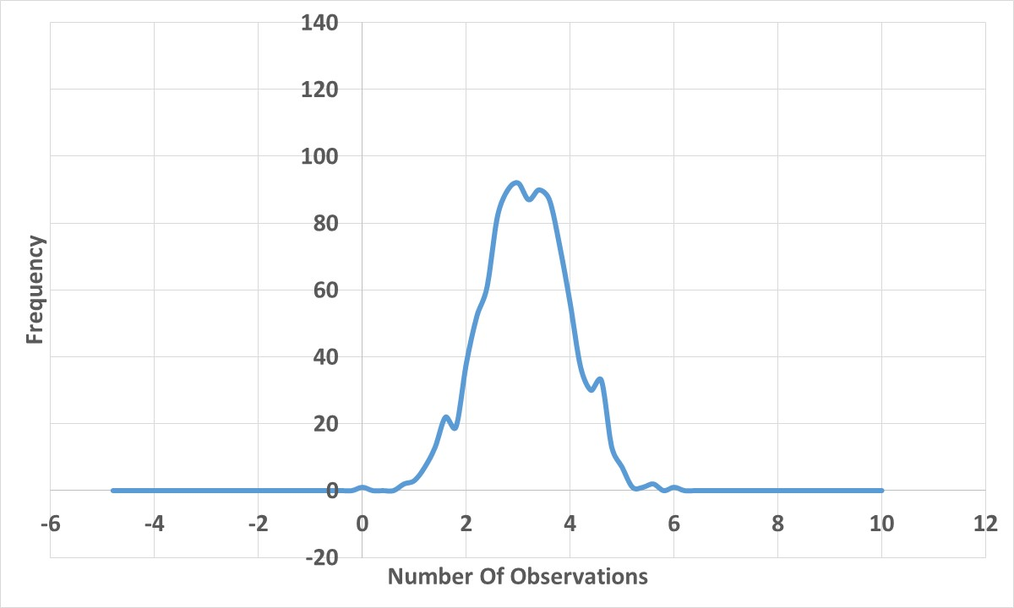
Average of
15
Observations

Slide 22
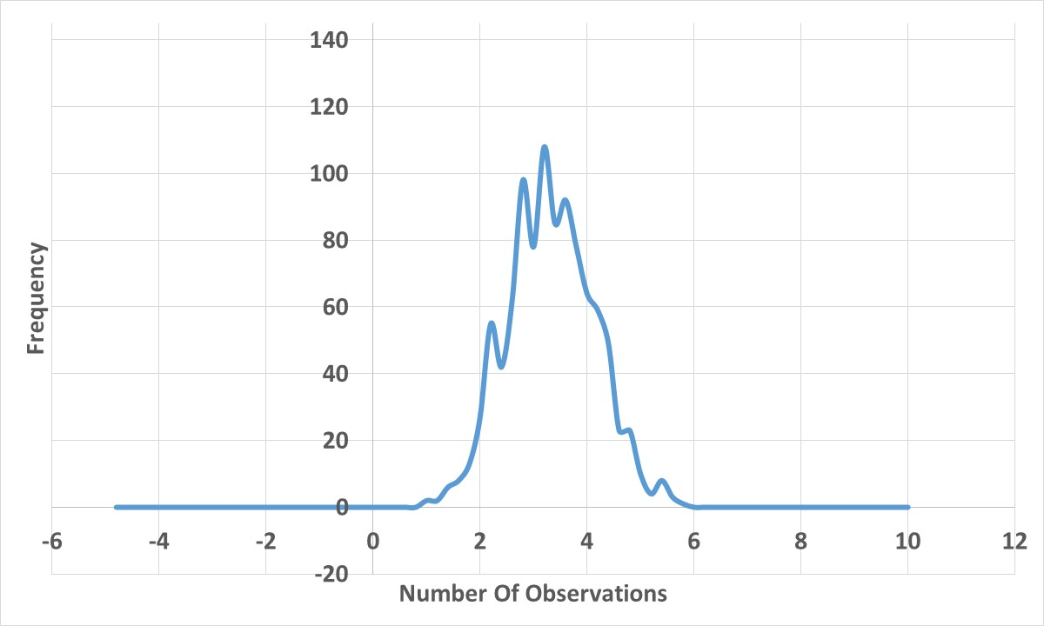
Average of
16
Observations

Slide 23
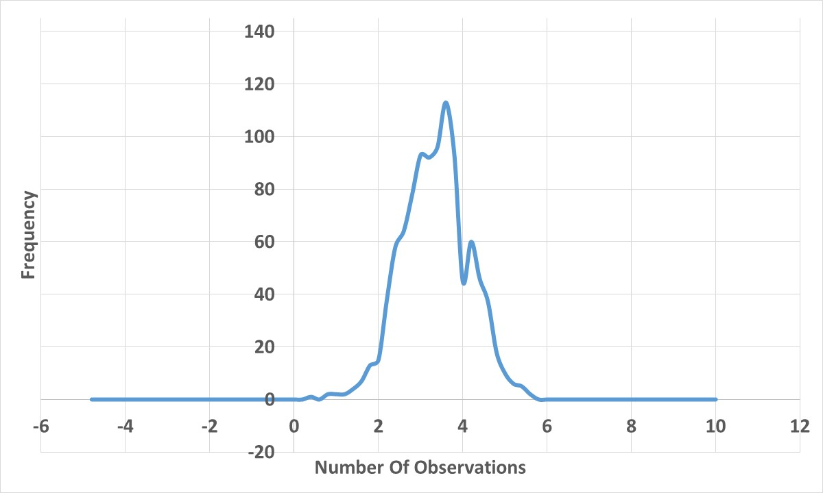
Average of
17
Observations

Slide 24
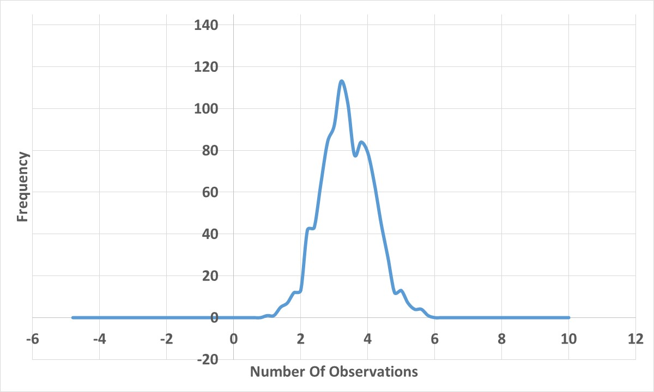
Average of
18
Observations

Slide 25
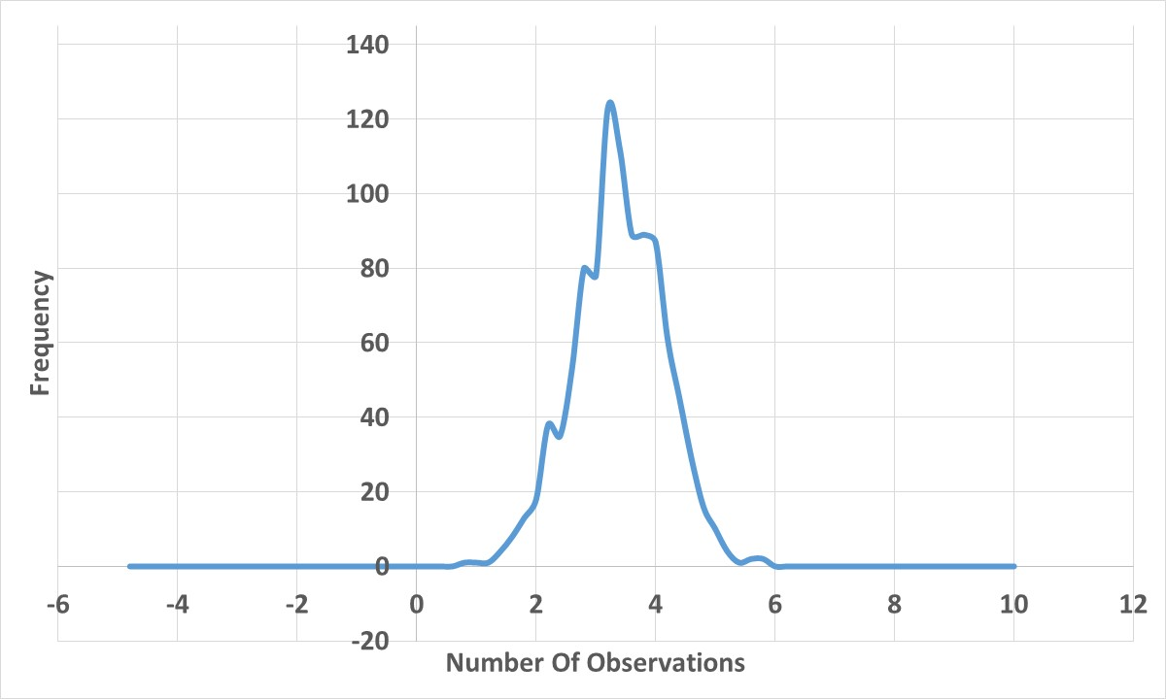
Average of
19
Observations

Slide 26
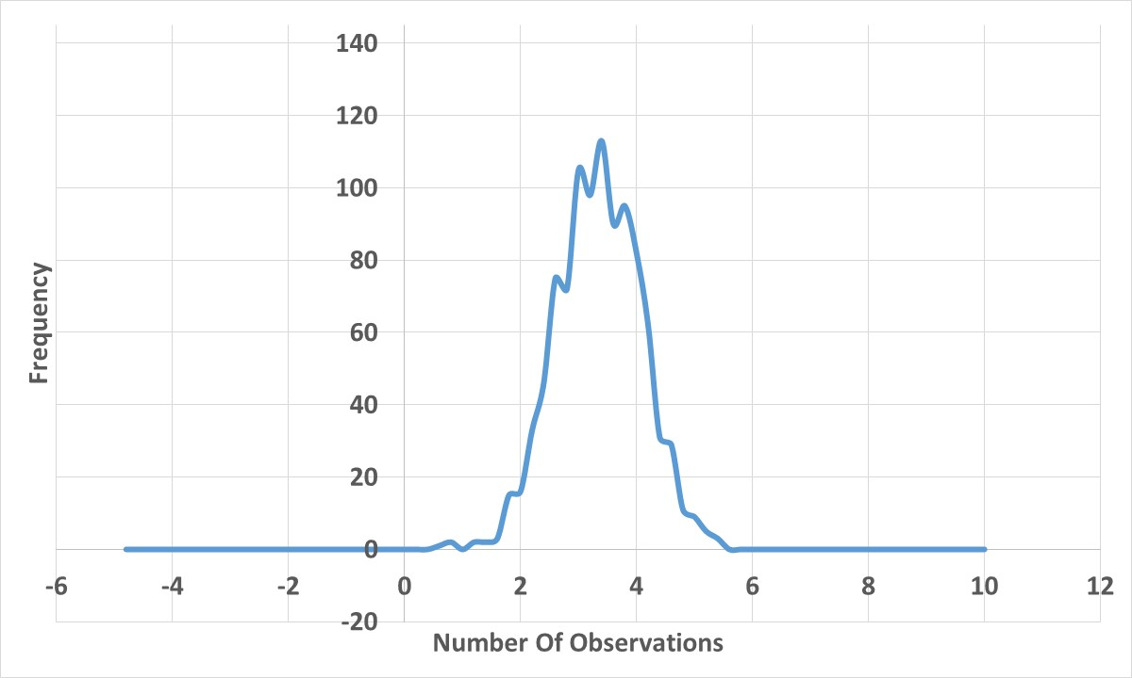
Average of
20
Observations

Slide 27
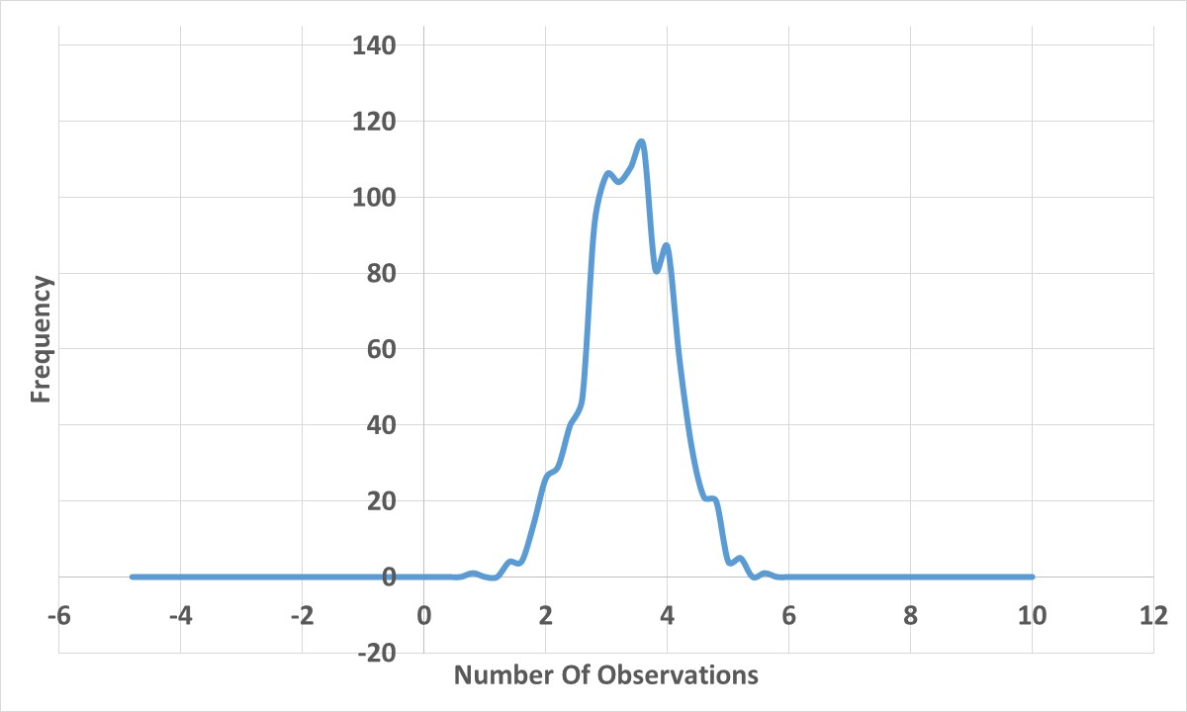
Average of
21
Observations

Slide 28
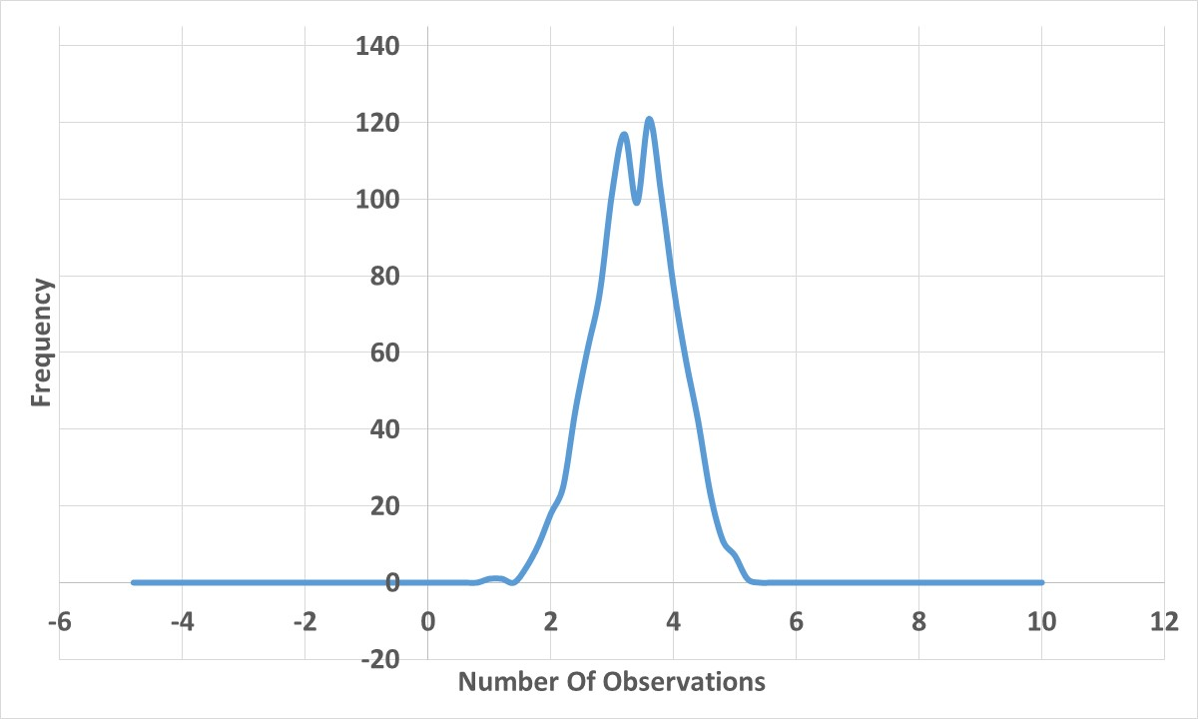
Average of
22
Observations

Slide 29
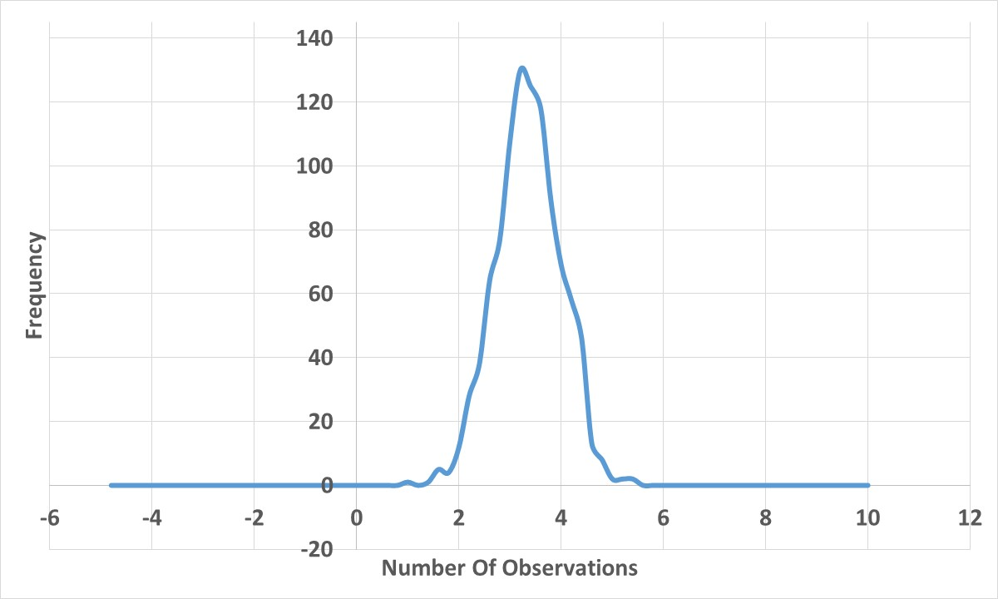
Average of
23
Observations

Slide 30
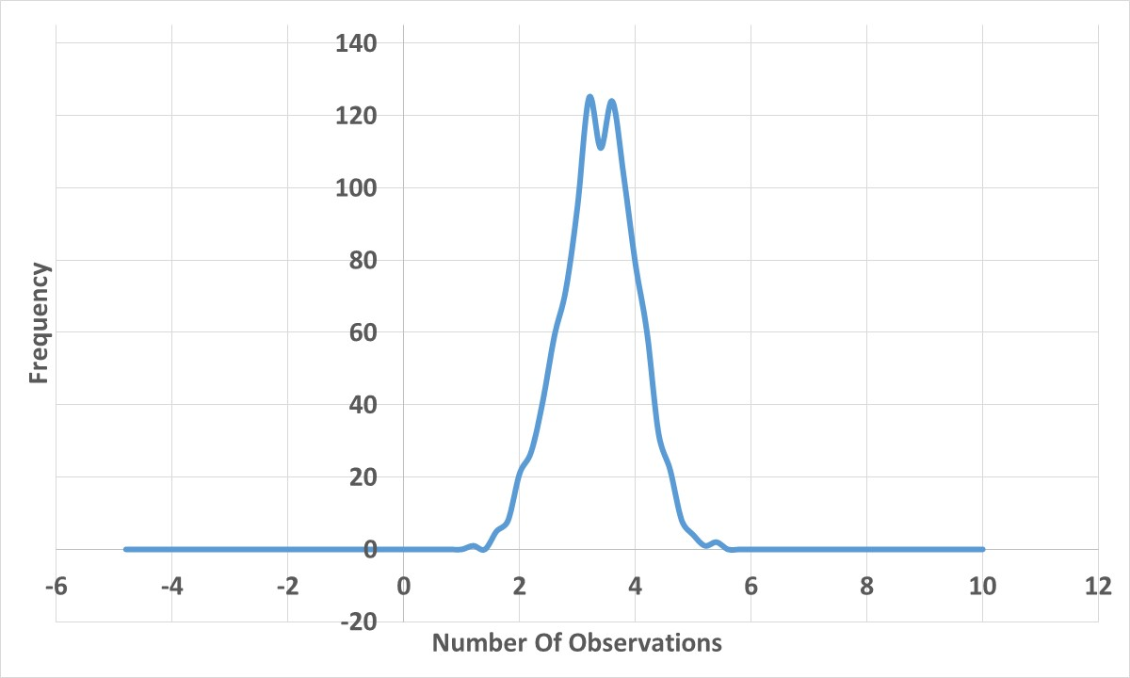
Average of
24
Observations

Slide 31
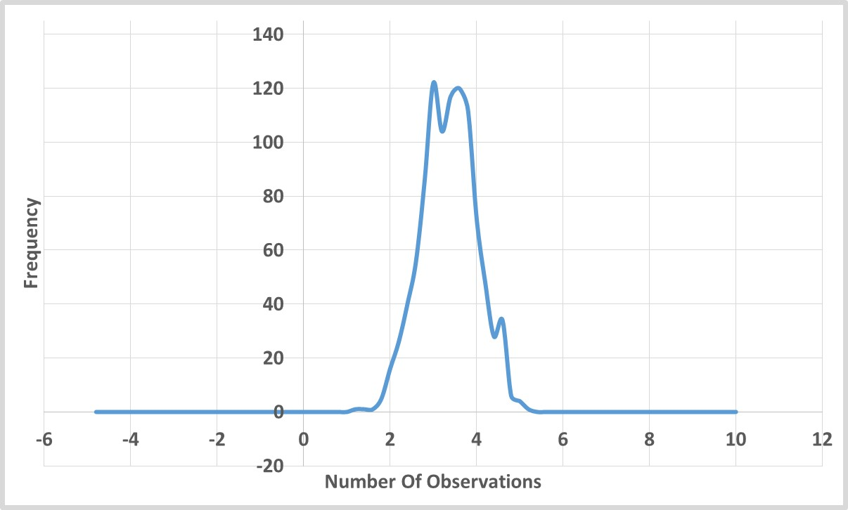
Average of
25
Observations

Slide 32
Average of
26
Observations
Notes:
Sampling refers to the process of examining a subset of cases to infer the rate in the entire population

Slide 33
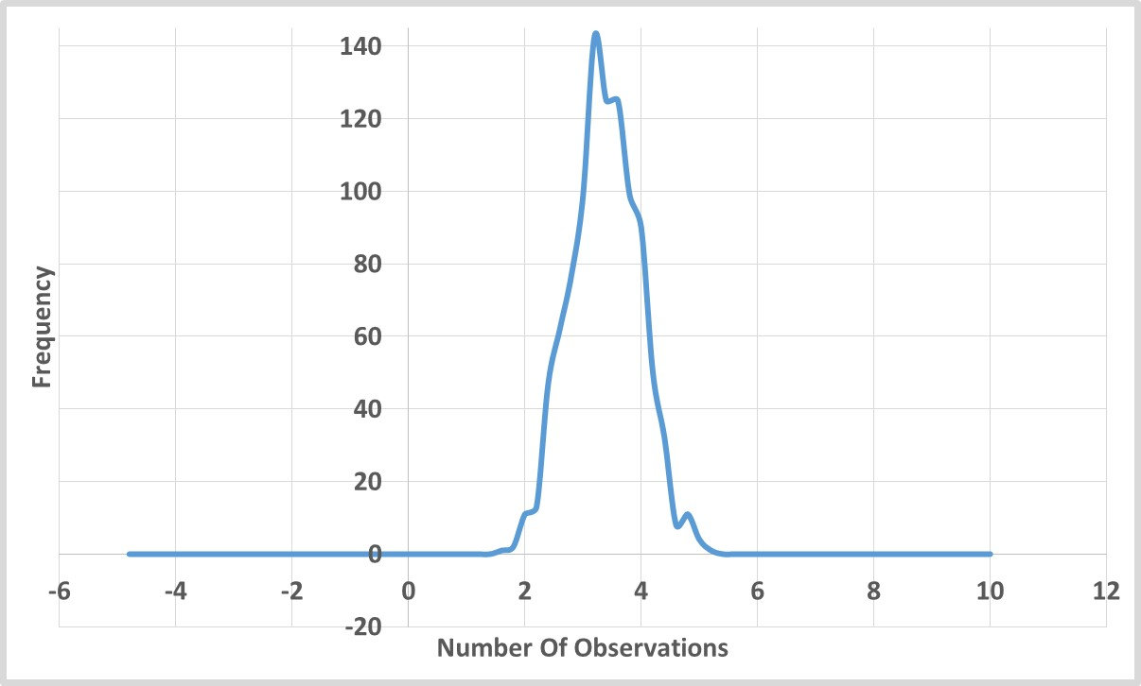
Average of
27
Observations

Slide 34
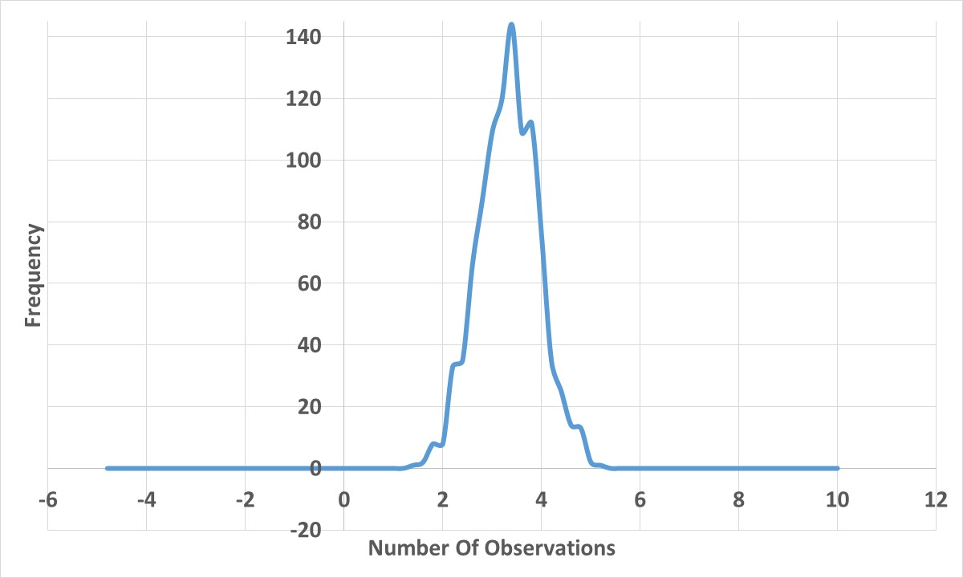
Average of
28
Observations

Slide 35
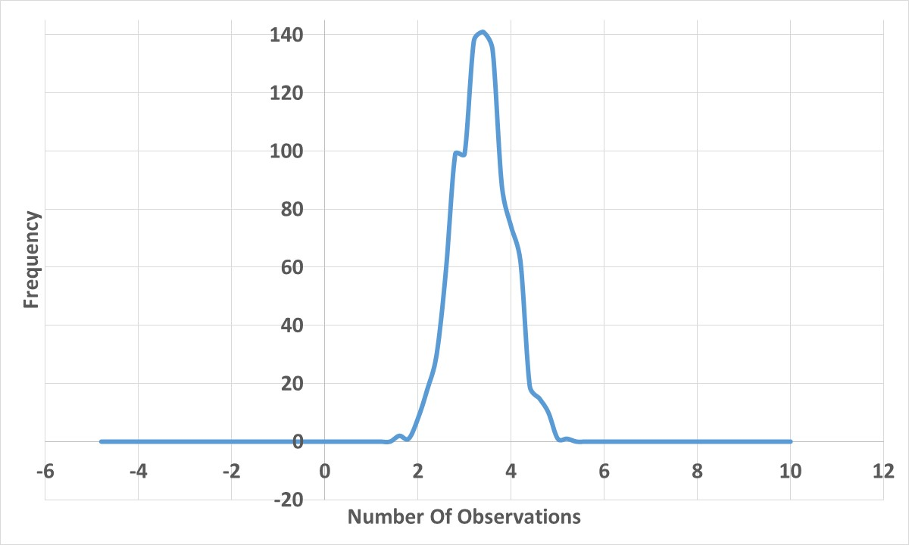
Average of
29
Observations

Slide 36
Average of
30
More Symmetrical and Near Normal
Observations

Slide 37
All Distributions End Up Normal

