Slide 1
Risk Assessment
HAP 725 (Teach one)
Instructed by: Farrokh Alemi
Presented by: Srideepthi Reddy Ramidi

Slide 2
Problem Statement
Question 2:
Calculate the likelihood ratio associated with each diagnosis in predicting above or below average length of stay.

Slide 3
DATA

Slide 4
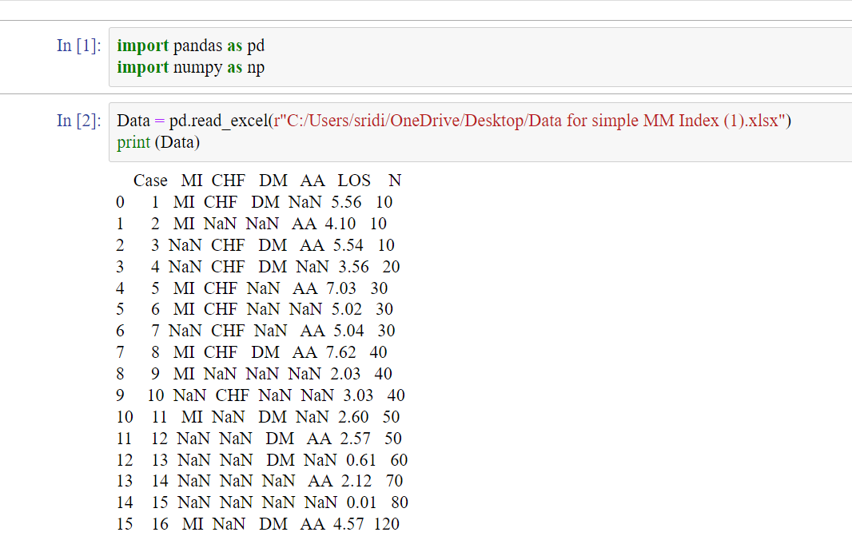
Step 1: Import & Load

Slide 5
Step:2 –Calculating the weighted average los

Slide 6
Step3: Binarizing the data

Slide 7
Step 4: Counting the combination of MI and LOS

Slide 8
Step 5- Calculate Likelihood Ratio

Slide 9
CHF

Slide 10
DM

Slide 11
AA

Slide 12
Likelihood Ratios

Slide 13
Conclusion
The patients who have MI are 3.47 more likely to stay longer at the hospital.
The patients who have CHF are 5.525 more likely to stay longer at the hospital.
The patients who have DM are 1.625 more likely to stay longer at the hospital.
The patients who have AA are 2.6 more likely to stay longer at the hospital.

Slide 14
Thank you

