Slide 1
Teach One Presentation Week 5-6: X-Bar and Risk Adjusted X-Bar Control Chart (Q#1)
Renu Karmacharya
HAP 725 Taught By: Dr. Farrokh Alemi

Slide 2
Question 1. In Health Administration Programs conducting satisfaction surveys are usually covered in courses on quality improvement. This exercise shows how data from satisfaction surveys can be analyzed over time. Assume that, in different time periods, 4 randomly selected patients rated their satisfaction with our services. Are we improving?

Slide 3
Step 1: Import Library & read Excel file
STEP 2: CREATE TWO DATAFRAMES

Slide 4
Step 3: CalculatE Average of each time period

Slide 5
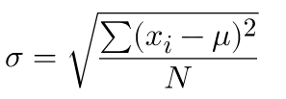
Step 4: CalculatE Standard Deviation of all values
STEP 5: CALCULATE STANDARD DEVIATION FOR EACH TIME PERIOD

Slide 6
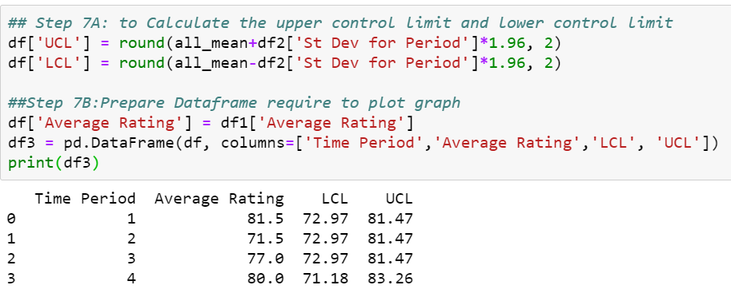
Step 6: Calculate average for all values
STEP 7: PREPARE DATAFRAME TO PLOT

Slide 7
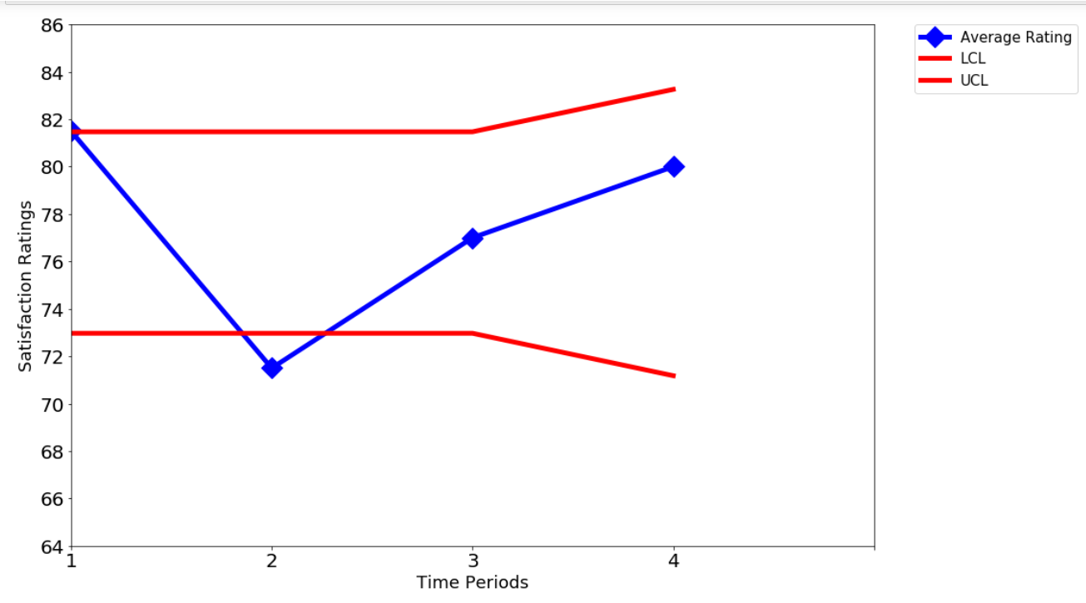
Step 8:

Slide 8
This Photo by Unknown Author is licensed under CC BY

