Slide 1


BENCH MARKING CLINICIANS
Sai Keerthi Kalluri
HAP 725
FALL 2021

Slide 2
QUESTION
What is the expected outcome if Dr. Smith sees patients of Dr. Jones?
Note that Dr. Smith does not see any patient like patient 4 of Dr. Jones.
We need to estimate a synthetic control for this patient.

Slide 3
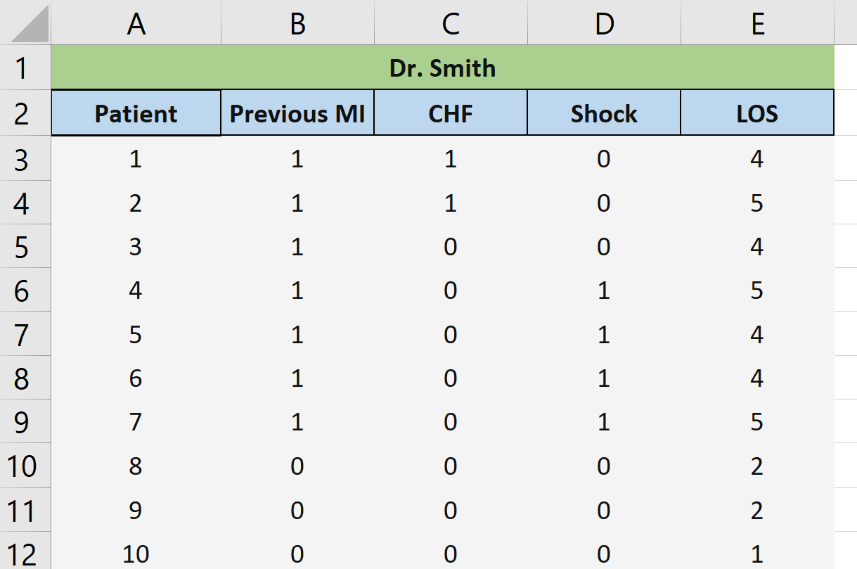
DATA

Slide 4
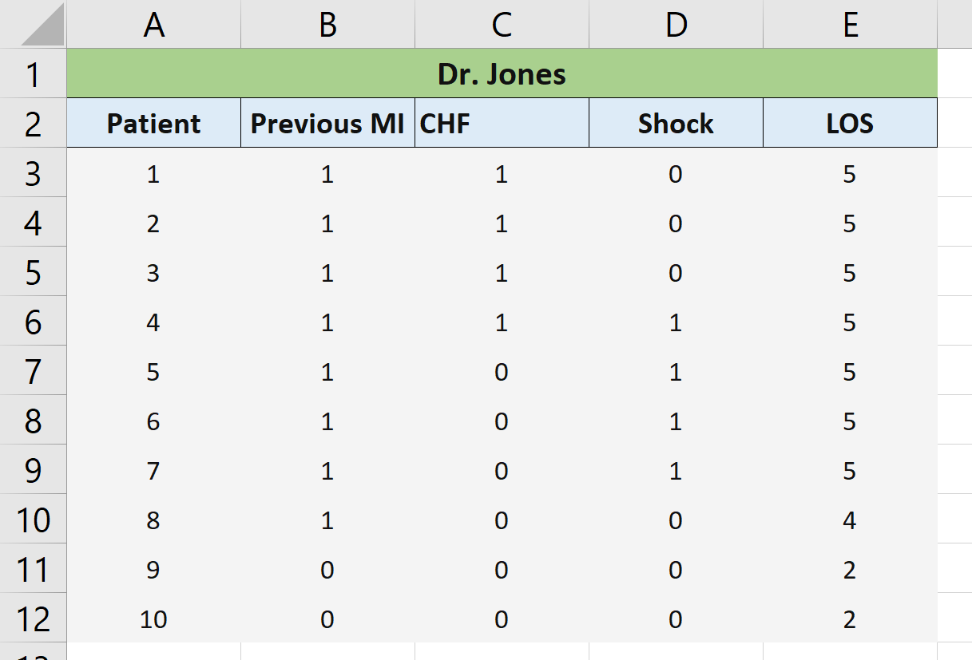
DATA

Slide 5
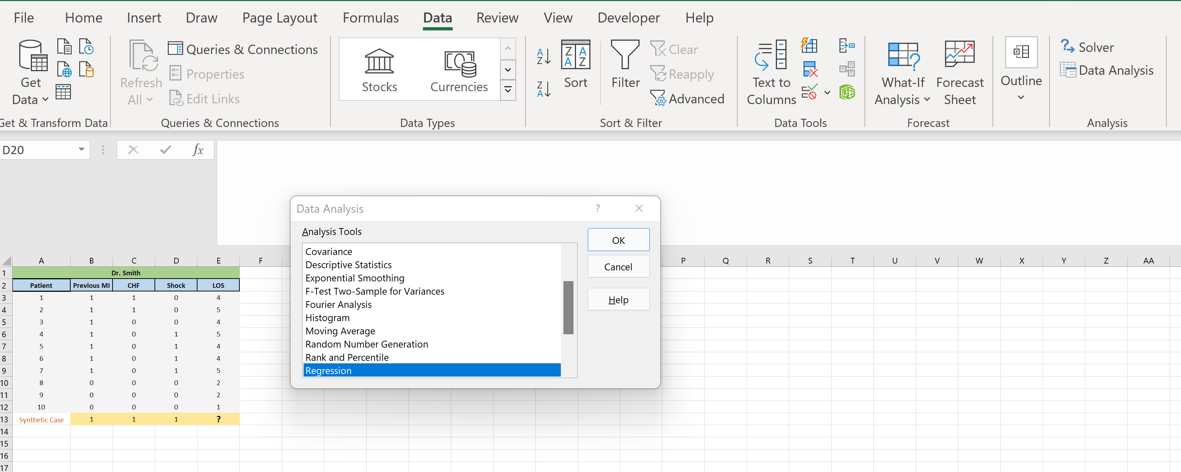
REGRESSION MODEL

Slide 6
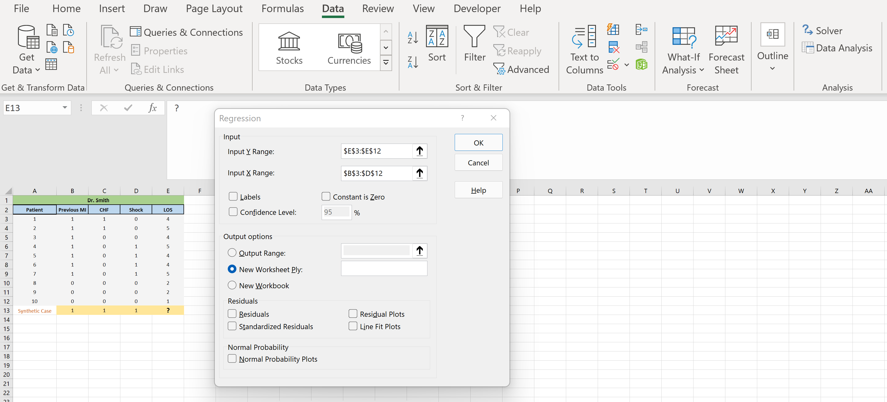


Slide 7
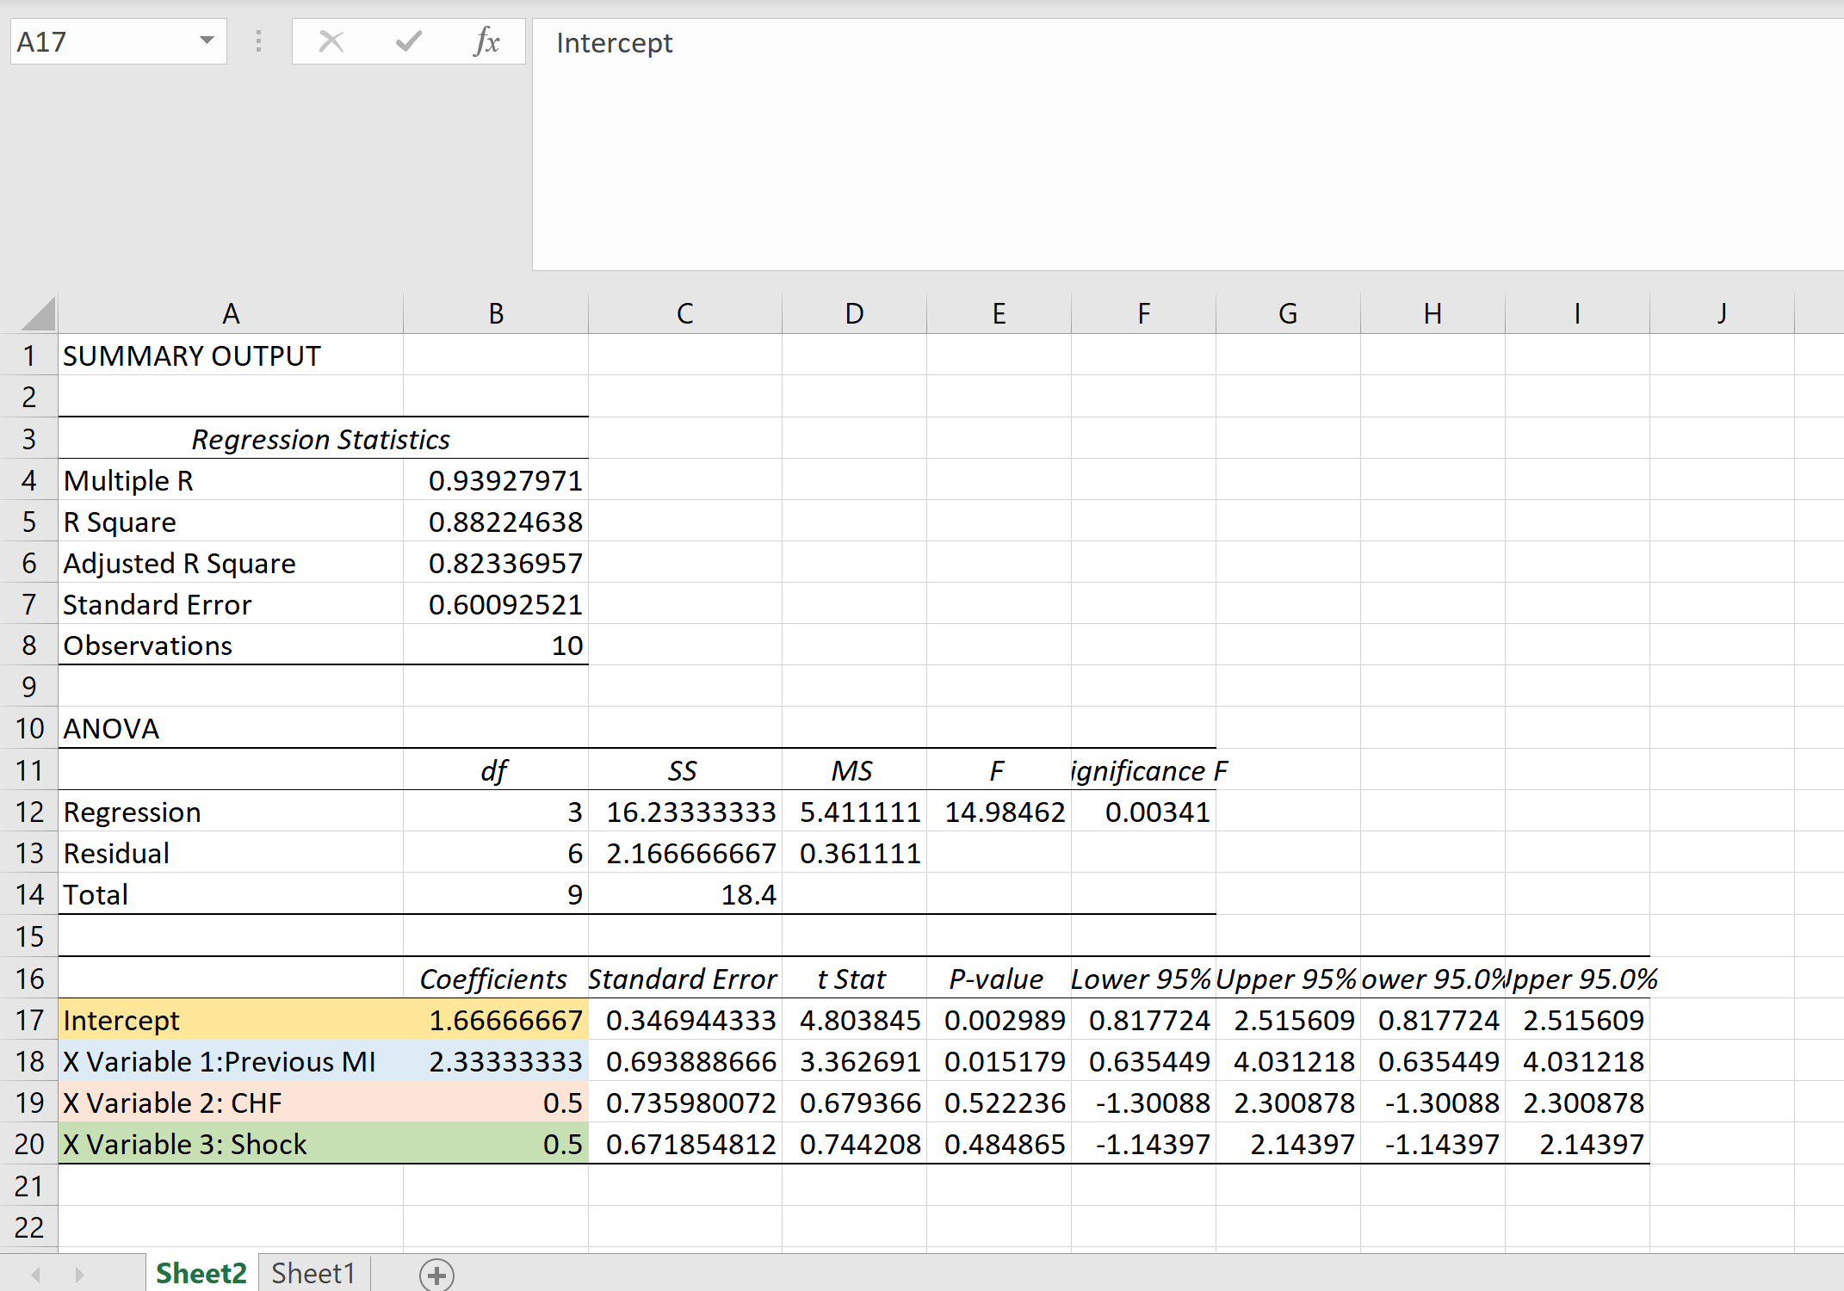
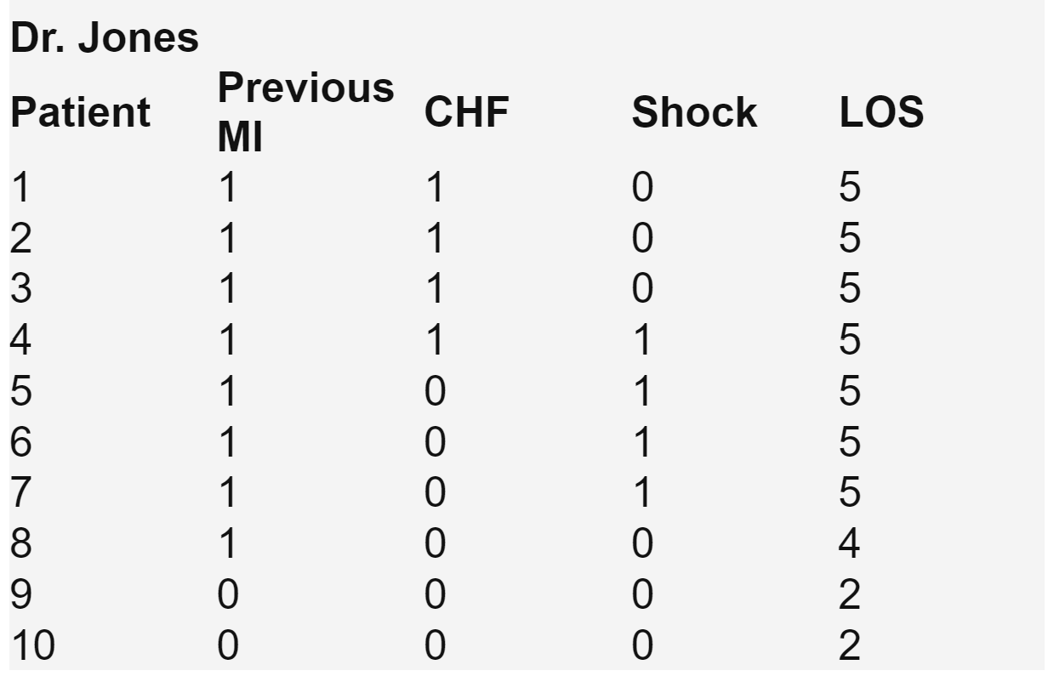
Synthetic Case

Slide 8
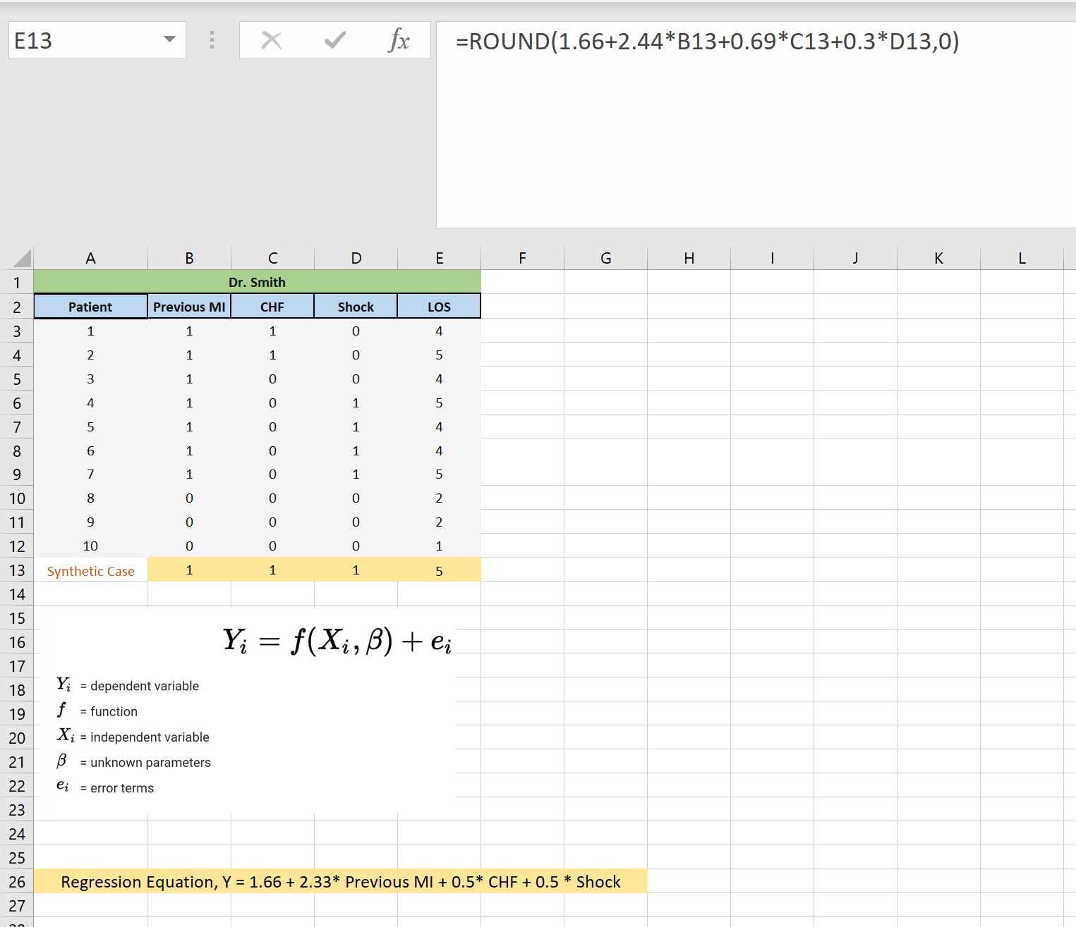
CALCULATE LOS FOR SYNTHETIC CONTROL

Slide 9


