Slide 1
Multivariate Analysis Project
Marla Surette

Slide 2
Overview
Remove cases where:
Patients died before visits
Diagnoses have no age or a negative age
One person has more than 365 diagnoses in a year
Create Training and Validation Sets
Complete likelihood ratio for training set diagnoses and list of diagnoses
Use training set to calculate likelihood ratio:
Where each diagnosis that repeats at least 29 times
Associated with each category of diagnosis
Associated with 2nd and 3rd Occurrences of the same person that repeats at least 29 times
Use validation set to calculate posterior odds of mortality
Calculate sensitivity and Specificity

Slide 3
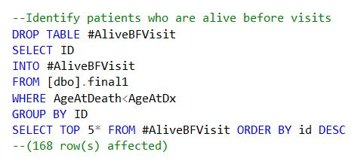
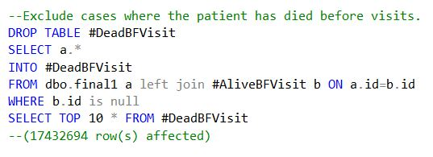
Removing Cases: Patients Dead Before Visits
Step 2: Exclude cases found in step one by left joining Final Table with #AliveBFVisit
Step 1: Identify patients who are alive before visits by using
‘WHERE AgeAtDeath<AgeAtDx’

Slide 4
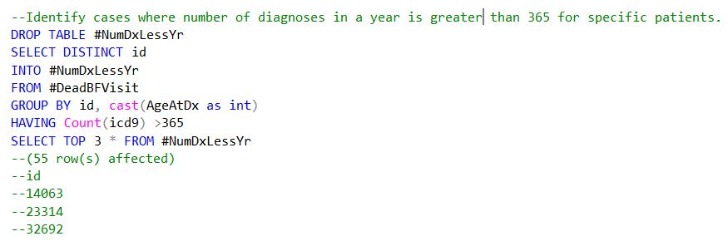
Removing Cases:
One person has more than 365 diagnoses in a year
Step 1: Find cases where # of Dx is greater than 365 per one year
Change AgeAtDx into an integer by using ‘cast’ command
Find cases with greater than 365 by using ‘Count’ command with icd9
Step 2: Exclude cases where diagnoses is over 365 per one year
Left join #DeadBFVisit & #NumDxLessYr
ALSO add ‘AgeAtDx >0’ to remove patients where there is no AgeAtDx

Slide 5
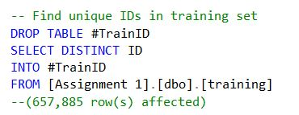
Creating Training & Validation Sets
Step 1: Create training set by collecting 80% randomly from #Data3, by using the ‘rand’ command
Step 2: Select unique IDs from the training set by using ‘SELECT DISTINCT’
Step 3: Create validation set with remaining 20% of data found in #Data3 by left joining #Data3 and #TrainID, so that the validation table does not include the same IDs found in the training set.

Slide 6
Calculating Likelihood Ratios
Basic Steps of Calculating Likelihood Ratios:
Calculate number of patients dead and alive within table being used
Select patients who died six months after diagnosis
Select patients who did not die within six months after diagnosis
Calculate the likelihood ratio by utilizing this equation:
Patients who died within six months after diagnosis
Dead Patients
Patients who lived six months after diagnosis
Alive Patients
Likelihood Ratio =

Slide 7
Finding Cases that Occurred More than 29 Times and Excluding Those that Did Not
Step One: Determine cases in which Dx occurs at least 29 times
Use ‘Count’ command with AgeAtDx
Step Two: Exclude cases in which Dx occurs less than 29 times
Use ‘inner join’ command with Training set and #DxOver29

Slide 8
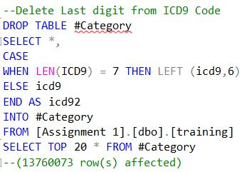
Finding Categories
When the length of ICD9 is seven characters
2. Shorten ICD9 to six characters long
3. If length is less than 7 characters long, then keep ICD9 the same
4. Create new column called ICD92 which includes both changed and unchanged ICD9s

Slide 9
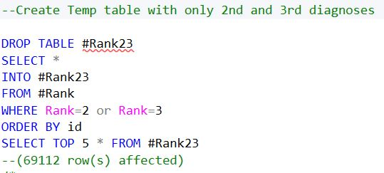
Finding Second & Third Occurrences
Step 1: Use ‘Rank’ command to create a column that indicates number of occurrence
e.g. 1st occurrence Rank = 1
Step 2: Create a table that only shows Ranks of 2 and 3, indicating 2nd and 3rd Occurrences.

Slide 10
Finding 2nd & 3rd Occurrences that Have Repeated over 29 times
Step One: Count the number of times each ICD9 occurs in the table
Step Two: Find ICD9 codes that have a count of at least 29
Step Three: Create a table that only has the information of those with ICD9s found in #Occur29

Slide 11
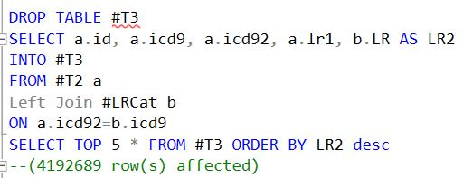
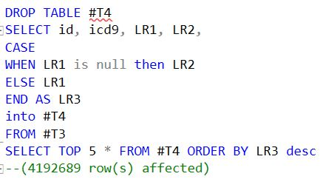
Calculating Posterior Odds of Mortality

Slide 12
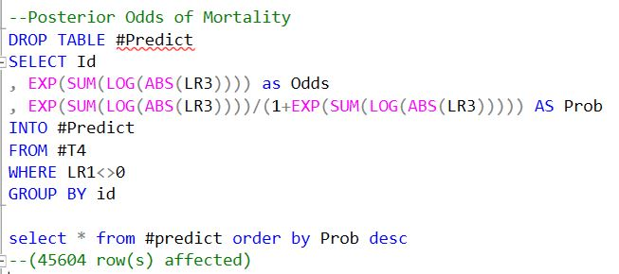
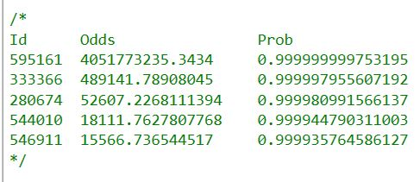
Calculating Posterior Odds of Mortality
Results:

