Slide 1
HAP 725 – STATISTICAL PROCESS CONTROL
WEEK 9& 10 Question 6
TIME TO ADVERSE EVENTS
By Shreya Reddy

Slide 2
QUESTION
In the past 3 years, there have been the following incidences of privacy violations: A disgruntled employees sold information on May 11 of year 1. Another disgruntled x-employee sold password to the system on Dec 12 of year 3. There have been four incidences of clinician discussing patient information in social gathering on the following dates: December 5 year 2, January 25 Year 3, May 27 year 3, and September 1 year 3. Days of incidences of any other types of privacy violations were May 11 year 1, Nov 22 year 2, Dec 27 year 3. Which types of privacy violations are more frequent? Use Excel formulas to calculate the average days to event and daily probability of the event.

Slide 4
IMPORT DATA INTO EXCEL :

Slide 5
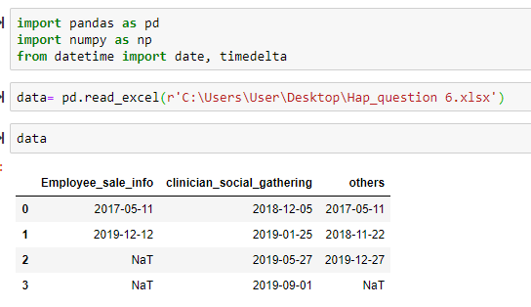
READ DATA INTO PYTHON

Slide 6
CALCULATE AVERAGE DAYS TO EVENT FOR EMPLOYEE SALE OF INFORMATION

Slide 7
CALCULATE AVERAGE DAYS TO EVENT FOR CLINICIAN DISCUSSION IN SOCIAL GATHERING

Slide 8
CALCULATE AVERAGE DAYS TO EVENT FOR OTHER PRIVACY ISSUES

Slide 9
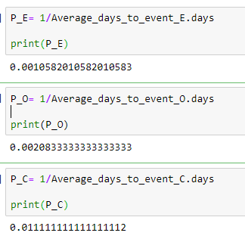
CALCULATING PROBABILITIES FOR PRIVACY ISSUES

Slide 10
THANK YOU

