Slide 1
STATISTICAL PROCESS CONTROL
HAP 725- WEEK 11 & 12 : BENCHMARKING CLINICIANS

Slide 2
QUESTION
The following table shows the observed and expected length of stay for 30 patients. Use paired comparison of means to test that the expected and observed length of stay are the same. Assuming normal distribution of the length of stay, use risk-adjusted control chart to plot the data. Make sure that control limits are derived from the expected values and observations are contrasted to these limits. This analysis can be done using Tukey or XmR and you need to select which chart produces tighter control limits. The conclusions you arrive at based on (a) paired comparison of expected and observed length of stay and (b) the risk-adjusted control charts should be the same if in both situations we were calculating the control limits from the same number of cases. Are they?

Slide 3
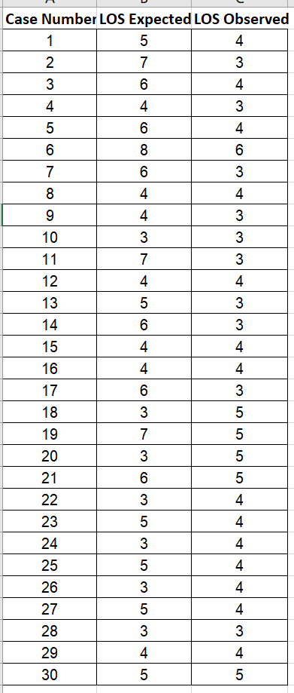
MAKE CHANGES IN EXCEL

Slide 4
READ DATA FROM EXCEL TO PYTHON

Slide 5
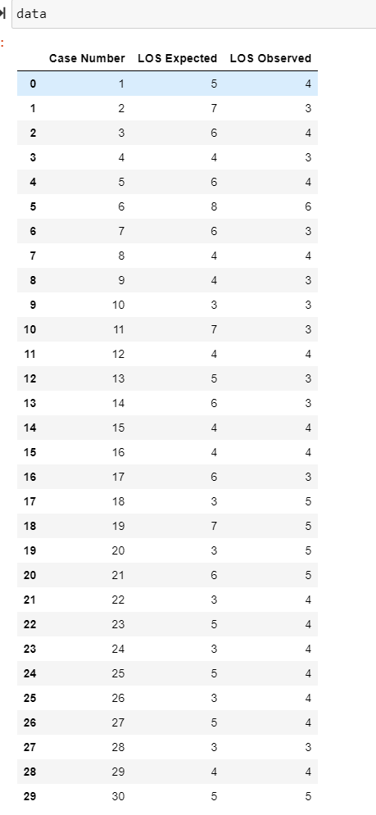
DATA LOADED FROM EXCEL TO PYTHON

Slide 6
CONVERT DATA TO NUMERIC

Slide 7
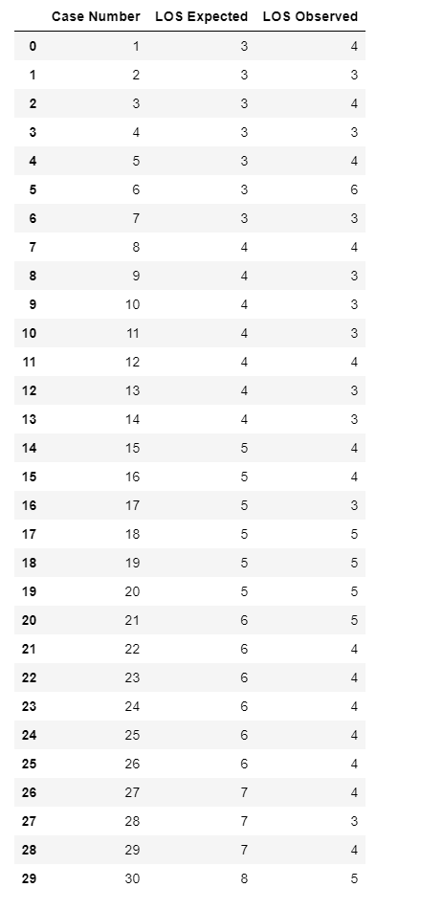
SORT EXPECTED LOS VALUES
OUTPUT

Slide 8
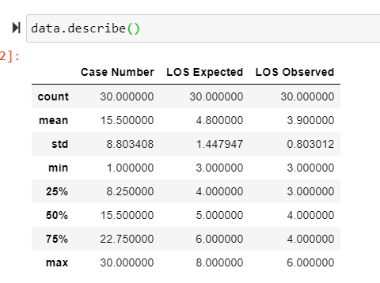
FIND THE LOWER FOURTH AND UPPER FOURTH VALUES

Slide 9
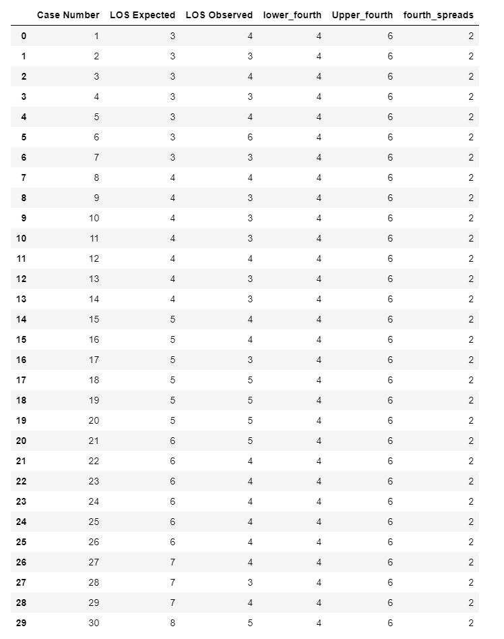
CALCULATE FOURTH SPREAD VALUE
OUTPUT:

Slide 10
CALCULATE UCL AND LCL VALUES
OUTPUT

Slide 11
PLOT THE DATA

Slide 12
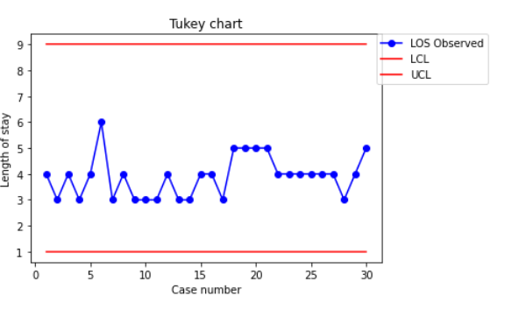
TUKEY CHART

