Slide 1
TEACH ONE
WEEK 4 TUKEY CONTROL CHARTS (Q4)
Hannah Ji Won Yoo
HAP 725-001 FALL 2020
DR. FARROKH ALEMI
DR. MARIA URIYO
GEORGE MASON UNIVERSITY

Slide 2
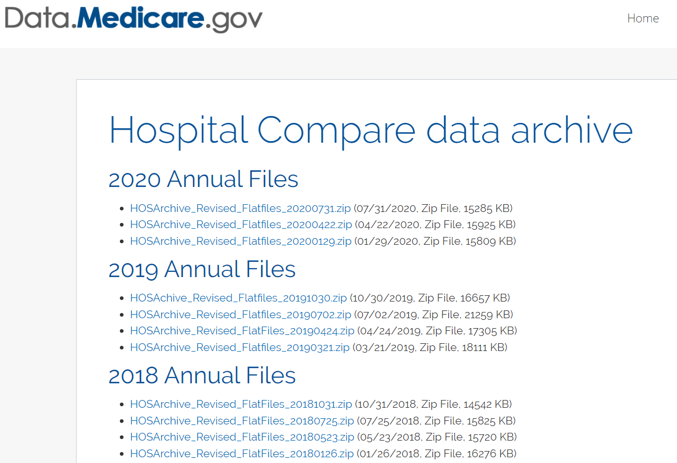
Question 4: Analyze "Death rate for CABG surgery patients." Measure code = MORT_30_CABG Choose George Washington University Hospital VS. Medstar Washington, VHC, and INOVA Fairfax. Find measure inside "Complications and Deaths - Hospital" file. Compare the performance of the hospital to the competing hospitals. Draw the observed rate at GWU. The control limits should come from the experiences of its competitors, which is a weighted average of each of the competitor.
https://data.medicare.gov/data/archives/hospital-compare

Slide 3
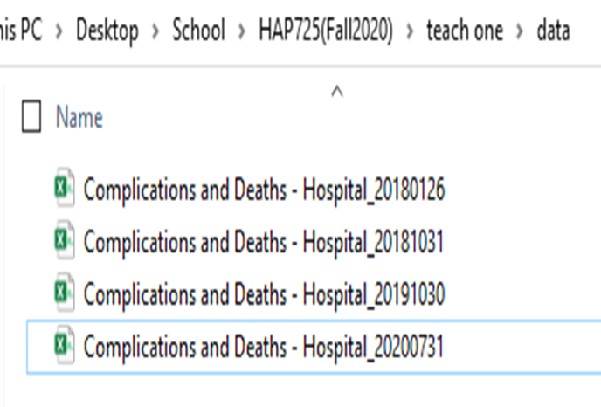
STEP 1: SETUP

Slide 4
STEP 1: SETUP (cont.)
Check if data loading is properly done. (ex. 2019 dataset)

Slide 5
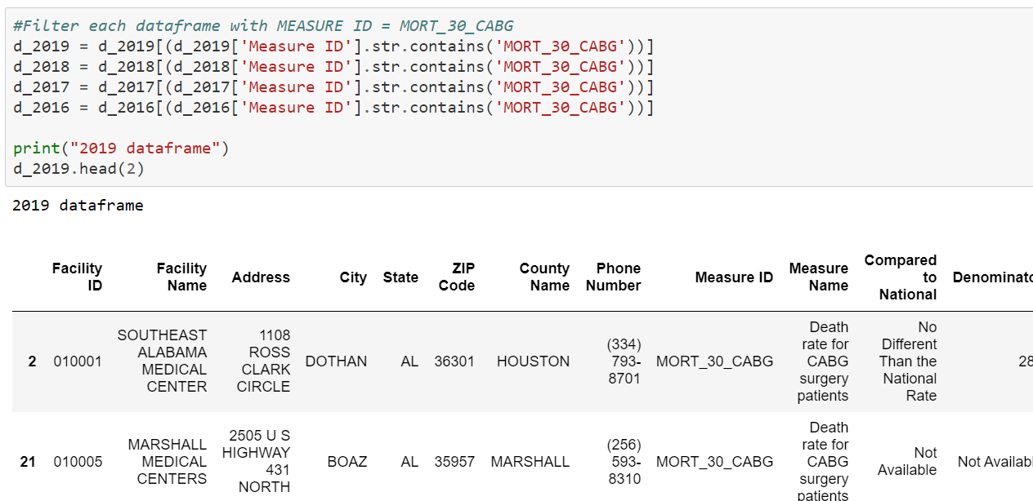
STEP 2: FILTER DATASETS

Slide 6
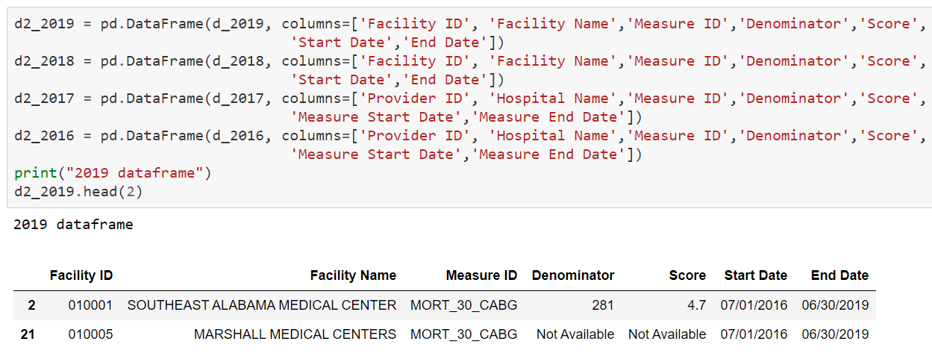
STEP 2: FILTER DATASETS (cont.)
Caution: Few column names for four periods are not consistent. Ex. ‘Facility ID’ in d2_2019, ‘Provider ID’ in d2_2017

Slide 7
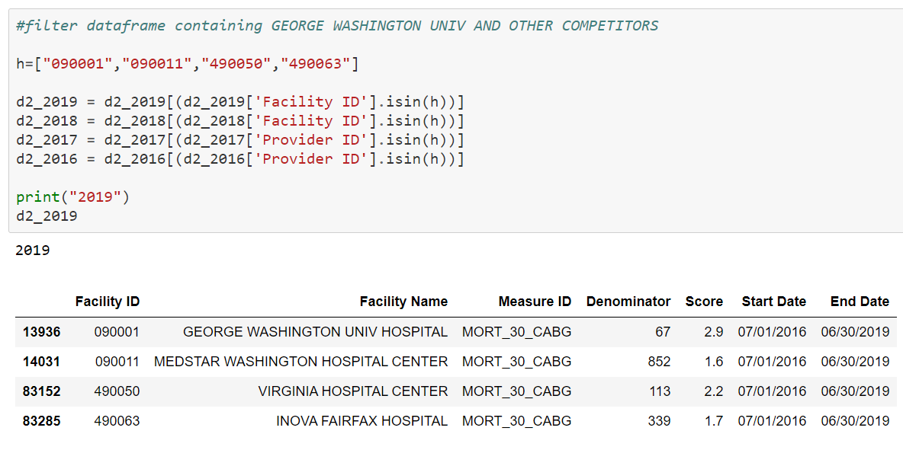
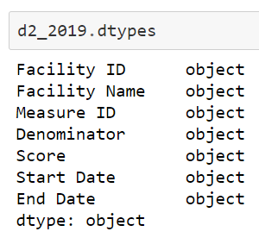
STEP 2: FILTER DATASETS (cont.)

Slide 8
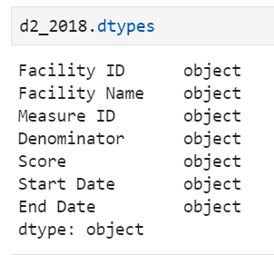
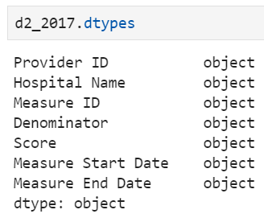
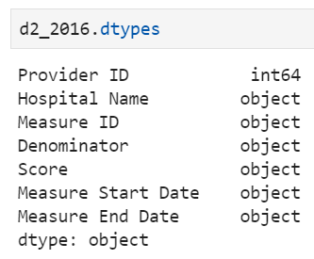
STEP 3: VIEW FILTERED DATASETS AND CHECK DATA TYPES

Slide 9
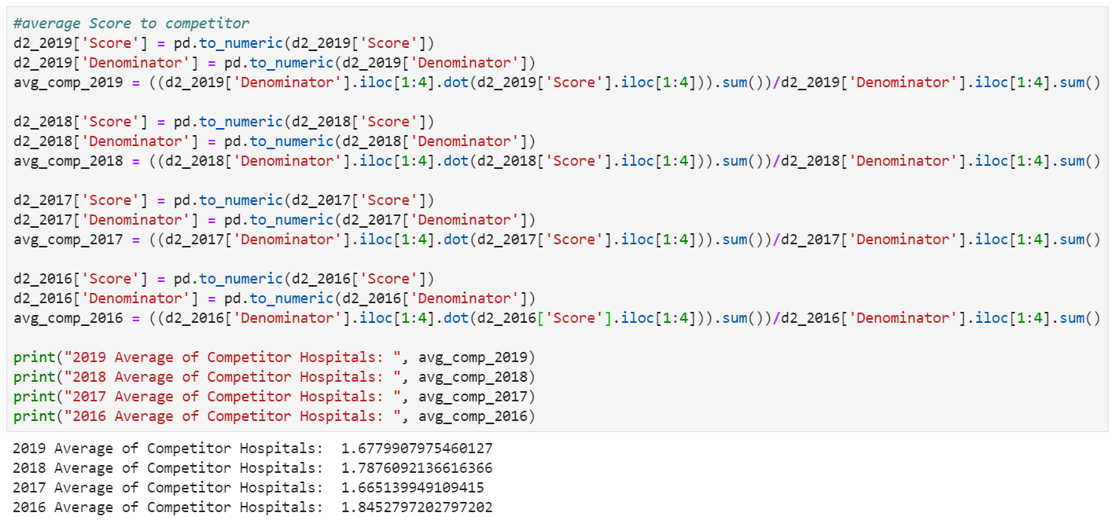
STEP 4: CALCULATE AVERAGE OF COMPETITORS

Slide 10
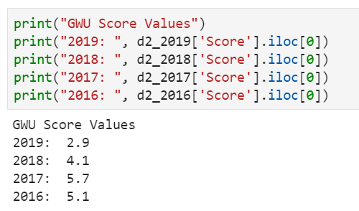
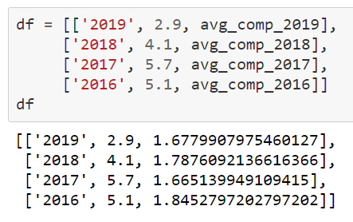
STEP 5: CREATE A TABLE CONTAINS GWU VS. COMPETITORS

Slide 11
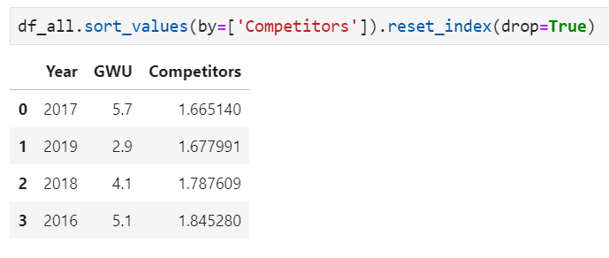
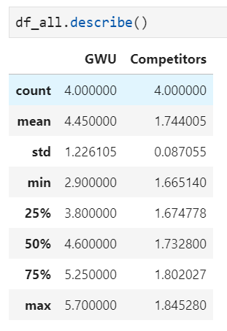
STEP 6: FIND LOWER & UPPER 4th VALUES OF COMPETITORS
SORT [Competitors] FROM LOWEST TO HIGHEST

Slide 12
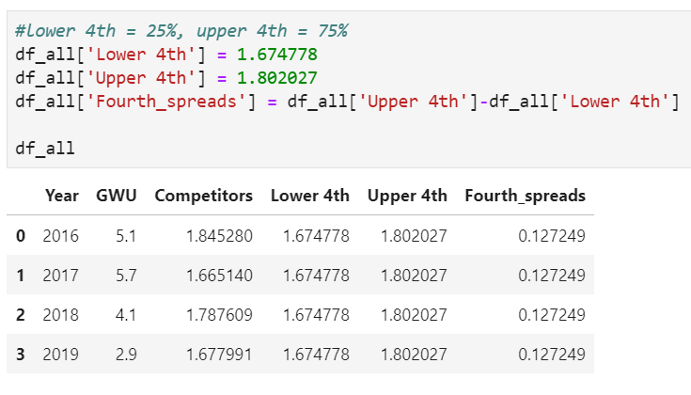
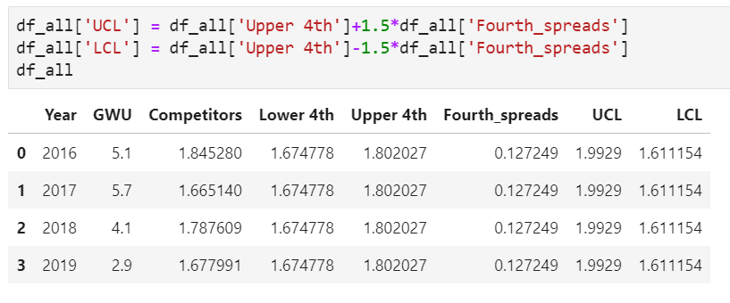
STEP 7: CALCULATE FOURTH SPREADS, UCL, LCL
Fourth Spreads:
UCL & LCL:

Slide 13
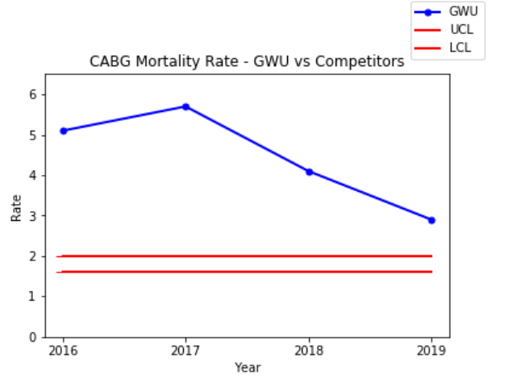
STEP 8: PLOT TUKEY CONTROL CHART
INTERPRETATION:
Since 2016, GWU CABG mortality rate is above the UCL.
The CABG Mortality rate of GWU was the highest in 2017.
Overall, the death rate for CABG surgery patients in GWU is worst than other three competitor hospitals.

