Slide 1
HAP 725 – Statistical Process Control
Week 9 & 10 Tukey and Time between charts
Question 1 from second link
By
Shreya Reddy

Slide 2
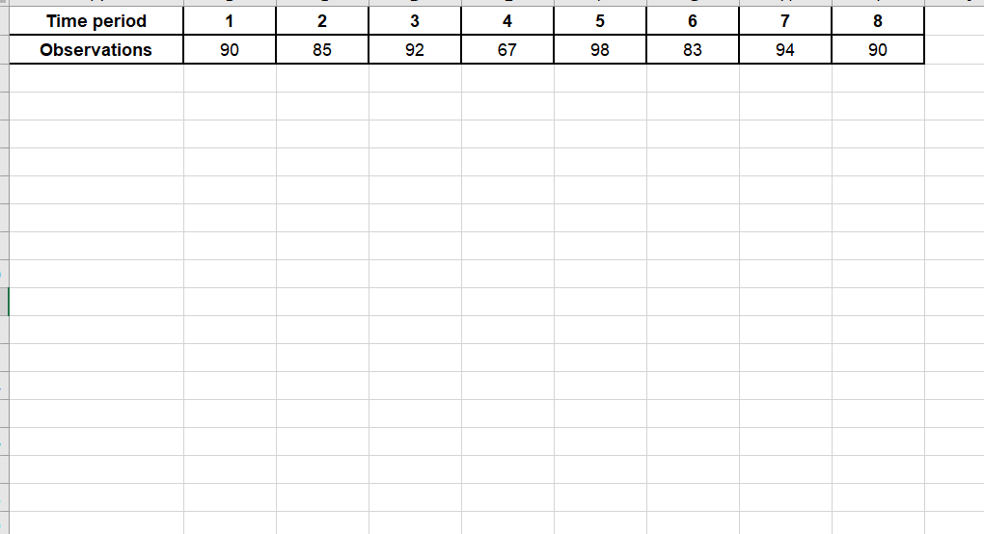
QUESTION:
In health administration programs, data on waiting time are examined in courses on quality and operations research. Using the attached data, determine if the waiting time in our urgent care center has changed?

Slide 3
Read the Data from Excel

Slide 4
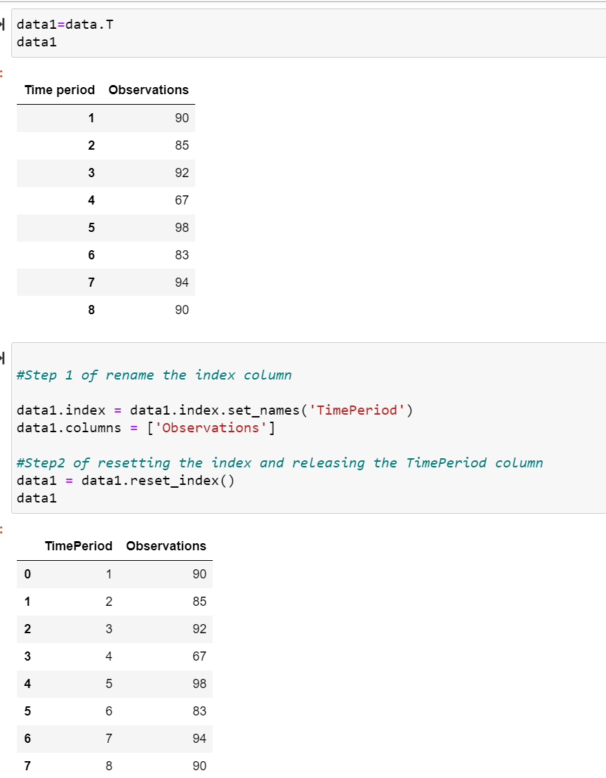
Convert rows in Excel to columns in Python
Note: There are many ways to do this conversion, I chose the following way to make it easier.

Slide 5
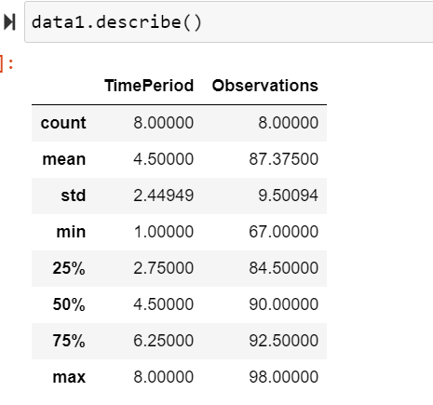
Finding the Quartiles

Slide 6
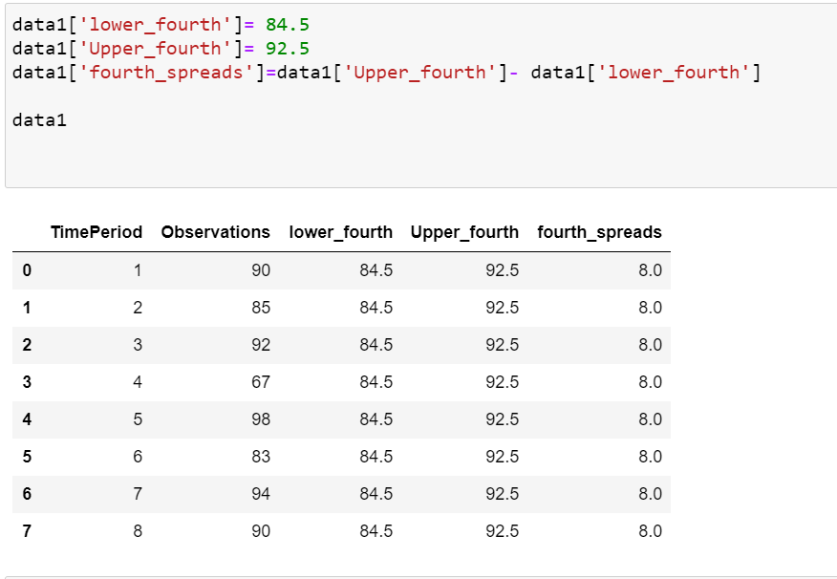
Calculate Upper and Lower fourth values and finally fourth spread value
Lower_fourth = 25% of data
Upper_fourth= 75% of data
Note: Upper Fourth = 75% of Observations
Lower fourth= 25% of Observations
Fourth spread= Upper fourth – Lower fourth

Slide 7
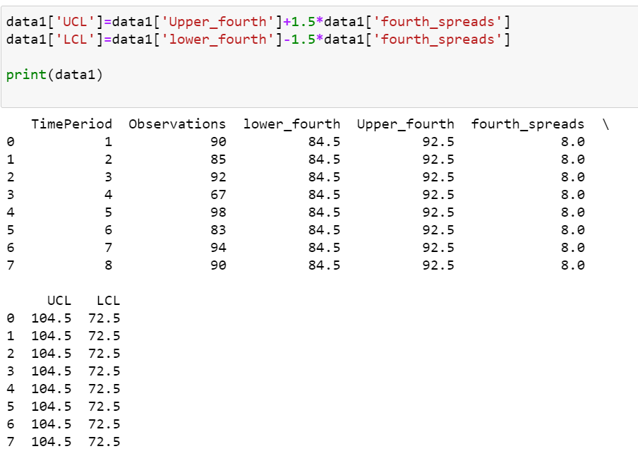
Using the formula find out the upper and lower control limits

Slide 8
Finally plot the data as shown

Slide 9
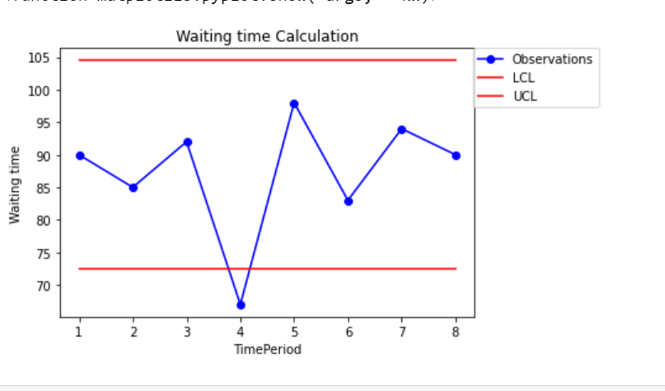

Slide 10
Thank you
Email Id: Sthotire@gmu.edu

