Slide 1

Statistical Process Control
HAP 725
Analysis of Watch Data

Slide 2
Question
Watch data include both heart rates and exercise level. Unfortunately, heart data is not always accurate as exercise levels affect heart rate measures and interfere with the ability of the watch to alert for unusual watch rates. Use a risk adjusted control chart to analyze heart rate. Compare observed heart rate to heart rate expected from exercise.

Slide 3

Data
Use Sample Apple Watch Data Excel 1
Select November 2021 data from the Heart Rate and HKQuantityTypeIdentifierBasalEn Sheet
Import Files into python

Slide 4
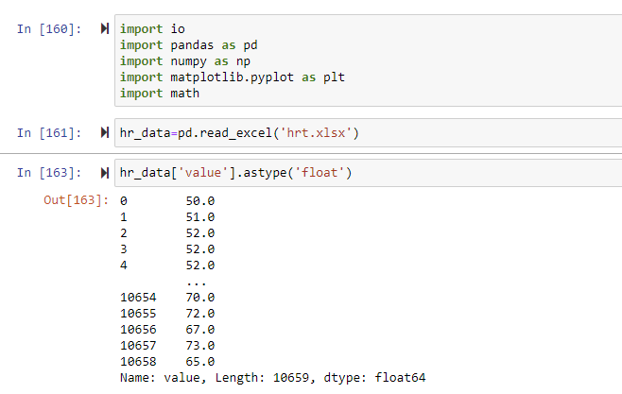
Risk Adjusted control chart
Import libraries and heart rate data
Insure heart rates as float.

Slide 5
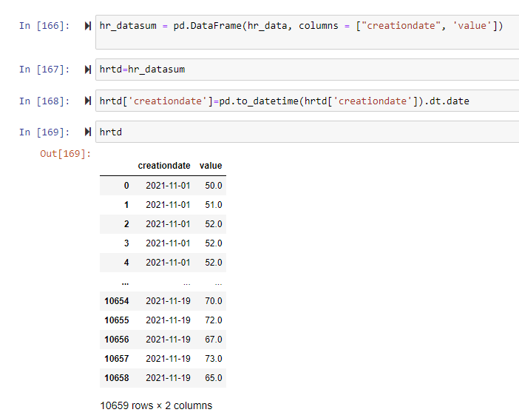
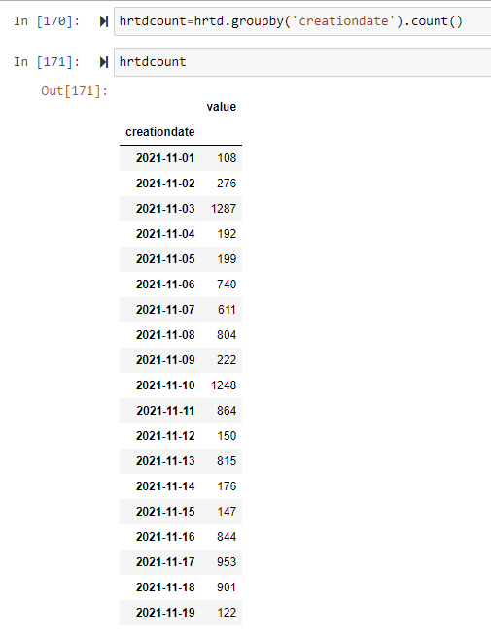
Creationdate column without time
COUNT RECORDS PER DATE

Slide 6
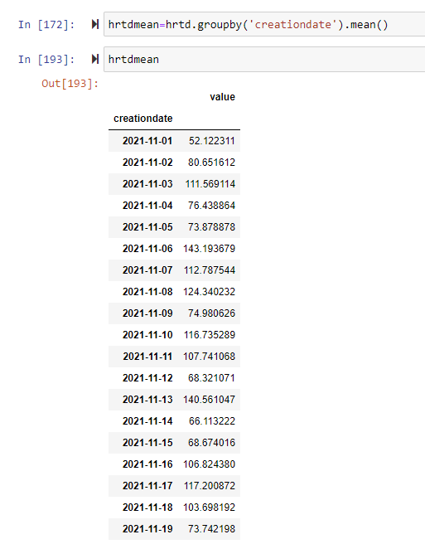
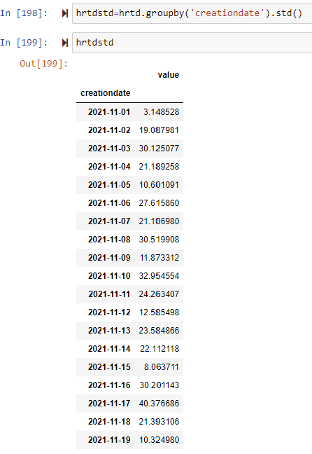
Calculate average heart rate per day and standard deviation per day

Slide 7
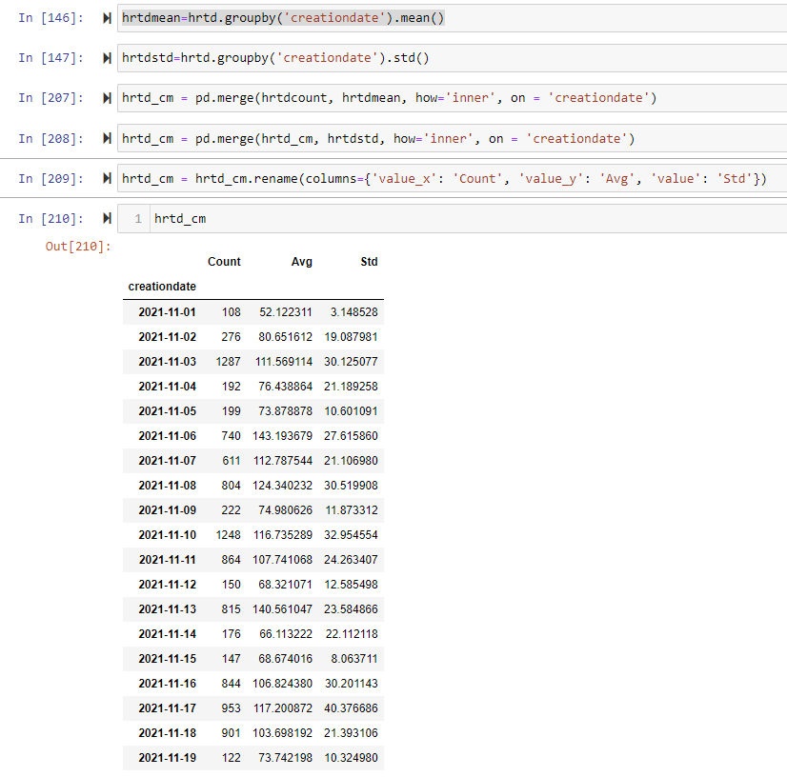
Merge mean and standard deviation data into table with counts

Slide 8
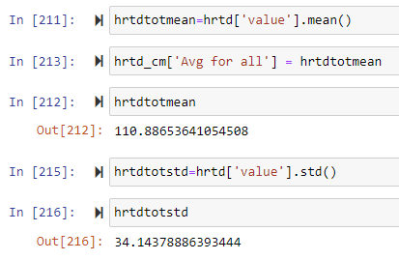
Calculate total mean and standard deviation

Slide 9
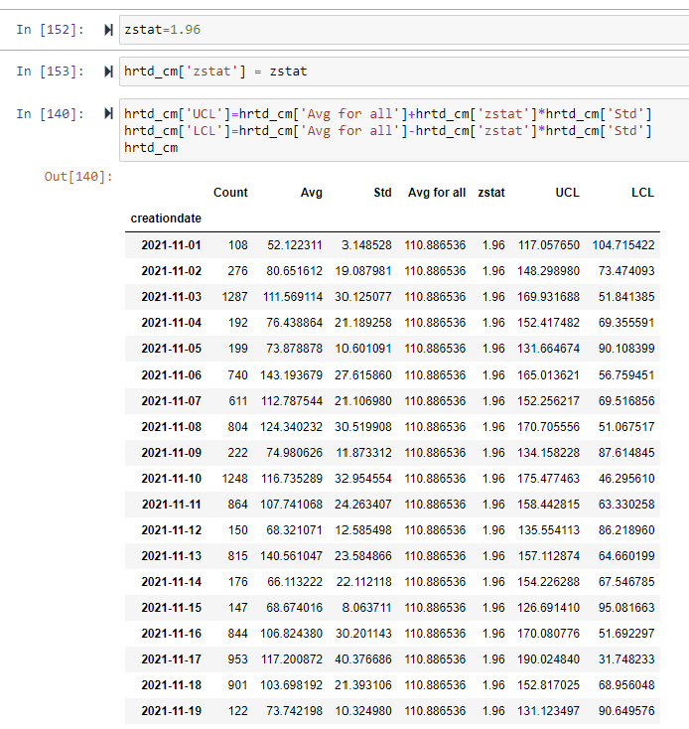
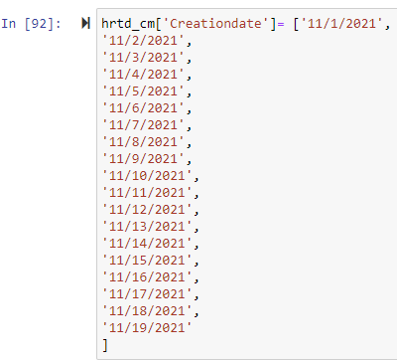
Add zstat ucl and lcl Column.
Create Creationdate column

Slide 10
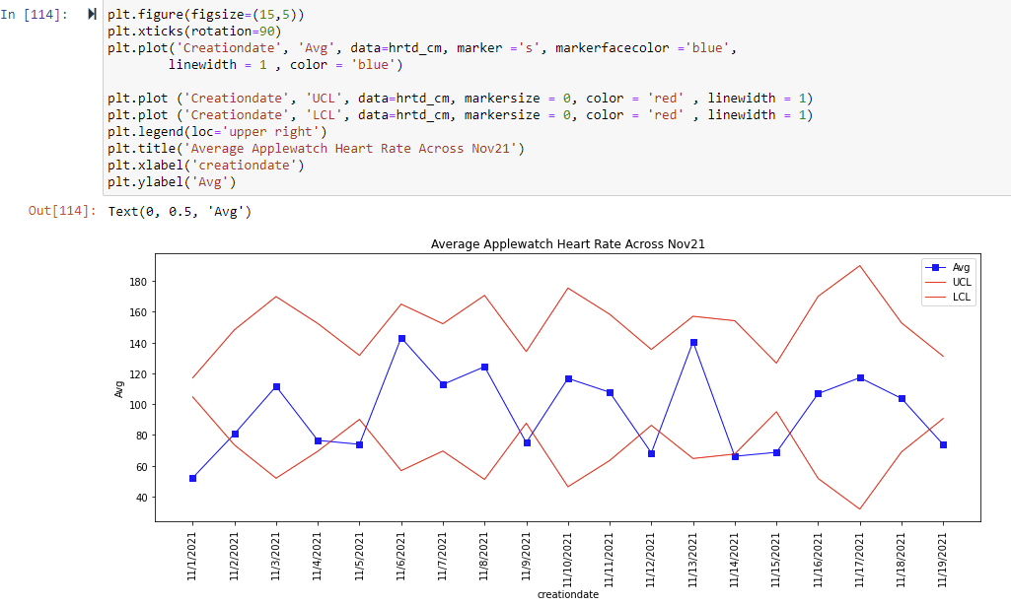
Risk Adjusted xbar CHART

Slide 11
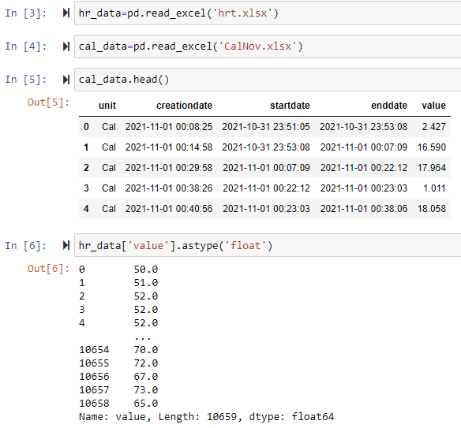
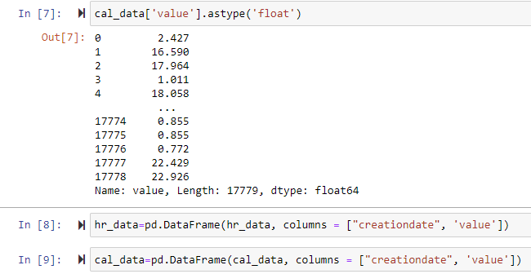
Import/view data select data type select relevant data from columns import sklearn for regression

Slide 12
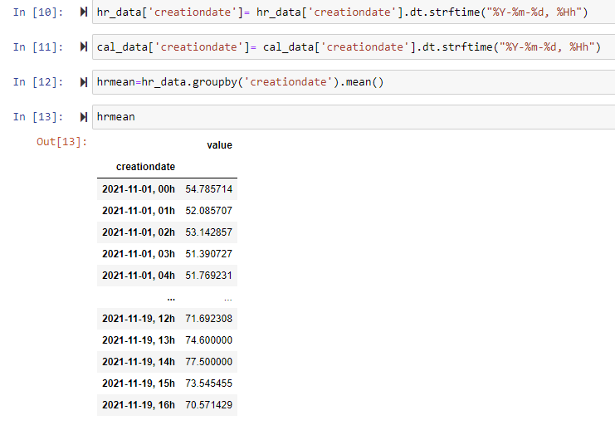
Minimize overlapping heart rate values in dataset by grouping by heart rate across each hour

Slide 13
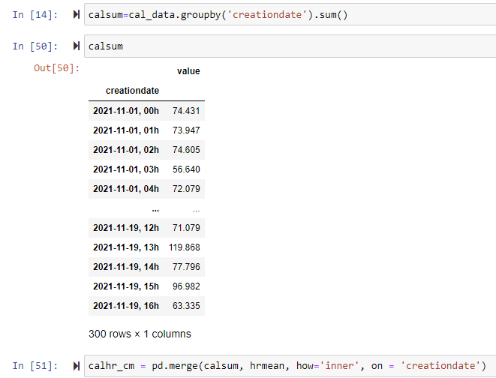
MINIMIZE OVERLAPPING CALORIE VALUES IN DATASET BY GROUPING OVERLAPPING DATA AND GETTING SUM OF CALORIES BURNED PER HOUR

Slide 14
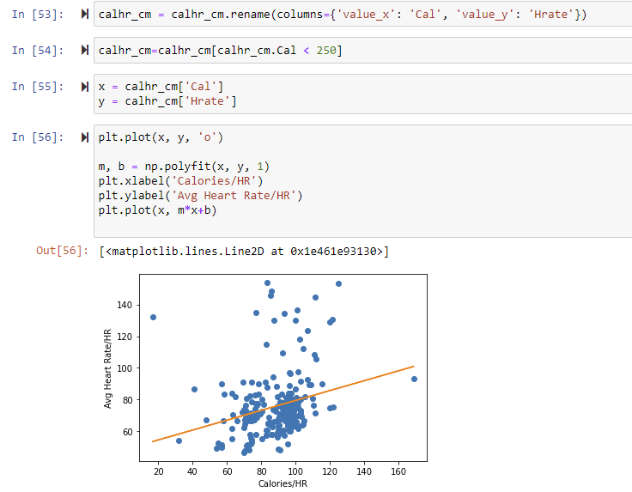
Rename merged columns remove extreme outliers as potential errors and plot data

Slide 15
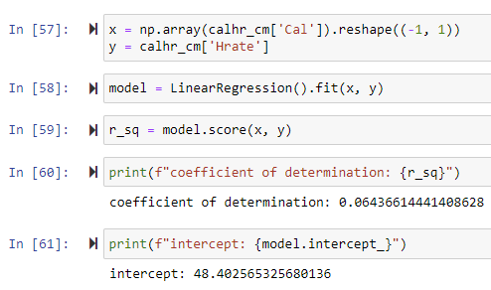
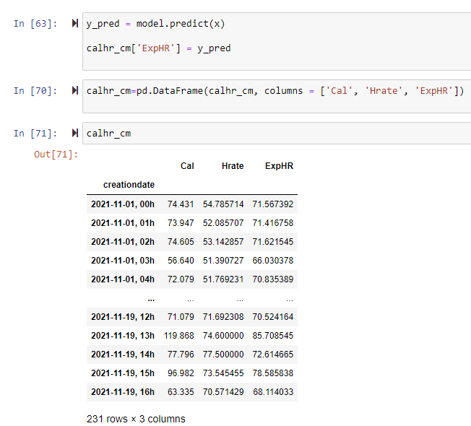

Use sklearn to regress heart rate of energyand calculate expected heart rate

Slide 16
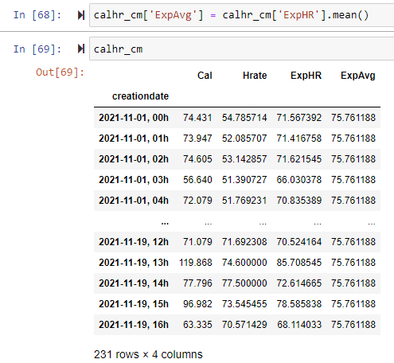
Calculate expected average

Slide 17
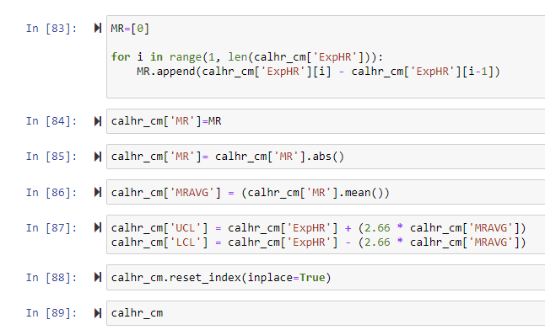
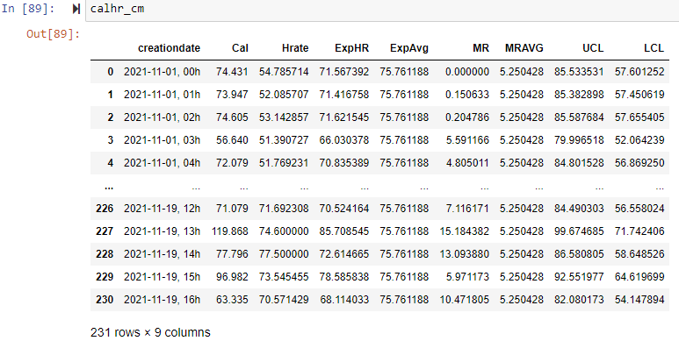
Calculate MR, MRAVG, UCL, AND LCL

Slide 18
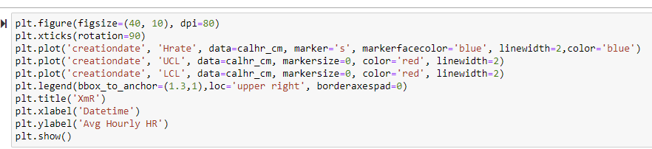
Plot Data

Slide 19
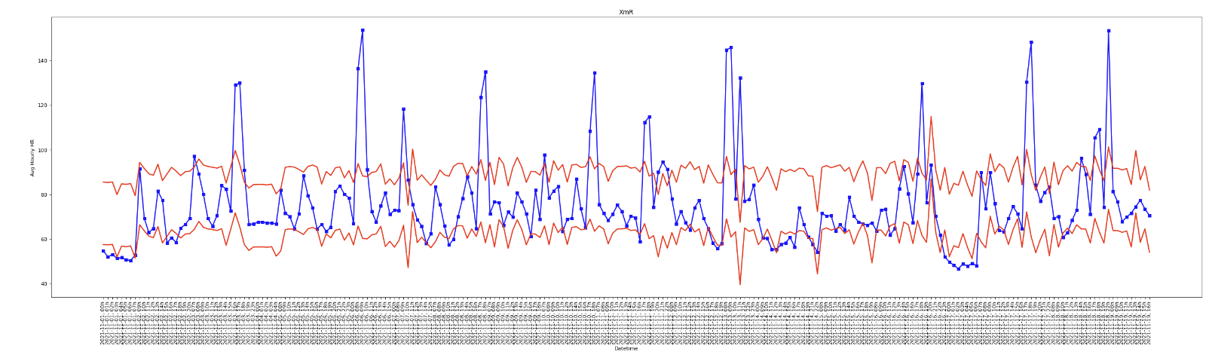
Solution

