Slide 2
Goal
Use python to calculate & construct a control chart showing rate of overuse of prophylactic antibiotic over time in Southeast Alabama Medical Center (Q.1 week5)
Download Hospital Compare data for 2015 and 2016 years
Select measure ID "SCIP_INF_3"; refers to prophylactic antibiotic use
Select data from "Southeast Alabama Medical Center"; this is provider ID "010001".
Calculate rate of overuse of antibiotics
Construct a control chart showing rate of overuse of prophylactic antibiotic over time in Southeast Alabama Medical Center

Slide 3
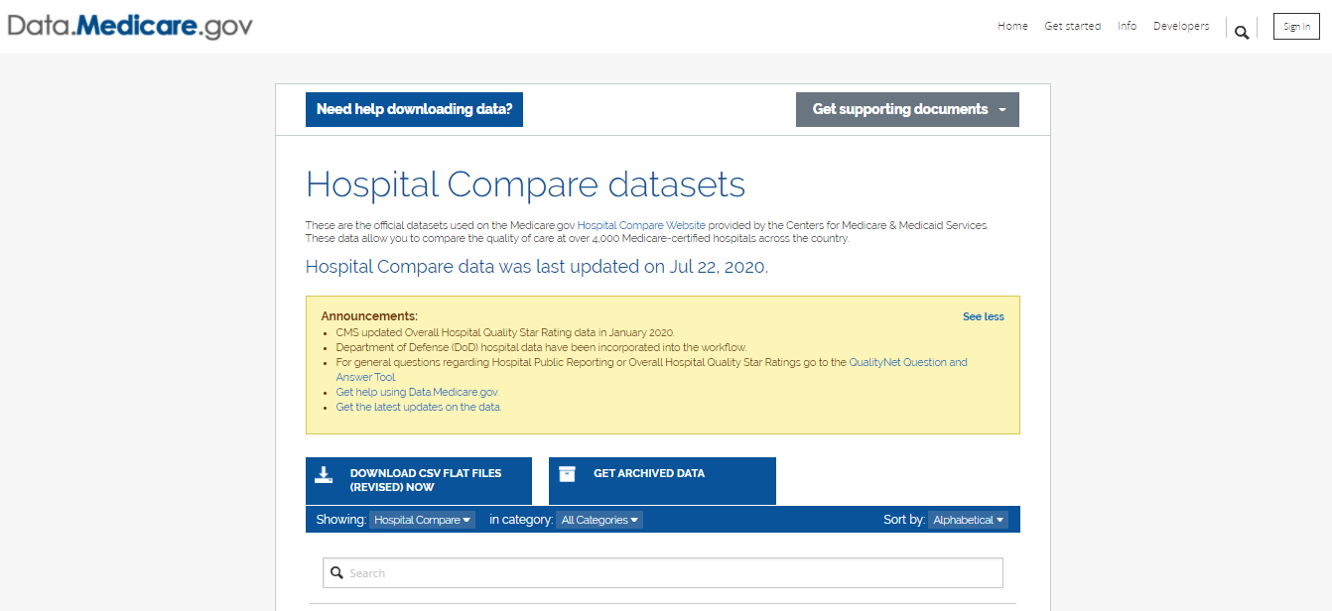
Data Source & Download Source of data derived from CMS Hospital Compare https://data.medicare.gov/data/hospital-compare

Slide 4
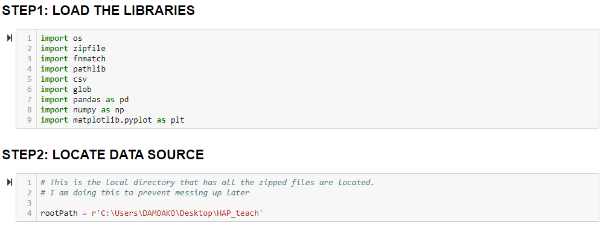

Slide 5
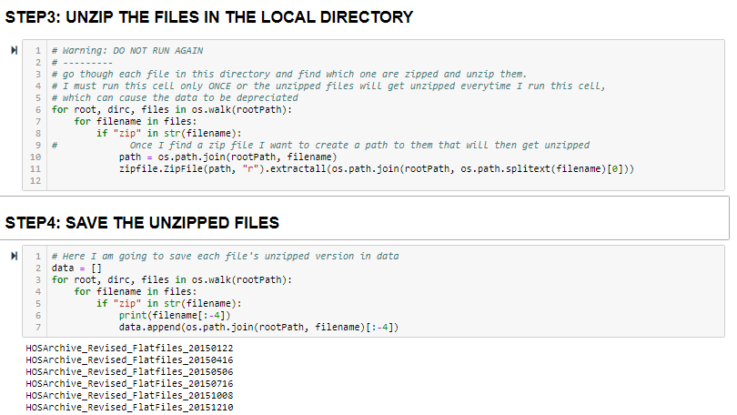

Slide 6
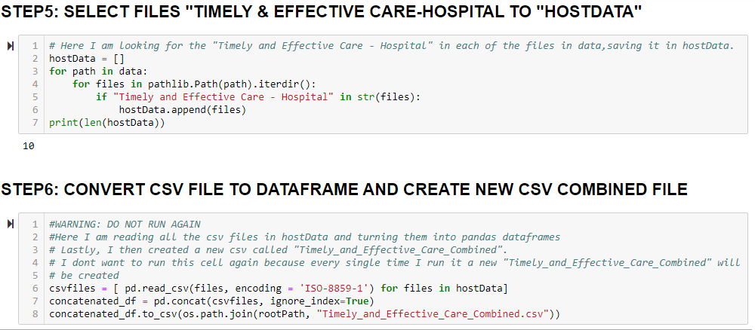

Slide 7
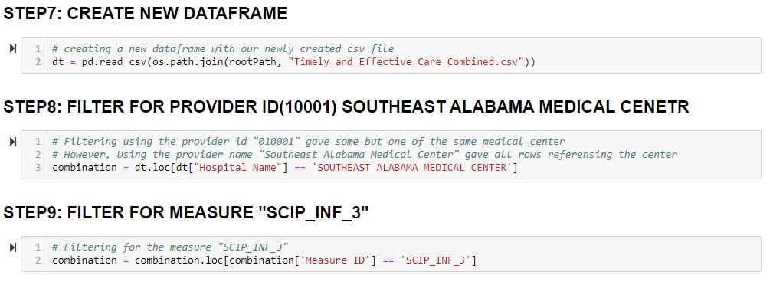

Slide 8
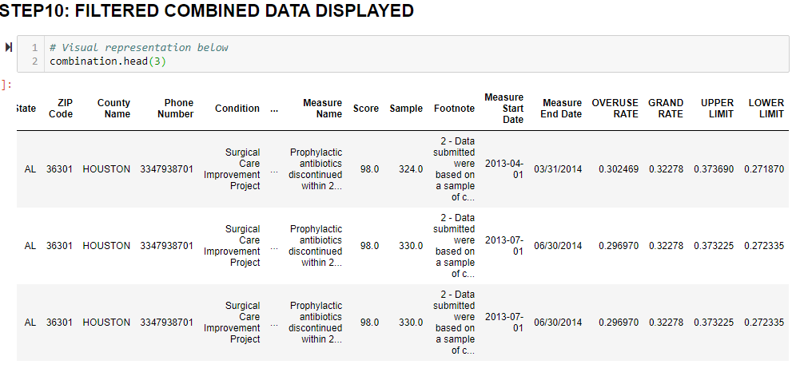

Slide 10
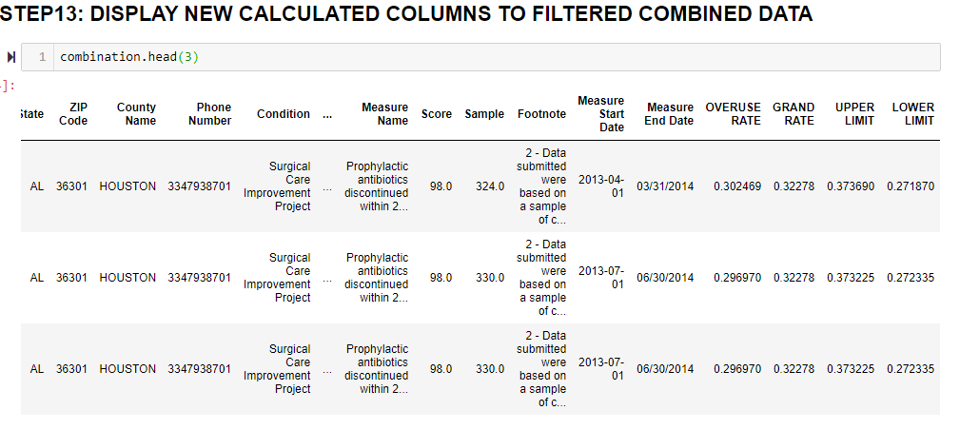

Slide 11
