Slide 1
HAP725 WEEK 7&8 COMPARISON OF RATES Risk-adjusted control chart Q #2 INSTRUCTOR: Farrokh Alemi, PhD
BY:
Spandana Polam

Slide 2
Question
Nursing home and hospital administrators implement many initiatives to reduce falls. This problem shows how these initiatives can be measured and evaluated. Prepare a risk-adjusted control chart for data on falls in a nursing home.

Slide 3
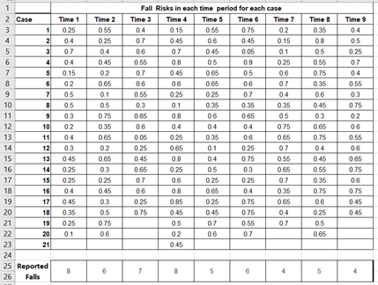
Data Provided

Slide 4
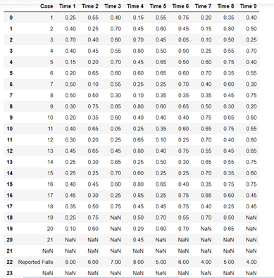
Step 1 : Import data into Python

Slide 5
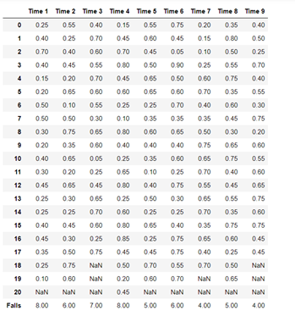
Step 2: Data cleaning

Slide 6
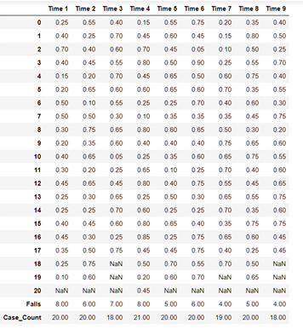
STEP 3: CALCULATING TOTAL NUMBER OF CASES FOR EACH TIME PERIOD

Slide 7
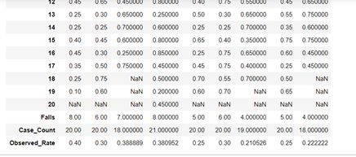
STEP 4: CALCULATING OBSERVED RATE

Slide 8
STEP 5: CALCULATING EXPECTED RATE

Slide 9
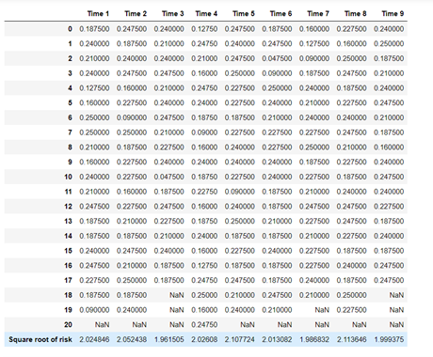
STEP 6: CALCULATING EXPECTED DEVIATION
STEP - A, B & C

Slide 10
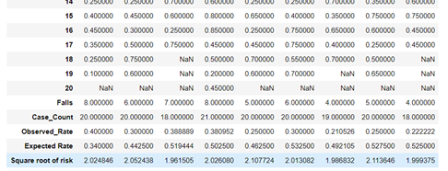
STEP D & E

Slide 11
STEP 7: ADDING T-VALUES FROM T-TABLE
Degree of freedom = Number of Cases - 1
T- Value for degree of freedom 17, 18, 19 and 20 are 2.110, 2.101, 2.093, 2.086.
T-Table source -- https://www.sjsu.edu/faculty/gerstman/StatPrimer/t-table.pdf

Slide 12
STEP 8: CALCULATING UCL AND LCL VALUES

Slide 13
STEP 9: TRANSPOSING THE DATAFRAME

Slide 14
STEP 10: FINAL DATA FOR PLOTTING CHART

Slide 15
STEP 11: PLOTTING CHART

