Slide 1
Teach One: Comparison of Rates
Debora Vito Vittorio HAP 725

Slide 2
Question
In this assignment, you are asked to examine percentage of healthcare workers given influenza vaccination for preventive care. This is a patient safety measure for timely and effective care. Following Donabedian’s domains of quality (structure, process, outcome), this measure falls under the process domain. “Process refers to the way in which diagnoses, treatments, practices to avoid harm to patients and other care are rendered – whether steps known to be effective in preventing infections and medical errors, for example, are built into hospital routine.” The CDC states that during 2019-2020 flu season, flu vaccination coverage among health care personnel was 80.6%, similar to coverage during the past five seasons (77.3% -81.1%). The IMM-3-FAC-ADHPCT measure is defined as percentage of healthcare workers given influenza vaccination.
Construct a control chart showing percentage of health care professional's vaccination over time in "Brookdale Hospital Medical Center" in New York; this is provider ID "330233".
Estimate the control limits based on the "Presbyterian Hospital" in New York; this is provider ID "330101".

Slide 3
Datasets
http://openonlinecourses.com/spc/Comparison%20of%20Rates.html

Slide 4
Import libraries and Datasets
2018
2020

Slide 5
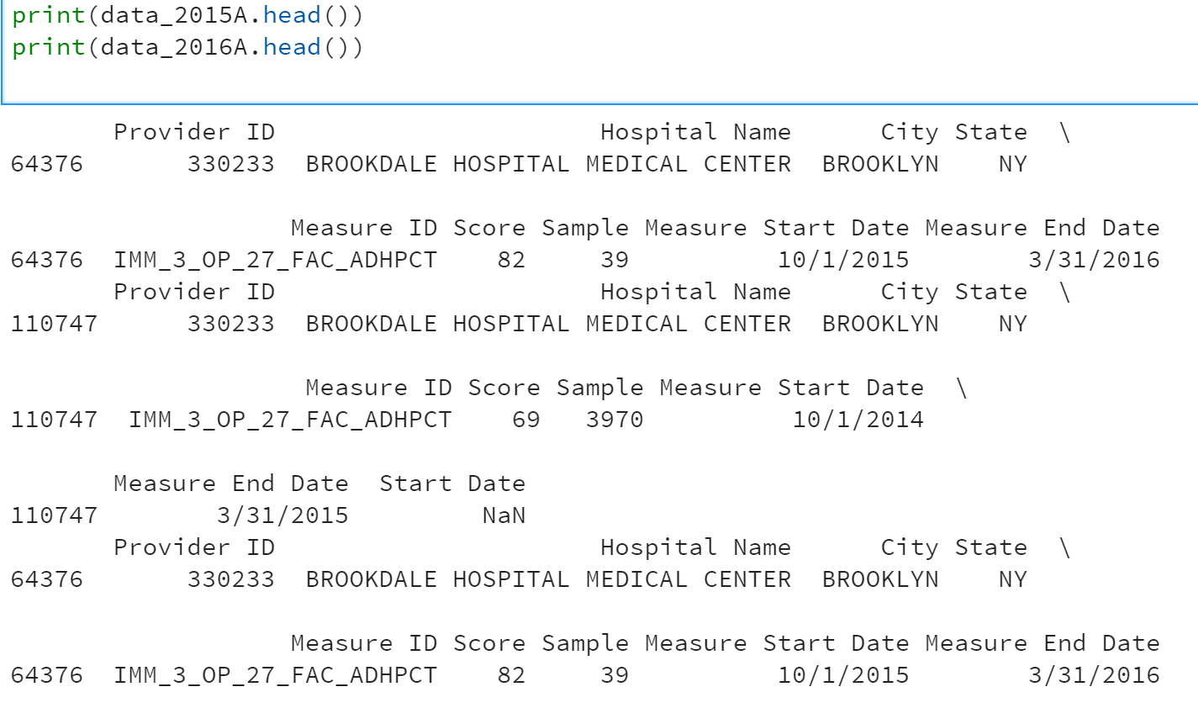
Filter Brook Dale Hospital Center

Slide 6
Filter NY Presbyterian Hospital

Slide 7
Rename Columns of 2019 and 2020 for both data sets

Slide 8
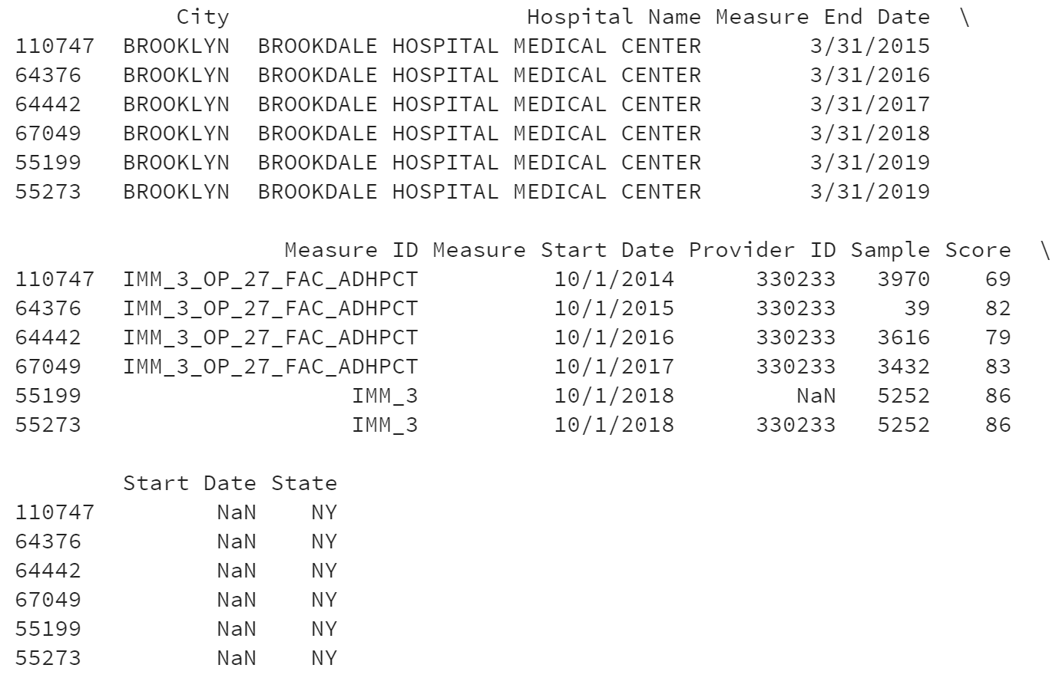
Combine datasets into 1 dataframe for each hospital
Brookdale Hospital
Above is only for Brookdale Hospital Center. Please follow same code for Presbyterian Hospital data

Slide 9
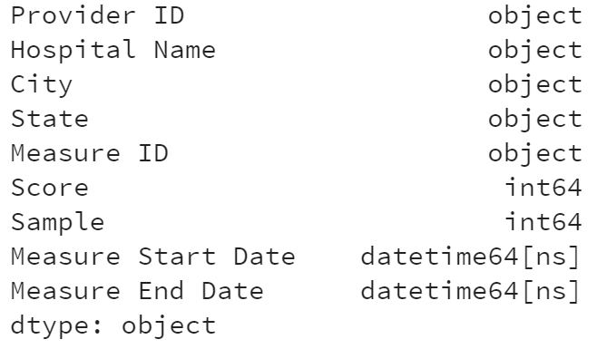
Convert Data types to allow calculation
Above is only for Brookdale Hospital Center. Please follow same code for Presbyterian Hospital data

Slide 10
Calculate Midway: ( [Measure Start Date] + [Measure End Data] ) / 2

Slide 11
Calculate UCL and LCL

Slide 12
Plot Data

Slide 13
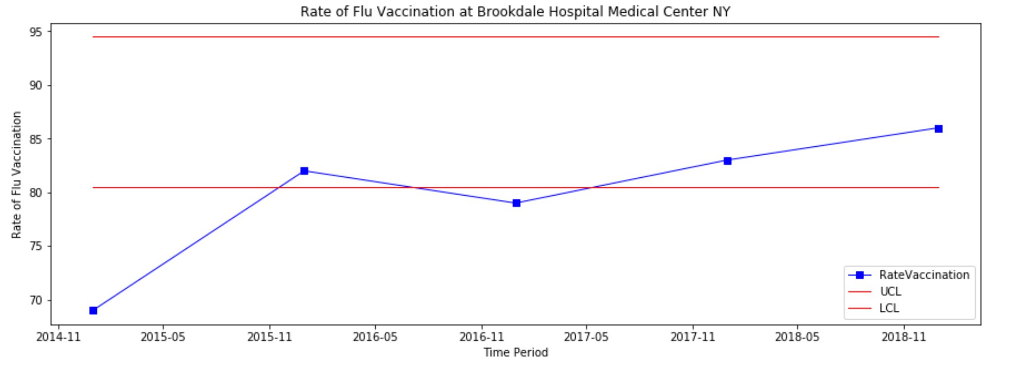
Control Chart for Rate of Vaccination in Brookedale Medical Center

