Slide 1
Risk-Adjusted P-Chart Using Python
Author and Narrator: Sara Scannell
Part of HAP 752 taught by Farrokh Alemi, PhD.
George Mason University

Slide 2
What is a Risk-Adjusted P-Chart?
P-Charts tell us if observed rates are within historical patterns.
Risk-Adjusted P-Charts tell us if observed rates are within expectations given the risk for each observation.
Assumptions:
Exclusive
Exhaustive
Rare
Independent
Change in Rates over Time
Notes:
These events should be mutually exclusive meaning that the two events could not occur together.
These events should be exhaustive events, meaning that one of the two events must occur
The event is not rare, meaning the probability of it occurring exceeds 5% for each time period
The observations should be independent
The probability of the event does change over time

Slide 3
Week 5 Question 3
Question : Following data were obtained on post surgical infection rates. Are we having more infections than expected from the patients' conditions?
Week | Risk of Infection for each Patient |  |  |  |  |  | Number Infected
1 | 0.9 | 0.8 | 0.7 | 0.8 | 0.9 | 0.85 | 6
2 | 0.7 | 0.8 | 0.7 | 0.6 | 0.8 | 0.9 | 5
3 | 0.8 | 0.95 | 0.92 | 0.87 |  |  | 4
4 | 0.5 | 0.6 | 0.66 | 0.67 |  |  | 3
5 | 0.3 | 0.4 | 0.5 | 0.4 | 0.5 | 0.34 | 2
6 | 0.3 | 0.4 | 0.5 |  |  |  | 1

Slide 4
Solution
Solution : Use python to create a risk-adjusted p-chart.
Week | Risk of Infection for each Patient |  |  |  |  |  | Number Infected
1 | 0.9 | 0.8 | 0.7 | 0.8 | 0.9 | 0.85 | 6
2 | 0.7 | 0.8 | 0.7 | 0.6 | 0.8 | 0.9 | 5
3 | 0.8 | 0.95 | 0.92 | 0.87 |  |  | 4
4 | 0.5 | 0.6 | 0.66 | 0.67 |  |  | 3
5 | 0.3 | 0.4 | 0.5 | 0.4 | 0.5 | 0.34 | 2
6 | 0.3 | 0.4 | 0.5 |  |  |  | 1

Slide 5
Steps to Create a Risk-Adjusted P-Chart
Step 0 : Check and Clean Your Data
Step 1 : Calculate the Observed Rate
Step 2 : Calculate Expected Rate
Step 3 : Calculate Expected Deviation
Step 4 : Get T-Values
Step 5 : Calculate Control Limits
Step 6 : Plot a Risk-Adjusted P-Chart
Notes:
Always check and clean your data before starting any calculations or analysis.

Slide 6
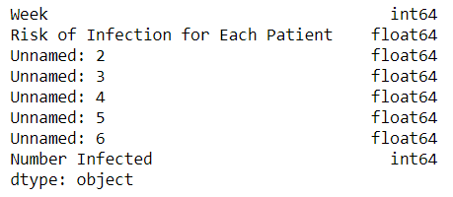
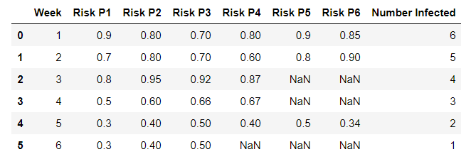
Step 0
Check and Clean Your Data
import pandas as pd
import numpy as np
pd.set_option('display.max_columns', None)
import matplotlib.pyplot as plt
data=pd.read_excel(r'C:\Users\sscan\Documents\GMU\FALL 2020\HAP 725\Wk5 Assignment\HAP 725 Wk5 Q3 Data.xlsx')
###### Step 0 Check and Clean Data ######
data
# check your data types
data.dtypes
# renaming columns
df1 = data.rename(columns={'Risk of Infection for Each Patient':' Risk P1',
'Unnamed: 2':'Risk P2',
'Unnamed: 3':'Risk P3',
'Unnamed: 4':'Risk P4',
'Unnamed: 5':'Risk P5',
'Unnamed: 6':'Risk P6'},)
df1

Slide 7
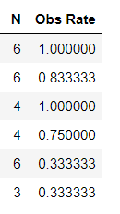
Step 1
Calculate the Observed Rate
###### Step 1 Calculate the Observed Rate ######
## Observed Rate = Number Infected / Number of Cases
## where Number of Cases is the count in each week.
# Calculate Number of Cases per week
df1['N']=df1[['Risk P1','Risk P2','Risk P3','Risk P4','Risk P5','Risk P6']].count(1)
df1
# Calculate Observed Rate
df1['Obs Rate']=df1['Number Infected']/df1['N']
df1

Slide 8
Step 2
Calculate Expected Rate
###### Step 2 Calculate Expected Rate ######
## Expected Rate = Average of each week
df1['Exp Rate']=df1[['Risk P1','Risk P2','Risk P3','Risk P4','Risk P5','Risk P6']].mean(1)
df1

Slide 9
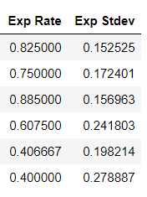
Step 3
Calculate Expected Deviation
###### Step 3 Calculate Expected Deviation ######
## Expected Deviation = The square root of the sum of [Risk(of each pt) * 1-Risk(of each pt)] in each week / Number of Cases
# removing nulls, replacing with 0
df2 = df1.fillna(0)
df2
df1['Exp Stdev']=(np.sqrt((df2['Risk P1']*(1-df2['Risk P1']))+
(df2['Risk P2']*(1-df2['Risk P2']))+
(df2['Risk P3']*(1-df2['Risk P3']))+
(df2['Risk P4']*(1-df2['Risk P4']))+
(df2['Risk P5']*(1-df2['Risk P5']))+
(df2['Risk P6']*(1-df2['Risk P6']))))/df1['N']
df1

Slide 10
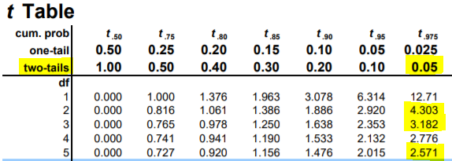
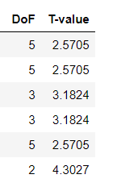
Step 4
Get T-Values
###### Step 4 Get T-Values ######
## Two-tailed T-value = value found in table using Degrees of Freedom and Alpha. For our test, we will be using Alpha = 0.05.
## Degrees of freedom = Number of Cases-1
# calculate degrees of freedom
df1['DoF']=df1['N']-1
df1
# insert t-value from table (this can be found online) 5dof=2.5705, 3dof=3.1824, 2dof=4.3027
df1['T-value']=[2.5705,2.5705,3.1824,3.1824,2.5705,4.3027]
df1
T-table Source: https://www.sjsu.edu/faculty/gerstman/StatPrimer/t-table.pdf
T-Value Calculator Resource
http://www.ttable.org/student-t-value-calculator.html

Slide 11
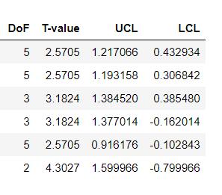
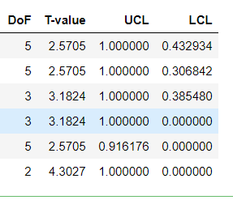
Step 5
Calculate Control Limits
###### Step 5 Calculate Control Limits ######
## UCL = Expected Rate + (T-value * Expected Deviation)
## LCL = Expected Rate - (T-value * Expected Deviation)
## Any limit that is a negative value is changed to 0 (negatives are impossible in probability)
## Any limit that is >1 is changed to 1 (The highest possible probability is 1)
# calculating UCL and LCL
df1['UCL']=(df1['Exp Rate']+(df1['T-value']*df1['Exp Stdev']))
df1['LCL']=(df1['Exp Rate']-(df1['T-value']*df1['Exp Stdev']))
df1
# Replacing any limit less than 0 with 0 and greater than 1 with 1
df1.loc[df1.LCL < 0, 'LCL'] = 0
df1.loc[df1.UCL > 1, 'UCL'] = 1
df1

Slide 12
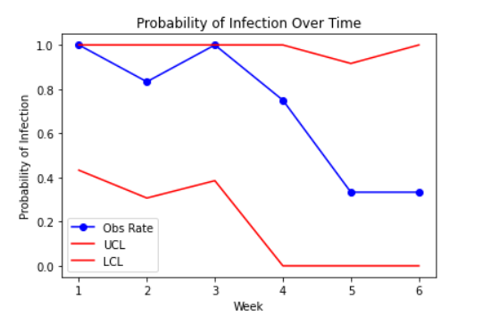
Step 6
Plot a Risk-Adjusted P-Chart
###### Step 6 Create Risk Adjusted P-Chart ######
## We'll use the Observed Rate, UCL, and LCL
plt.plot('Week','Obs Rate',data=df1,marker='o', color='blue')
plt.plot('Week','UCL',data=df1, markersize=0, color='red')
plt.plot('Week','LCL',data=df1, markersize=0, color='red')
plt.legend()
plt.title('Probability of Infection Over Time')
plt.xlabel('Week')
plt.ylabel('Probability of Infection')

Slide 13
Answer
Question : Following data were obtained on post surgical infection rates. Are we having more infections than expected from the patients' conditions?
Answer : No, we are not having more infections than expected from the patients’ conditions because our observations are within the upper and lower control limits.

