Slide 1
Xbar Chart
By Farrokh Alemi Ph.D
Notes:
This lecture was organized by Dr. Alemi.

Slide 2
Check assumptions
Calculate grand average
Calculate standard deviation
Calculate standard deviation for each time period
Calculate control limits
Plot chart
Interpret and distribute
Notes:
This set of slides walk you through the development of an X-bar control charts

Slide 3
Time Period | Satisfaction Ratings of 4 Patients per Time Period
 | 1st | 2nd | 3rd | 4th
1 | 80 | 84 | 82 | 80
2 | 70 | 72 | 74 | 70
3 | 76 | 78 | 76 | 78
4 | 80 | 78 | 78 | 80
Notes:
Suppose that Over several months, we tracked the satisfaction with our unit. In each time period we asked 4 patients to rate us. The question is whether the unit has improved over time. How would you answer this question? Look at the data. There are wide variations in the data. Could these variations be due to chance?

Slide 4
Assumption
Interval Scale
Notes:
We begin with checking assumptions of X-bar control charts. The first assumption is that we are measuring a variable that has a continuous interval scale. The variable being averaged must be a continuous variable on an interval scale, where the differences between the scores are meaningful. An ordinal scale cannot be averaged. Satisfaction rating and health status ratings are generally assumed to be interval scales. Cost and time are continuous interval scales.

Slide 5
Assumption
Interval Scale
Notes:
The second assumption is that the patients are independent from each other. The observations over each period of time are not affected by the previous observations. In our example, the satisfaction ratings in time period two should not be affected by ratings in the first time period. This assumption will be violated in an example where the same patient is rating the unit in every time period. It is likely that this patient's first impression affects subsequent evaluations. The assumption seems reasonable when different patients are rating in different time periods.

Slide 6
Assumption
Normal
Notes:
The third assumption is that the data have a Normal distribution. If we were to stack all the ratings, most will fall on the average rating, some on each side. A normal distribution suggests that the stack will peek on the average, slowly decline on both sides of the average, and the shape of the curve will be symmetrical. The law of large numbers says that no matter what the distribution of a variable is, the average of the variable will tend to have a Normal distribution. As the number of cases for calculation of the average increases, the average is more likely to be Normal. A minimum of four cases is needed for applying the law of large numbers. The law of large numbers tells us that the average of any distribution, no matter how strange, has a Normal distribution.

Slide 7
Assumption
Average Tends Normal
Notes:
The third assumption is that the data have a Normal distribution. If we were to stack all the ratings, most will fall on the average rating, some on each side. A normal distribution suggests that the stack will peek on the average, slowly decline on both sides of the average, and the shape of the curve will be symmetrical. The law of large numbers says that no matter what the distribution of a variable is, the average of the variable will tend to have a Normal distribution. As the number of cases for calculation of the average increases, the average is more likely to be Normal. A minimum of four cases is needed for applying the law of large numbers. The law of large numbers tells us that the average of any distribution, no matter how strange, has a Normal distribution.

Slide 8
Normal?
Notes:
Using Excel, we created a histogram of the data. Select data analysis, then select histogram to reach this option. Here is how the data looks like. An eyeball test suggest that these data may be near Normal. Most of the data is in the center. The data are spread symmetrically around the peak of the center.

Slide 9
Assumption
Interval Scale
Notes:
The last assumption is that the variance is constant. A variable variance will be observed if the patient’s severity of illness changes over time. This assumption can be verified on a control chart. It states that deviations from the average should not consistently increase or decrease over time. So plotting the deviations from average can help us understand if this assumption is met.

Slide 10
Notes:
The next step is to calculate and plot the average for each time period. This x-y plot already tells you a lot about changes in average rating over time. But it does not tell a full story. It will tell you more, if you add to it the upper and lower control limits, between which one expects 95% of the data.

Slide 11
Notes:
Next calculate and plot the grand average. The grand average is the average of all ratings across all time periods. Do not calculate this by averaging the mean of each time period. The correct way to do this is to sum all the ratings for all time periods and divide the sum by the number of ratings. In the example provided here, it makes no difference how you calculate the grand average, but in situations where the number of cases in each time period is changing, it does make a difference. With the central tendency line in, we have a visual line to compare the data to. It already tells us a lot, it gives us a sense of which time periods are closer to our central tendency line.

Slide 12
S = [∑_{i=1,…,nj j = 1, …m} (X_{ij} –Grand Average )² / (n-1)]^{0.5}
Notes:
To calculate control limits, we need to first calculate standard deviation. Excel has a function for calculating standard deviation. Here we are showing a formula for doing us, in case you want to do it by yourself. First the sum of squared residuals is calculated. This sum is divided by number of cases minus one. The square root of the calculated value is the standard deviation.

Slide 13
S_{t} = S / (n_{t})^{0.5}
Notes:
Estimate the standard deviation for observations within each time period by dividing the standard deviation of all of the observations by the square root of the number of cases in the time period.

Slide 14
  UCL = Grand Average + 1.96 * S_{t}
  LCL = Grand Average – 1.96 * S_{t}
Notes:
Calculate the upper lower limit for each time period as the grand average plus 1.96 times the standard deviations of the time. 1.96 sets the limits so that 95% data fall within the two limits. Calculate the lower limit for each time period as the grand average minus 1.96 times the standard deviation of that time period.

Slide 15
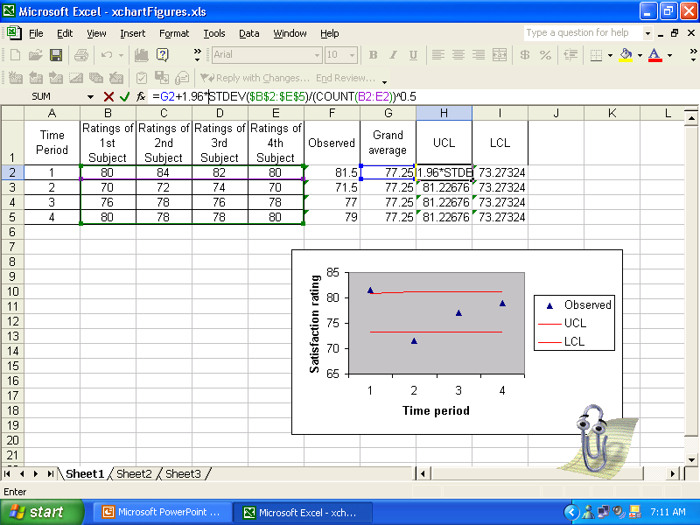
Standard deviation function over range of all observations
Notes:
Let us look at these calculations inside Excel. We begin with the calculation of the standard deviation. You can use the standard deviation function in Excel to calculate the standard deviation of observations. The function is =stdev and the arguments of the function are the range of the data. In this example, it is taking the data from the range B2 through E2. The standard deviation is then divided by the count of cases in the time period and taken to the power of 0.5, which is the same as taking the square root. This provides the estimate for standard deviation of the time period.

Slide 16
Standard deviation function over range of all observations
Dividing by square root of number of observations in the time period
Notes:
The standard deviation is then divided by the square root of the count of cases in the time period. Taking something to the power of 0.5 is the same as taking the square root. This provides the estimate for standard deviation of the time period.

Slide 17
Constant for 95% data within two control limits
Standard deviation function over range of all observations
Dividing by square root of number of observations in the time period
Notes:
The t statistic is 1.96 that guarantees that 95% data fall within the two control limits

Slide 18
Constant for 95% confidence limits
Grand average
Standard deviation function over range of all observations
=Average(B2:E2)
Dividing by square root of number of observations in the time period
Notes:
The grand average is calculated using the average function within Excel from the entire set of data.

Slide 19
Notes:
Now we are ready to plot the data. In X-bar control chart the x-axis is time, the Y-axis is the observed average for each time period. Observations are show by single markers. Control limits are shown as lines with no markers and preferably in red. Note that the control limits are straight lines in this example because in every time period we sampled the 4 cases. If this were not the case, the control limits would be tighter when the sample size was larger and wider otherwise.

Slide 20
Notes:
Any point that falls outside the control limit is not due to chance. The first time period is above the limit. Patients rated us higher than the historical trend in the first time period. Note also that the second time period is lower than the lower control limit. Therefore, patients rated our services worst in this time period and the change in the ratings were not due to chance events. It marks a real change in satisfaction with our services. We would not have known this until we created a control chart

Slide 21
Distribute Chart
Assumptions
Notes:
Tell a story. Distribute your control chart. Include in the report how you checked assumptions of the control chart.

Slide 22
Distribute Chart
Key Findings
Notes:
Include a summary of key findings and hypothesize the likely factors

Slide 23
X-bar chart tells if observations are within historical patterns
Notes:
X-bar chart can tell us if observations are within historical patterns

