Slide 1
XmR Chart in Excel
Farrokh Alemi, Ph.D.
Notes:
These slides show you how to create an XmR Chart

Slide 2
Time Period | Observed Value | Absolute Difference of 2 Consecutive Values
1 | 199
2 | 201 | 2
3 | 197 | 4
4 | 197 | 0
5 | 200 | 3
6 | 195 | 5
7 | 193 | 2
Notes:
XmR chart is based on consecutive differences in observed values. Here we see the observations for 7 time periods. A moving range of 2 would select any two consecutive values and calculate their absolute difference.

Slide 3
Time Period | Observed Value | Absolute Difference of 2 Consecutive Values | Absolute Difference of 3 Consecutive Values
1 | 199
2 | 201 | 2
3 | 197 | 4 | 4
4 | 197 | 0 | 4
5 | 200 | 3 | 3
6 | 195 | 5 | 5
7 | 193 | 2 | 7
Notes:
A moving range of 3 would select the maximum difference in three consecutive values. The difference in time period 3 is calculated to be 4 which is the difference between 201 and 197, the maximum and the minimum of three consecutive values.

Slide 4
Time Period | Observed Value | Absolute Difference of 2 Consecutive Values | Absolute Difference of 3 Consecutive Values | Absolute Difference of 4 Consecutive Values
1 | 199
2 | 201 | 2
3 | 197 | 4 | 4
4 | 197 | 0 | 4 | 4
5 | 200 | 3 | 3 | 4
6 | 195 | 5 | 5 | 5
7 | 193 | 2 | 7 | 7
Notes:
A moving range of 4 would select the maximum difference in four consecutive values. Differences in consecutive values have Normal distribution as moving range is calculated on larger number of time periods

Slide 5
Moving Range
Time Period | Observed Value | Absolute Difference of 2 Consecutive Values | Absolute Difference of 3 Consecutive Values | Absolute Difference of 4 Consecutive Values
1 | 199
2 | 201 | 2
3 | 197 | 4 | 4
4 | 197 | 0 | 4 | 4
5 | 200 | 3 | 3 | 4
6 | 195 | 5 | 5 | 5
7 | 193 | 2 | 7 | 7
Most common
approach
Notes:
The most common approach is to use the difference of 2 consecutive values. It is the simpler method.

Slide 6
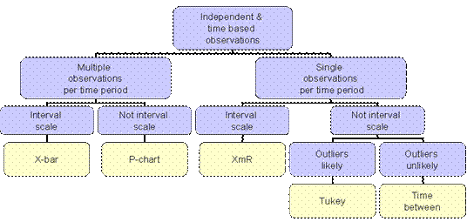
Independent, Time-based Observations
Notes:
For different outcomes different control charts are appropriate. The selection of which chart should be used in a particular situation should be based on the type of data that is available. XmR Chart relies on independent time-based observations.

Slide 7
Independent, Time-based Observations
One Observation per Time Period
Notes:
XmR chart requires one observation per time period.

Slide 8
Independent, Time-based Observations
One Observation per Time Period
Interval scale
Notes:
XmR chart requires Interval scale

Slide 9
Observation at time “t”
Number of observations
Average Range = ∑ | X_{t} – X_{t-1} | / (n-1)
Absolute value of difference of 2 consecutive observations
Notes:
Control limits in XmR chart are calculated from moving range (mR). A range is based on the absolute value of consecutive differences in observations. To calculate the average of the moving range, count the number of observations. Then calculate the absolute value of the difference of every consecutive value, call this moving range. Add the moving ranges and divide by number of observations minus 1 to get the average moving range.

Slide 10
Formula for Calculating Upper and Lower Control Limits
  Upper Control Limit = Average of observations + E * Average of moving range
  Lower Control Limit = Average of observations - E * Average of moving range
Notes:
Upper control limit is average of the observations plus the constant E times the average range, The lower control limit is calculated as the average of the observations minus the constant E times the average moving range. The value of constant E is chosen so that 99% of the data fall within the control limits.

Slide 11
Typically we look at two consecutive periods
Notes:
The constant E depends on the number of time periods within the moving range. If the moving range is calculated from two consecutive time periods, then the correction factor that should be used is 2.66. If moving range is calculated from 4 time periods then 1.467 should be used.

Slide 12
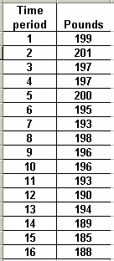
Example
Diabetes patient measured weight for 16 weeks
First 7 weeks were pre-intervention
Has the patient’s weight changed?
Notes:
Let’s look at a diabetic patient’s weight. His clinician asked him to weigh himself weekly and to bring the data to their follow-up visit. The patient attempted to lose weight by changing the food shopped for the household. He started the intervention in week 8, so the first 7 weeks show the data prior to the intervention and the remainder show the data post the intervention. The data in this Table show Jim's weight over time. He started at 199 but his weight went up and down. The question is has he improved?

Slide 13
1. Check Assumptions
One observation per time period
Interval scale
Independent observations
Notes:
We analyze this data in seven steps. First we need to check that the assumptions of XmR chart apply to this sample data. There is one observations per time period. Therefore this assumption is met. Data are weights, which are indeed calculated on an interval scale, therefore this assumption is also met. Finally observations are independent or can reasonably be assumed to be independent. There is no reason to expect that last week’s weight might tell us if this week Jim’s weight goes up or down. Therefore all assumptions are met.

Slide 14
2. Select Pre- Or Post-Intervention Period
Pre-intervention
Notes:
Second, we need to make a decision whether to calculate the control limit from either pre-intervention or post intervention data. To make this decision, we need to select a time period with least variability. The maximum value minus the minimum value in the pre-intervention period is 8 Lbs. The range for the post intervention period is 13 Lbs. The pre-intervention period has the lower variability and therefore control limits calculated from this period will be tighter. Therefore, we select to calculate the control limits from the pre-intervention period.

Slide 15
Time period | Weight in Pounds | Range of 2 consecutive values
1 | 199 | Not available
2 | 201 | 2
3 | 197 | 4
4 | 197 | 0
5 | 200 | 3
6 | 195 | 5
7 | 193 | 2
8 | 198 | Not relevant to control limits from pre-intervention period
9 | 196
10 | 196
11 | 193
12 | 190
13 | 194
14 | 189
15 | 185
16 | 188
Average | 197.43 | 2.67
Notes:
Third, we calculate the average range between any two consecutive values. This is done by calculating the absolute value of the difference of any two consecutive number and then taking the average of these differences

Slide 16
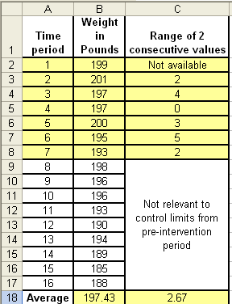
=abs(B3-B2)
Notes:
This slide shows how the various values were calculated within Excel. The value of moving range was calculated using the absolute value function within Excel.

Slide 17
=Average(C3:C8)
Notes:
The average value of moving range was calculated using the average function within Excel. Note that the average is taken over the 6 time period in which there are valid values for moving range.

Slide 18
=Average(B2:B8)
Notes:
The average value of observations is also calculated from the pre-intervention period.

Slide 19
UCL = 197.43 + 2.66 * 2.67 = 204.52
LCL = 197.43 - 2.66 * 2.67 = 190.33
Notes:
Fourth, using the averages, we calculate the Upper and Lower control limits. Note that the E correction factor 2.66 is used in the calculations because the range was over two consecutive differences.

Slide 20
5. Plot the Control Chart
Plot the x and y axis, plot the observations
Plot the limits as line with no marker
Plot solid line for pre-intervention period
Notes:
Fifth, we plot the chart for the entire 16 weeks. We show the control limits as solid lines for the pre-intervention period and as a dashed line for the post intervention period. The x-axis is weeks since start and the Y-axis is the weight of Jim.

Slide 21
6. Interpret the Chart
Notes:
Sixth, we interpret the findings. During the first 7 weeks, no points are outside the control limit. After this period, when food shopping patterns were changed, we see 4 points outside the limit. These points mark a departure from the pattern in the first 7 weeks. They show that the patient's weight has declined. This decline is not a random fluctuation but marks a real change in the process.

Slide 22
XmR Chart Helps you analyze one Continuous Data point per Time Period

