Slide 1
HAP 725 Question 2 Solution
Maria Uriyo, Ph.D.

Slide 2
Problem
Nursing home and hospital administrators implement many initiatives to reduce falls. This problem shows how these initiatives can be measured and evaluated. Prepare a risk-adjusted control chart for data on falls in a nursing home.

Slide 3
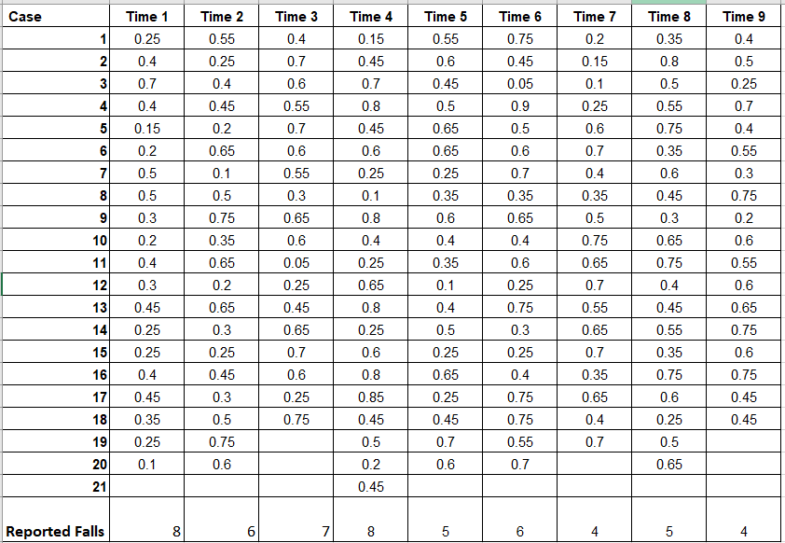
Step 1. Clean Provided Excel Data

Slide 4
Step 2: Read File into Pandas

Slide 5
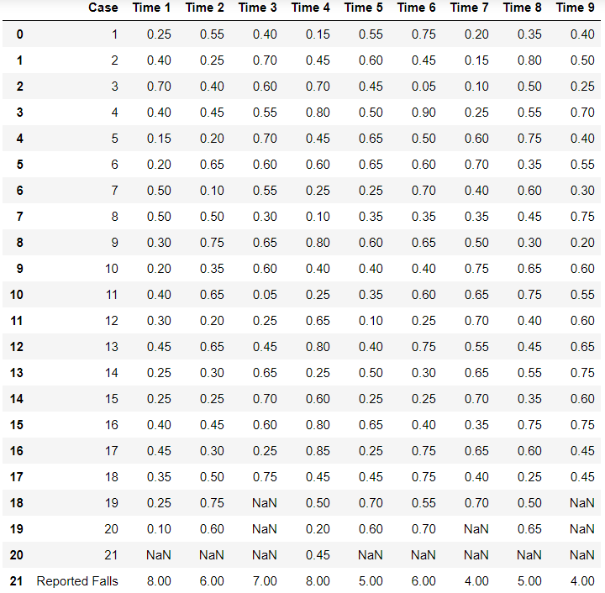
Step 2a: Output

Slide 6
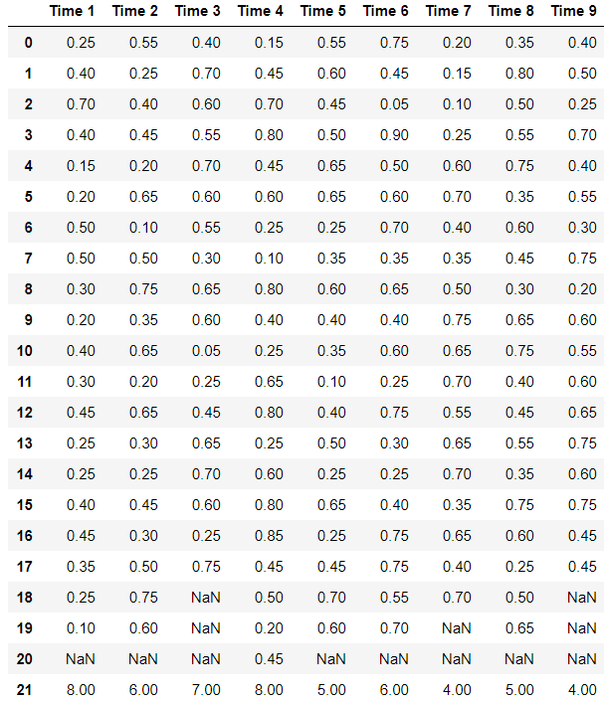
Step 3: Drop Cases Column

Slide 7
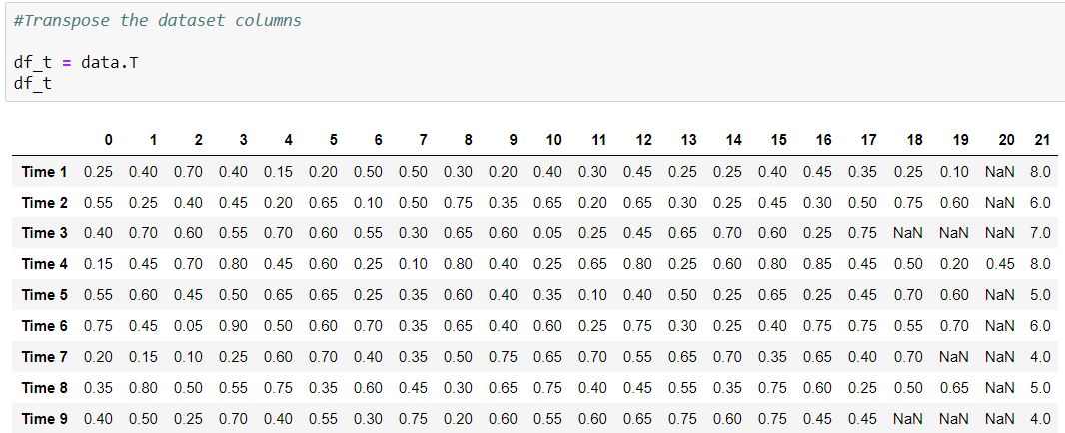
Step 4: Transpose the Dataframe

Slide 8
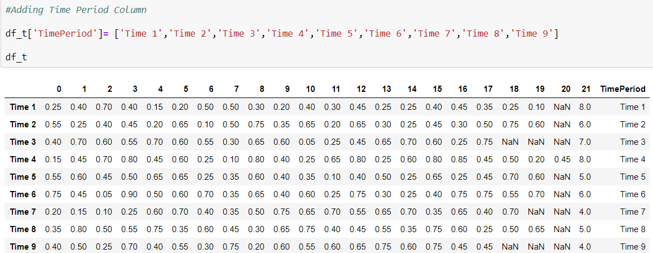
Step 5: Add Time Period Column

Slide 9
Step 6: Rename column names
Partial output shown

Slide 10
Step 7a: Count Number of Cases
Partial output shown

Slide 11
Step 7b: Finalize Count Number of Cases
Partial output shown

Slide 12
Step 7c: Drop Count Column
Partial output shown

Slide 13
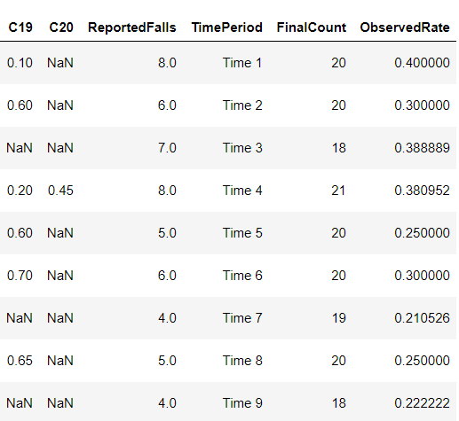
Step 8: Calculate Observed Rate
Partial output shown

Slide 14
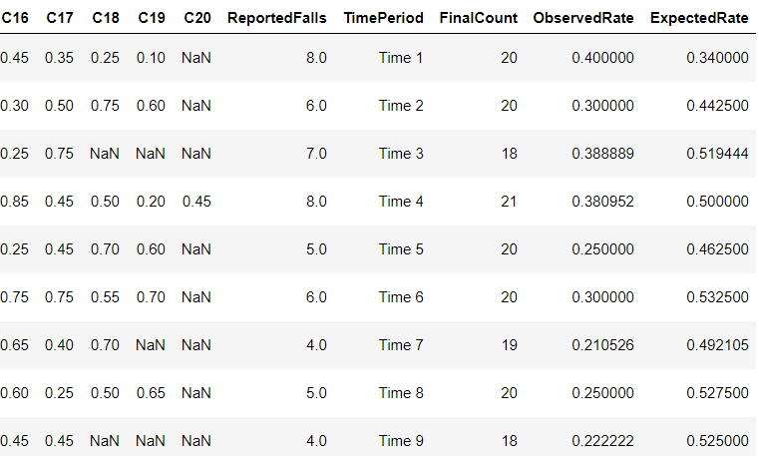
Step 9: Expected Rate Calculation
Partial output shown

Slide 15
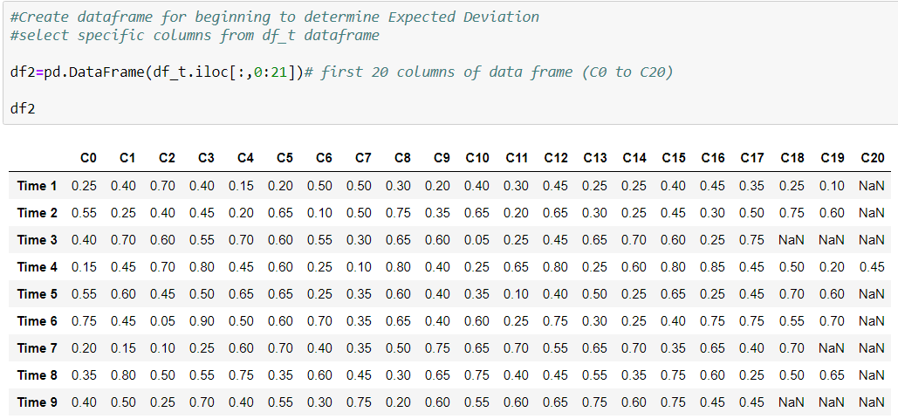
Step 10: Create Dataframe

Slide 16
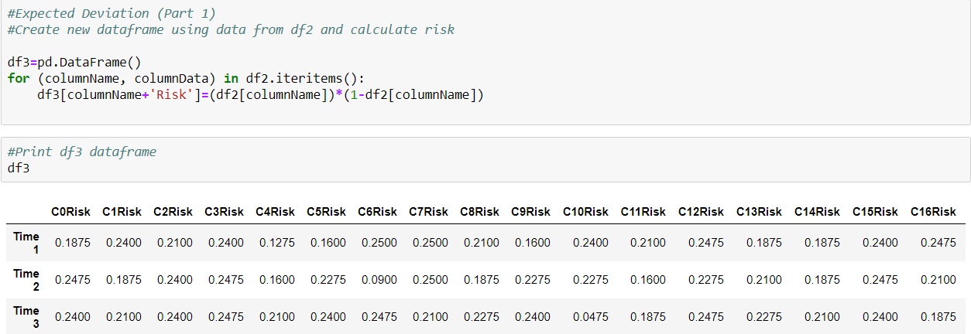
Step 11a: Calculating Risk
Partial output shown

Slide 17
Step 11b: Calculating Sum of Risk
Partial output shown

Slide 18
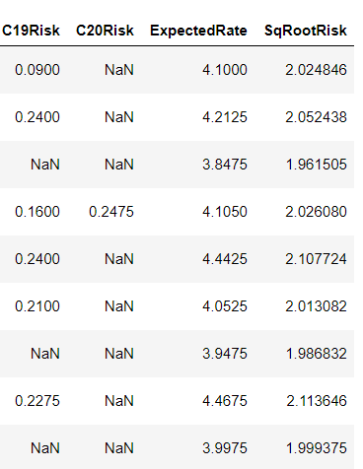
Step 11c: Calculating Square Root of Risk
Partial output shown

Slide 19
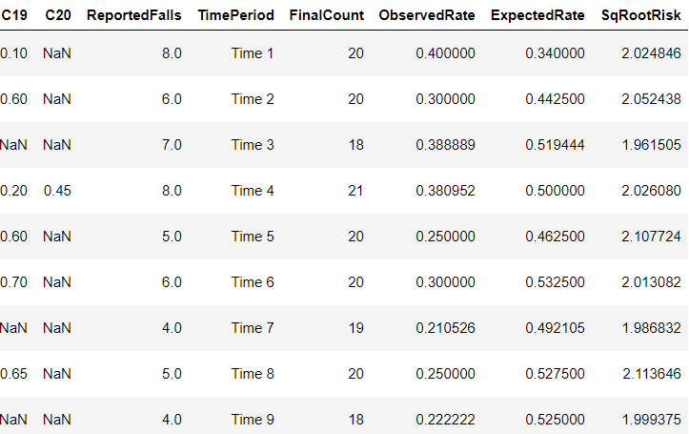
Step 12: Copy Square Root of Risk to df_t Dataframe
Partial output shown

Slide 20
Step 13: Calculate Expected Deviation
Partial output shown

Slide 21
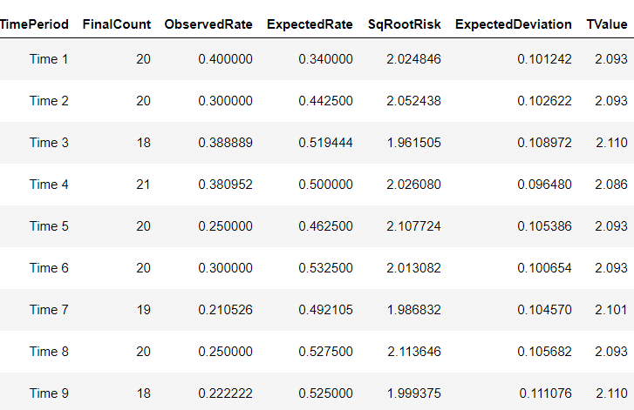
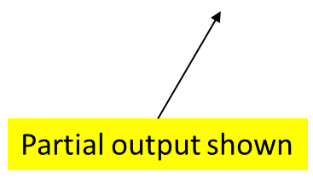
Step 14: Add T-Values

Slide 22
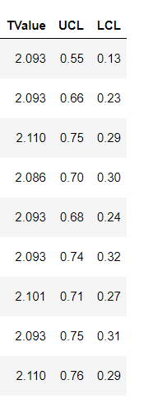
Step 15: Calculate UCL & LCL
Partial output shown

Slide 23
Step 16: Plot the Chart

Slide 24
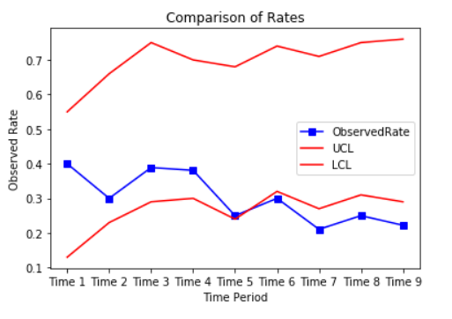
Solution
The decline in the Observed Rate over time, shows the initiatives implemented by nursing home administrators to reduce the
number of falls is working

