Slide 1
Time/Aging
Unable to Toilet
Urinary Incontinence
Most Likely Next Event
Unable to Walk
Unable to Transfer
Unable to dress
Unable to Bathe
Unable to Groom
Unable to Feed
Bowel Incontinence

Slide 2
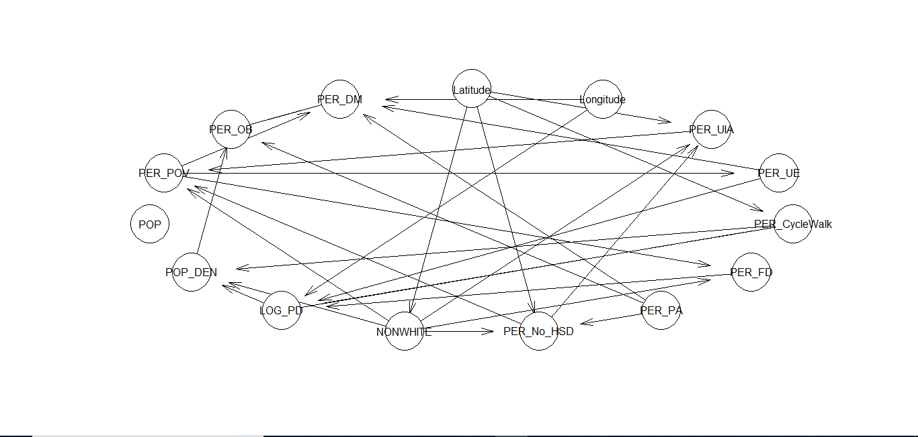

Slide 3
Age
Markov Blanket
U
Death
T
Gender
W
D
S
B
G
E
L

