Slide 1
Teach one
Suhashini Ramanathan
HAP 725 q4

Slide 2
Question?
Download Hospital Compare data for the year 2015 and 2016. Start from 1/1/2015 till the most recent available database.
In these files the denominator indicates the number of patients. Whether the hospital had above average payments are reported in different fields: [Compared to National], [Category], and [Payment Category] Select data that meet the following conditions:
Select the "PAYM_30_AMI" measure
Select hospitals that in the denominator do not have "Not Available".
Construct a control chart showing probability of change over time.

Slide 3
Import Data to SQL Server - 1
Among the data sets provided, the following 3 unique time periods are identified
2010 to 2013
2011 to 2014
2012 to 2015
The source data provided is a Microsoft Access DB file and filename for each time period is different.
We will use SQL Server Management Studio’s in-built import data option to load the data in to SQL Server.

Slide 4
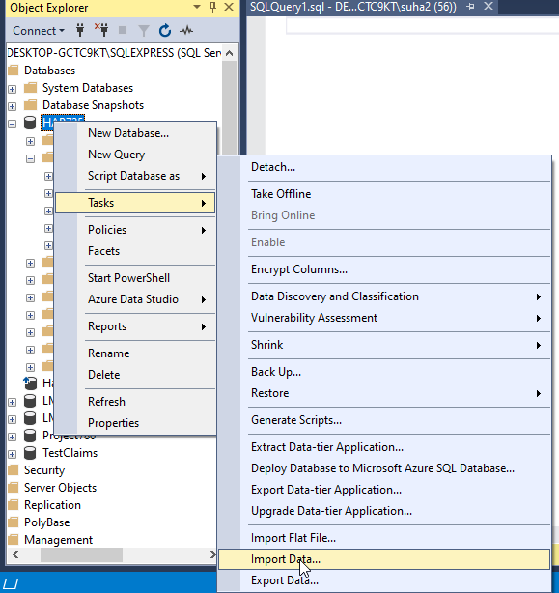
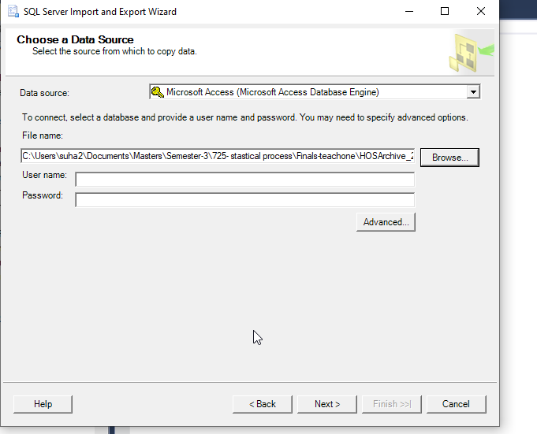
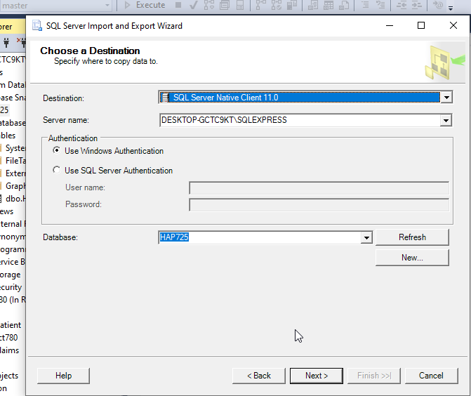
Import Data to SQL Server - 2
Open SQL Server Management Studio
Right Click on your Database and navigate to Tasks > Import Data
The SQL server Import Wizard will open and you can select the source/destination options & the .mdb file to import

Slide 5
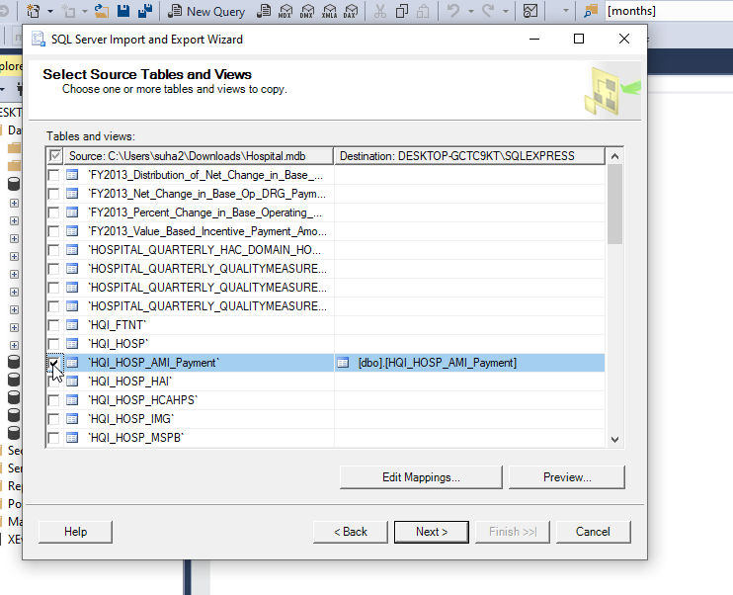
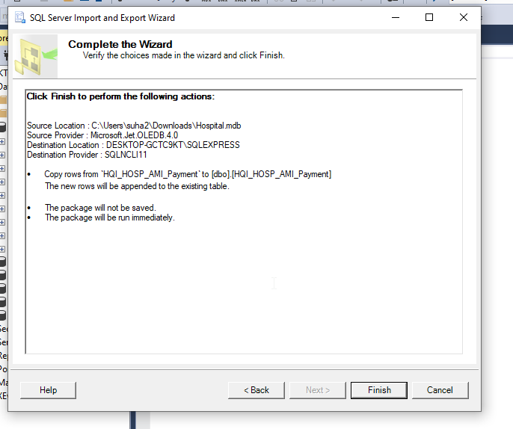
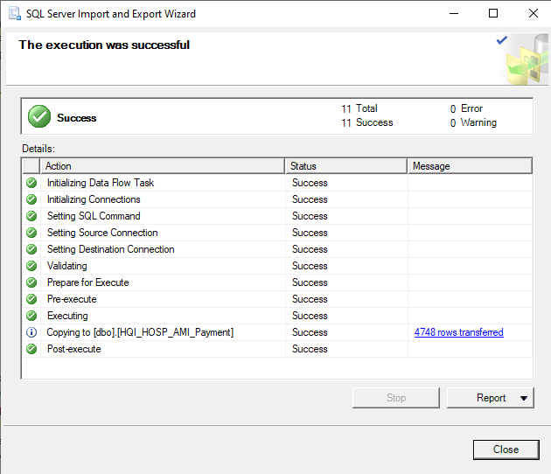
Import Data to SQL Server - 3
Note that each data set has different table names to import.
In the next step, select the corresponding filename for the time period. For 2010 to 2013 time period, the filename is “HQI_HOSP_AMI_Payment”
Click Next and Finish to import data into SQL Server Database

Slide 6
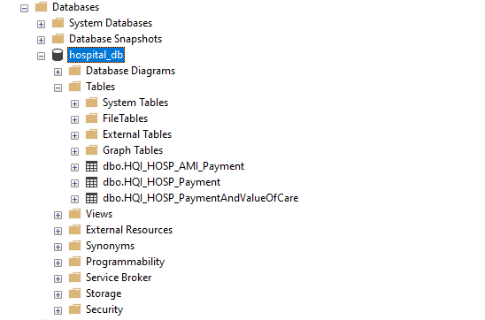
Import Data to SQL Server - 4
Repeat the steps for the remaining time periods.
The filename to import are as follows
2011 to 2014: HQI_HOSP_AMI_Payment
2012 to 2015: HQI_HOSP_PaymentAndValueOfCare
Once all data sets are imported you should see 3 tables in SQL Server.
In the next steps we will use Python to fetch and analyze the data.

Slide 7
Connect SQL Server to Python
To access the SQL Server Database, the pyodbc module is used
Make a note of the SQL Server Name and Database that was used in the previous steps to import the Hospital data
Once the connection is established, we can retrieve the data by executing the SQL queries.
Data with denominator “Not Available” and Null data will be filtered using the Where clause in the respective SQL Query.

Slide 8
2010-2013 Data
Using the below query, the Hospital Count & Observed Range is calculated
The resulting data set is assigned to a DataFrame : df1

Slide 9
2011-2014 Data
Using the below query, the Hospital Count & Observed Range is calculated
The resulting data set is assigned to a DataFrame : df2

Slide 10
2012-2015 Data
Using the below query, the Hospital Count & Observed Range is calculated
The resulting data set is assigned to a DataFrame : df3

Slide 11
Combining the Results
Use the concat function to merge dataframe for all time periods

Slide 12
Calculate Grand Average Rate & Standard Deviation

Slide 13
Calculate UCL & LCL

Slide 14
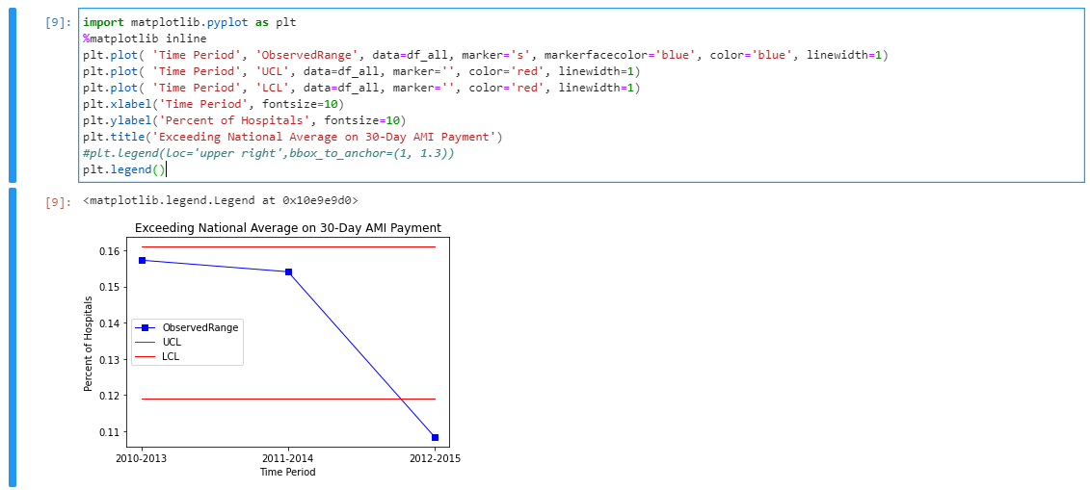
Plot the Control Chart
Fewer Hospitals Exceeded Average National 30-day AMI Payments.

