Slide 1
Teach One: Benchmarking Clinicians
Joanne Ji Hyun Min
George Mason University
HAP725 | Statistical Process Improvement
Notes:
Hello this is Joanne Min. This presentation was prepared as part of the HAP 725 course on Statistical Process Improvement taught by Dr. Farrokh Alemi, PhD at George Mason University Department of Health Administration and Policy. In this presentation, I will be covering question 4 under Benchmarking Clinicians topic.

Slide 2
Importing the Data in SQL
Notes:
First, the data was imported into SQL server.

Slide 3
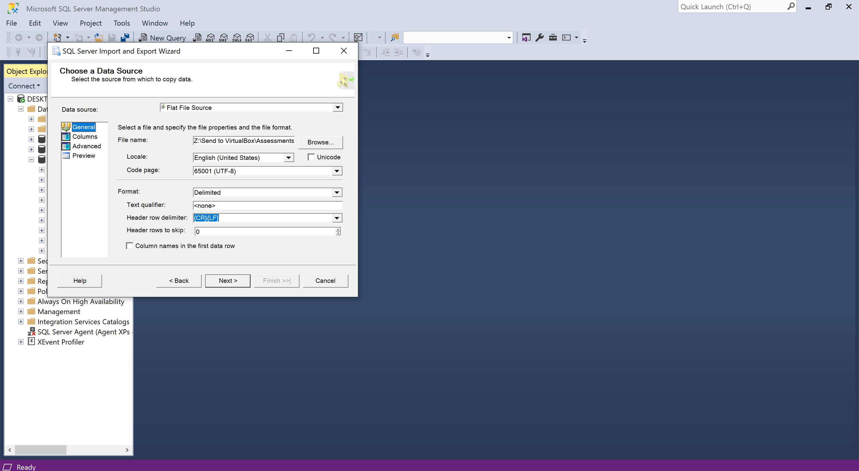
Importing the Data in SQL
Notes:
When you import the data, make sure to uncheck the box where it says ‘column names in the first data row’

Slide 4
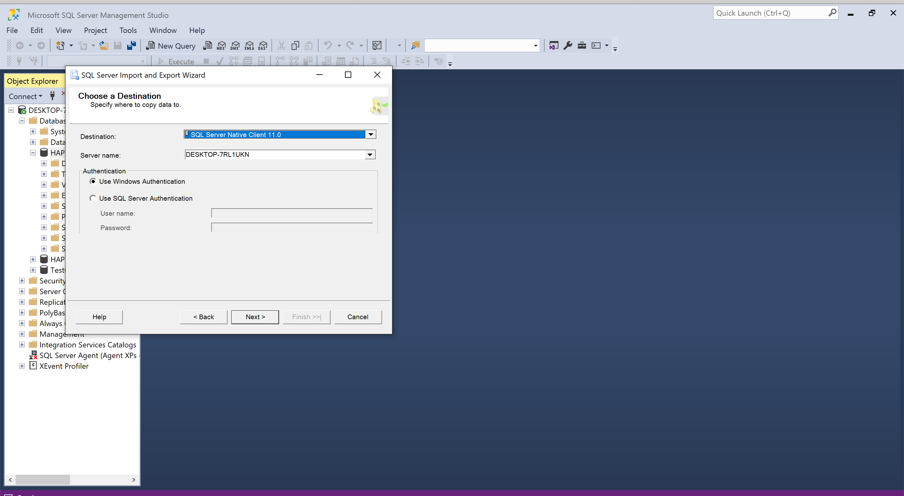
Importing the Data in SQL
Notes:
The data was imported to the native sql server

Slide 5
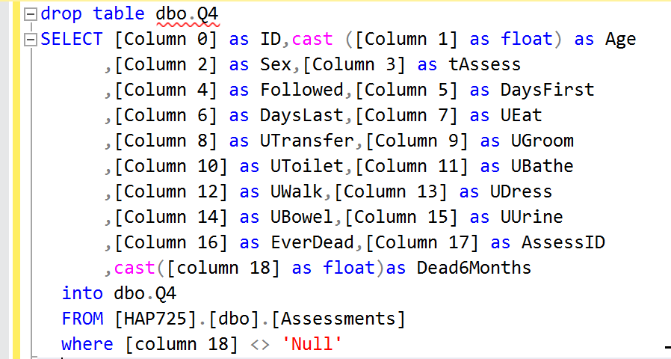
Change the Column Name & Data Type
Notes:
The column name and data type for Age and Deadin6Months were changed within SQL server

Slide 6
Connect SQL to Python
Notes:
Then the SQL server was connected to jupyter notebook for further analysis in python
When connecting to your server, make sure to type your server name and database name where the data table is imported and saved.
The table in the below shows the correct table with correct column names

Slide 7
Synthetic case
Notes:
This table shows the synthetic case for 80 years old residents who have walking and toilet disabilities

Slide 8
1. Mortality Rate for 80 years old with Walking Disability and Residents with Toilet Disability

Slide 9
Mortality Rate for 80 years old with Walking Disability and residents with Toilet Disability
Notes:
Then first, the estimated mortality rate was calculated for 80 years old residents who are unable to walk, which was about 0.137
Then the same calculation was done to calculate the estimated mortality rate for residents who are unable to Toilet, which was about 0.141

Slide 10
Mortality Rate for 80 years old with Walking Disability and residents with Toilet Disability
Notes:
Then the estimated mortality rate for 80 years old with Walking Disability and residents with Toilet Disability was calculated by multiplying the estimated mortality rate for walking disability and the estimated mortality rate for toilet disability, which was calculated in the previous slide. And It was calculated to be approximately 0.02

Slide 11
2. Mortality Rate for 80 years old with Toilet Disability and Residents with Walking Disability

Slide 12
Mortality Rate for 80 years old with Toilet Disability and residents with Walking Disability
Notes:
Next, the mortality rate for 80 years old with Toilet Disability and residents with Walking Disability was calculated.
To do so, first the estimated mortality rate of 80 years old who are unable to toilet was calculated, which was about 0.067.
Then the estimated mortality rate of residents who are unable to walk was calculated, which was about 0.109.

Slide 13
Mortality Rate for 80 years old with Toilet Disability and residents with Walking Disability
Notes:
Then finally, the estimated Mortality Rate for 80 years old with Toilet Disability and residents with Walking Disability was calculated by multiplying previously calculated mortality rate for 80 years old with toilet disability and residents with walking disability. And it was calculated to be approximately 0.007.

Slide 14
Thank you :)

