Slide 1
HAP 725 Question 4 Solution
Maria Uriyo, Ph.D.

Slide 2
Problem
Download Hospital Compare data for the year 2015 and 2016. In these files the denominator indicates the number of patients. Whether the hospital had above average payments are reported in different fields: [Compared to National], [Category], and [Payment Category]. Select data that meets the following conditions:
Select the "PAYM_30_AMI" measure
Select hospitals that don’t have “Not Available” in the denominator
Construct a control chart showing probability of change over time.

Slide 3
Step 1. Download 3 MS Access Datasets
From Hospital Compare Website:
HOSArchive_20150122
HOSArchive_20150716
HOSArchive_20161110
http://openonlinecourses.com/spc/Comparison%20of%20Rates.html

Slide 4
Use HOSArchive_20150122 Contains data from 2010 – 2013

Slide 5
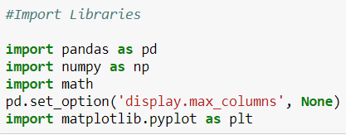
Step 2. Import Libraries

Slide 6
Step 3. Connect MS Access to Python

Slide 7
Step 4. Output of Dataframe

Slide 8
Step 5: Check Unique Values in Denominator
Partial Output

Slide 9
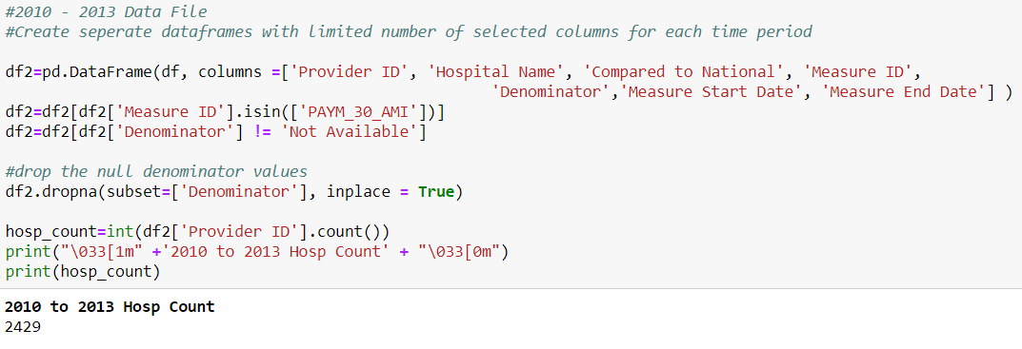
Step 6: Create New DataFrame

Slide 10
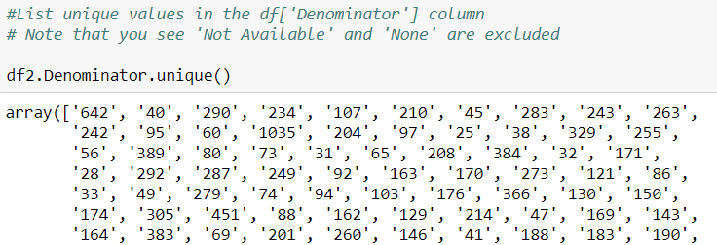
Step 7: Check Unique Values in Denominator
Partial Output

Slide 11
Step 8: Count of Hospitals Based on Conditions

Slide 12
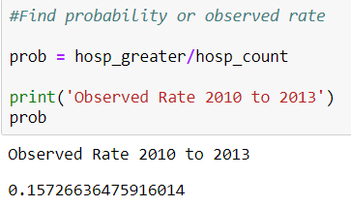
Step 9: Determine Observed Rate (2010 – 2013)

Slide 13
Use HOSArchive_20150716 Contains data from 2011 – 2014

Slide 14
Step 10. Connect MS Access to Python

Slide 15
Step 11. Output of Dataframe

Slide 16
Step 12: Check Unique Values in Denominator
Partial Output

Slide 17
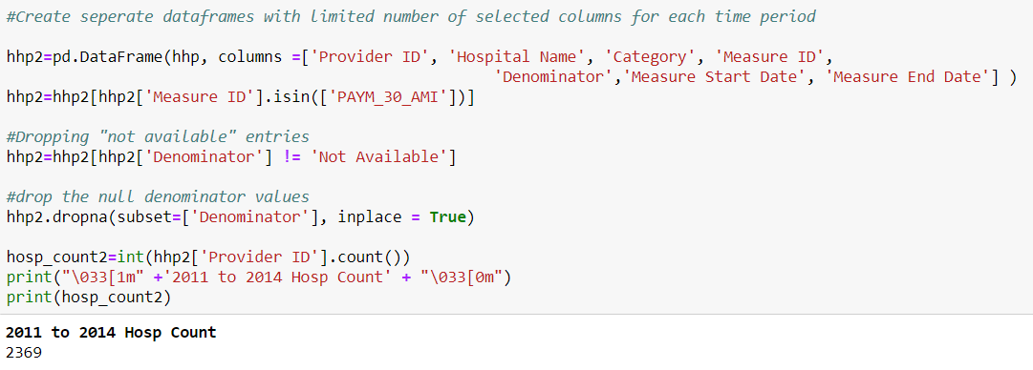
Step 13: Create New DataFrame

Slide 18
Step 14: Count of Hospitals Based on Conditions

Slide 19
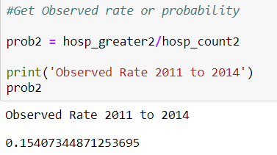
Step 15: Determine Observed Rate (2011 – 2014)

Slide 20
Use HOSArchive_20161110 Contains data from 2012 – 2015

Slide 21
Step 16. Connect MS Access to Python

Slide 22
Step 17. Output of Dataframe
Partial output, not all columns shown

Slide 23
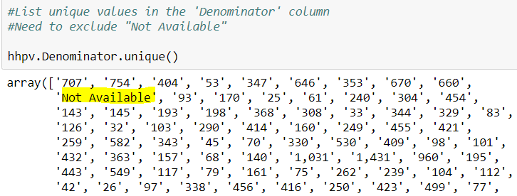
Step 18: Check Unique Values in Denominator
Partial Output

Slide 24
Step 19: Create New DataFrame

Slide 25
Step 20: Count of Hospitals Based on Conditions

Slide 26
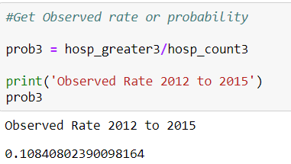
Step 21: Determine Observed Rate (2012 – 2015)

Slide 27
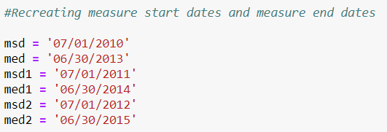
Step 22: Recreating Dates

Slide 28
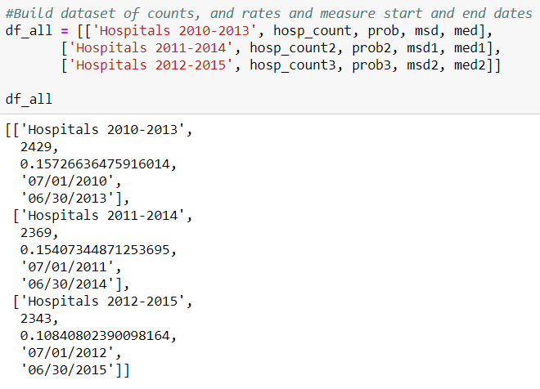
Step 23: Build Dataset of Counts, Rates and Dates

Slide 29
Step 24: Add Column Names to New Dataframe

Slide 30
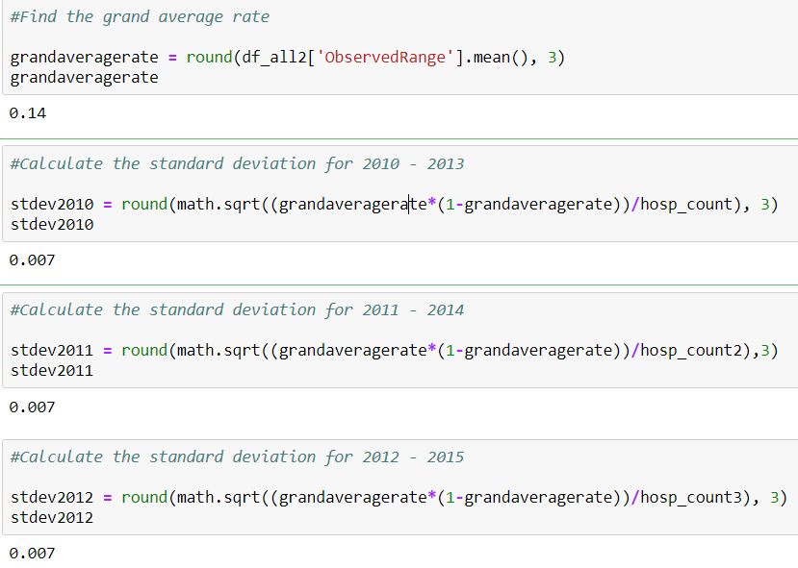
Step 25: Find Grand Average & Standard Deviation

Slide 31
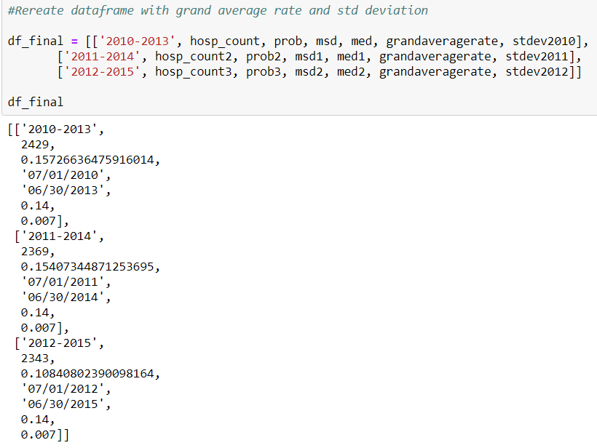
Step 26: Recreate Final Dataframe

Slide 32
Step 27: Add Column Headings

Slide 33
Step 28: Calculate UCL & LCL

Slide 34
Step 29: Plot the Chart

Slide 35
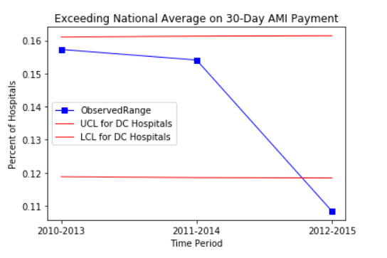
Solution
Fewer Hospitals Exceeded Average National 30-day AMI Payments.

