Slide 1
Introduction to Avatar
Farrokh Alemi, Ph.D.
Notes:
I am an Avatar organized by Dr. Alemi, from George Mason University.

Slide 2
Two Way Analysis of Variance
Farrokh Alemi, Ph.D.
Notes:
In this presentation we will discuss two way analysis of variance.

Slide 3
Purpose
2 Randomized Variables
Notes:
We use two way analysis of variance to examine the effects of two completely randomized variables, called X one and X two, on a common outcome, such as variable Y.

Slide 4
Purpose
2 Randomized Variables
2 Factorial Combinations
Notes:
Two way analysis of variance can also be used to examine the impact of 2 factorial combination of variables.

Slide 5
Purpose
2 Randomized Variables
2 Factorial Combinations
Full Factorial Design
Notes:
A full factorial design is the combination of every level of the first factor with all levels of the second factor.

Slide 6
Two Way ANOVA: Why We Use It?
Analyze both variables at same time
Control for confounding
Examine interactions between variables
Notes:
The purpose of two way analysis of variance is to examine the joint impact of two variables.

Slide 7
Two Way ANOVA: Why We Use It?
Analyze both variables at same time
Control for confounding
Examine interactions between variables
Notes:
Use one variable to control or block the confounding that occurs among the two variables.

Slide 8
Two Way ANOVA: Why We Use It?
Analyze both variables at same time
Control for confounding
Examine interactions between variables
Notes:
Finally, to assess the interaction between the two variables.

Slide 9
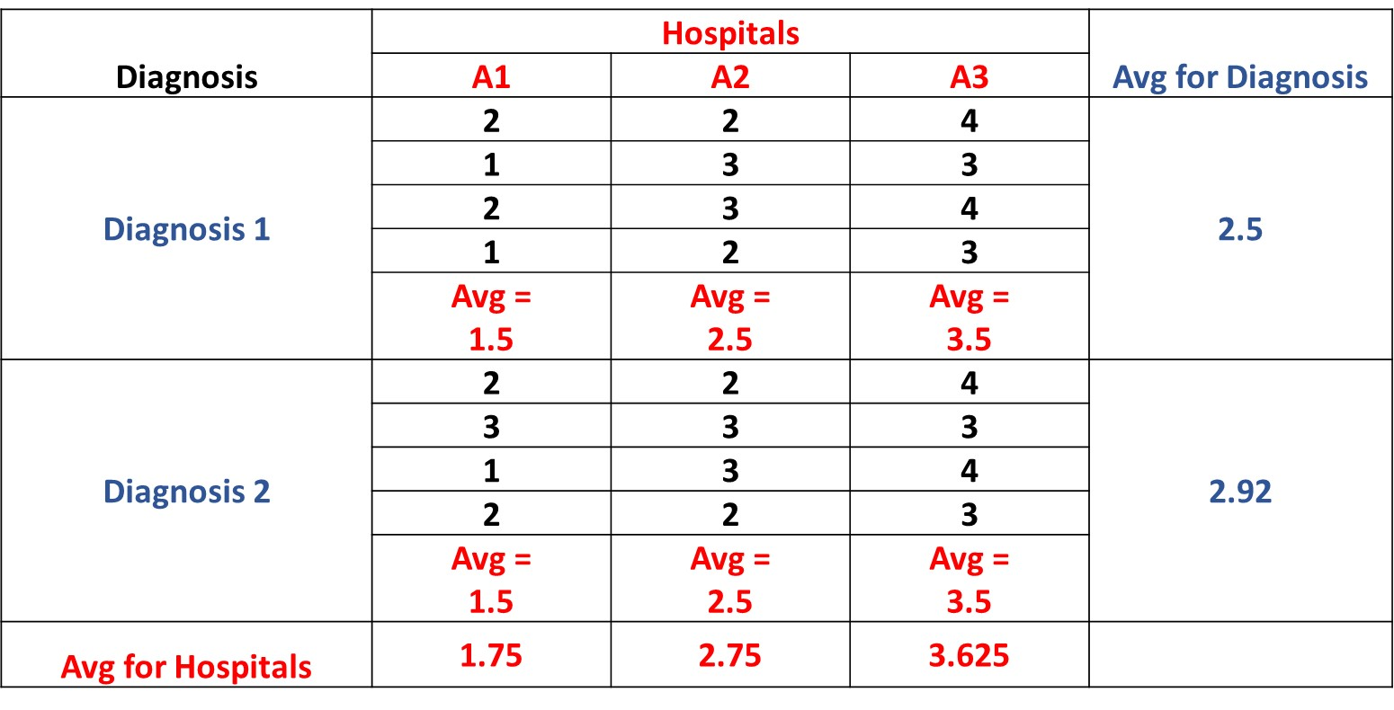
Example
Notes:
These data show the length of stay at three hospitals for patients with 2 different diagnosis.

Slide 10
Example
Notes:
Notice that the average stay is different at the three hospitals, from low of 1.75 days to high of 3.625 days.

Slide 11
Example
Notes:
Notice that the average stay is also different for different diagnoses, from 2.5 days to 2.92 days.

Slide 12
Example
Notes:
In fact, the average stay is different from combination of hospitals and diagnoses. Each cell in the table has a different average length of stay.

Slide 13
Example
Which hospital is more efficient after controlling for case mix of patients
Notes:
The purpose of 2 way analysis of variance for these data is to determine how much of length of stay is due to diagnoses of the patients and how much is a function which hospital admitted the patient, so a measure of care at the hospital.

Slide 14
Hypotheses
1. All row means are the same
Notes:
In 2 way analysis of variance there are three different null hypotheses. The first one is that all row means are the same. In our example, this is that the two diagnoses have the same length of stay. The alternative hypothesis is that at least one of the diagnoses has a different length of stay.

Slide 15
Hypotheses
2. All column means are the same
Notes:
The second hypothesis is that all column means are the same. In our example, this hypothesis is that the three hospitals have the same length of stay. The alternative hypothesis is that at least one of the hospitals has a different mean.

Slide 16
Hypotheses
2. All cell means are the same
Notes:
The third hypothesis is that all cell means are the same. In our example, this hypothesis says that all combinations of hospitals and diagnoses have the same mean. The alternative hypothesis is that at least one of the combination of diagnoses and hospitals has a different mean.

Slide 17
Interaction
The effect of one variable depends on another
Notes:
Interaction occurs when the effects of one independent variable vary based on the levels of the other independent variable.

Slide 18
Interaction
Hospital efficiency depends on the patient’s diagnosis
Notes:
For example, if length of stay of patients in the hospital depends on their diagnosis. Some hospitals are more efficient in certain diagnosis.

Slide 19
ANOVA
Notes:
This shows a typical output for two way analysis of variance for our data.

Slide 20
ANOVA
Notes:
The first column shows the sum of squares. For Rows it measures how much variation is due to the differences between the diagnosis and the average across the diagnosis. For columns, it shows how much the sum of square differs from the average of hospitals.

Slide 21
ANOVA
Notes:
This column shows degrees of freedom.

Slide 22
ANOVA
Notes:
There are 2 diagnoses and therefore the degrees of freedom for rows is 2 minus 1.

Slide 23
ANOVA
Notes:
There are 3 hospitals and therefore the degrees of freedom for columns is 3 minus 1.

Slide 24
ANOVA
Notes:
Mean sum of squares is the sum of squares divided by degrees of freedom.

Slide 25
ANOVA
Notes:
The F statistics is the ratio of mean sum of square divided by within mean sum of square.

Slide 26
ANOVA
Notes:
The critical value from the standardized F distribution is given in this column.

Slide 27
ANOVA
Notes:
The probability of observing the calculated F value is given in the last column.

Slide 28
ANOVA
Notes:
The very high F value allows us to reject that there are no differences among the hospitals.

Slide 29
ANOVA
Notes:
The low F value does not allow us to reject that there are no differences among the diagnoses.

Slide 30
ANOVA
Notes:
The null hypothesis of no interaction effects cannot be rejected..

Slide 31
ANOVA
Hospitals differ.
Not likely due to diagnoses.
Notes:
The analysis allows us to conclude that there are differences among the hospitals and it is unlikely that these differences are due to case mix of the diagnosis of the patients admitted to these hospitals.

Slide 32
Two Way ANOVA
Notes:
This presentation has focused on two way analysis of variance and its interpretation.

Slide 33
Thank You
Notes:
Thank you for looking at this presentation. Please examine other videos we have on one way ANOVA and use of R in ANOVA.

