Slide 1
ANCOVA

Slide 5
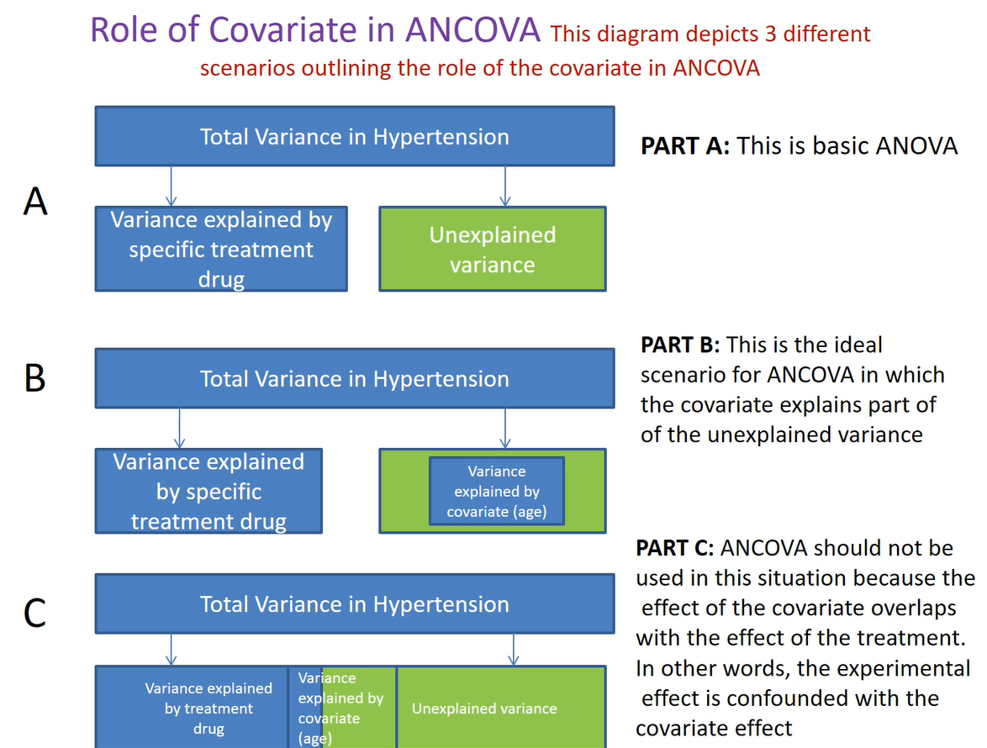

Slide 22
Questions and Comments?

