Slide 1
ANCOVA Q1
Stratified Covariant Balancing

Slide 2
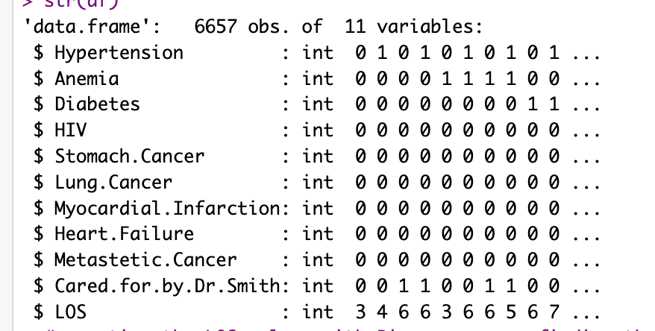
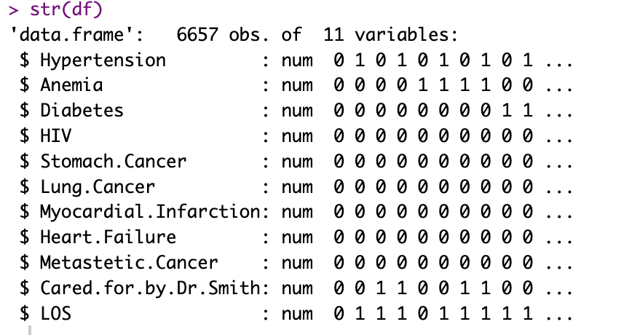
Converting Int to numeric:
We are changing the LOS column to binary: df$LOS <- ifelse(df$LOS >= mean(df$LOS), 1, 0)

Slide 3
Balancing the Data using Stratified Covariate Balancing:
Here we can see that the P- Value is 0.018, we can say that it is statistically significant at alpha level of 5%
It is Clinically meaningful as the effect size is large enough.
The overlap between cases and controls is greater than 60%.

Slide 4
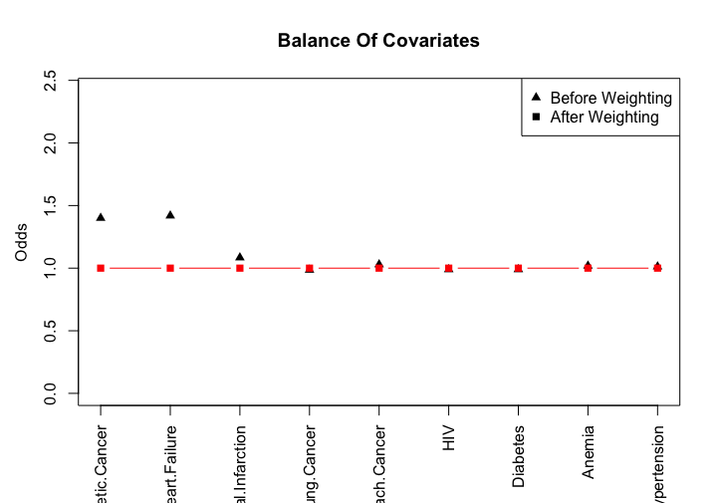
The odds of observing a covariate among treated and untreated group is 1 to 1

