Slide 1
ANOVA Q2

Slide 2
Summarizing the data and providing count, mean and standard deviation for each treatment group
Summarizing the data with ANOVA model fitting

Slide 3
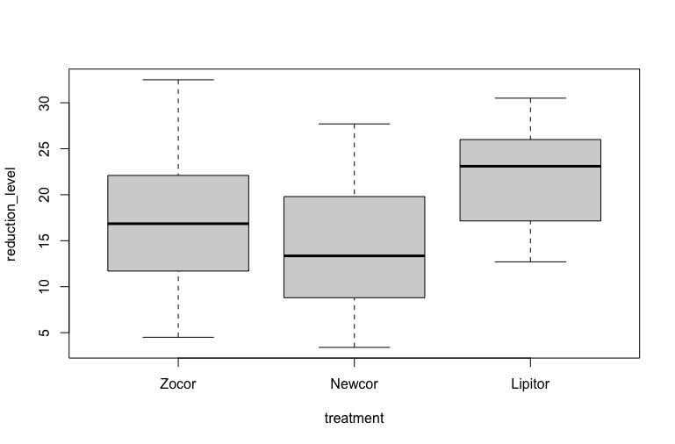
Box plot to visualize the distributions of each treatment group:

Slide 4
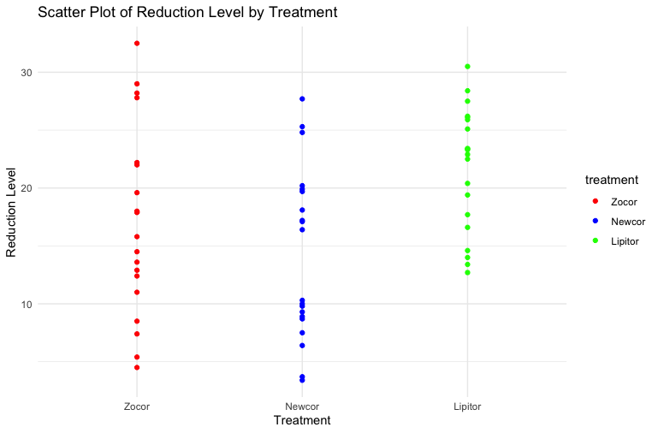

Slide 5
Are there significant differences in cholesterol reduction due to drug type?
The F-statistic is 5.804.
The p-value (Pr(>F)) is 0.00508.
The p-value (0.00508) is less than the typical significance level of 0.05, which suggests that there are significant
differences in cholesterol reduction due to the drug type.

